Slide 1
Multiresolution Bilateral Filtering for image denoising

Slide 2
Content
Brief summarization of the paper key-findings.
An introduction to the multiresolution bilateral filtering and its various methods that it consists of.
Our implementation and comparison against different filters.
Conclusion

Slide 3
Paper studied
The paper studied was called: Multiresolution Bilateral Filtering for Image Denoising, by Ming Zhang and Bahadir K. Gunturk.
The paper presented a non-linear signal filtering algorithm that is effective against removing low-resolution noise. It does this by using bilateral filtering in combination with wavelet-thresholding.
The paper compared this method against white gaussian noise in comparison to other filtering methods. This filter was shown to be very effective according to this paper. [1]

Slide 4
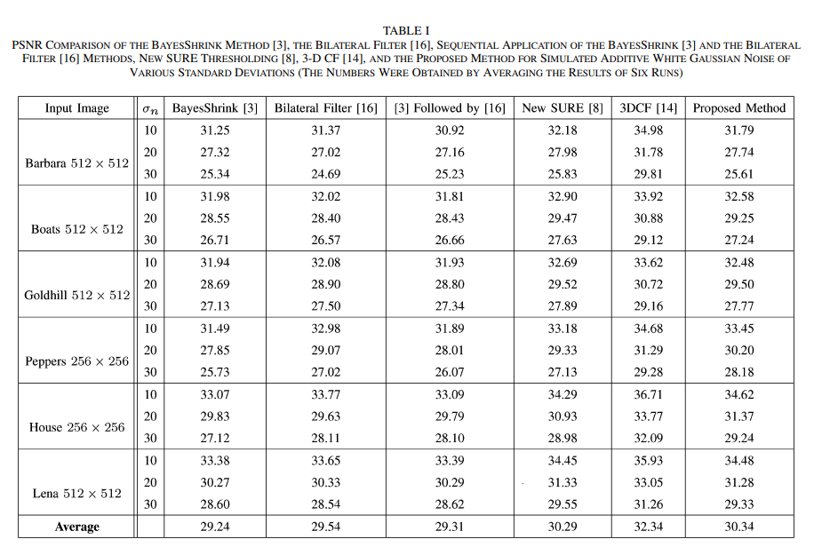
Paper PSNR comparison
Results
The paper compared different filtering methods against white gaussian noise with different mean square error values.
This was attempted with multiple images.
Different filters gave the following PSNR-values: [1]

Slide 5
Bilateral Filter 1
A non-linear (algorithmic) filter that does spatial averaging without smoothing out the edges.
Works in images by taking weighted sum of the pixels in a local neighborhood that depend both on the spatial and intensity distance. This method allows the filter to preserve edges of the image, while filtering out the noise.
Is used in tone-mapping, volumetric denoising, image-enhancement, etc. [1]

Slide 6
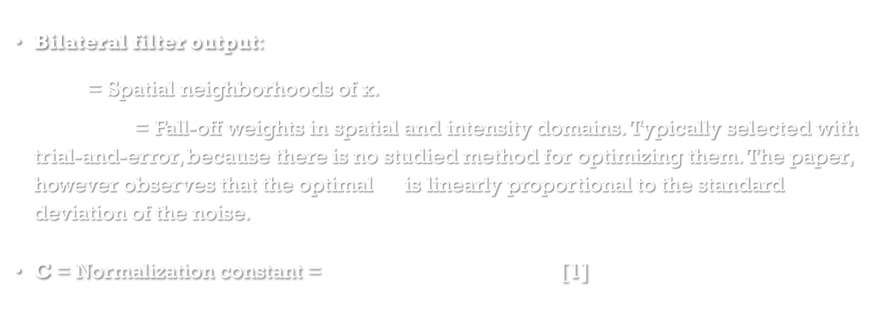
Bilateral Filter 2
Bilateral filter output: $\tilde{I}\left(x\right)=\frac{1}{C}\sum_{yε𝒩\left(x\right)}{e^{\frac{−{\left\|y−x\right\|}^{2}}{2σ_{d}^{2}}}e^{\frac{−{\left|I\left(y\right)−I\left(x\right)\right|}^{2}}{2σ_{r}^{2}}}}I\left(y\right)$
$𝓝\left(x\right)$ = Spatial neighborhoods of x.
$σ_{d}$ and $σ_{r}$ = Fall-off weights in spatial and intensity domains. Typically selected with trial-and-error, because there is no studied method for optimizing them. The paper, however observes that the optimal $σ_{r}$ is linearly proportional to the standard deviation of the noise.
C = Normalization constant = $\sum_{yε𝒩\left(x\right)}{e^{\frac{−{\left\|y−x\right\|}^{2}}{2σ_{d}^{2}}}e^{\frac{−{\left|I\left(y\right)−I\left(x\right)\right|}^{2}}{2σ_{r}^{2}}}}$ [1]

Slide 7
Wavelet-thresholding
Wavelet-thresholding: A denoising method. Consists decomposing the signal into approximation (low-frequency) and detail (high-frequency) sub-bands. These sub-bands are a sparse representations for signals and images. In them, noise can be made more visible and can be more easily shrunk out.
Thresholding strategies include BayesShrink, VisuShrink, and SureShrink. [1],[2]

Slide 8
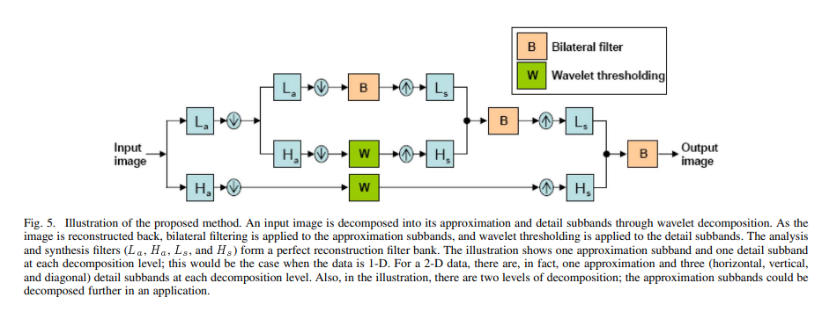
Multiresolution Bilateral Filter
Scheme Picture
The filter uses wavelet transform on the image. The detail sub-bands are decomposed at two levels.
Bilateral filter is applied to approximation sub-band.
Wavelet thresholding is applied to detail sub-bands.
The image is reconstructed with inverse wavelet transform. [1]

Slide 9
Our implementation
We have our own implementation on this filter.
Our implementation is made with Python using OpenCV, Skimage, and Pywavelets packages.
We will be demoing this implementation against both white gaussian noise (like in the paper) and uniform noise using multiple images.
Because we do not have the images, nor do we have the exact parameters used by the paper’s study. This why, we will not be making the same comparisons as the paper.
The paper’s method used BayesShrink method, our method uses VisuShrink because it gives better results.

Slide 10
Take-aways
Multiresolution Bilateral Filter is a non-linear filter that is works well against low-resolution noise while preserving the image edges.
It works by combining bilateral filtering and wavelet thresholding.

Slide 11
References
[1] M. Zhang, B. Z. Gunturk, Multiresolution Bilateral Filtering for Image Denoising, IEEE Transactions On Image Processing, 11.6 (2002): 670-684
[2] MathWorks, Wavelet Denoising, 2023, Available at (Referenced in 12.04.2023)

Slide 12
Thank you! Questions?

