Slide 1
Bayesian model selection metrics in retail datasets
(valmiin työn esittely)
Leevi Rönty
11.6.2021
Ohjaajat: Mikko Ervasti & Paavo Niskala
Valvoja: Fabricio Oliveira
Työn saa tallentaa ja julkistaa Aalto-yliopiston avoimilla verkkosivuilla. Muilta osin kaikki oikeudet pidätetään.

Slide 2
Contents
Backgroud
Used data
Models
Metrics
Results
Conclusions

Slide 3
Backgroud
Multiple methods exist for selecting bayesian models
No metric is free of practical issues in a commercial framework
With commercial models problems may arise from model fitting time or limited availability of data
Purpose of this thesis: To study applicability of selected model selection metrics in a commercial environment. Measure evaluation times, study metric stability, and compare metric results for multiple models.

Slide 4
Used data
Kaggle open domain dataset
Weekly sales data of 45 stores of same chain over two years period
Sales data is available on departement level
Levels of granularity: department < store < store group
Additionally, time series of fuel price, temperature, unemployment and consumer price index are available for each store
National special days such as important sports events and valentines days are also available

Slide 5
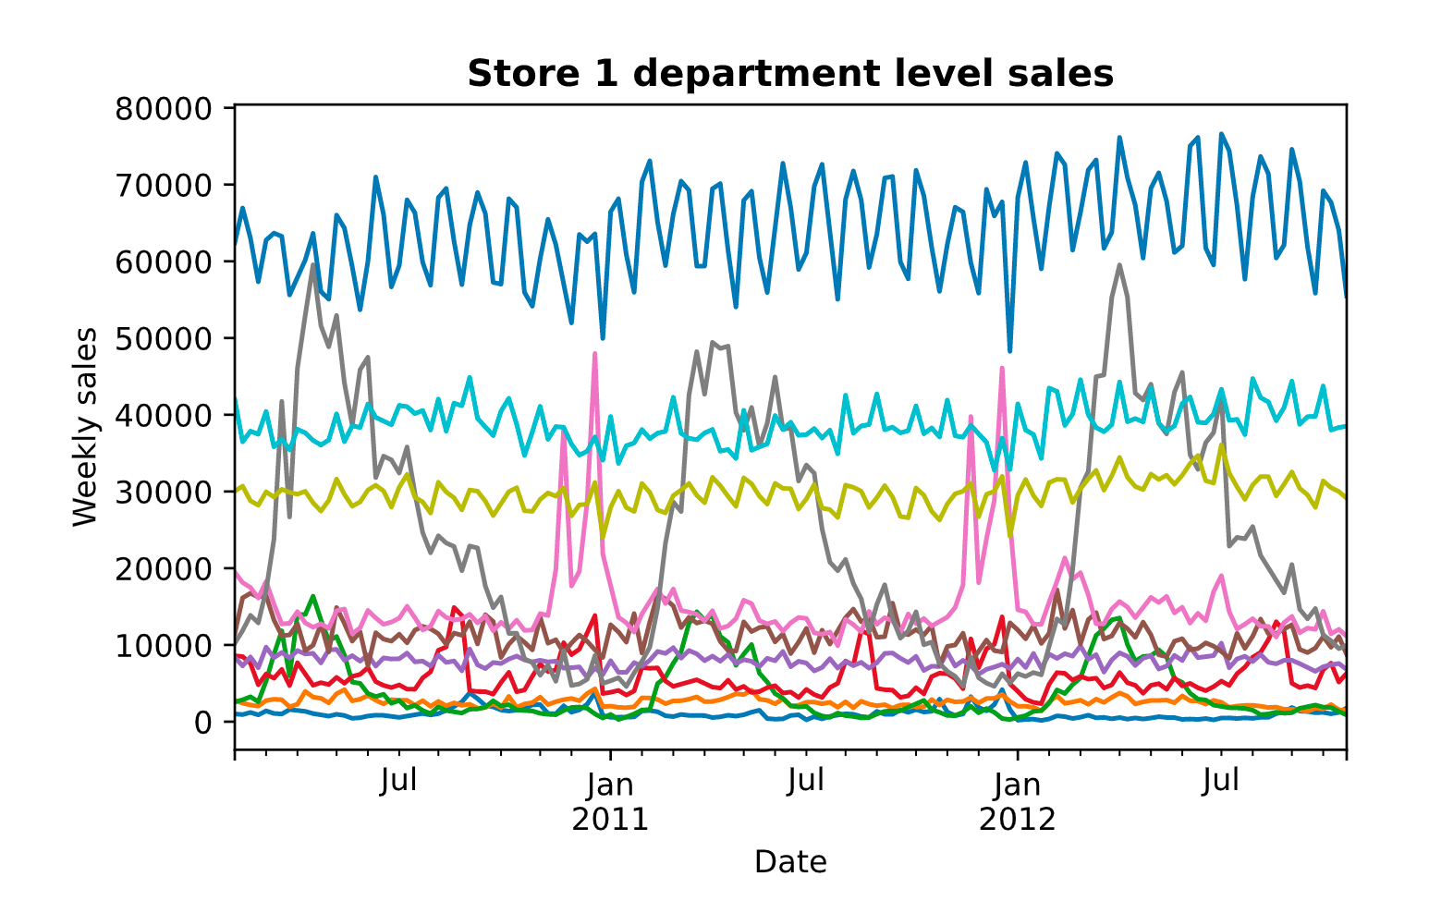
Used data

Slide 6
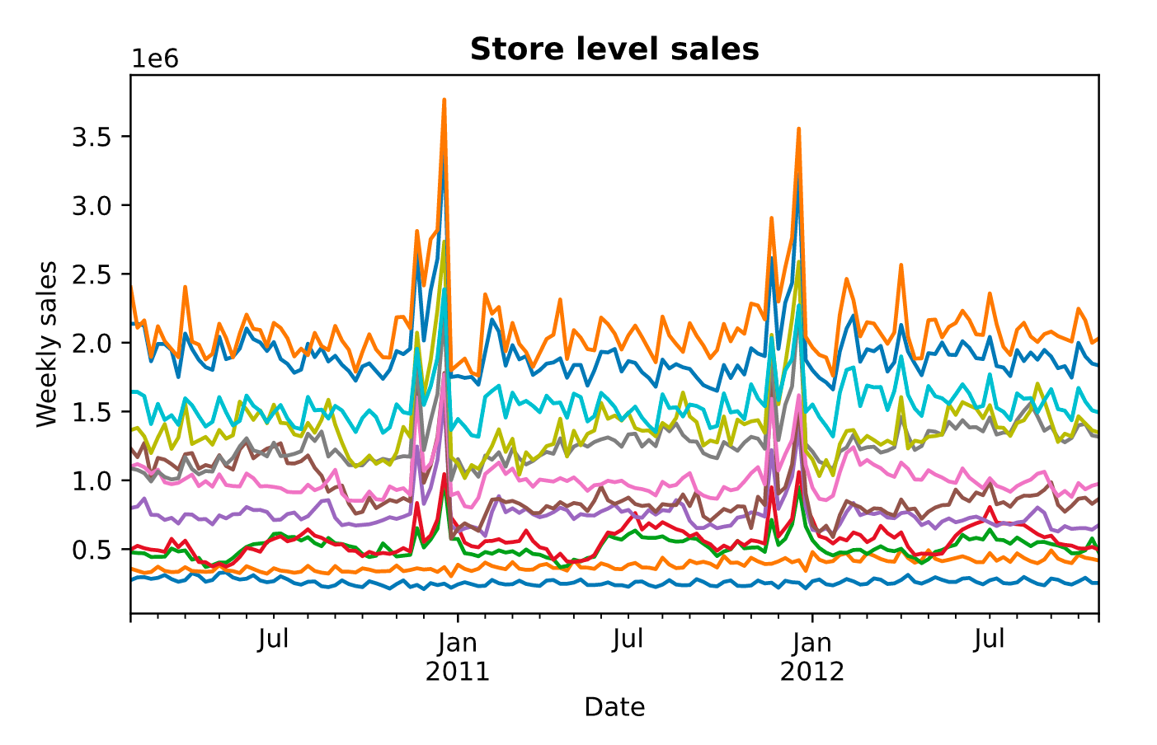
Used data

Slide 7
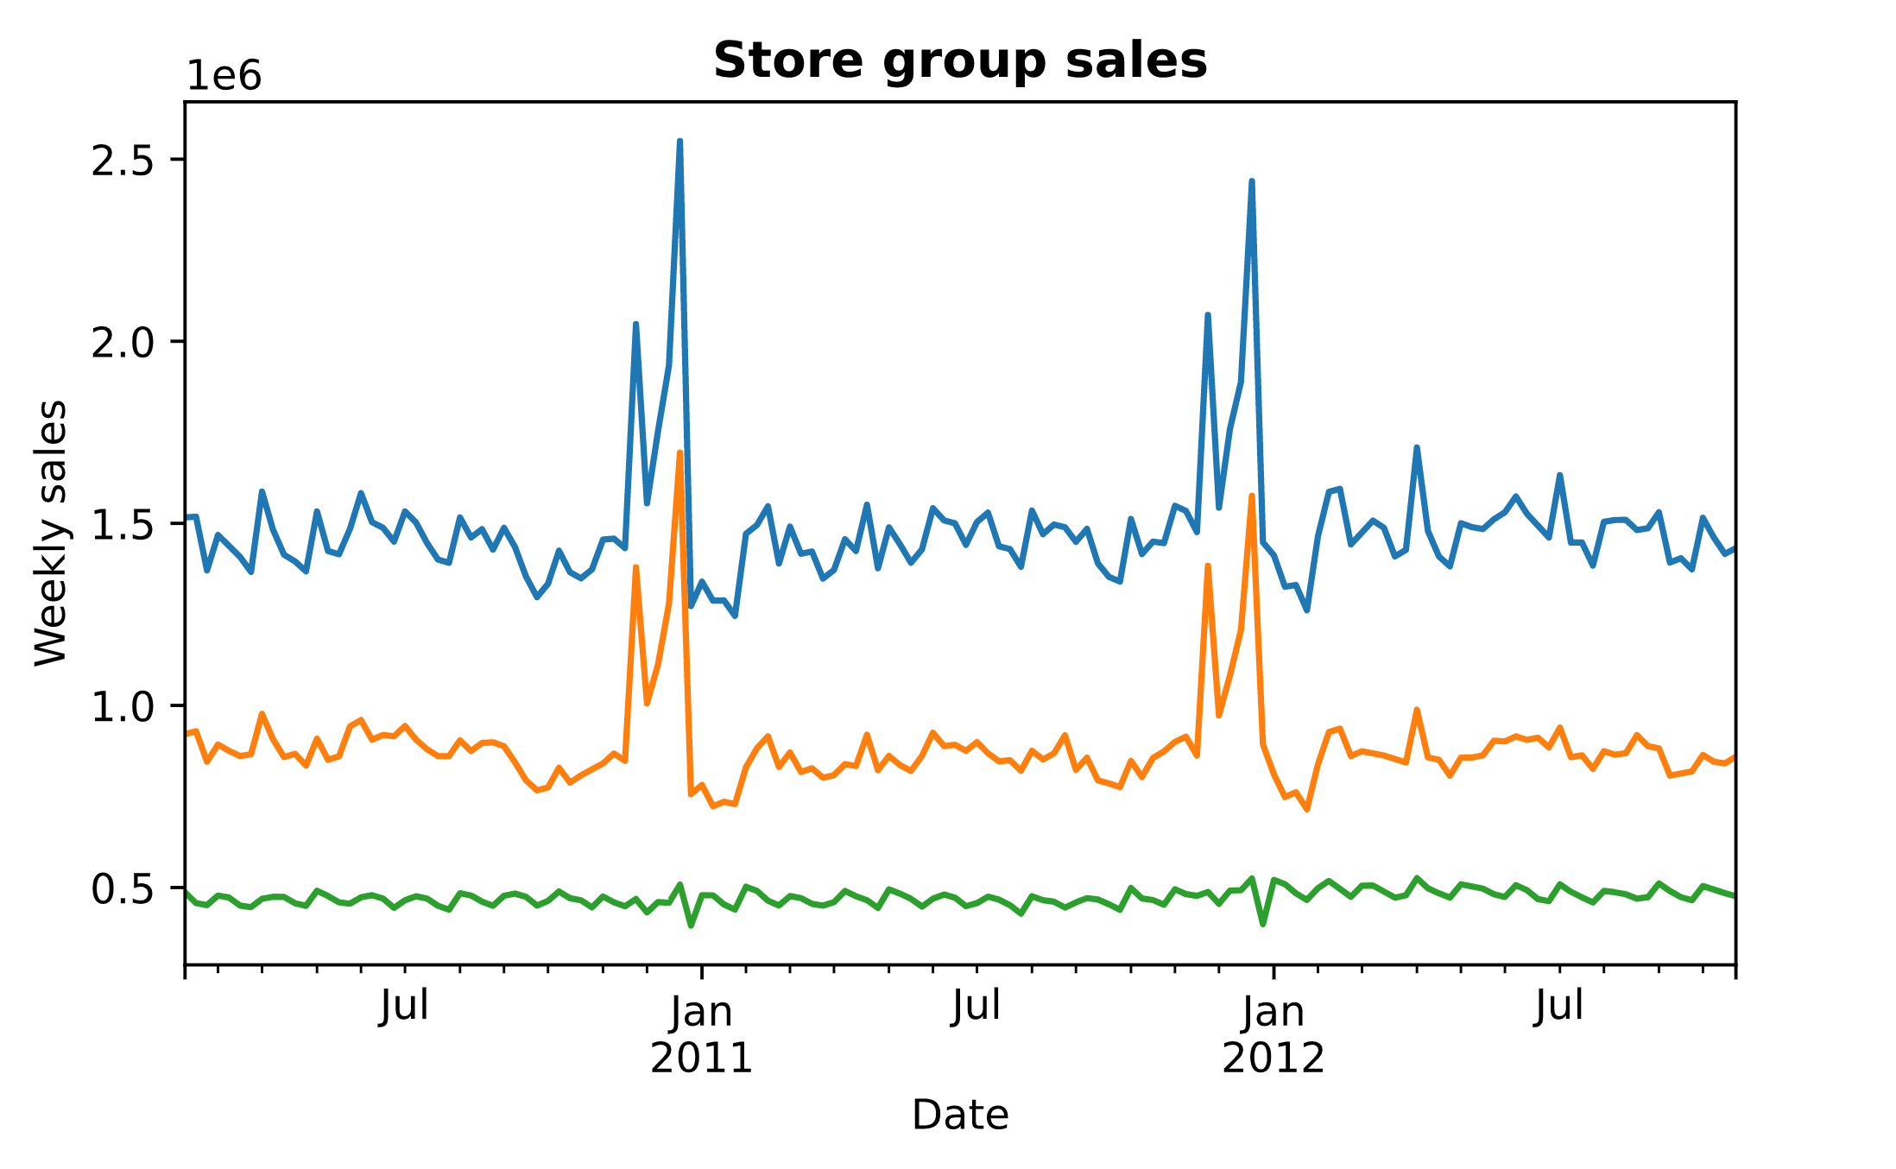
Used data

Slide 8
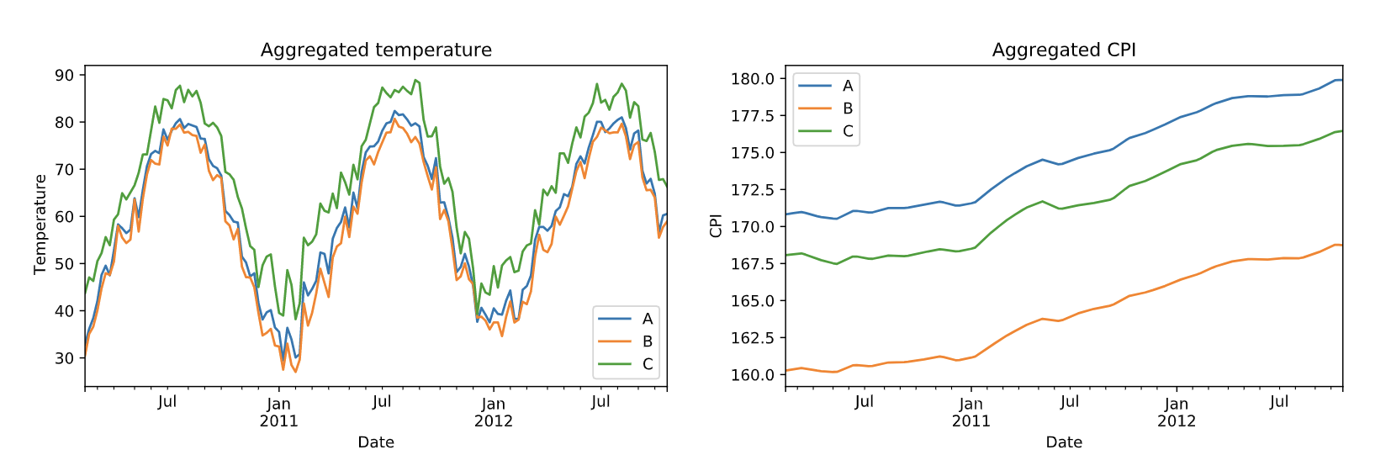
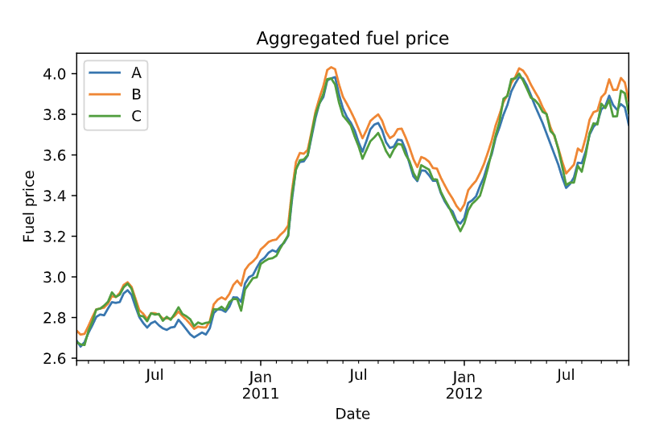
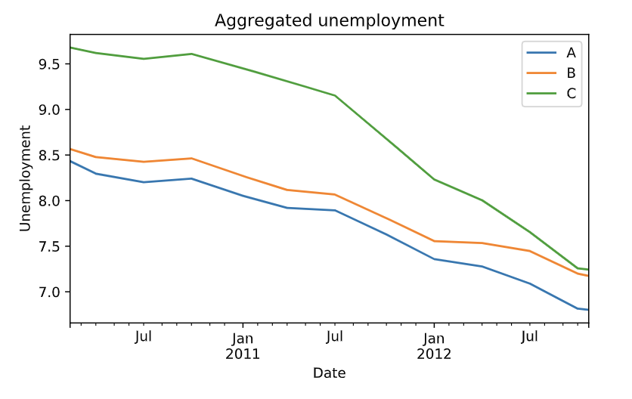
Used data – external features

Slide 9
Models - Prophet
Facebook Prophet
Divides prediction to seasonal, trend, and external features components
Seasonality is modelled with a finite Fourier series
Trend is piecewise linear. Alternatively Prophet framework allows for using logistic trend between known base and saturation levels.
Business knowledge can be easily incorporated into the model by setting appropriate priors or saturation and base levels.

Slide 10
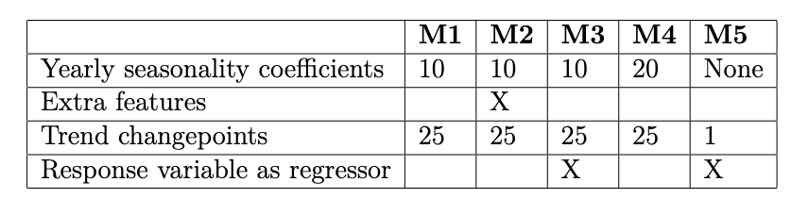
Models
Five different models, each having a unique combination of model parameters and features.

Slide 11
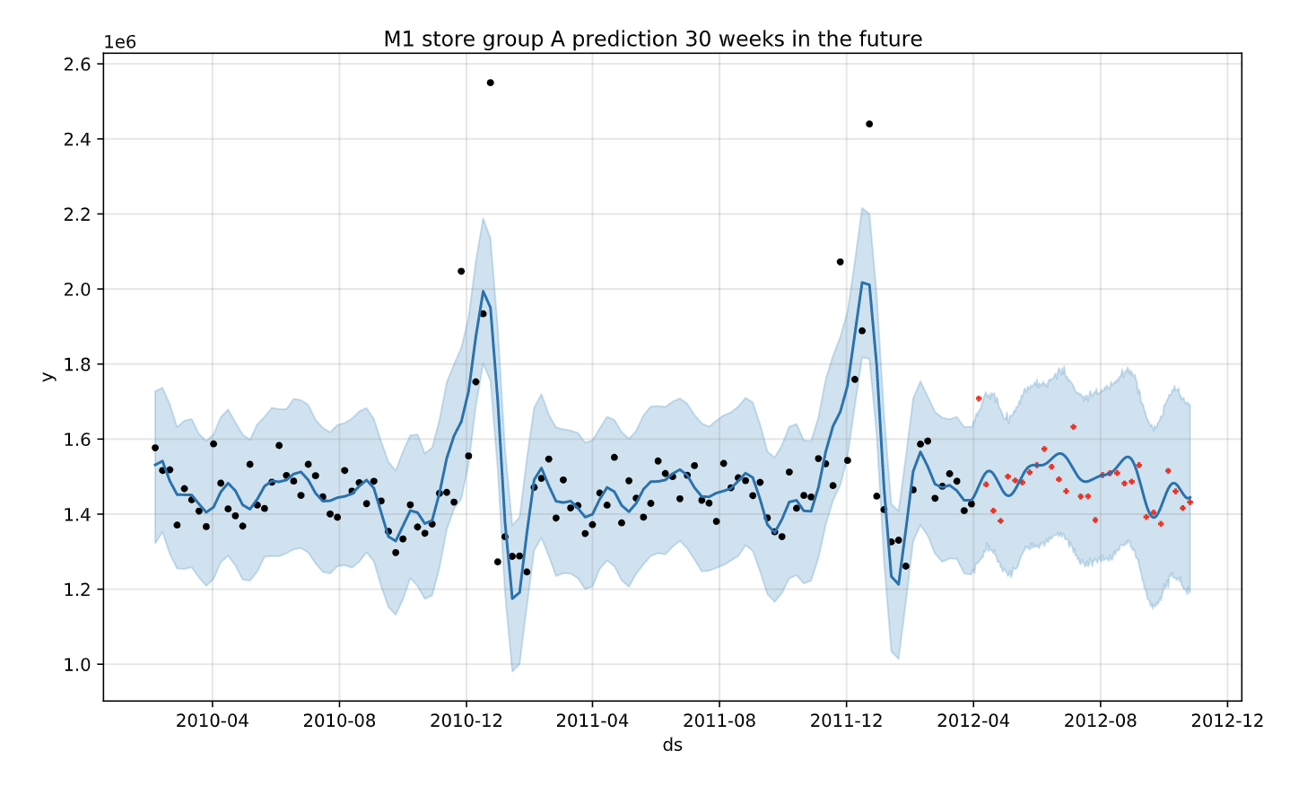
Models – Example of a prediction
Model 1 preciction 30 weeks in future
Weekly sales
Date

Slide 12
Metrics
Akaike information criterion AIC
Deviance information criterion DIC
Widely applicable information criterion WAIC
MAPE validation
10-fold cross validadtion

Slide 13
Metric calculation methods
Information criteria are based on in-sample fit log likelihood penalised by model complexity
MAPE: 15 week hold-out set, calculate MAPE for hold-out after fitting on remaining data, repeat three times each time cutting hold-out set out seven weeks earlier.
10-fold CV: split data randomly to 10 parts. Each part will act as a hold-out set once.

Slide 14
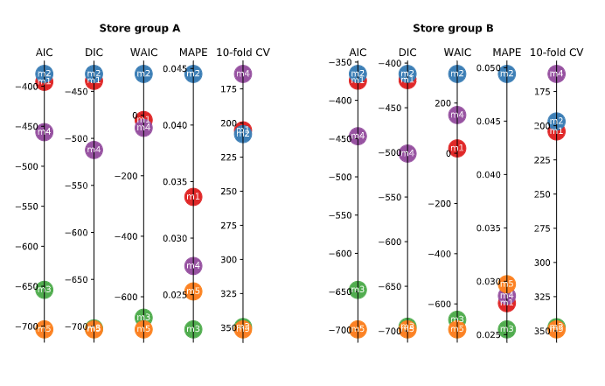
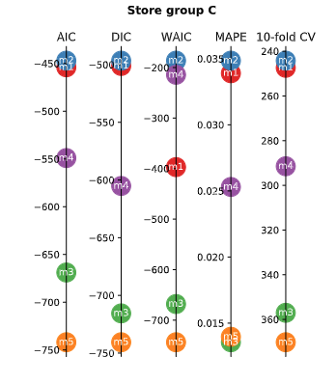
Results – Metric visualisation

Slide 15
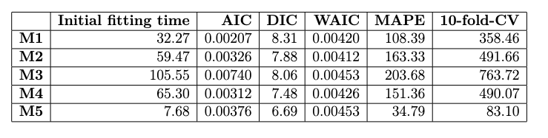
Results – Metric evaluation times in seconds

Slide 16
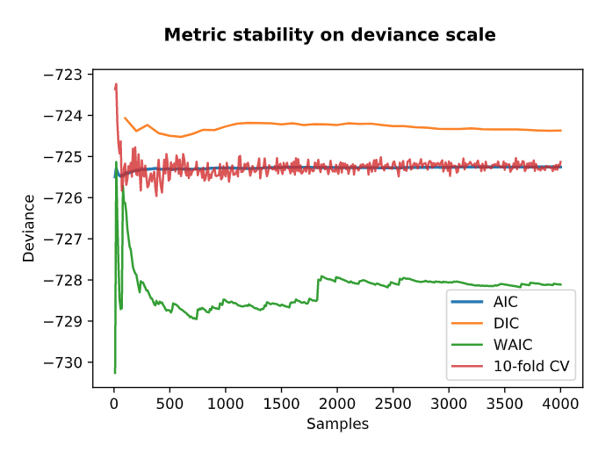
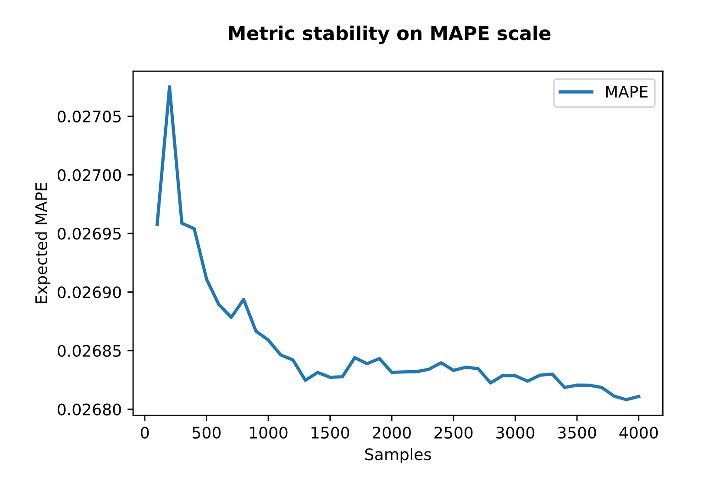
Results – Metric stability

Slide 17
Conclusion
Metrics generally agreed on model ranking
Evaluation times varied greatly. Both MAPE and 10-fold CV are infeasible to use with slow-fitting model
Metriikat käyttäytyivät stabiilisti tarpeeksi suurilla näytemäärillä
Metrics were stable after 500 samples
Time series length limited count of MAPE validation fits

