Slide 1

RPA Project Development
Wang Lee

Slide 2



Scenario
Notes:
Develop a comprehensive automation project—flowchart → Process Design Document (PDD) → working Python workflow—then define metrics to measure its value.
Scenario - You are a Business Analyst at TechAutomation Solutions. Your mission is to map, document, and code-automate a business process that runs each day inside the organization.
Task: Need to combine data onto a single file

Slide 3
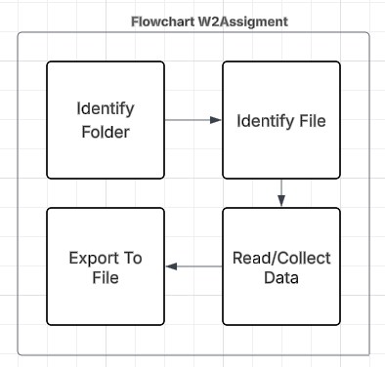
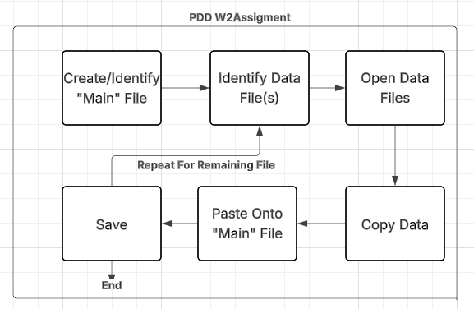
Identifying Task
Notes:
A Flowchart (Lucidchart)
Create a clear start-to-finish diagram of every step, decision, loop, and external system your bot will touch. Export as PNG or PDF for your slide deck.
B Process Design Document (PDD)
Explain the current manual process, inputs/outputs, exceptions, SLAs, controls, and target state. Use any template you like; clarity and completeness matter most.
C Python Automation Workflow
Replace the “RPA tool” step with this code-first stack:

Slide 4

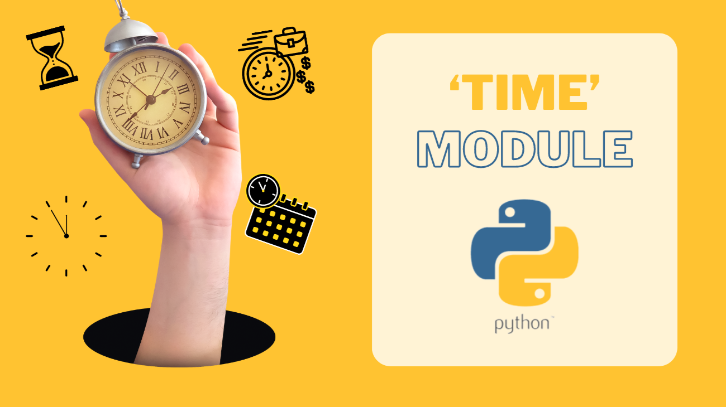

Tools
Notes:
Identify Tools / libraries (pandas, playwright, etc) API
Anaconda:
Python
Python:
OS : File Access
Glob : File Access
Pandas : Data Management via Dataframe
Time : Metric

Slide 5
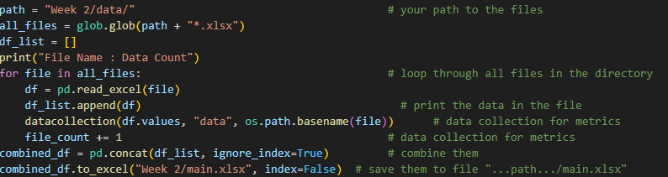
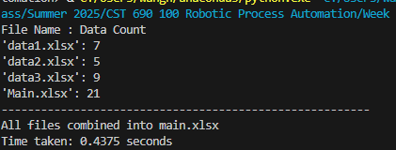
Implementation
Notes:
Show Code, and core parts
Code Break Down:
Identify Path using “path” variable
“all_file” looks for file with the desired extension, ‘xlsx’ because of excel, and puts them in a list
For loops runs through the list with the variable ‘file’ as the file
While in loop, save data in file to dataframe ‘df’
While in loop, ‘append(…)’ adds dataframe ‘df’ to a list for dataframe
Combine dataframe in dataframe list into ‘combined_df’
‘…to_excel(…)’ saves and formats dataframe for excel file name ‘main.xlsx’

Slide 6
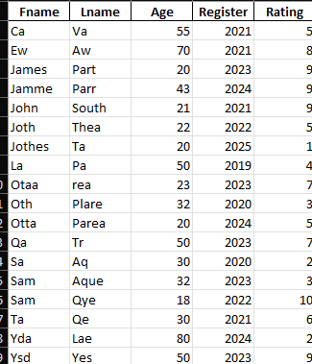

Metrics
Notes:
Discuss Metrics
Metric:
Time: Measure time taken
File: Identify amount of File read
Data: Identify amount of data in each file

Slide 7
Source
“How to Merge Multiple Excel Files into a Single Files with Python”(2025, 5 June). Geeksforgeeks. https://www.geeksforgeeks.org/python/...
Sharma, T.(2024, 27 Jun). “How To Create A Project Design Document(PDD) For The CDM Project Cycle”. Corpseed. https://www.corpseed.com/...
“time.process_time() function in Python”(2025, 11 Jul). GeeksforGeeks. https://www.geeksforgeeks.org/python/...
“Pandas DataFrames”(n.d). W3school. https://www.w3schools.com/python/pandas/...
“Python Program to Get the File Name From the File Path”(2024, 21 Aug). GeeksforGeeks. https://www.geeksforgeeks.org/python/...
“Pandas DataFrame”(2025, 14 Jun). GeeksforGeeks. https://www.geeksforgeeks.org/pandas/...

