Slide 1
S2A: Substitution Model, Recursion, Iteration
CS1101S AY20/21 Sem 1
Studio 2D
Lee Wei Min
Notes:
Add studio name

Slide 2
Table of Contents
Review of missions
Substitution model
Applicative order vs normal order
Recursive processes vs iterative

Slide 3
Additional Information
Don't worry about the math
Plagiarism check
Don’t abuse unsubmits!
24 hours, please follow up
Class part – last week not counted

Slide 4
Mission Review
Code style -> will start penalising poor organisation
Code comments
Counting up vs down
“Compressing” information in parameters
Functional abstraction
Autograder
For details, please see individual comments

Slide 5
How to prepare for RA??

Slide 6
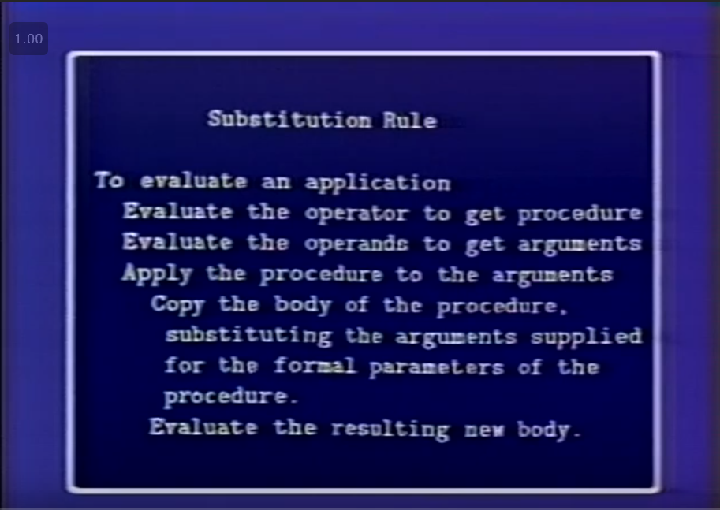

Slide 7
Applicative Order

Slide 8
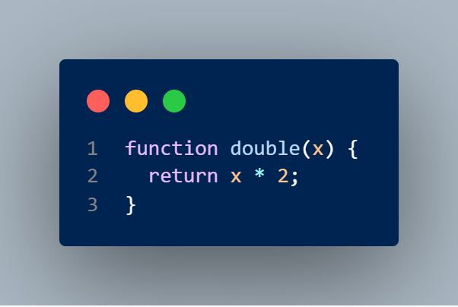

Slide 9
Substitution in Action: double(2)
Evaluate the body of function -> x * 2
Evaluate the arguments -> x = 2
Replace parameters by arguments -> 2 * 2
Return 4 (* is a primitive function)

Slide 10
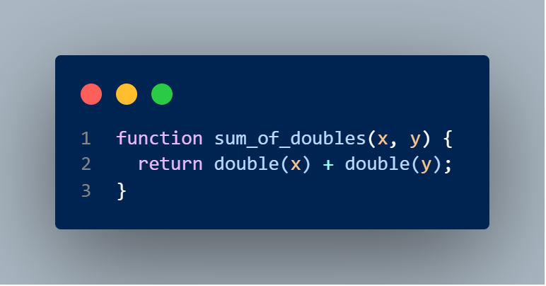

Slide 11
Substition in Action: sum_of_doubles(1, 2)
Evaluate the body of function -> double(x) + double(y)
Evaluate the arguments -> x = 1, y = 2
Replace parameters by arguments -> double(1) + double(2)
Same thing again – see previous slide! -> 1 * 2 + 2 * 2
Primitive functions + operator precedence -> return 6

Slide 12
Normal Order

Slide 13
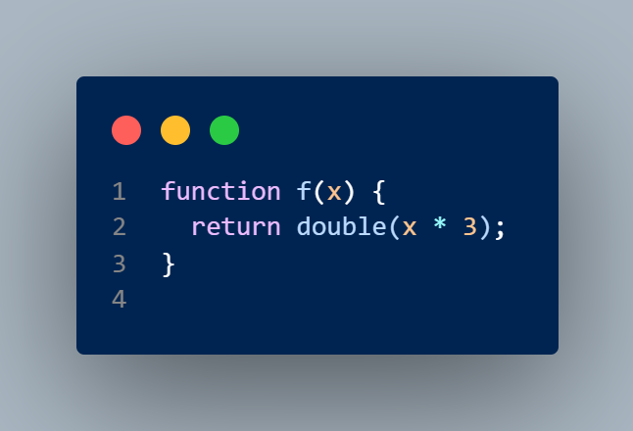

Slide 14
Substitution in Action: f(2)
Evaluate the body of function -> double(x * 3)
Evaluate the arguments -> x = 2
Replace parameters by arguments -> double(2 * 3)
Avoid evaluating argument -> 2 * 3 * 2
Primitive functions + operator precedence -> return 12

Slide 15
Recursion

Slide 16
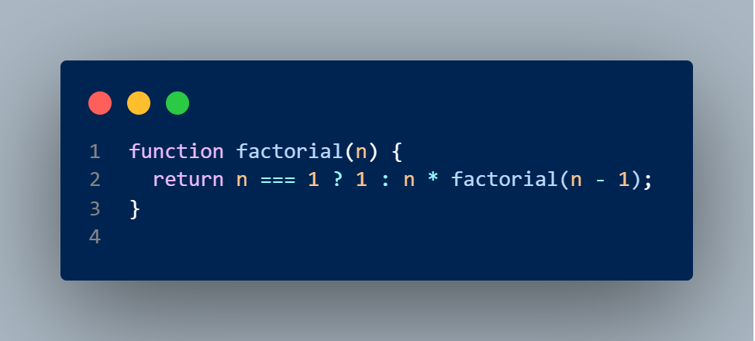
Recursive Function
function declaration refers to itself

Slide 17
Recursive Process
How the function application is evaluated
Deferred operations

Slide 18
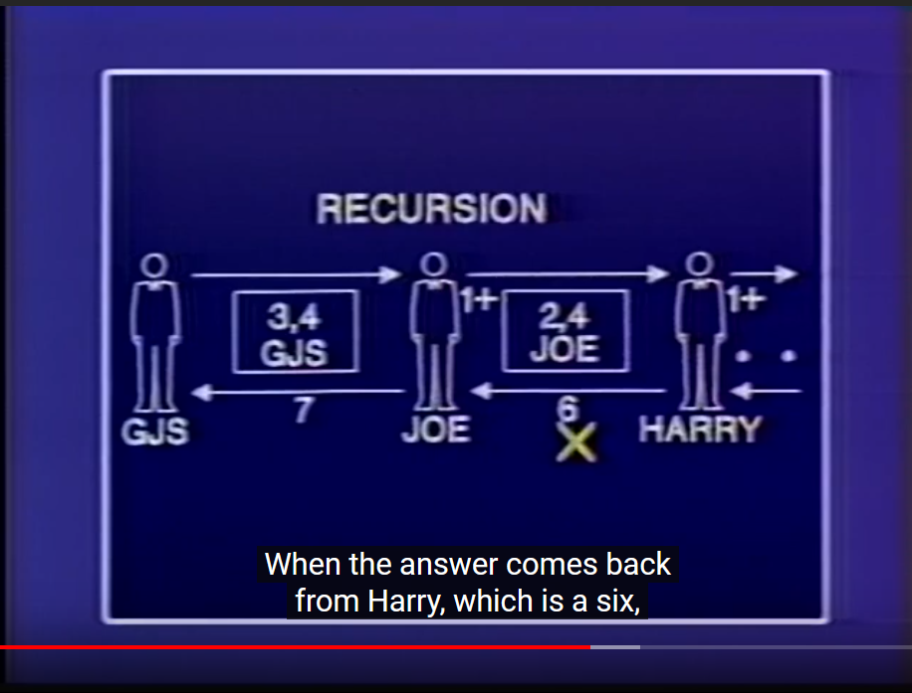

Slide 19
Iterative Process
State can be summarized by a fixed number of state variables
Rule for updating state variables
End test for termination
No deferred operations

Slide 20
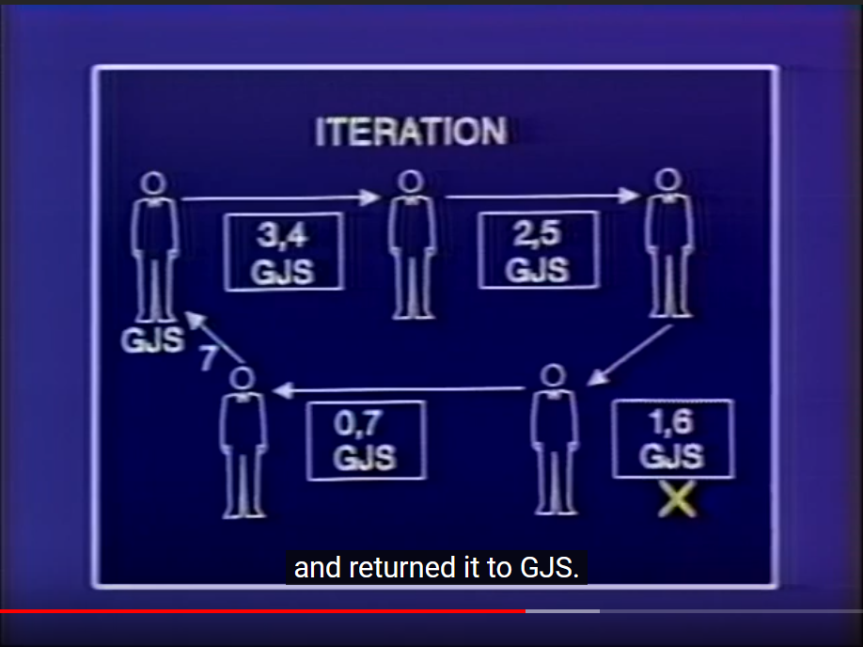

Slide 21
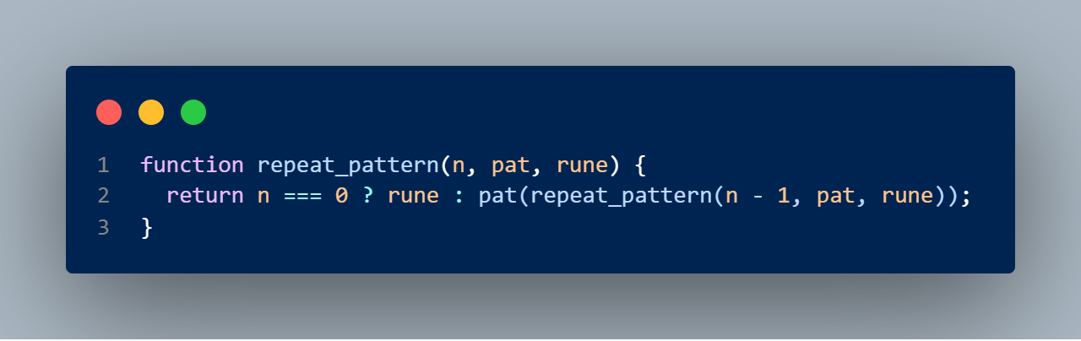
Recursive or Iterative?

Slide 22
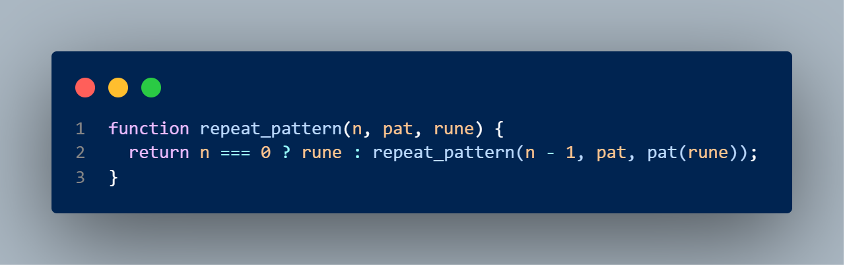
Recursive or Iterative?

Slide 23
Studio

Slide 24
Resources
Lecture
Textbook: 1.1.5, 1.2.1

