Slide 1
S4: Higher Order Functions
CS1101S AY20/21 Sem 1
Studio 2D
Lee Wei Min
Notes:
Add studio name

Slide 2
Table of Contents
Info

Slide 3
Additional Information
Missions / quests
RA1 – past years
Mastery checks
Class part adjustment

Slide 4
Mastery Checks
Random or pair up?
Earlier the better
Recorded
Mastery check 1 – best within two weeks

Slide 5
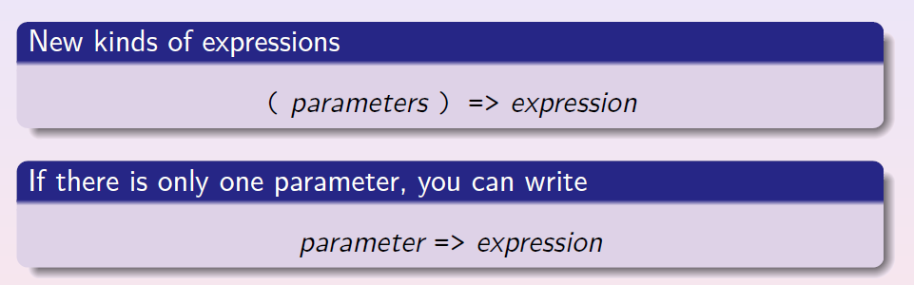
Lambda Expressions

Slide 6
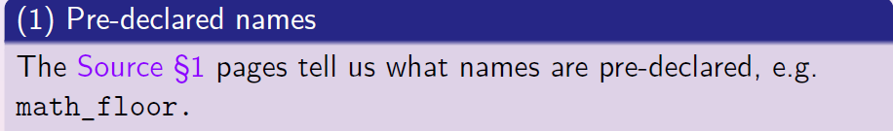
Scoping – Pre-declared functions

Slide 7
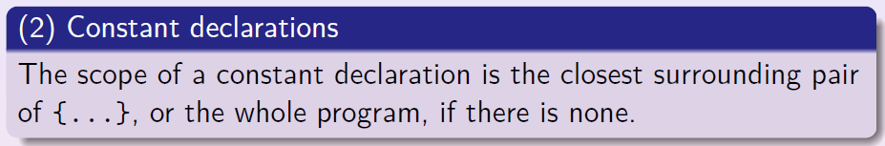
Scoping - Constants

Slide 8
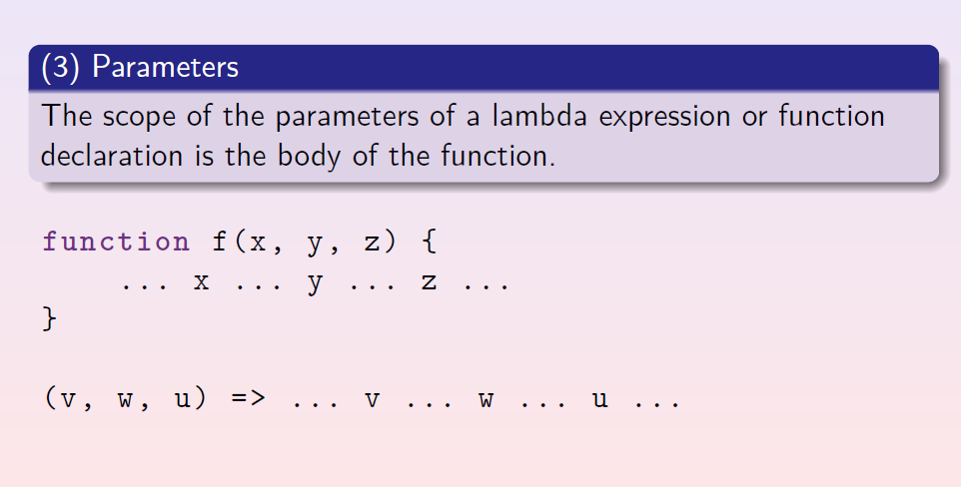
Scoping - Functions

Slide 9
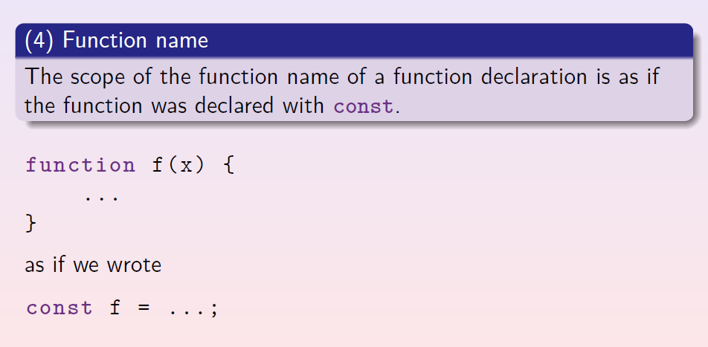
Scoping - Functions

Slide 10
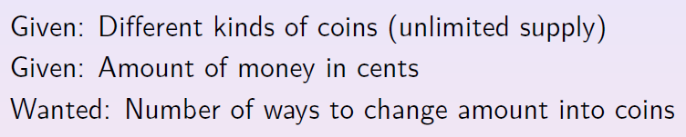
Coin Change

Slide 11
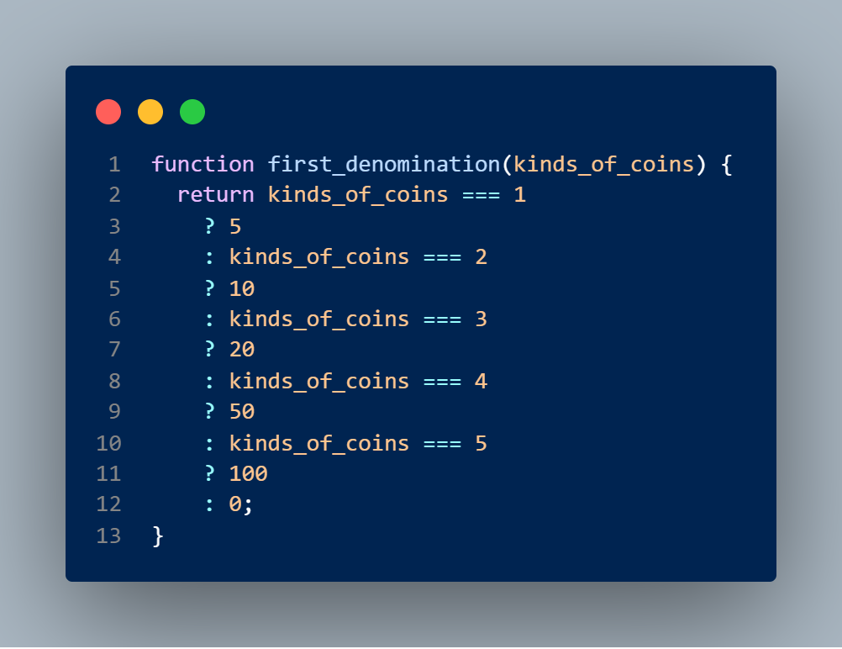
Coin Change – First Denom?

Slide 12
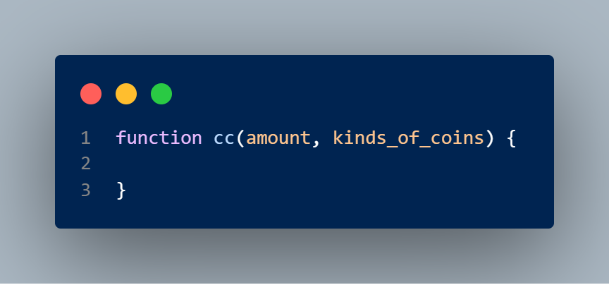
Coin Change - Skeleton

Slide 13
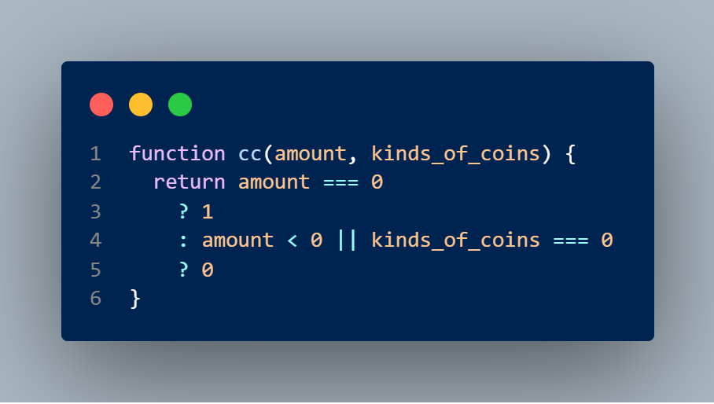
Coin Change – Base Cases

Slide 14
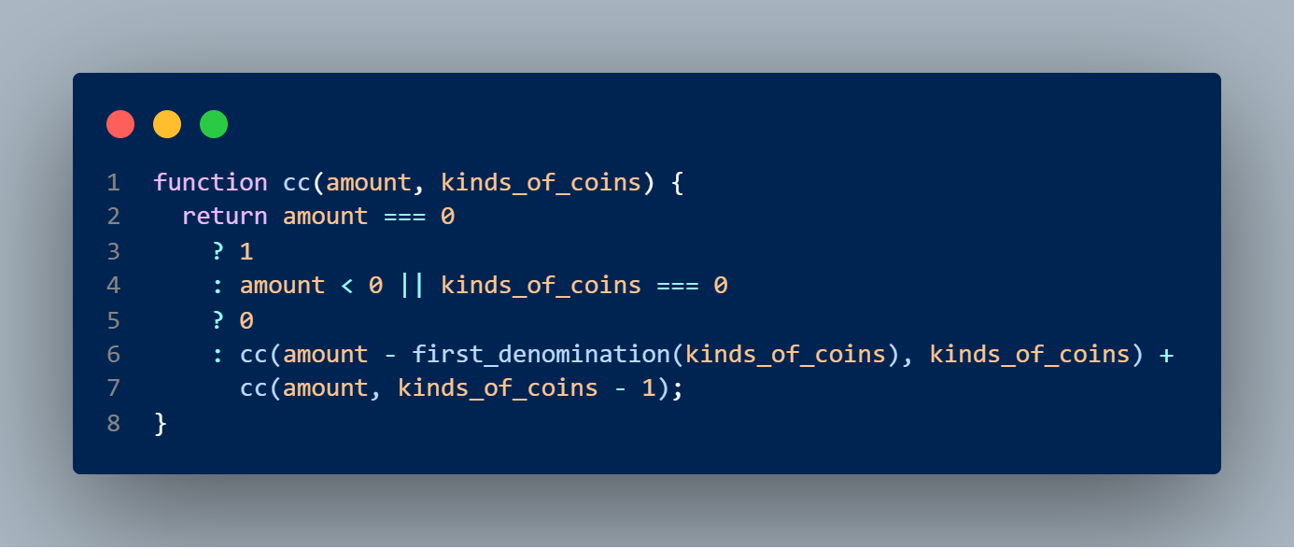
Coin Change – Subproblems

Slide 15
Studio Sheet

