Slide 1
Kubernetes-based & Event-Driven HPA: KEDA
Intern
Woobin Lee (E947263)
ARTA1D Technical Architecture

Slide 2
Introduction
What is Horizontal Pods Autoscaler (HPA)?
Weakness & Challanges of Autoscaling in Event-Driven-Architecture
Necessity of a tailored Autoscaler: KEDA
General Overview of KEDA
Demo (Java Consumer + Go Producer) ☺

Slide 3
What is Horizontal Pods Autoscaler (HPA)?
Horizontal Pods Autoscaler (HPA) VS Cluster Autoscaler (CA)
Kubernetes | Openshift etc.
Kubernetes | Openshift etc.
Node 1
Node 3
Node 1
Node 3
Service N – Pod 1
Service N – Pod 3
Service N – Pod 1
Service N – Pod 3
Service N – Pod 4
Node 2
Node 2
Node 4
Service N – Pod 2
Service N – Pod 2
Scales the number of pods of certain services deployed as ‚Deployment‘ or ‚Replicat set‘
Requires application / service specific rules
Adjusts the size of kubernetes cluster depending on resource usage
Removes unneeded nodes (physical/virtual) or attach additional nodes if required.

Slide 4
Weakness & Challenges of Autoscaling in Event-Driven-Architecture
Case: Unprecedentedly high kafka loads in terms of messages to be processed
We have a tranditional way of autoscaling applied to the Consumer Group: Depending on CPU/Memory Usage
The number of messaged produced was on average 300/sec, which the consumer group can process with pods that have the capability of processing 100 messages per second 300 produced messages – 100 (capacity per pod) * 3 (number of pods) = 0 left in Kafka
Producer 1
Kafka Cluster
Consumer-Group
300/sec => 500/sec
300/sec
Pod 1 (100/Sec)
Producer 2
Pod 2 (100/Sec)
Producer N
Pod 3 (100/Sec)
200 Messages remains unprocessed in each second, which means 720,000 Messages in an Hour
The CPU / Memory of each pod is not stressed enough to trigger the traditional hardware-based Autoscaler

Slide 5
Necessity of a tailored Autoscaler: Event-Driven HPA
Solution: Event driven Autoscaler
Consumer-Group
Producer 1
Kafka Cluster
Pod 1 (100/Sec)
300/sec => 500/sec
300/sec =>
500/sec
Pod 2 (100/Sec)
Producer 2
Pod 3 (100/Sec)
Pod 4 (100/Sec)
Producer N
Pod 5 (100/Sec)
ScaledObject
Retrieves Kafka Metrics
(Lags, Topic etc.)
HPA based on the remained / unprocessed Messages of configured Topics & Consumer-Group.

Slide 6
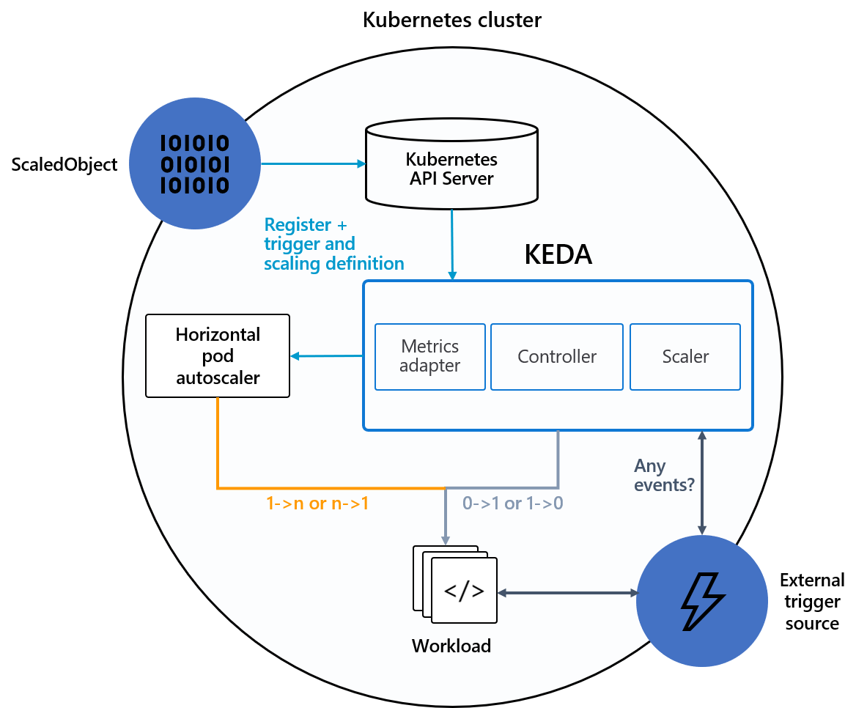
General Overview of KEDA
KEDA is a Kubernetes-based Event Driven Autoscaler. With KEDA, you can drive the scaling of any container in Kubernetes based on the number of events needing to be processed.
Official production-ready Sandbox-Project of Cloud Native Cloud Foundation (CNCF)
The Supporters / Maintainers are Microsoft and RedHat
HPA based on Events from following systems is already enabled
Apache Kafka (used by ZAV, IFRS17 etc.)
AWS SQS / SNS (used by DigitialFactory, other Organisations applying AWS etc.)
IBM MQ
Azure Event Hubs
MSSQL
MySQL
MongoDB
Prometheus
Redis
InfluxDB
A lot more…..
Source: https://keda.sh/

Slide 7
Demo

