Slide 1

Analyzing and Predicting Bitcoin Price Using Machine Learning
Course: SEIS 763-03
Professor: Chi Lai
Group Members:
Emily Anderson
Summer Nie
Byunghun Lee
Matthew Johnson
This Photo by Unknown author is licensed under CC BY-SA-NC.

Slide 2
Purpose
This presentation describes the machine learning models for predicting Bitcoin prices. This information is meant for the professors in the Center for Applied Artificial Intelligence in the School of Engineering at the University of St Thomas to determine the optimal machine learning model that could best be utilized to gain advantageous insights in the Bitcoin marketplace.

Slide 3
Overview
Background
Dataset
Prediction
Implementation
Train/Test/Predict Strategy
File Architecture
MATLAB Model – Linear Regression
MATLAB Model – Logistic Lasso
MATLAB Model – Support Vector Machine
Python Models – Linear Regression, Logistic Regression, SVM
Summary
Questions
References

Slide 4
Background I – Bitcoin History
The cryptocurrency market now worth more than $2 trillion.
Bitcoin (BTC) was first described in 1998 by Wei Dai, suggesting idea of a new form of money.
BTC remains at the top of this market after more than a decade of existence.
BTC has a unique advantage to the rest being the first cryptocurrency on the market.
BTC has managed to create a global community and give rise to a whole new industry.
BTC has lost its undisputed dominance.
BTC remains the largest cryptocurrency, with a market capitalization.
BTC surpassed the $1 trillion mark in 2021.
BTC’s price reached an all-time high of $68,521 on Nov 5, 2021.

Slide 5
Background II – Motivations
Interesting Problems
Dataset Selection
Minute vs. Daily
Pros and Cons
MATLAB
Python

Slide 6
Dataset Details
4,857,377 rows × 8 columns in the dataset
After filtering NaN’s the total number of records is 3,613,769, a reduction of 25.6%
Date – Unix Time
Open – Opening price per minute
High – Maximum price per minute
Low – Minimum price per minute
Close – Close price per minute
Volume_BTC – Number of Bitcoins traded per minute
Volume_Currency – Total price of Bitcoins traded per minute
Weighted Price – Volume_Currency divided by Volume_BTC

Slide 7
Prediction
Description of the source of data
Questions we hope to answer with the data
Description of the data exploration & analysis phase of the project
Daily prices with 1-minute intervals and a range of week, month of data.
When was the best time to buy or sell by knowing price upward (1) or downward (0)?
% of missing NA Value = 25 %

Slide 8
Implementation
Selection of ML model
Model Analysis
Data update start of test
Up or Down Recommendation

Slide 9
Model Strategy
 | 2013 | 2016 | 2019 | 2021
Mar 17 – 19 | Linear regression Logit SVM | Linear regression Logit SVM | Linear regression Logit SVM | Linear regression Logit SVM
Mar 17 – 23 | Linear regression Logit SVM | Linear regression Logit SVM | Linear regression Logit SVM | Linear regression Logit SVM
Mar 17 – 30 | Linear regression Logit SVM | Linear regression Logit SVM | Linear regression Logit SVM | Linear regression Logit SVM

Slide 10
File Architecture I
 | File Linear regression | File Logit | File SVM
2013 | Mar 17 – 18 Mar 17 – 23 Mar 17 – 30 | Mar 17 – 18 Mar 17 – 23 Mar 17 – 30 | Mar 17 – 18 Mar 17 – 23 Mar 17 – 30
2016 | Mar 17 – 18 Mar 17 – 23 Mar 17 – 30 | Mar 17 – 18 Mar 17 – 23 Mar 17 – 30 | Mar 17 – 18 Mar 17 – 23 Mar 17 – 30
2019 | Mar 17 – 18 Mar 17 – 23 Mar 17 – 30 | Mar 17 – 18 Mar 17 – 23 Mar 17 – 30 | Mar 17 – 18 Mar 17 – 23 Mar 17 – 30
2021 | Mar 17 – 18 Mar 17 – 23 Mar 17 – 30 | Mar 17 – 18 Mar 17 – 23 Mar 17 – 30 | Mar 17 – 18 Mar 17 – 23 Mar 17 – 30

Slide 11
File Architecture II – Folder
Bitcoin Price Folder:
Bitcoin_Price_minute_LR_Final.mlx
Bitcoin_Price_minute_Logit_Final.mlx
Bitcoin_Price_minute_SVM_Final.mlx
SEIS_763_BTC_prediction.ipynb
bitcoin-dataset.csv
CFM_Stats.m

Slide 12
MATLAB Model I – Linear Regression I
Date Range | Records | Outliers | RMSE | Intercept
2013 2 Day | 521 | 96 | .0125 | .00065553
2016 2 Day | 2043 | 516 | .135 | .003668
2019 2 Day | 2528 | 133 | .74 | .016822
2021 2 Day | 2876 | 0 | 26.4 | .54961
Notes:
Here’s a quick table to show the differences in data during the same time frame over the four years we looked at. You can see how the number of records increase over the same time frame going from 521 total records transferred in 2013 to 2876 in 2021. Because we obviously didn’t get any more minutes in the day between those years, we know this increase is due to the number of transactions increasing causing less NaNs to need to be removed in the later years.
The change on the RMSE is also quite notable. As the years go on and Bitcoin’s price starts to fluctuate more our error starts to skyrocket. The error shows the increase volatility in Bitcoin behaviour

Slide 13
MATLAB Model I – Linear Regression II
Date Range | Records | Outliers | RMSE | Intercept
2013 7 Day | 3784 | 0 | .122 | .0022237
2016 7 Day | 7640 | 0 | .155 | .0019805
2019 7 Day | 9238 | 562 | .709 | .0084112
2021 7 Day | 10065 | 0 | 25.6 | .28567

Slide 14
MATLAB Model I – Linear Regression III
Date Range | Records | Outliers | RMSE | Intercept
2013 14 Day | 7409 | 0 | .192 | .0024907
2016 14 Day | 14704 | 416 | .167 | .0015517
2019 14 Day | 18719 | 2859 | .72 | .0062826
2021 14 Day | 20108 | 0 | 24.3 | .1912
Notes:
2021 outliers – as defined by Matlab 3 SD

Slide 15
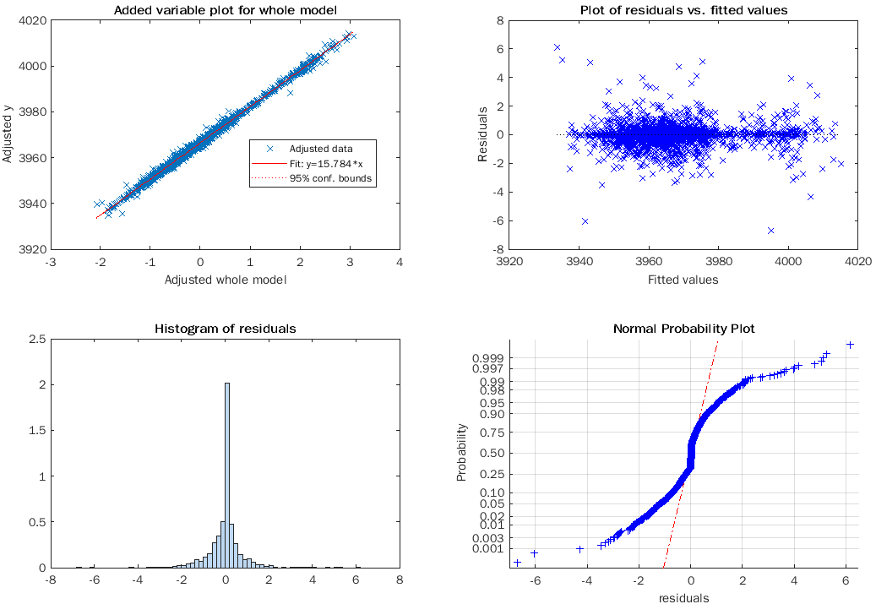
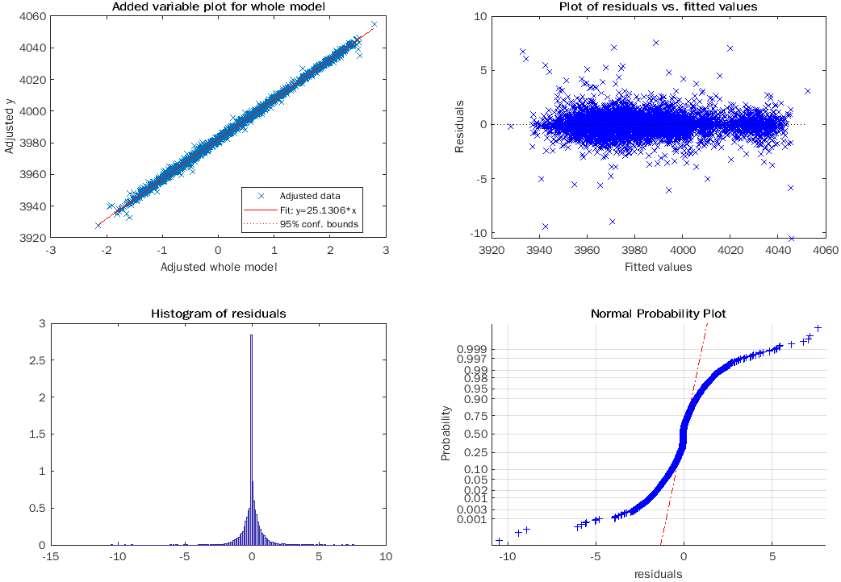
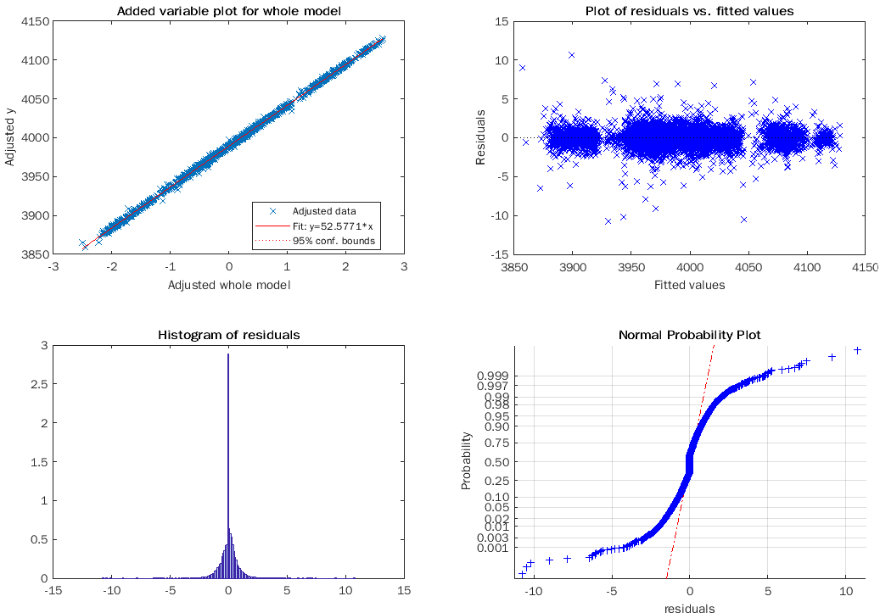
MATLAB Model I – Linear Regression IV
MATLAB – 2019 pre outlier removal
2 Days
7 Days
14 Days
2,528 records
RMSE 0.743
9,238 records
RMSE .723
18,719 records
RMSE .731
Notes:
As we saw in the previous slide 2019 had the most number of outliers as defined by Matlab, across the date ranges we looked at. This is the beginning of the

Slide 16
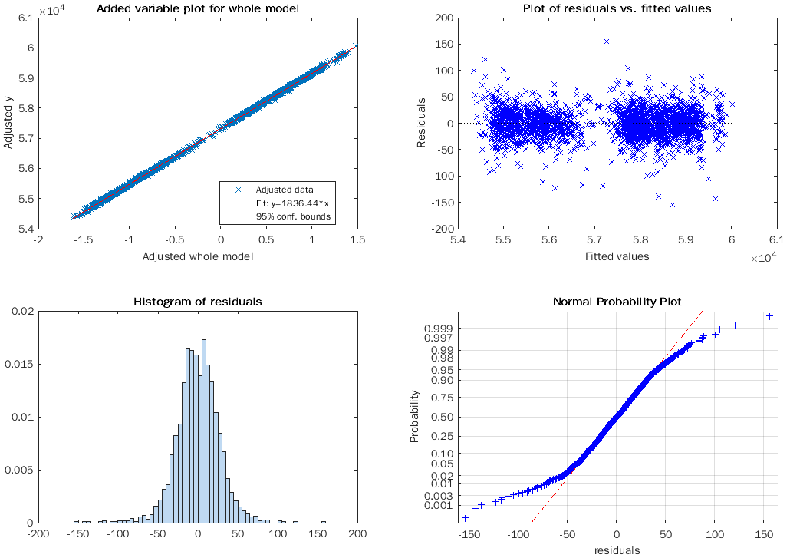
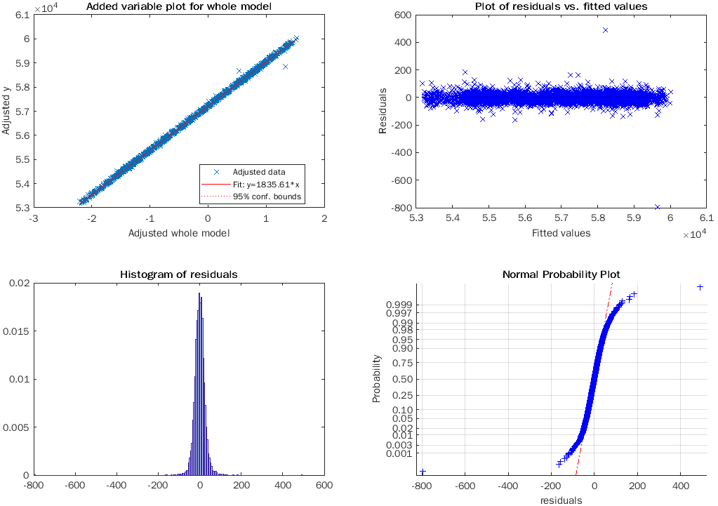
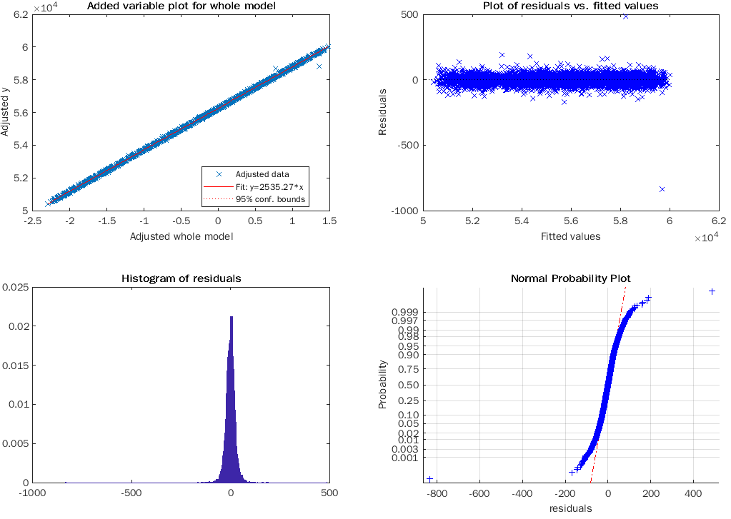
MATLAB Model 1 – Linear Regression V
Matlab 2021 – no outlier removal
2 Days
7 Days
14 Days
2,301 records
26.8 RMSE
8,052 records
26.2 RMSE
16,087 records
24.2 RMSE
Notes:
Compared to 2019, 2021 doesn’t have any outlier, as defined by Matlab, but the error is magnitude higher than the errors for any of the other years we looked at.
2 days – 2301, RMSE 26.8
7 days – 8,052, RMSE 26.2
14 days – 16,087, RMSE 24.2

Slide 17
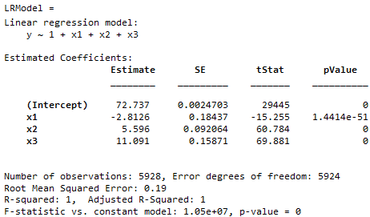
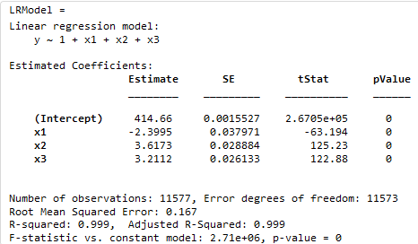
MATLAB Model I – Linear Regression VI MATLAB – Comparison: 14 Days, Year over year
2013
2016
Notes:
You can see the adjusted R-Squared stays relatively constant over the years, but the RMSE changes dramatically in 2021. This could be because there are more records, or that the data is just so volatile in March of 2021 that it’s hard to model with accuracy.
You can also see that, after accounting for NaNs and outliers as defined by Matlab (>3 median absolute deviations from median), over the same 14 day period we jump from just shy of 6,000 records to over 16,000. The sheer amount of data, as BitCoin starts to get popular is just staggering.
Low price appears to have the highest magnitude across all of the years

Slide 18
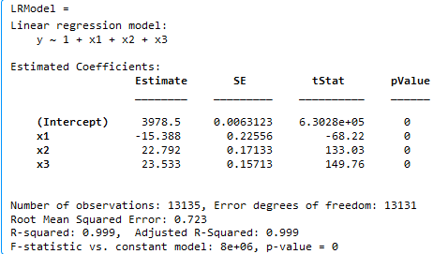
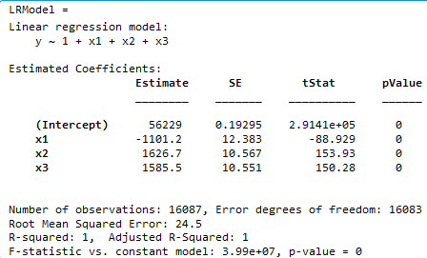
MATLAB Model I – Linear regression VII
2019
2021

Slide 19
MATLAB Model II – Logistic/Lasso Regression I
Logistic + Lasso Regression Observations:
The Open and Low variables are the most significant predictors during 2013, 2016, and 2019, according to the Lambda table and graphs
The Open and High variables are the most significant predictors during 2021, according to the Lambda table and graphs
The F-score values are the most consistent and highest (optimal) during the 2, 7, and 14 date ranges of 2021

Slide 20
MATLAB Model II – Logistic/Lasso Regression II
F-score for the 2-day range in 2021 is highest for all the date ranges in 2013, 2016, 2019, and 2021
 | accuracy | precision | recall | F-score
2021 2 day | 0.82087 | 0.81882 | 0.82168 | 0.82024
2021 2 day | 0.82087 | 0.82292 | 0.82007 | 0.82149
2021 7 day | 0.80417 | 0.79863 | 0.81294 | 0.80572
2021 7 day | 0.80417 | 0.80991 | 0.79543 | 0.80261
2021 14 day | 0.8095 | 0.79446 | 0.8377 | 0.81551
2021 14 day | 0.8095 | 0.82646 | 0.781 | 0.80308

Slide 21
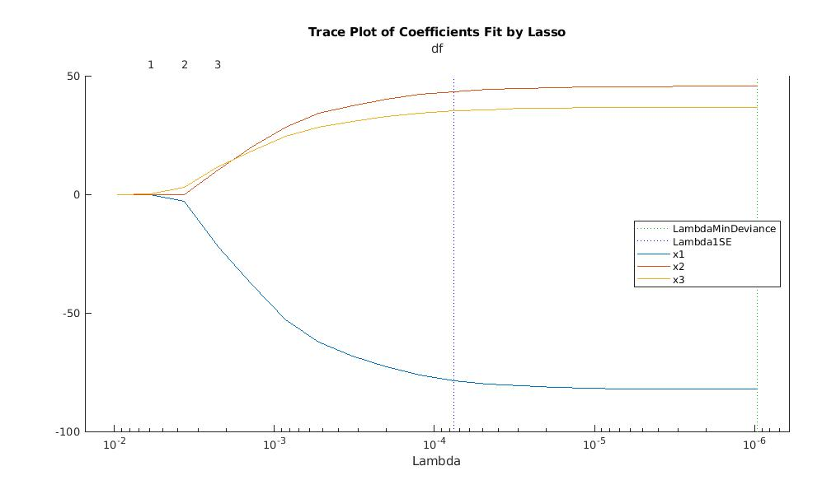
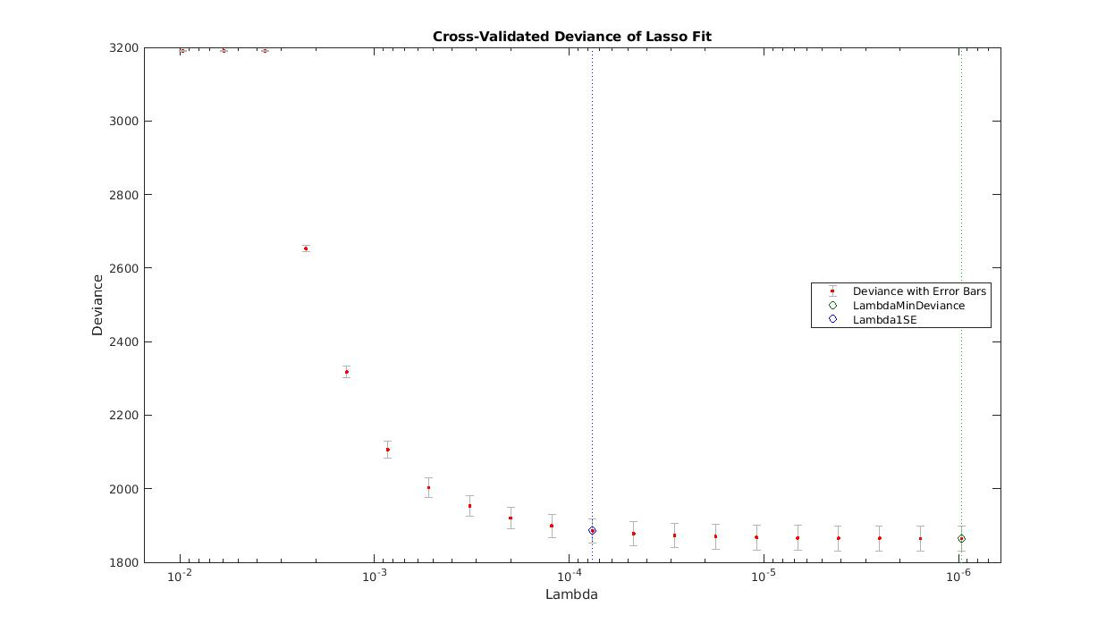
MATLAB Model II – Logistic/Lasso Regression III
March 17, 2021 – March 18, 2021

Slide 22
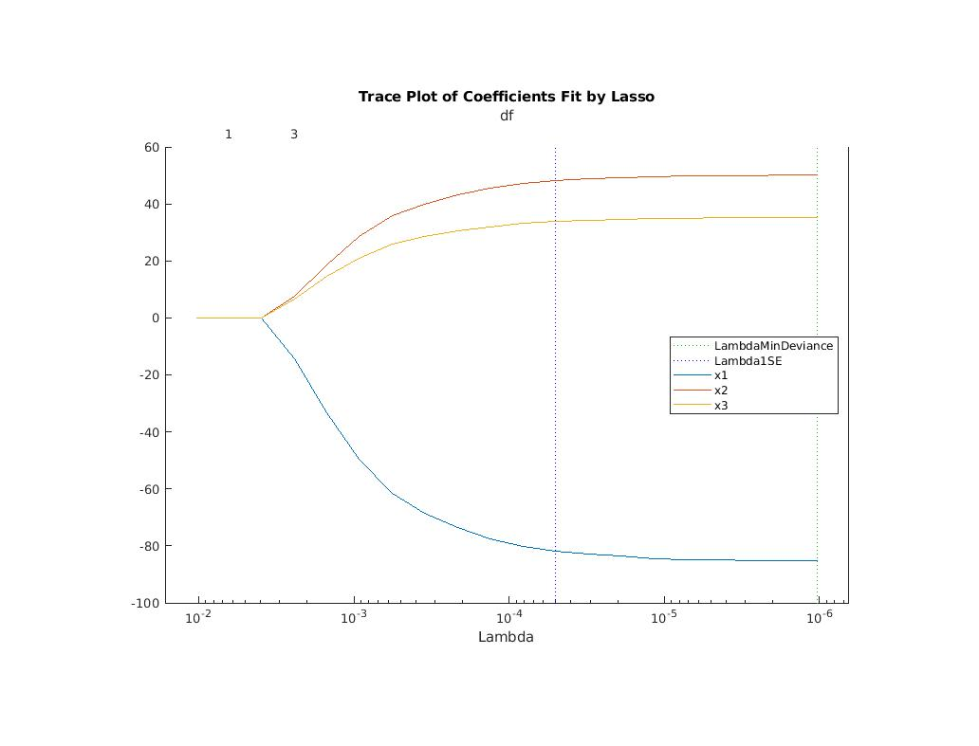
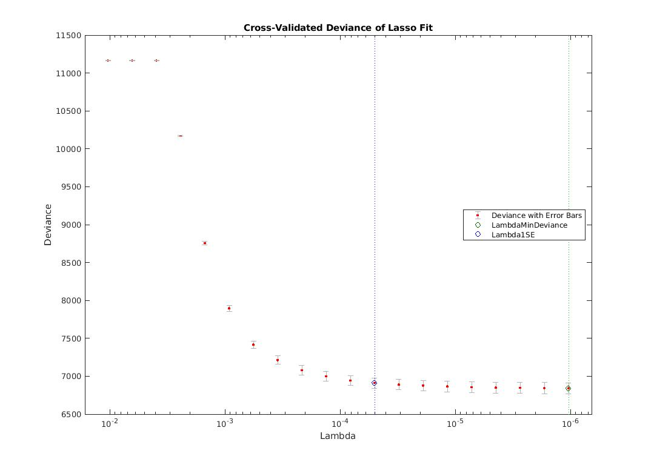
MATLAB Model II – Logistic/Lasso Regression IV
March 17, 2021 – March 23, 2021

Slide 23
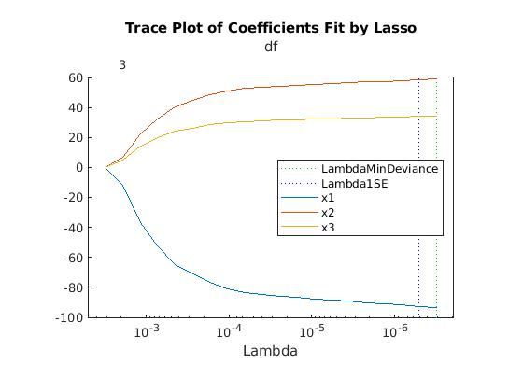
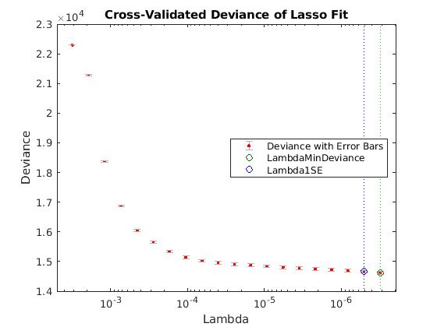
MATLAB Model II – Logistic/Lasso Regression V
March 17, 2021 – March 30, 2021

Slide 24
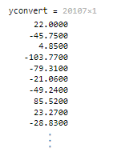
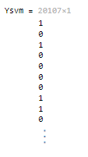
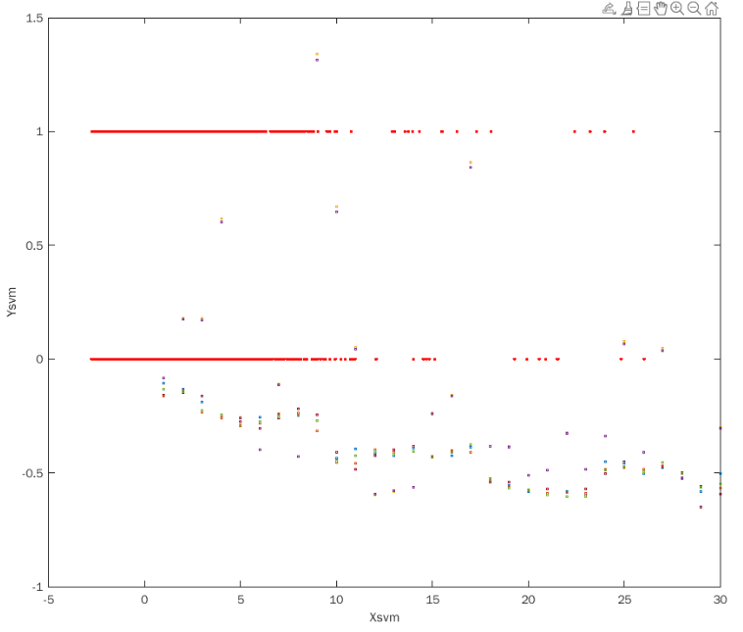
Model III – SVM – Overview of 2021 14-day Dataset
Convert the Target Column to 2 Classes
Overview of the data distribution
MATLAB Script：
yconvert = diff(BitcoinData2.Close)
Ysvm = double(yconvert >= 0)
sum(Ysvm) = 1,441

Slide 25
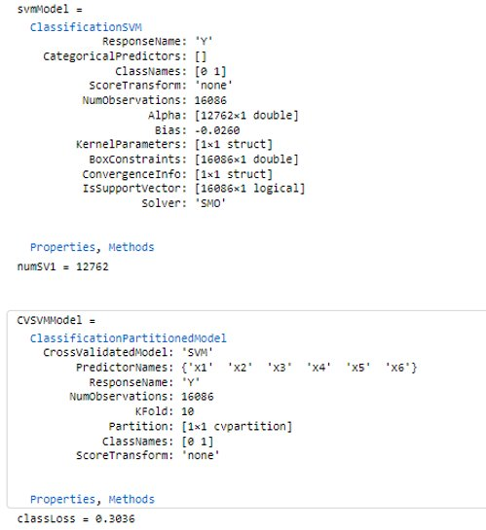
Model III – SVM – SVM Models in MATLAB
Support Vector Machine Model Scripts in MATLAB:
SVM Model Property
svmModel = fitcsvm(Xtrain, Ytrain, 'BoxConstraint', 5, 'KernelScale', 1,"KernelFunction","rbf")​
CVSVMModel = crossval(svmModel)​
classLoss = kfoldLoss(CVSVMModel)

Slide 26
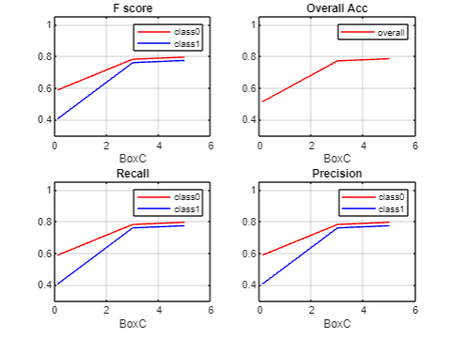
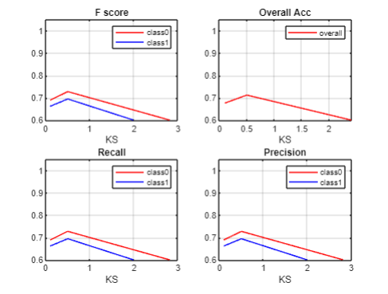
Model III – SVM - BoxConstriant and Kernel Scale
2021 Mar 17-30 -- 14days SVM Model Analysis
- Total # of records: 16,086
Matrix for the Up Class (Price Goes Up)
Box Constraint | Kernel Scale | SVs | Accuracy | Precision | Recall
0.1 | 1 | 15,898 | .5121 | .4933 | .3421
3 | 1 | 13,674 | .7712 | .7715 | .7485
5 | 1 | 12,762 | .7849 | .7874 | .7603
100* | 1 | 8,231 | .8015 | .8112 | .7836
1 | .1 | 13,955 | .6762 | .6682 | .6559
1 | .5 | 14,825 | .7123 | .7130 | .6775
1 | 3 | 15,874 | .5648 | .5530 | .5206
1 | 100* | 15,910 | .5024 | NaN | 0
* Matrix for Box Constraint of 100 and Kernel Scale of 100 are not included in the graphs on the right side.
Notes:
Mar 17-23 would be … … …

Slide 27
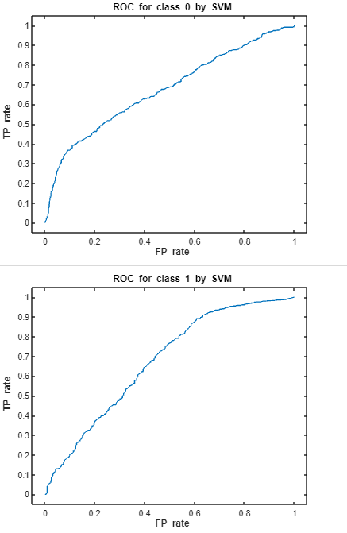
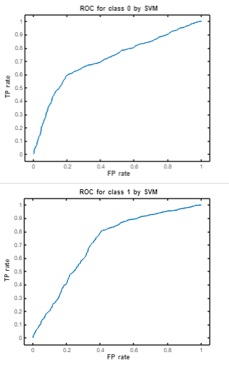
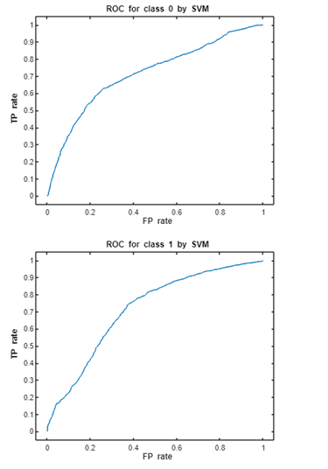
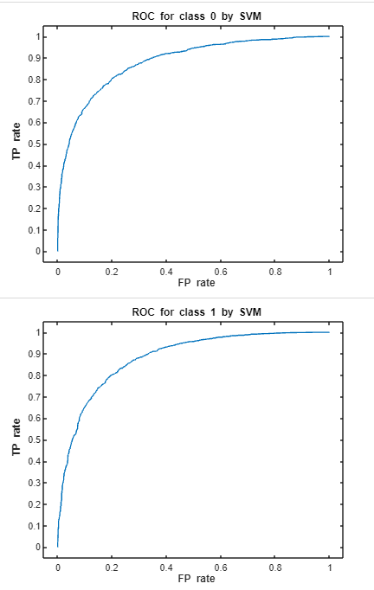
Model III – SVM- ROCs Curve
Box Constraint – 5 ; Kernel Scale – 1.
Compare year over year model performance with the same BoxConstraint, Kernel Scale, date range.
Use the 14-day data of the selected years.
2013
2016
2019
2021

Slide 28
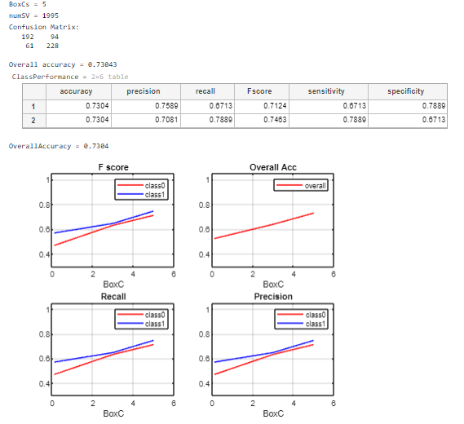
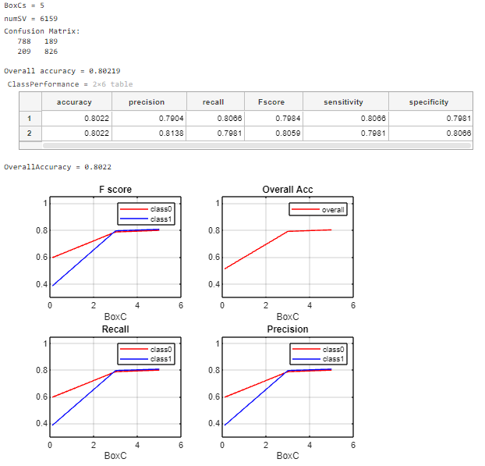
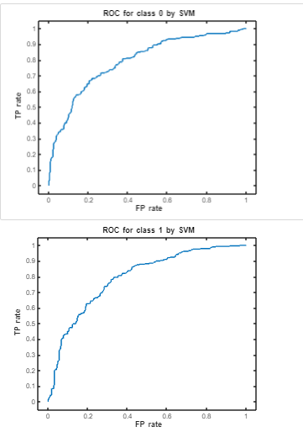
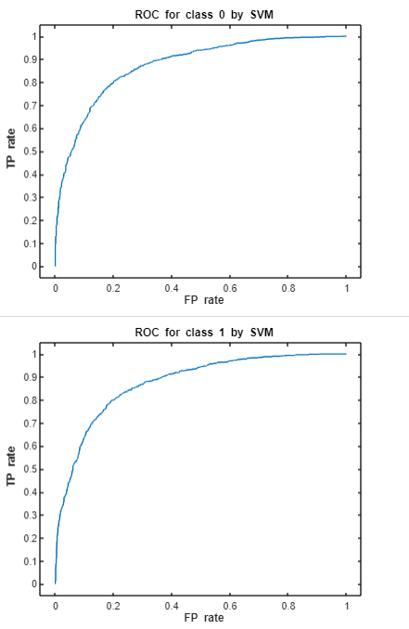
Model III – SVM – Compare Models with Different Date Ranges
BoxConstraint – 5, Kernel Scale – 1, RBF
2021 2-Day Data
2021 7-Day Data

Slide 29
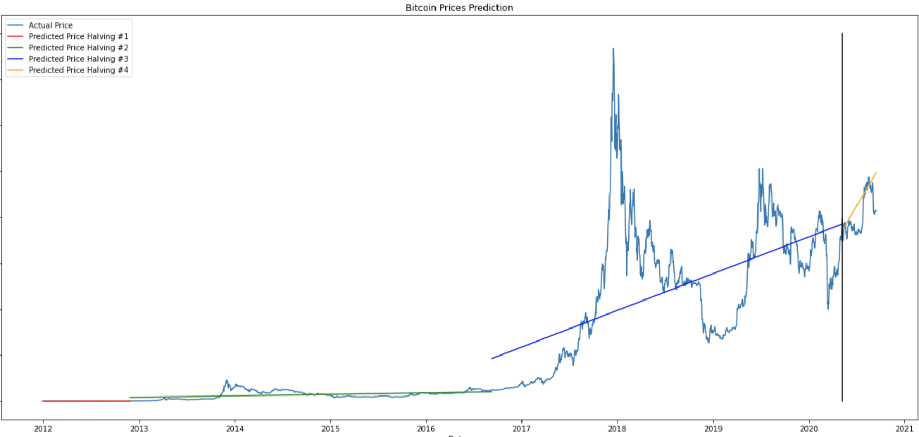
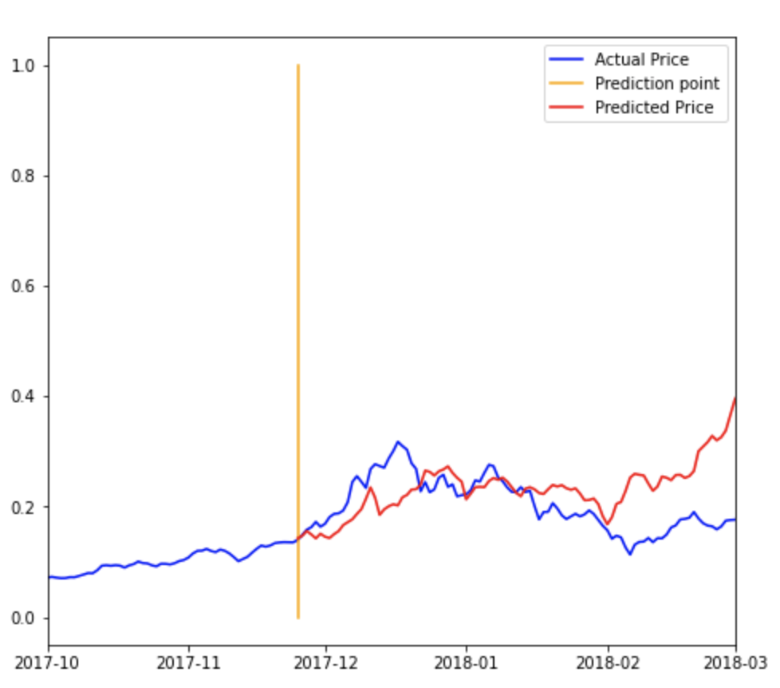
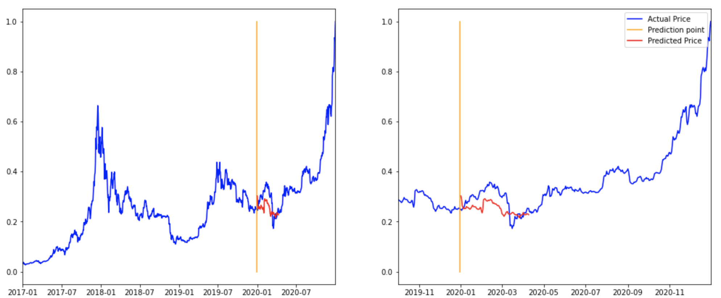
Model I – Linear regression In Python
Scale the dataset from 0 to 1
btc_halving = btc_day.loc['2016-12-31':'202O-12-31'] ​ 4 years
4 Month Prediction :2017-11-25 : 2018-03-01
2019-12-31 : 2020-03-31
2019-12-31 : 2020-04-15

Slide 30
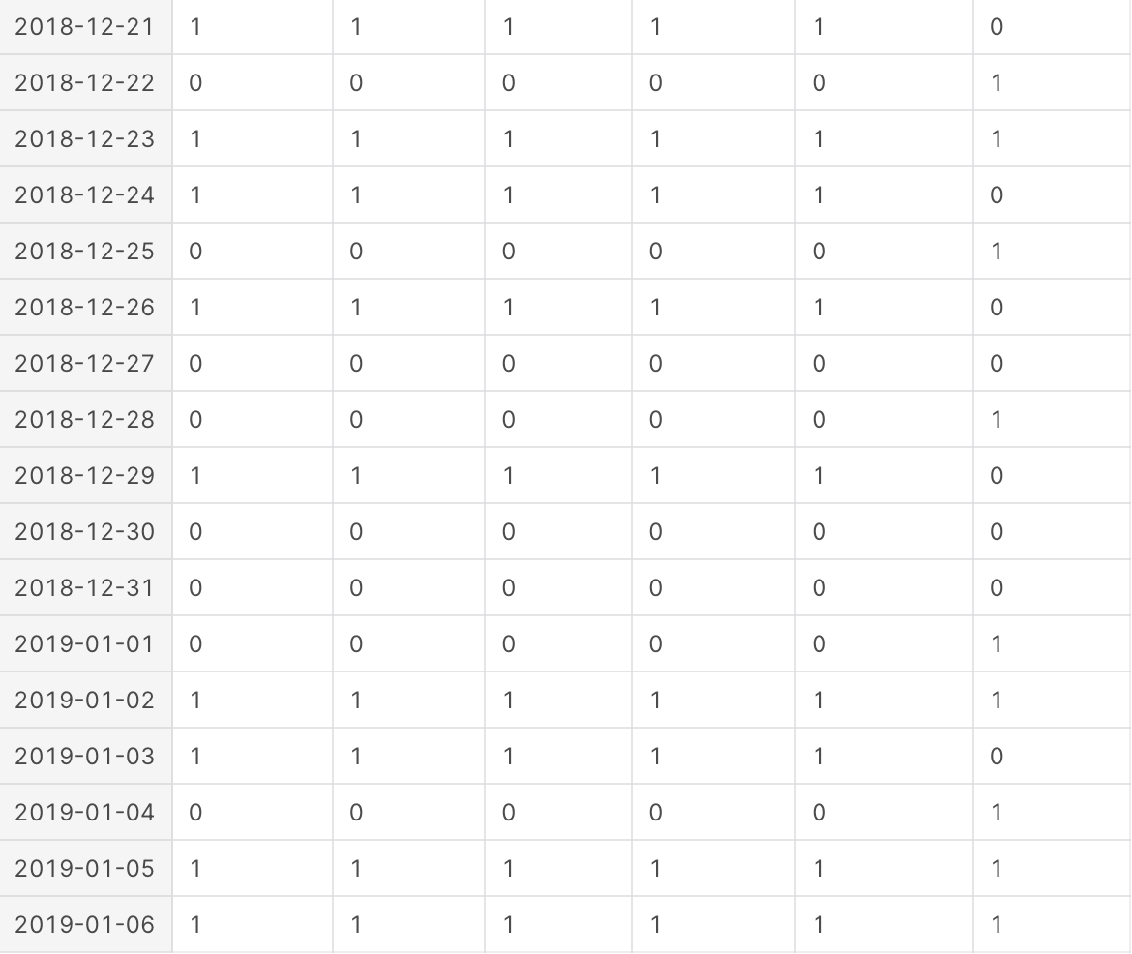
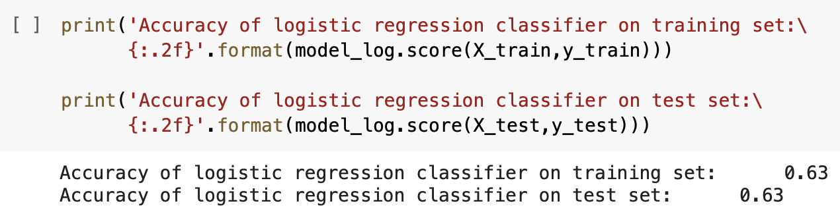
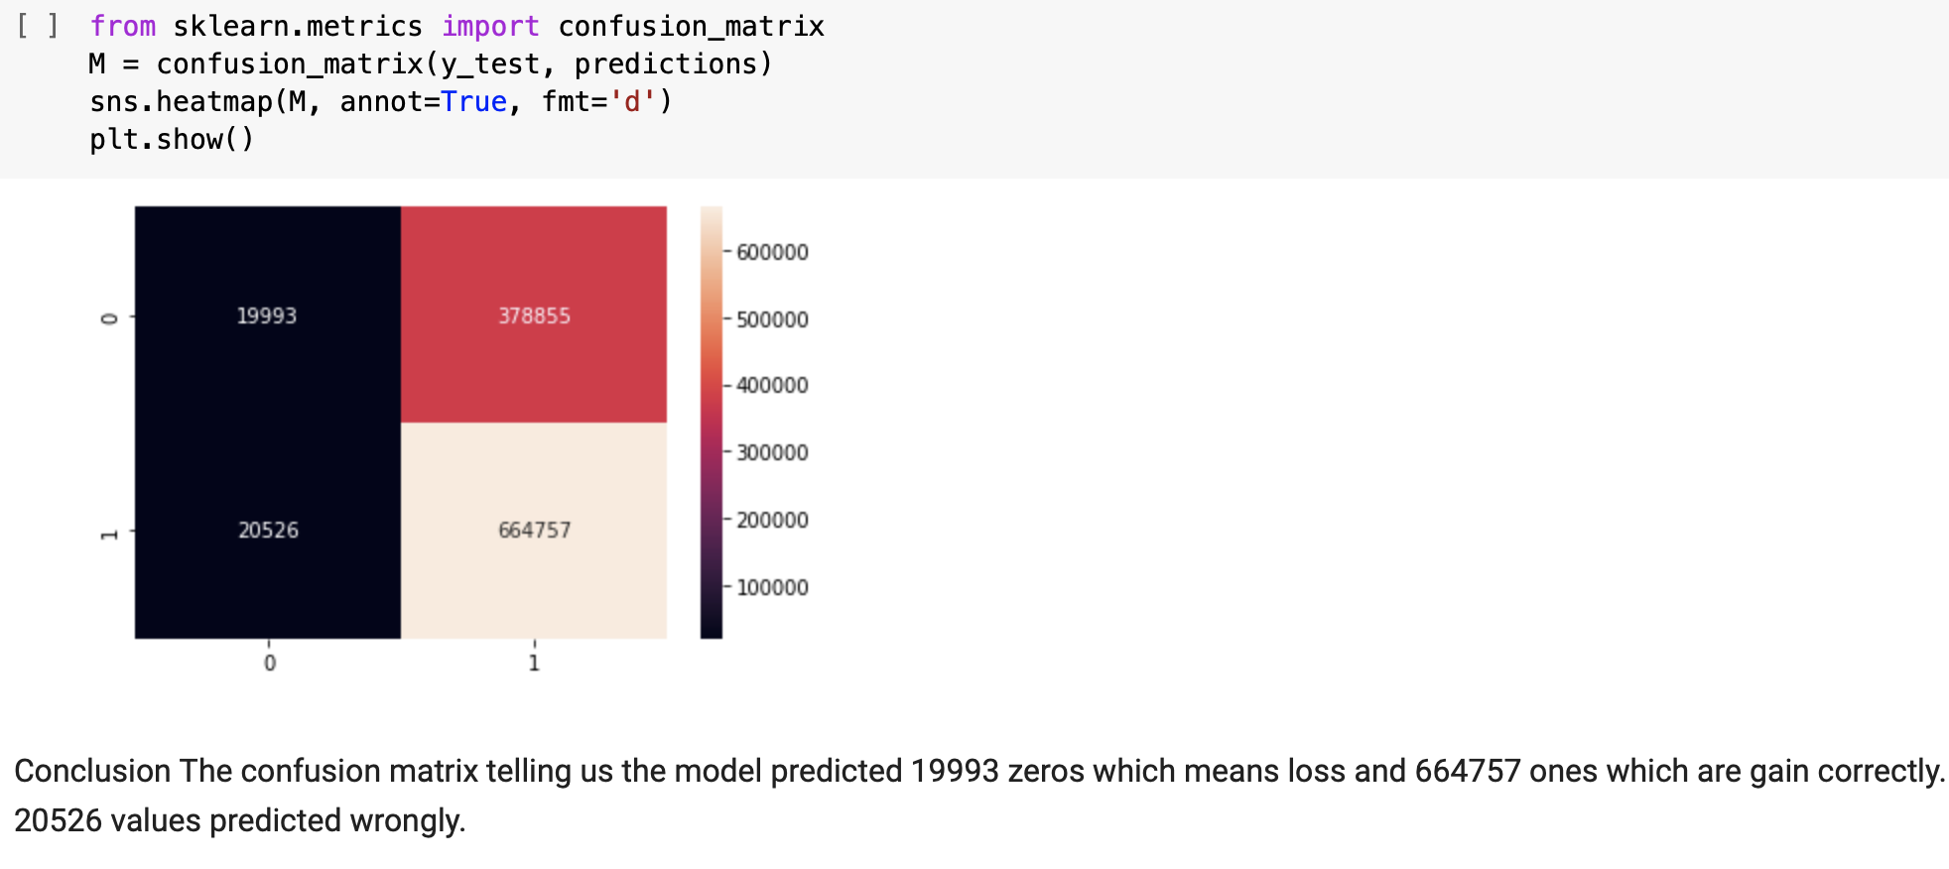
Model II – Logit In Python
btc_halving1 = btc_day.loc['2018-12-21':'2019-01-06']
btc_halving1 Target (Up/Down) Prediction
2011 – 2021 10 years Logit Analysis

Slide 31
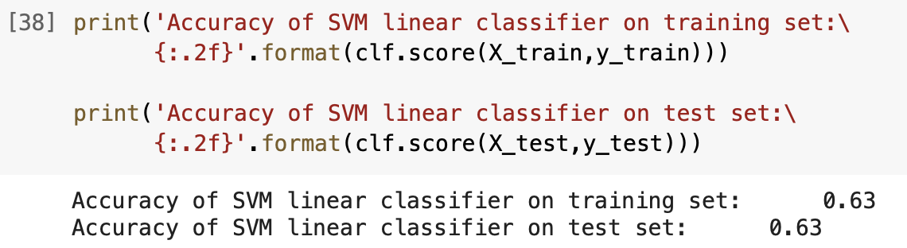
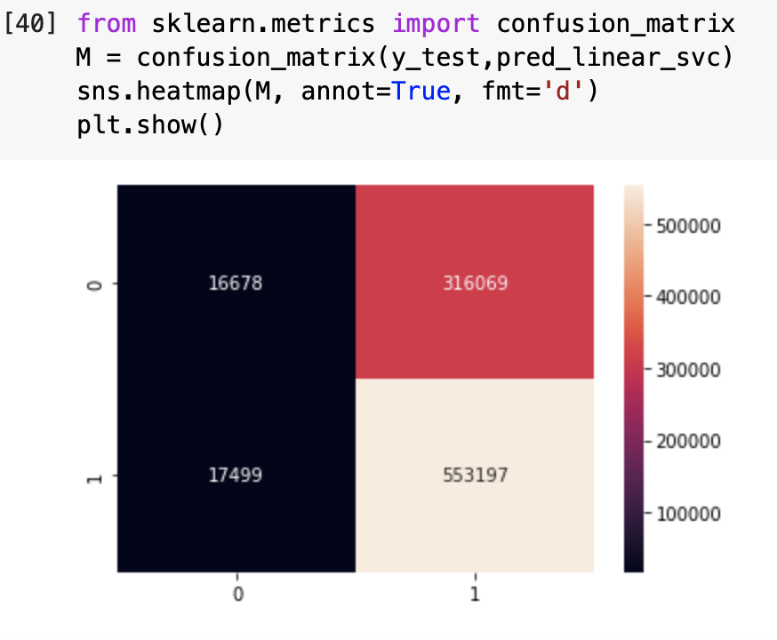
Model III – SVM In Python
2011 – 2021 10 years SVM Analysis
Conclusion : The confusion matrix telling us the model predicted 16678 zeros which means loss and 553197 ones which are gain correctly, 17499 values predicted wrongly.

Slide 32
Summary
AI > ML
SVM preferred, but still has drawbacks
Struggles with large, noisy data
2021 Data is both the best and the worst
Most accurate, best quality of data
Highest RMSE of the date ranges
What we would do with more time

Slide 33
Discussion

Slide 34
References
Bitcoin Historical Data - https://www.kaggle.com/mczielinski/bitcoin-historical-data
CFM_Stats - https://www.mathworks.com/matlabcentral/fileexchange/46035-confusionmatstats- group-grouphat - Courtesy of Dr. Lai
Logistic/Lasso Regression Prediction function - https://www.mathworks.com/help/stats/lassoglm.html#d123e527155
Isoutlier function - https://www.mathworks.com/help/matlab/ref/isoutlier.html
Outlier function (unused) - https://www.mathworks.com/matlabcentral/fileexchange/70280-outlier?s_tid=srchtitle_outliers_8

