Slide 1
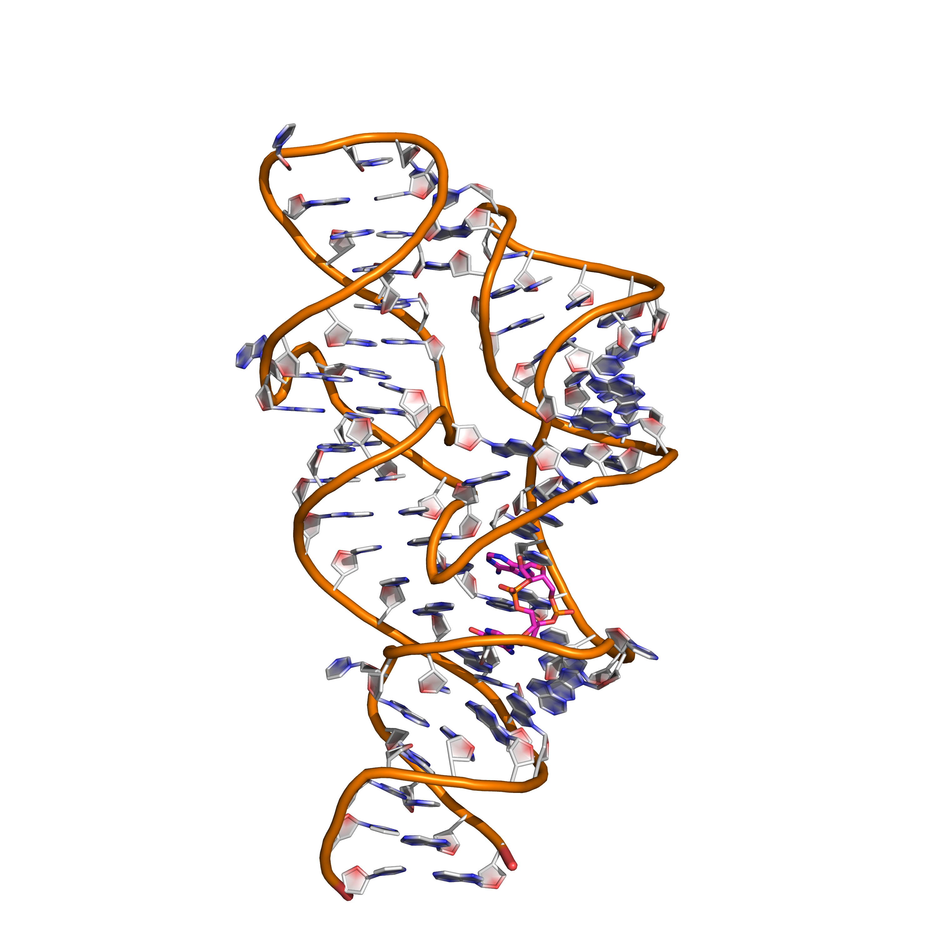
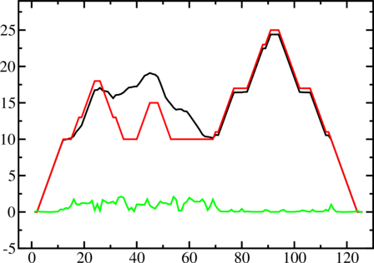
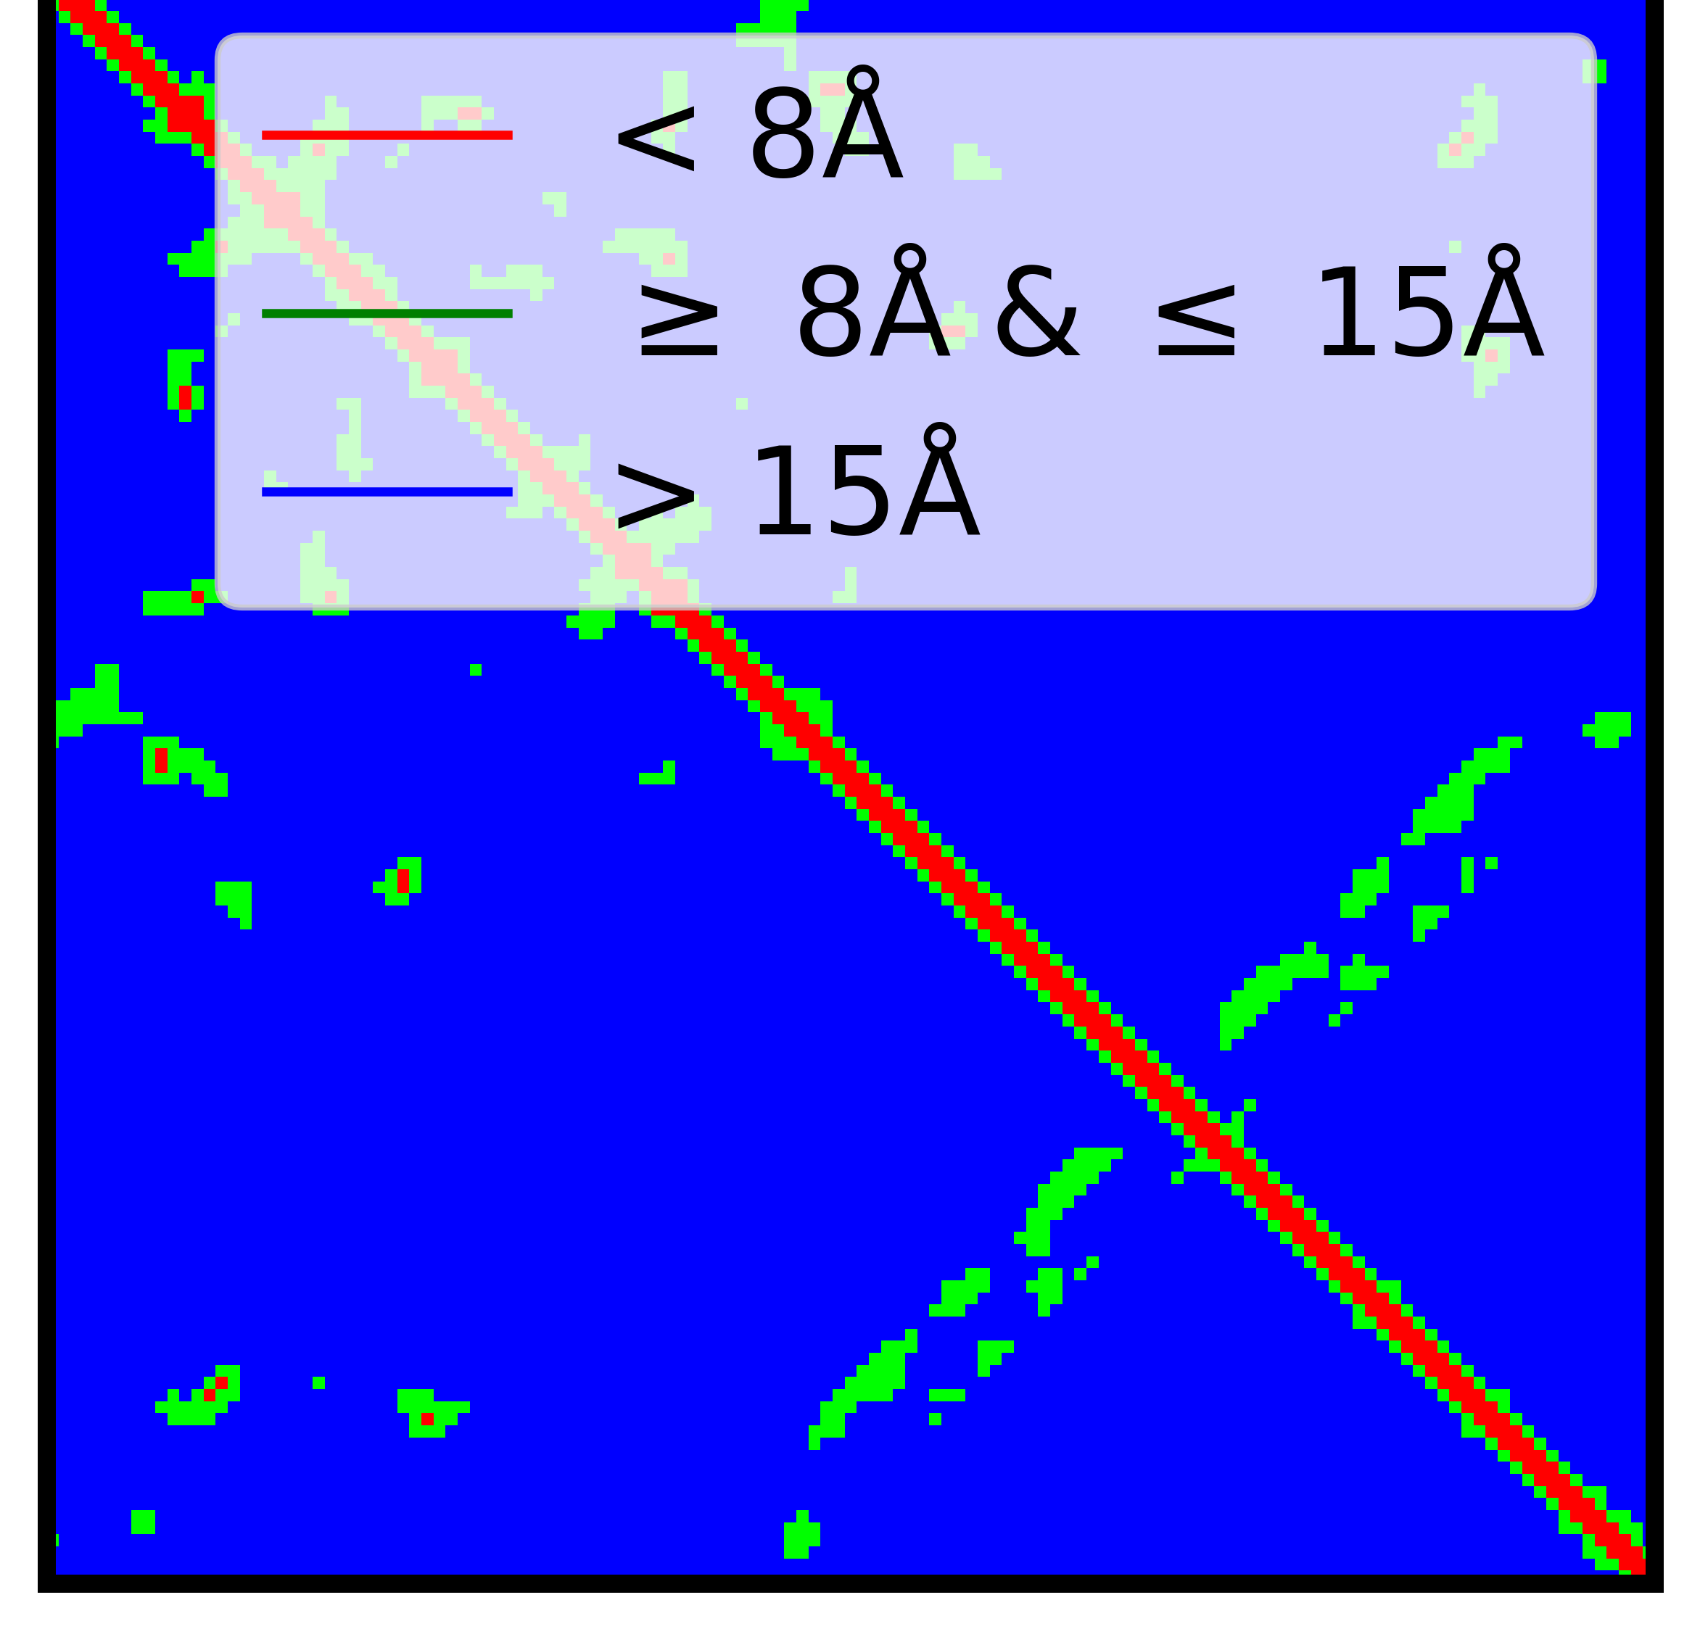
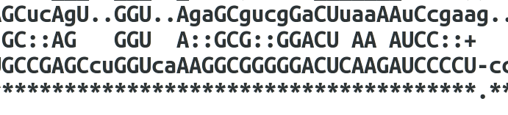
0. Inputs
1. RNA contact map – Deep learning
2. Fragment- assembly
Base pair probabilities (black) minimal free energy 2D structure(red), positional entropies(green) -ViennaRNA
Alignment to consensus sequence -infernal
Seq : AUGCGG … ...
Residue level features
(15 x Length x 1)
Pairwise Features
(Length x Length
x 1)
Secondary Structure -ViennaRNA
1D convolution
merge
Pairwise residue distances
→ sequence
(1 x Length
x 64)
(Length x Length x 3)
Rosetta modeling with restrains
{Length x Length
x (64 + 1) }
2D
convolution
Family-
Target-
Dot product

