Slide 1
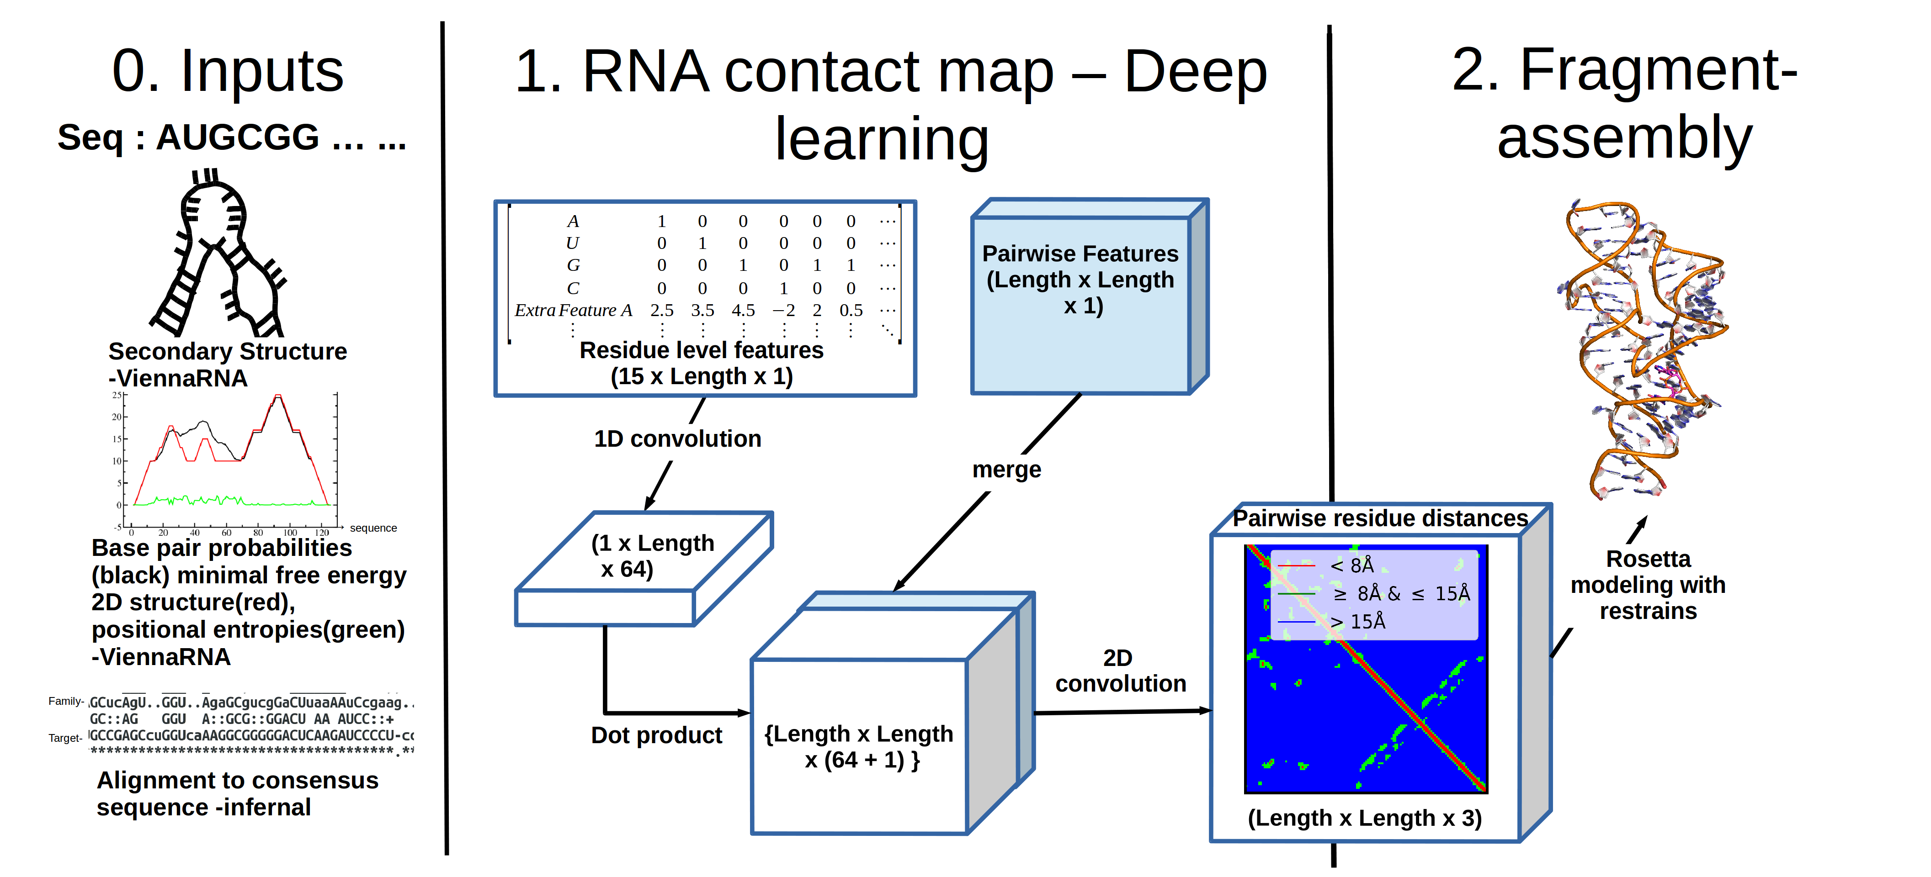
RNA Modeling
RNA structures are inherently flexible and difficult to resolve. There is a need for structural prediction methods and we are developing a computational pipeline to model RNA.
1. Convolution neural network to predict RNA tertiary contacts.
2. Fragment based assembly with pairwise restrains

