Slide 1
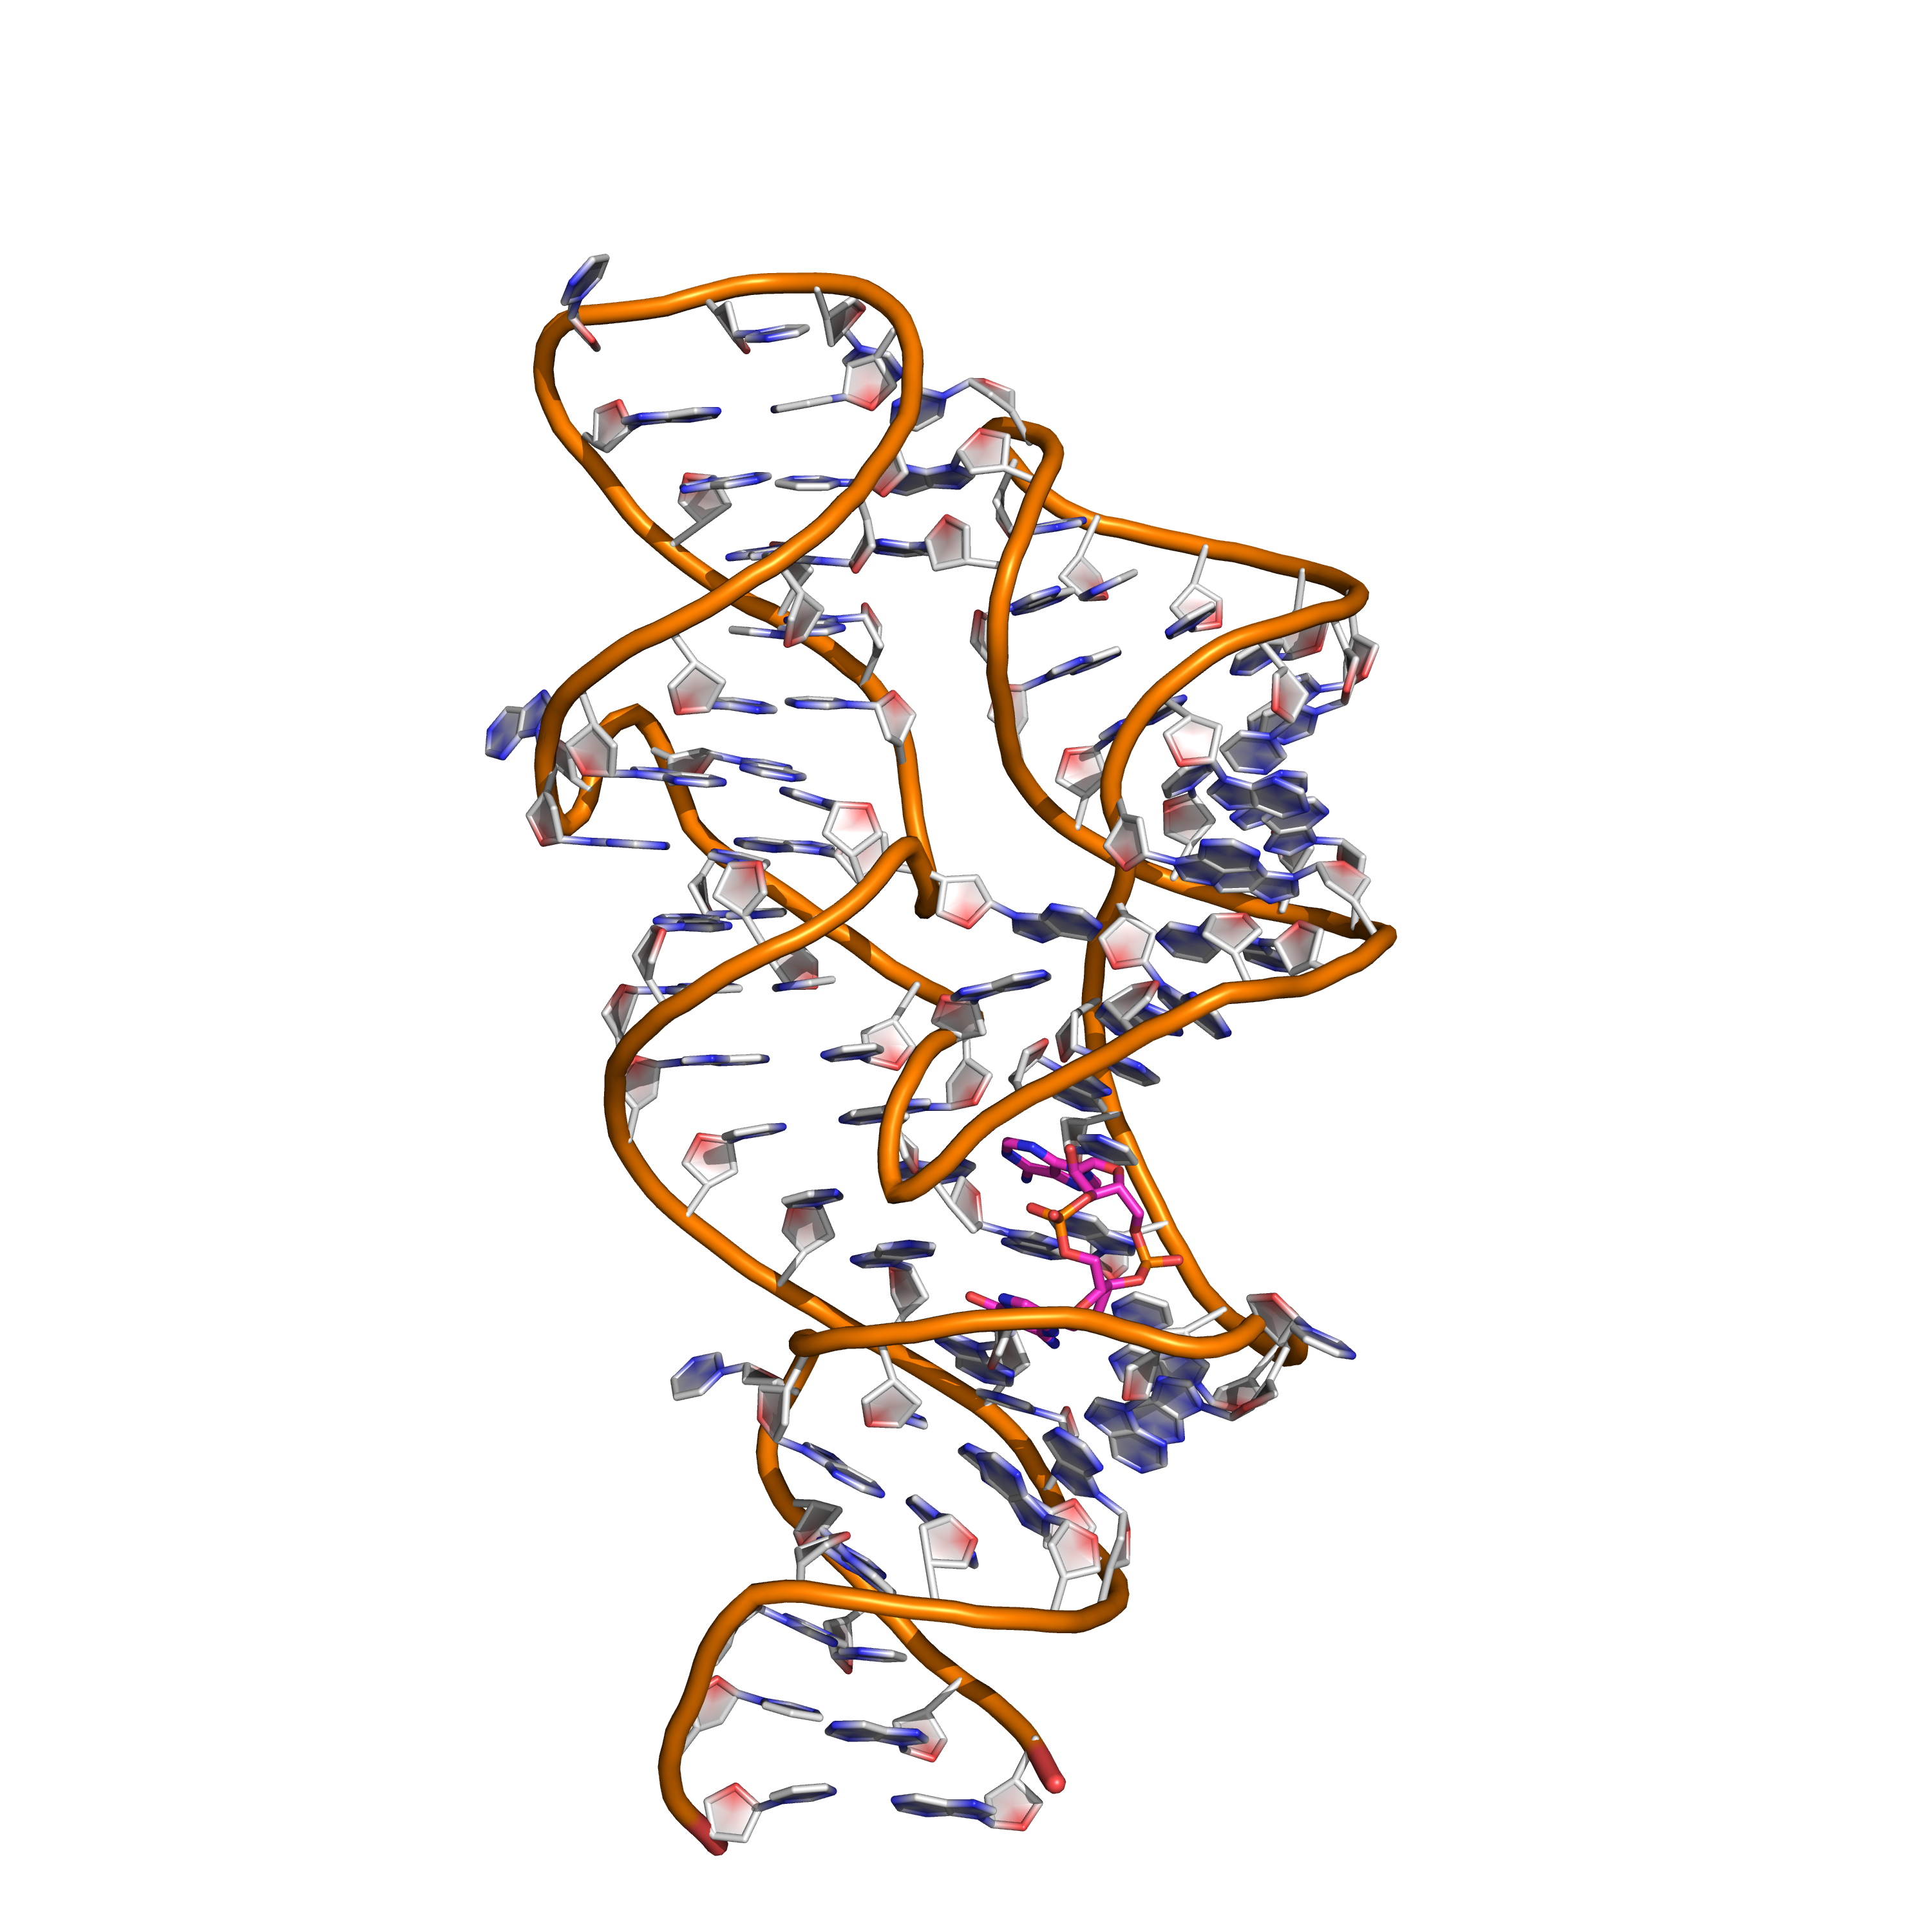
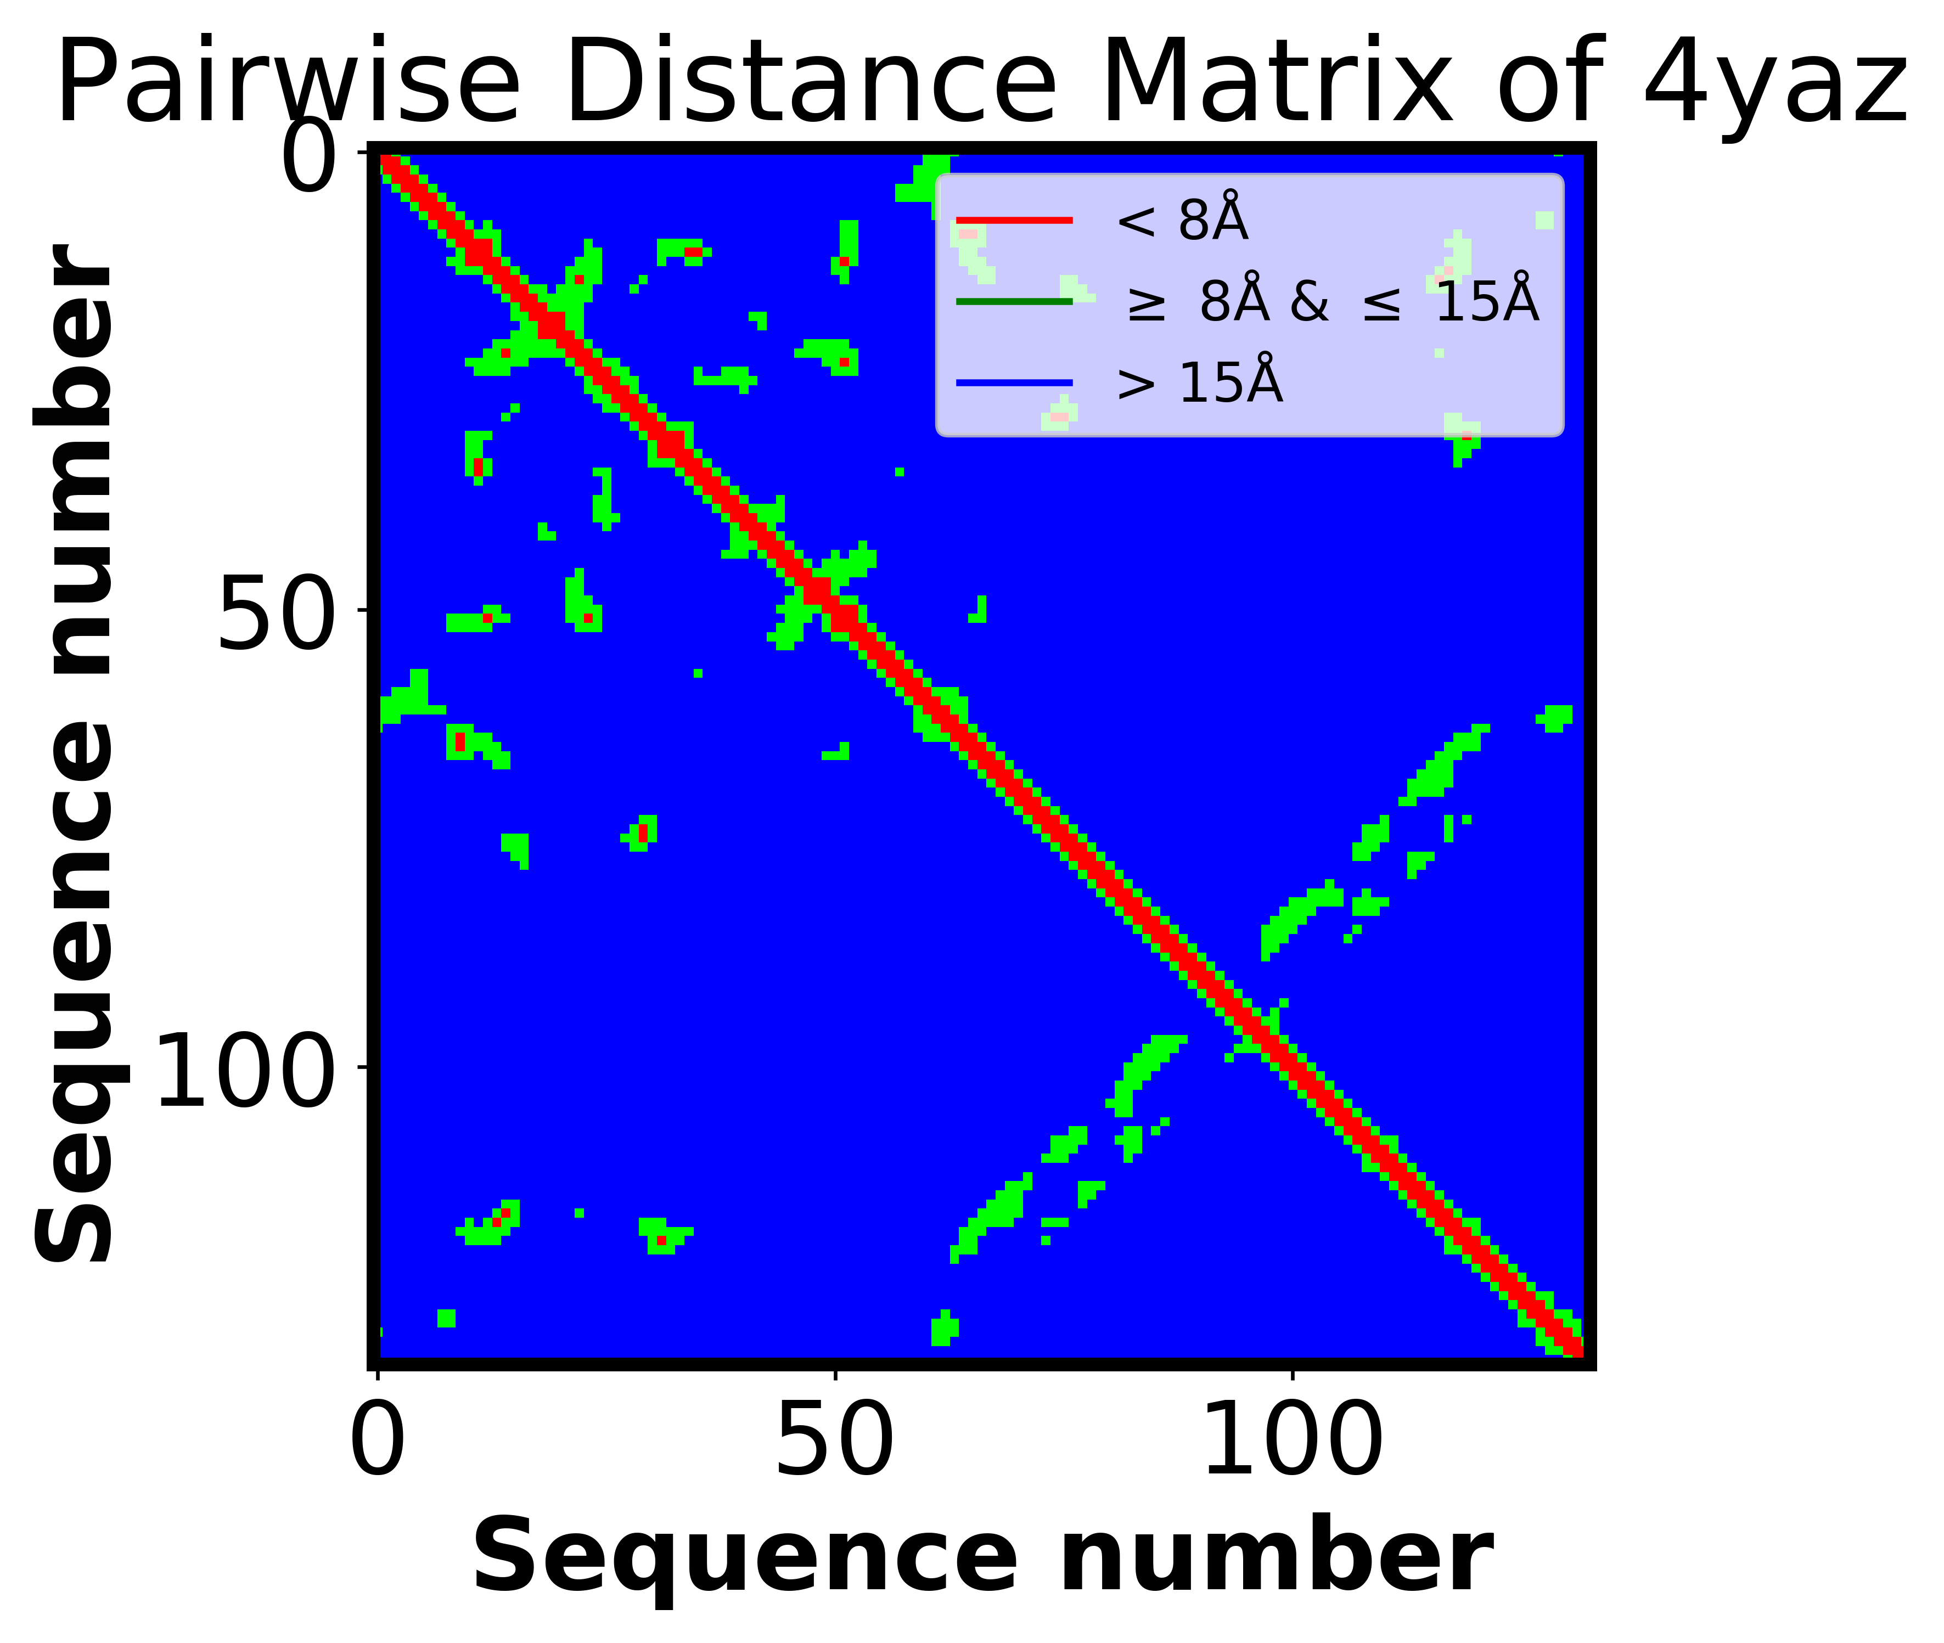
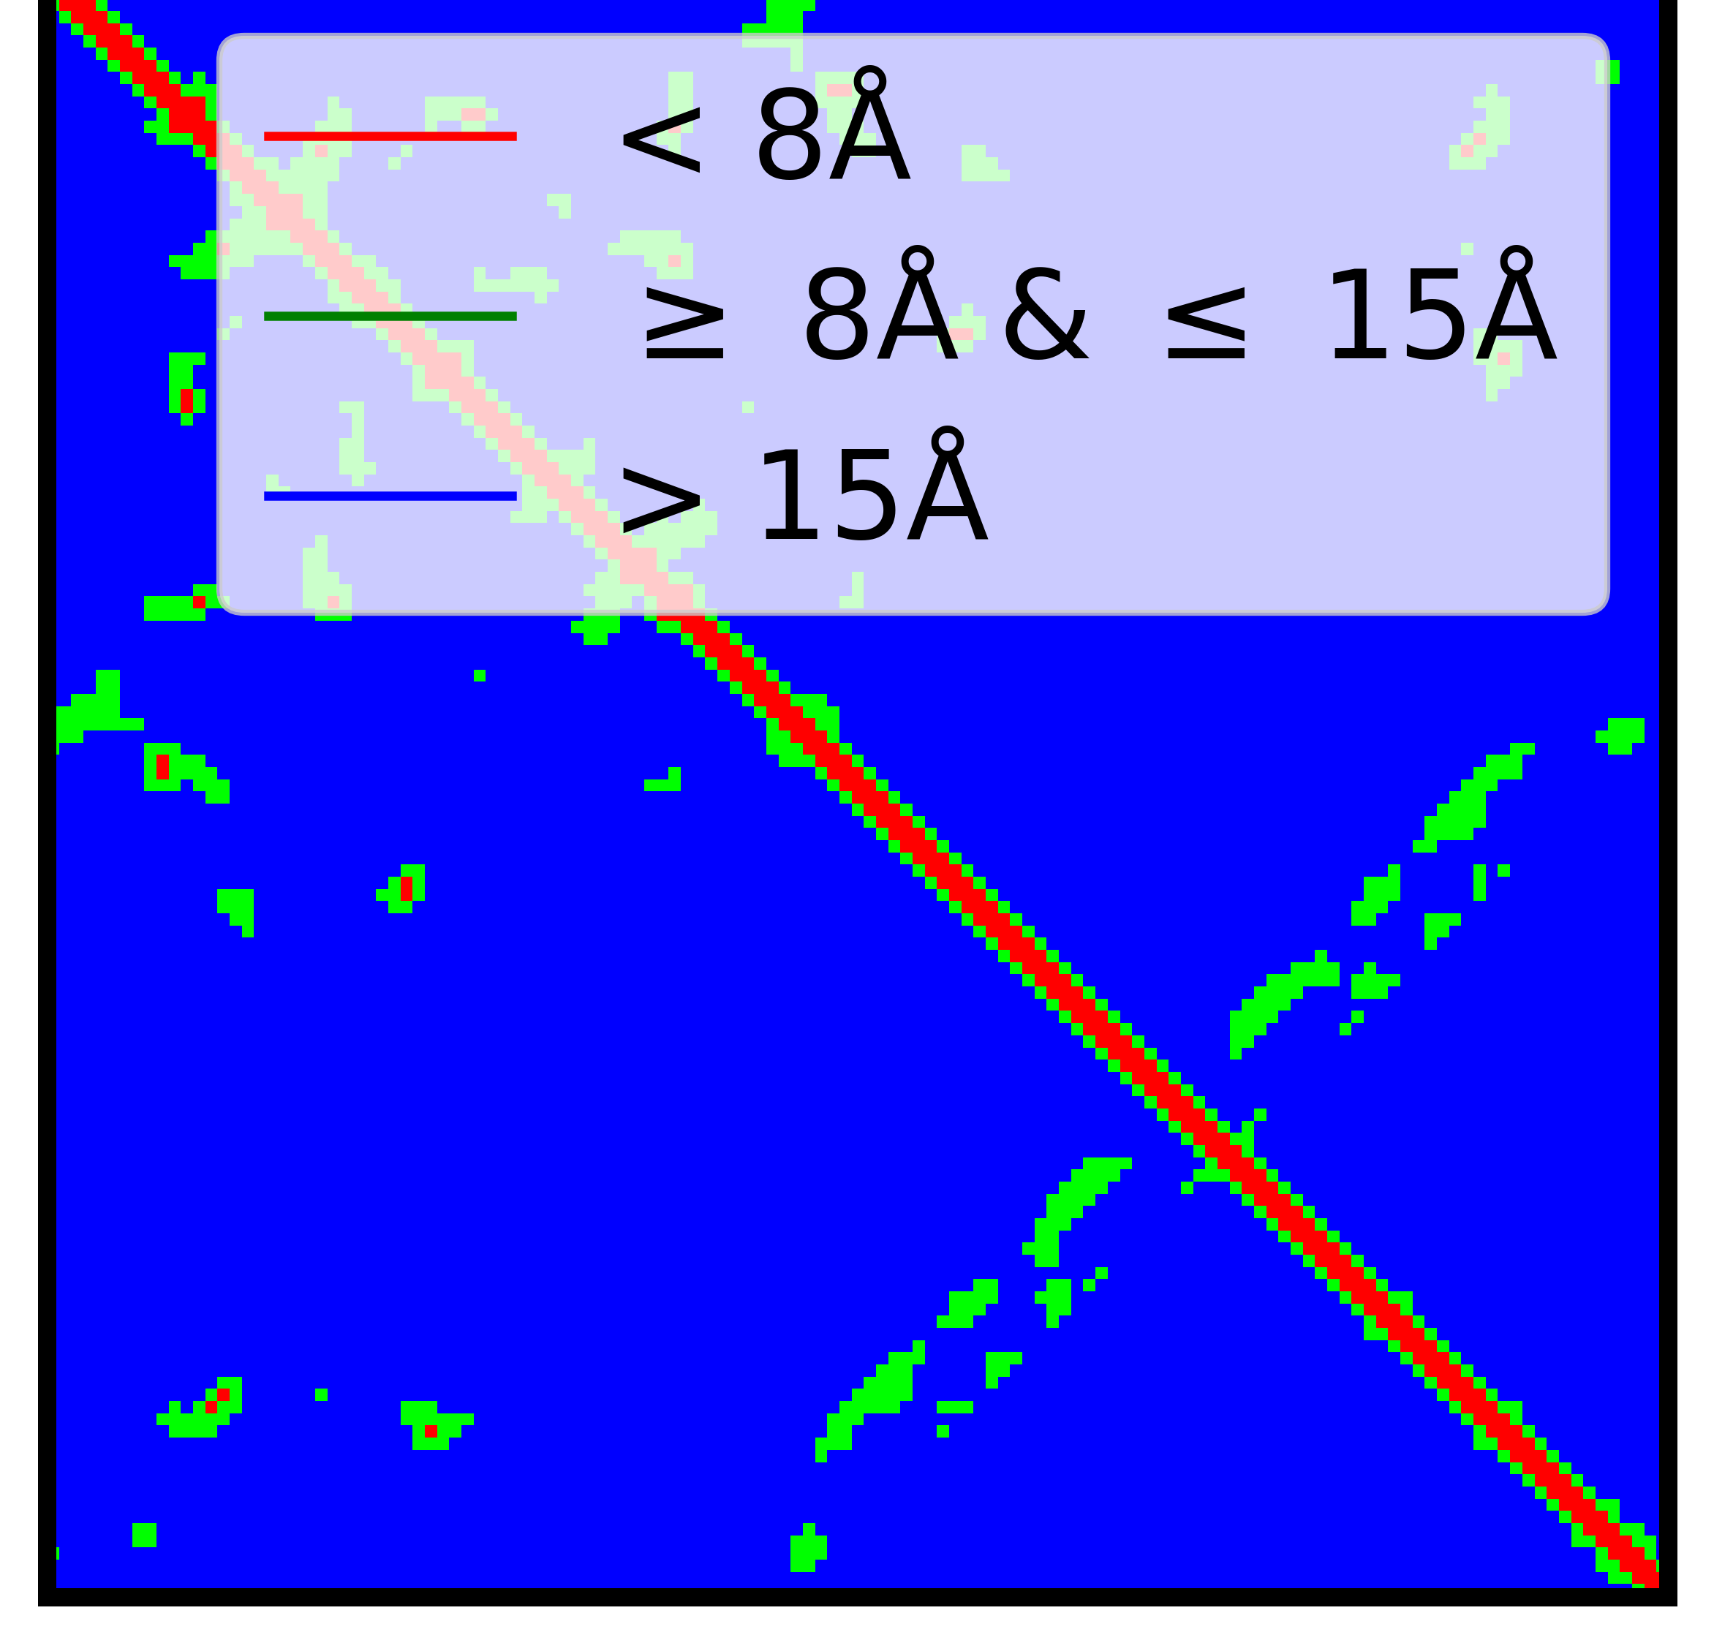
Neural Network Architexture
(15 x Length x 1)
(1 x Length
x 64)
(Length x Length x3)
(Length x Length
x 64)

