Slide 1
E-commence dataset test
Lee Xiong An
https://www.kaggle.com/carrie1/ecommerce-data
Due to severe lack of time, (this work should take a few weeks to analyze), but I am effectively only given 3 work days to do, this is obviously a rushed and dirty quick job.

Slide 2
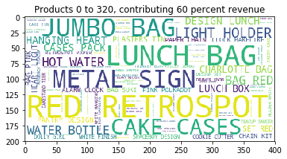
Dataset : wholesale retail
540K entries of purchases from Dec 2010- Dec 2011.
4328 Customers
3900 products (listed in word cloud below)
Retro store,
lifestyle store

Slide 3
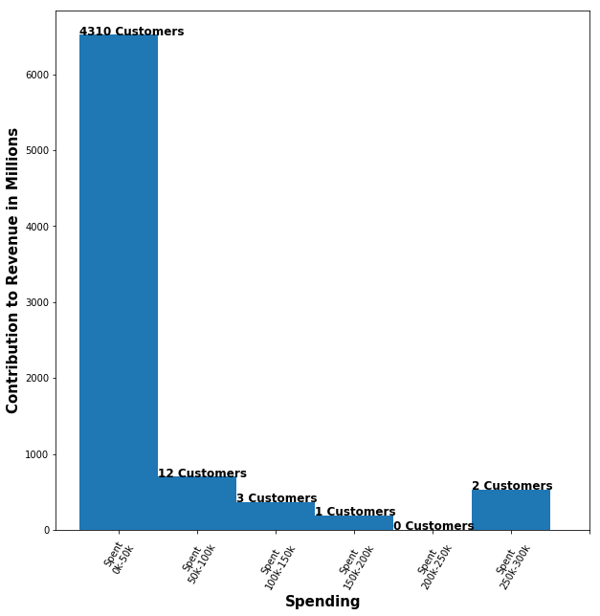
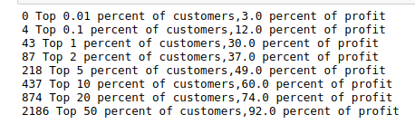
Distribution of customers
Largely skewed
A small group of customers provide much of the revenue

Slide 4
Predict future customer behavior
Largely skewed dataset, hence predict their log sales (magnitude)
Training data: Revenue from months Dec 2010 – Apr 2011, products + customer embeddings¹
Target variable : sales on May 2011
Revenue from Jun-Dec 2011 used to measure performance
1: Details next slide

Slide 5
Reducing customer dimension
Products/ Customers | 1 | 2 | 3 | ... | 1800
1
2
3
5000
5000 customers
1800 products used comprising of 97% revenue
Matrix contains products brought during training phase
Matrix factorization for both customers and products using SVD or other methods
Matrix too high dimension to be used directly

Slide 6
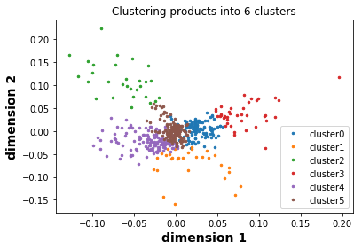
Reducing customer dimension
Dimensionality reduction to be used, I used three dimensions* out of 1800 dimensions.
Each customer and product has three associated dimension
Can be clustered into six clusters
1: Only the first three dimensions are useful for the revenue prediction model in next slidef found through model tuning

Slide 7
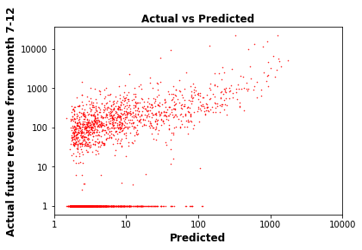
Model : predicting future revenue
Xgboost model has correlation ~0.5 on data from Jun-Dec 2011 training on Dec 2010 – May 2011
Two types of features are significant :
1. previous revenue data
2. customer embeddings (dimension reduction)
Feature Gain
0 mean_log_rev_train 34378.004687
1 Revenue_2011_3 16679.789211
2 svd_0 12900.540163
3 Revenue_2011_2 10492.150813
4 Revenue_2010_12 9622.231469
5 Revenue_2011_4 9599.633939
6 Revenue_2011_1 7988.990582
7 svd_1 6213.210567

Slide 8
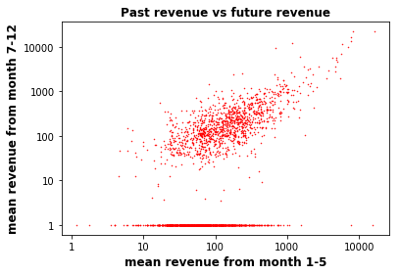
Previous Revenue Data
There is a linear trend where large past revenue is associated with large future revenue per customer
However there is a large group of customers who stop buying (churn) to recognise later
No future sales

Slide 9
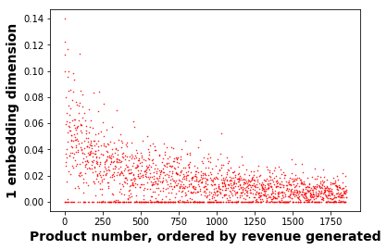
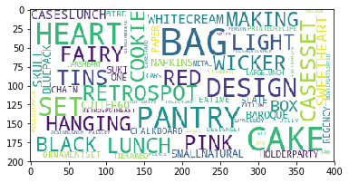
Customer/product embeddings dimension 1
Customer product matrix is too large to use for prediction, hence dimension-reduced with svd
The 1st - 4th dimensions are significant features for model
High values of 1st dimension associated with higher revenue, possibly ‘fast moving consumer goods’
Products associated
with high revenue
Have high values

Slide 10
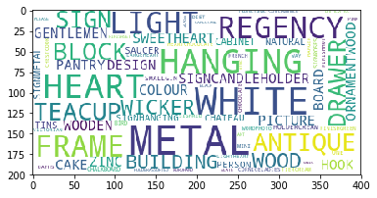
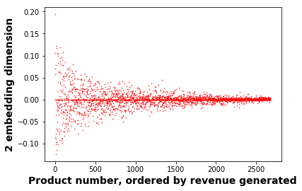
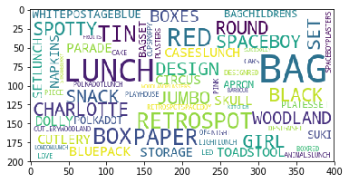
Customer/product embeddings dimension 2
Large absolute values of 2nd dimension associated with higher revenue, and there seems to be two classes of products with positive and negative values respectively with associated word clouds
Products associated
with high revenue
Have high |values|

Slide 11
Customer/product embeddings dimension 2
Positive dimension 2 values associated with decorative household objects, while negative dimension values associated with ‘standard’ products of the company
['REGENCY CAKESTAND 3 TIER', 'CREAM HANGING HEART T-LIGHT HOLDER', 'ASSORTED COLOUR BIRD ORNAMENT', 'WOOD BLACK BOARD ANT WHITE FINISH', 'SET OF 3 CAKE TINS PANTRY DESIGN ', 'VICTORIAN GLASS HANGING T-LIGHT', 'HEART OF WICKER LARGE', 'HEART OF WICKER SMALL', 'GIN + TONIC DIET METAL SIGN', 'ROSES REGENCY TEACUP AND SAUCER ', 'NATURAL SLATE HEART CHALKBOARD ', 'PLEASE ONE PERSON METAL SIGN', 'RED HANGING HEART T-LIGHT HOLDER', 'CREAM SWEETHEART MINI CHEST', 'COOK WITH WINE METAL SIGN ', 'WOODEN PICTURE FRAME WHITE FINISH', 'GREEN REGENCY TEACUP AND SAUCER', 'WOODEN FRAME ANTIQUE WHITE ', '3 DRAWER ANTIQUE WHITE WOOD CABINET', 'HOME BUILDING BLOCK WORD']
Top 20 products
['JUMBO BAG BAROQUE BLACK WHITE', 'POSTAGE', 'BLUE 3 PIECE POLKADOT CUTLERY SET', 'LUNCH BAG RED RETROSPOT', 'SPACEBOY LUNCH BOX ', 'ROUND SNACK BOXES SET OF4 WOODLAND ', 'JUMBO STORAGE BAG SUKI', 'DOLLY GIRL LUNCH BOX', 'RED TOADSTOOL LED NIGHT LIGHT', 'LUNCH BOX I LOVE LONDON', 'LUNCH BAG SUKI DESIGN ', 'LUNCH BAG BLACK SKULL.', 'ROUND SNACK BOXES SET OF 4 FRUITS ', 'LUNCH BAG CARS BLUE', 'PACK OF 72 RETROSPOT CAKE CASES', 'LUNCH BAG PINK POLKADOT', 'LUNCH BAG SPACEBOY DESIGN ', 'LUNCH BAG WOODLAND', 'PLASTERS IN TIN SPACEBOY', 'PLASTERS IN TIN WOODLAND ANIMALS']
Top 20 products

Slide 12
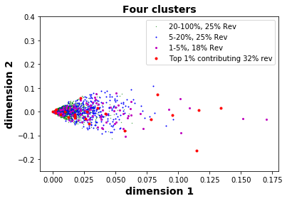
Customer segmentation from dimensions 1 and 2
Dimensions 1 and 2 are most associated with future sales segmenting customers by sales, and large customers are found in all four clusters
 | Customers who buy less fast moving consumer goods | Customers who buy mostly fast moving consumer goods
Customers who buy mostly decorative household objects
Customers who buy mostly standard objects of company

Slide 13
Studying cluster 2
Concentrating on this cluster to study – what product classes they like most, and building a recommendation system
 | Customers who buy less fast moving consumer goods | Customers who buy mostly fast moving consumer goods
Customers who buy mostly decorative household objects
Customers who buy mostly standard objects of company

Slide 14
What products do these customers like,

