Slide 1
Explainable AI : Shapley Values
A Unified Approach to Interpreting Model Predictions
Scott Lundberg, Su-In Lee

Slide 2
Background on myself
Graduated from NUS science 2015
Working in A*STAR Bioinformatics Institute in areas of computational biology (2015-17) and crop analytics (2018 onwards)
Attempted machine learning in areas of work and greatly helped by Deep Learning Developer's course
Hobbies : Deep Learning, keeping fit, church

Slide 3
Need for Explainable AI
Why?!
chance John will have repayment problems
model
55%
No loan
John, a bank customer
Why?!
AI magic!
https://github.com/slundberg/shap/blob/master/docs/presentations/NIPS%202017%20Talk.pptx
Notes:
We'll start with a simple motivational example. This is John, a typical bank customer. Like many consumers today, when he applies for a loan, information about him is sent through a predictive model XX.
This model is designed to calculate the risk that John will have repayment problems, XX which, unfortunately for John, is 55%. And because his risk is high, the bank declines his loan application XX.
A natural first question John has XX is “Why?” The bank XX also want to know why, because these are key business decisions. But unfortunately for the data scientist that built this model XX, she used a complex model and so these questions are hard to answer XX …. XX

Slide 4
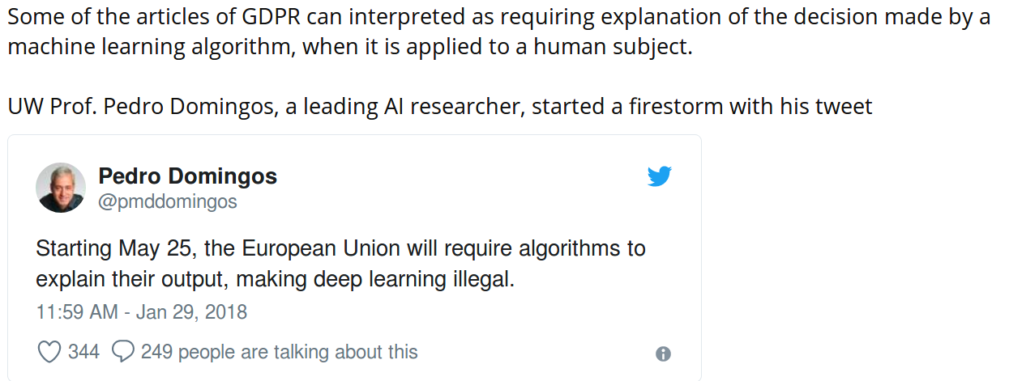
Need for Explainable AI

Slide 5

Complicated AI Model
data
Prediction
.
.
.
Notes:
Note that these attributions are specific to the model, f, being explained, and also, x, the input data used for this prediction.
It turns out that this way of explaining a model’s prediction, as a sum of feature attributions, is widely used. XX

Slide 6
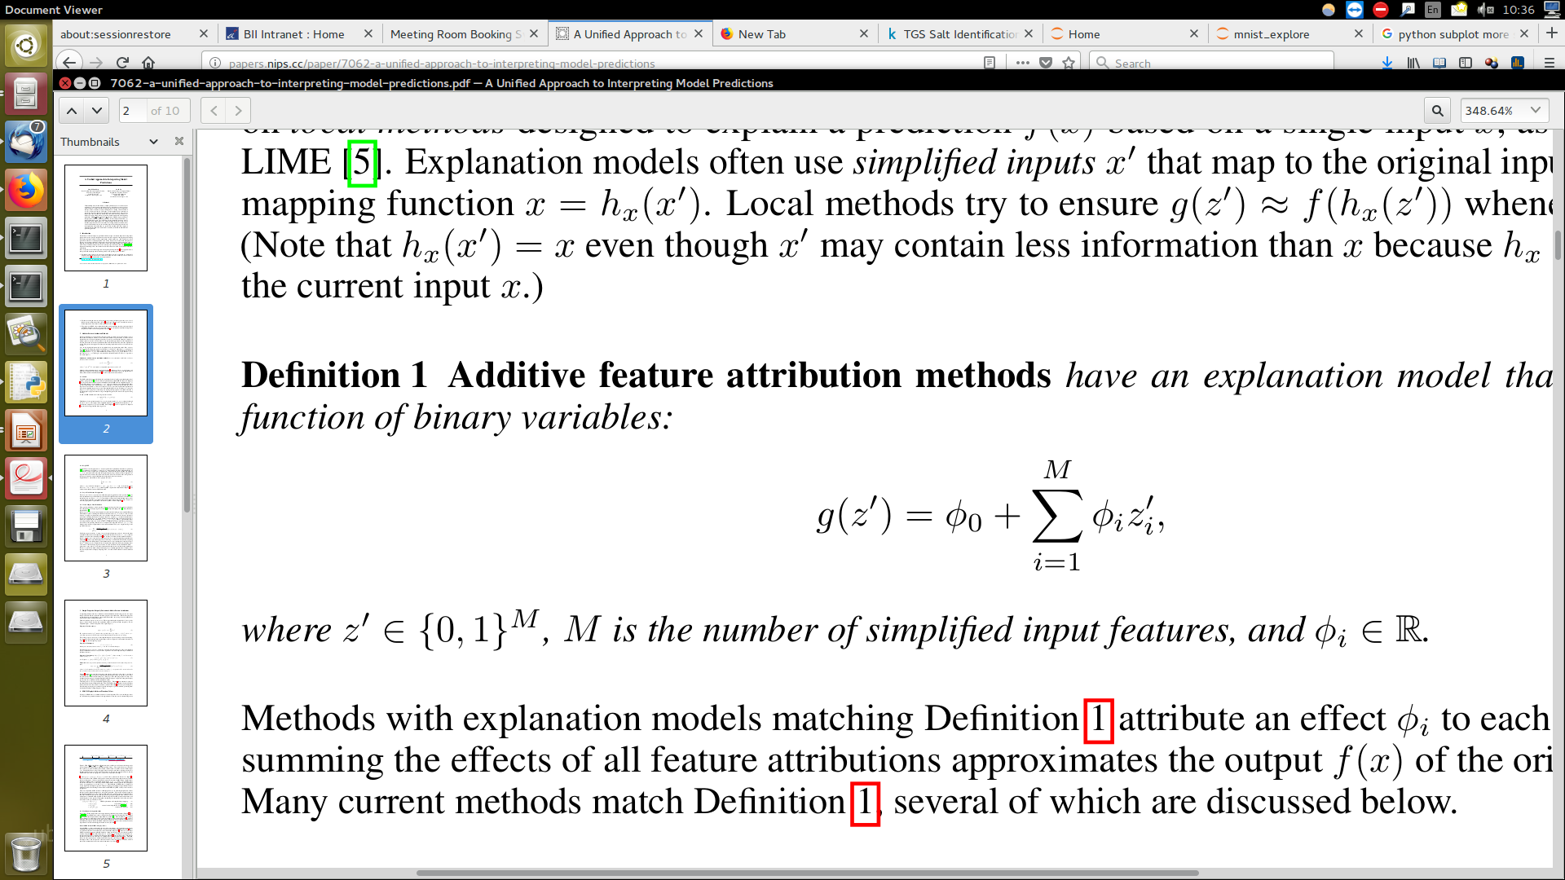
Explainable model:
Additive feature attribution model
data
prediction
.
.
.
.
.
.
Notes:
Note that these attributions are specific to the model, f, being explained, and also, x, the input data used for this prediction.
It turns out that this way of explaining a model’s prediction, as a sum of feature attributions, is widely used. XX

Slide 7
Additive feature attribution methods
DeepLIFT
LIME
DeepLIFT
LIME
Ribeiro et al. 2016
Shrikumar et al. 2016
Shapley reg. values
Shapley reg. values
Relevance prop.
Relevance prop.
Lipovetsky et al. 2001
Bach et al. 2015
QII
QII
Shapley sampling
Shapley sampling
Path expectations
Path expectations
Datta et al. 2016
Štrumbelj et al. 2011
Saabas 2014
Notes:
Path expectations is targeted at tree ensemble methods, while XX DeepLIFT and relevance propagation target neural networks.
Since these methods all produce explanations of the same form, they can be considered part of the same class, which we call XX “additive feature attribution methods”. XX

Slide 8
Additive feature attribution methods
DeepLIFT
LIME
DeepLIFT
LIME
Ribeiro et al. 2016
Shapley Values
Shrikumar et al. 2016
Shapley reg. values
Shapley reg. values
Shapley reg. values
Relevance prop.
Relevance prop.
Lipovetsky et al. 2001
Bach et al. 2015
QII
QII
Shapley sampling
Shapley sampling
Path expectations
Path expectations
Datta et al. 2016
Štrumbelj et al. 2011
Saabas 2014
Notes:
Path expectations is targeted at tree ensemble methods, while XX DeepLIFT and relevance propagation target neural networks.
Since these methods all produce explanations of the same form, they can be considered part of the same class, which we call XX “additive feature attribution methods”. XX

Slide 9
Why additive feature attribution methods may work
Input value
Output value
Complex models are inherently complex!
But a single prediction involves only a small piece of that complexity.
Notes:
These methods do not try and make an entire complex model interpretable, because there is inherently too much to succinctly explain. Instead they focus on explaining a single prediction XX, because mapping a single input to an output involves only a small part of the complexity of the overall model. XX

Slide 10
SHapley Additive exPlanation - (SHAP) values (1)
Base rate
Prediction for John
20%
55%
How did we get here?
Notes:
To see, let’s return to John and answer why his loan application was denied. To explain his denial it is important to start with the base rate of loan repayment problems XX, denoted here by the expected value of the model’s output.
To explain John's risk XX, we need to explain how we got from the base rate XX, to his risk of 55%. XX

Slide 11
SHapley Additive exPlanation (SHAP) values (2)
20%
35%
55%
70%
90%
Base rate
Day trader
Open accounts = 1
Age = 20
Married
Notes:
To see, let’s return to John and answer why his loan application was denied. To explain his denial it is important to start with the base rate of loan repayment problems XX, denoted here by the expected value of the model’s output.
To explain John's risk XX, we need to explain how we got from the base rate XX, to his risk of 55%. XX

Slide 12
SHapley Additive exPlanation (SHAP) values (2)
20%
35%
55%
70%
90%
Base rate
Day trader
Open accounts = 1
Age = 20
Married
Notes:
To see, let’s return to John and answer why his loan application was denied. To explain his denial it is important to start with the base rate of loan repayment problems XX, denoted here by the expected value of the model’s output.
To explain John's risk XX, we need to explain how we got from the base rate XX, to his risk of 55%. XX

Slide 13
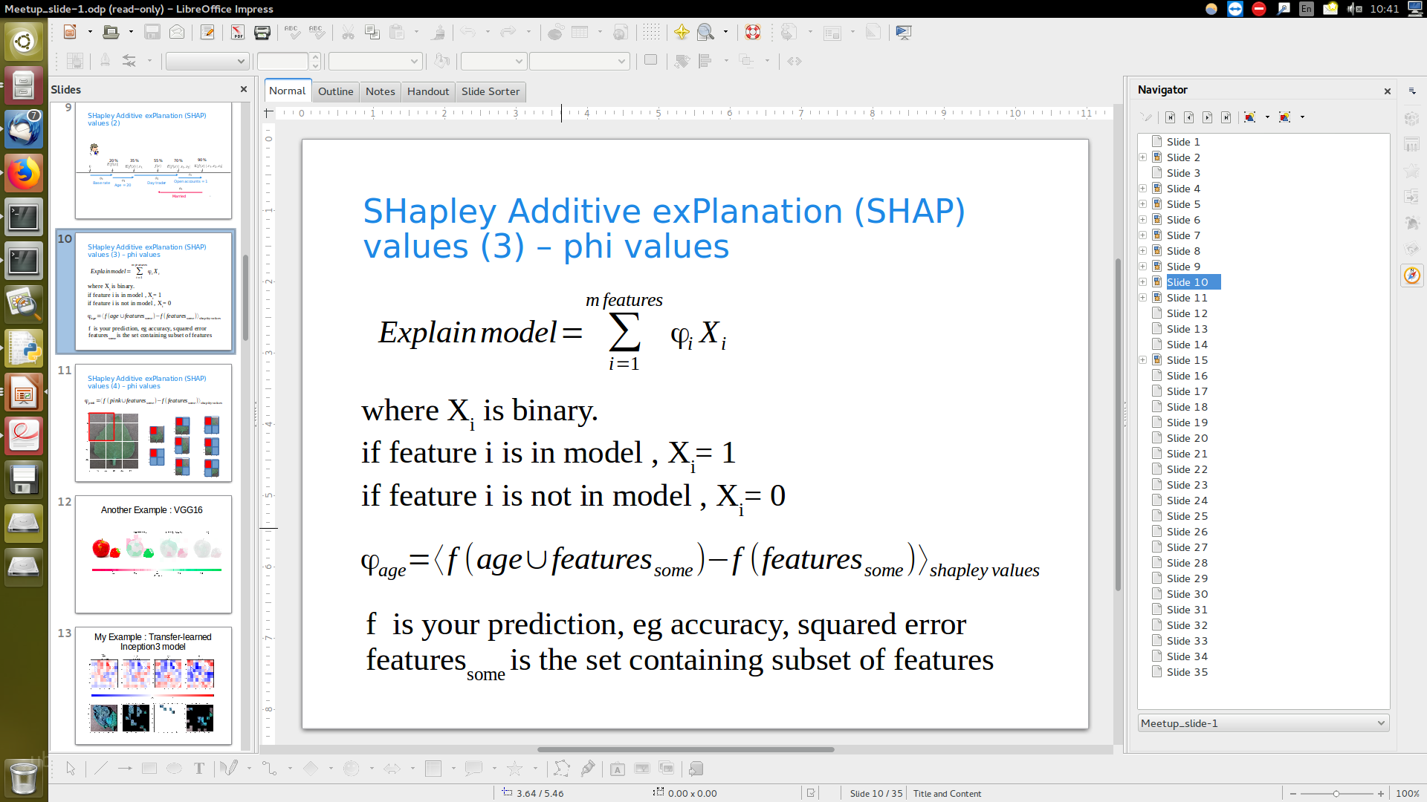
SHapley Additive exPlanation (SHAP) values (3) – phi values
where X_{i} an input and φ_{i} is the effect of X_{i} on the model.
f is your model output, eg accuracy, squared error
features_{some} is the set containing subset of features
Notes:
To see, let’s return to John and answer why his loan application was denied. To explain his denial it is important to start with the base rate of loan repayment problems XX, denoted here by the expected value of the model’s output.
To explain John's risk XX, we need to explain how we got from the base rate XX, to his risk of 55%. XX

Slide 14
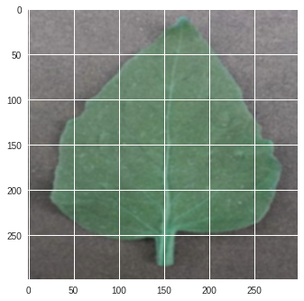
SHapley Additive exPlanation (SHAP) values (4) – phi values
Notes:
To see, let’s return to John and answer why his loan application was denied. To explain his denial it is important to start with the base rate of loan repayment problems XX, denoted here by the expected value of the model’s output.
To explain John's risk XX, we need to explain how we got from the base rate XX, to his risk of 55%. XX

Slide 15
SHapley Additive exPlanation (SHAP) values (4) – phi values φ
φ_{pink} = weight_avg( )
Notes:
To see, let’s return to John and answer why his loan application was denied. To explain his denial it is important to start with the base rate of loan repayment problems XX, denoted here by the expected value of the model’s output.
To explain John's risk XX, we need to explain how we got from the base rate XX, to his risk of 55%. XX

Slide 16
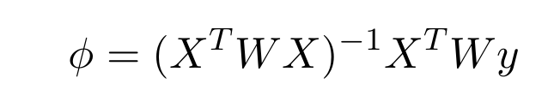
SHapley Additive exPlanation (SHAP) values (5) – solved using weighted linear regression
X is the feature binary vector of all combinations of X
W is weights for each example
y is model output for X
Notes:
To see, let’s return to John and answer why his loan application was denied. To explain his denial it is important to start with the base rate of loan repayment problems XX, denoted here by the expected value of the model’s output.
To explain John's risk XX, we need to explain how we got from the base rate XX, to his risk of 55%. XX

Slide 17
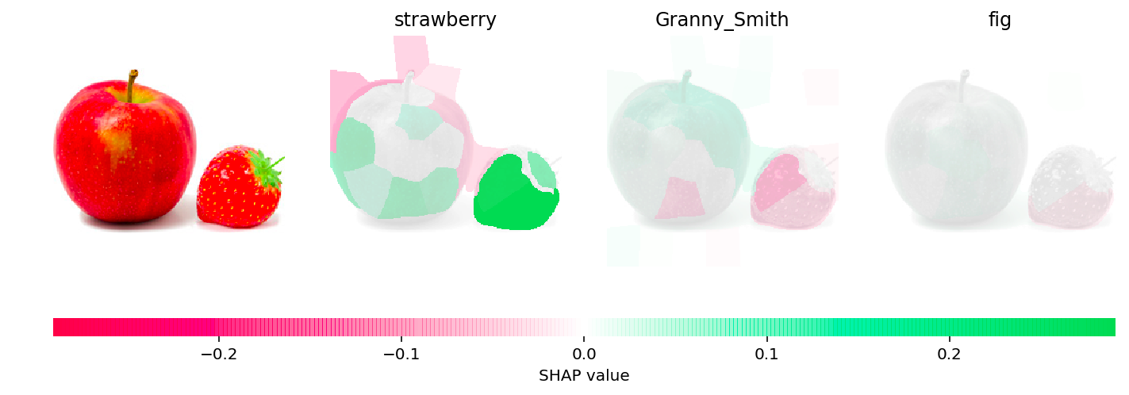
Another Example : VGG16

Slide 18
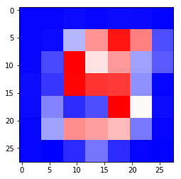
Applying to Mnist (1)
Mnist model with 4 convolutional layers and 2 dense layers.
Accuracy is 99.6%
for each test image {
  Split image to 7*7 = 49 pixels for shapley value computation
  Sample 7367 combinations of pixels
  ~ all -1 pixel images, ⁴⁹C₁ = 49
  ~ all -2 pixel images, ⁴⁹C₂ = 1176
  ~ 33% of -3 pixel images, ⁴⁹C₃ /3 = 6142
  Calculate shapley values for each pixel
  using weighted regression
  }

Slide 19
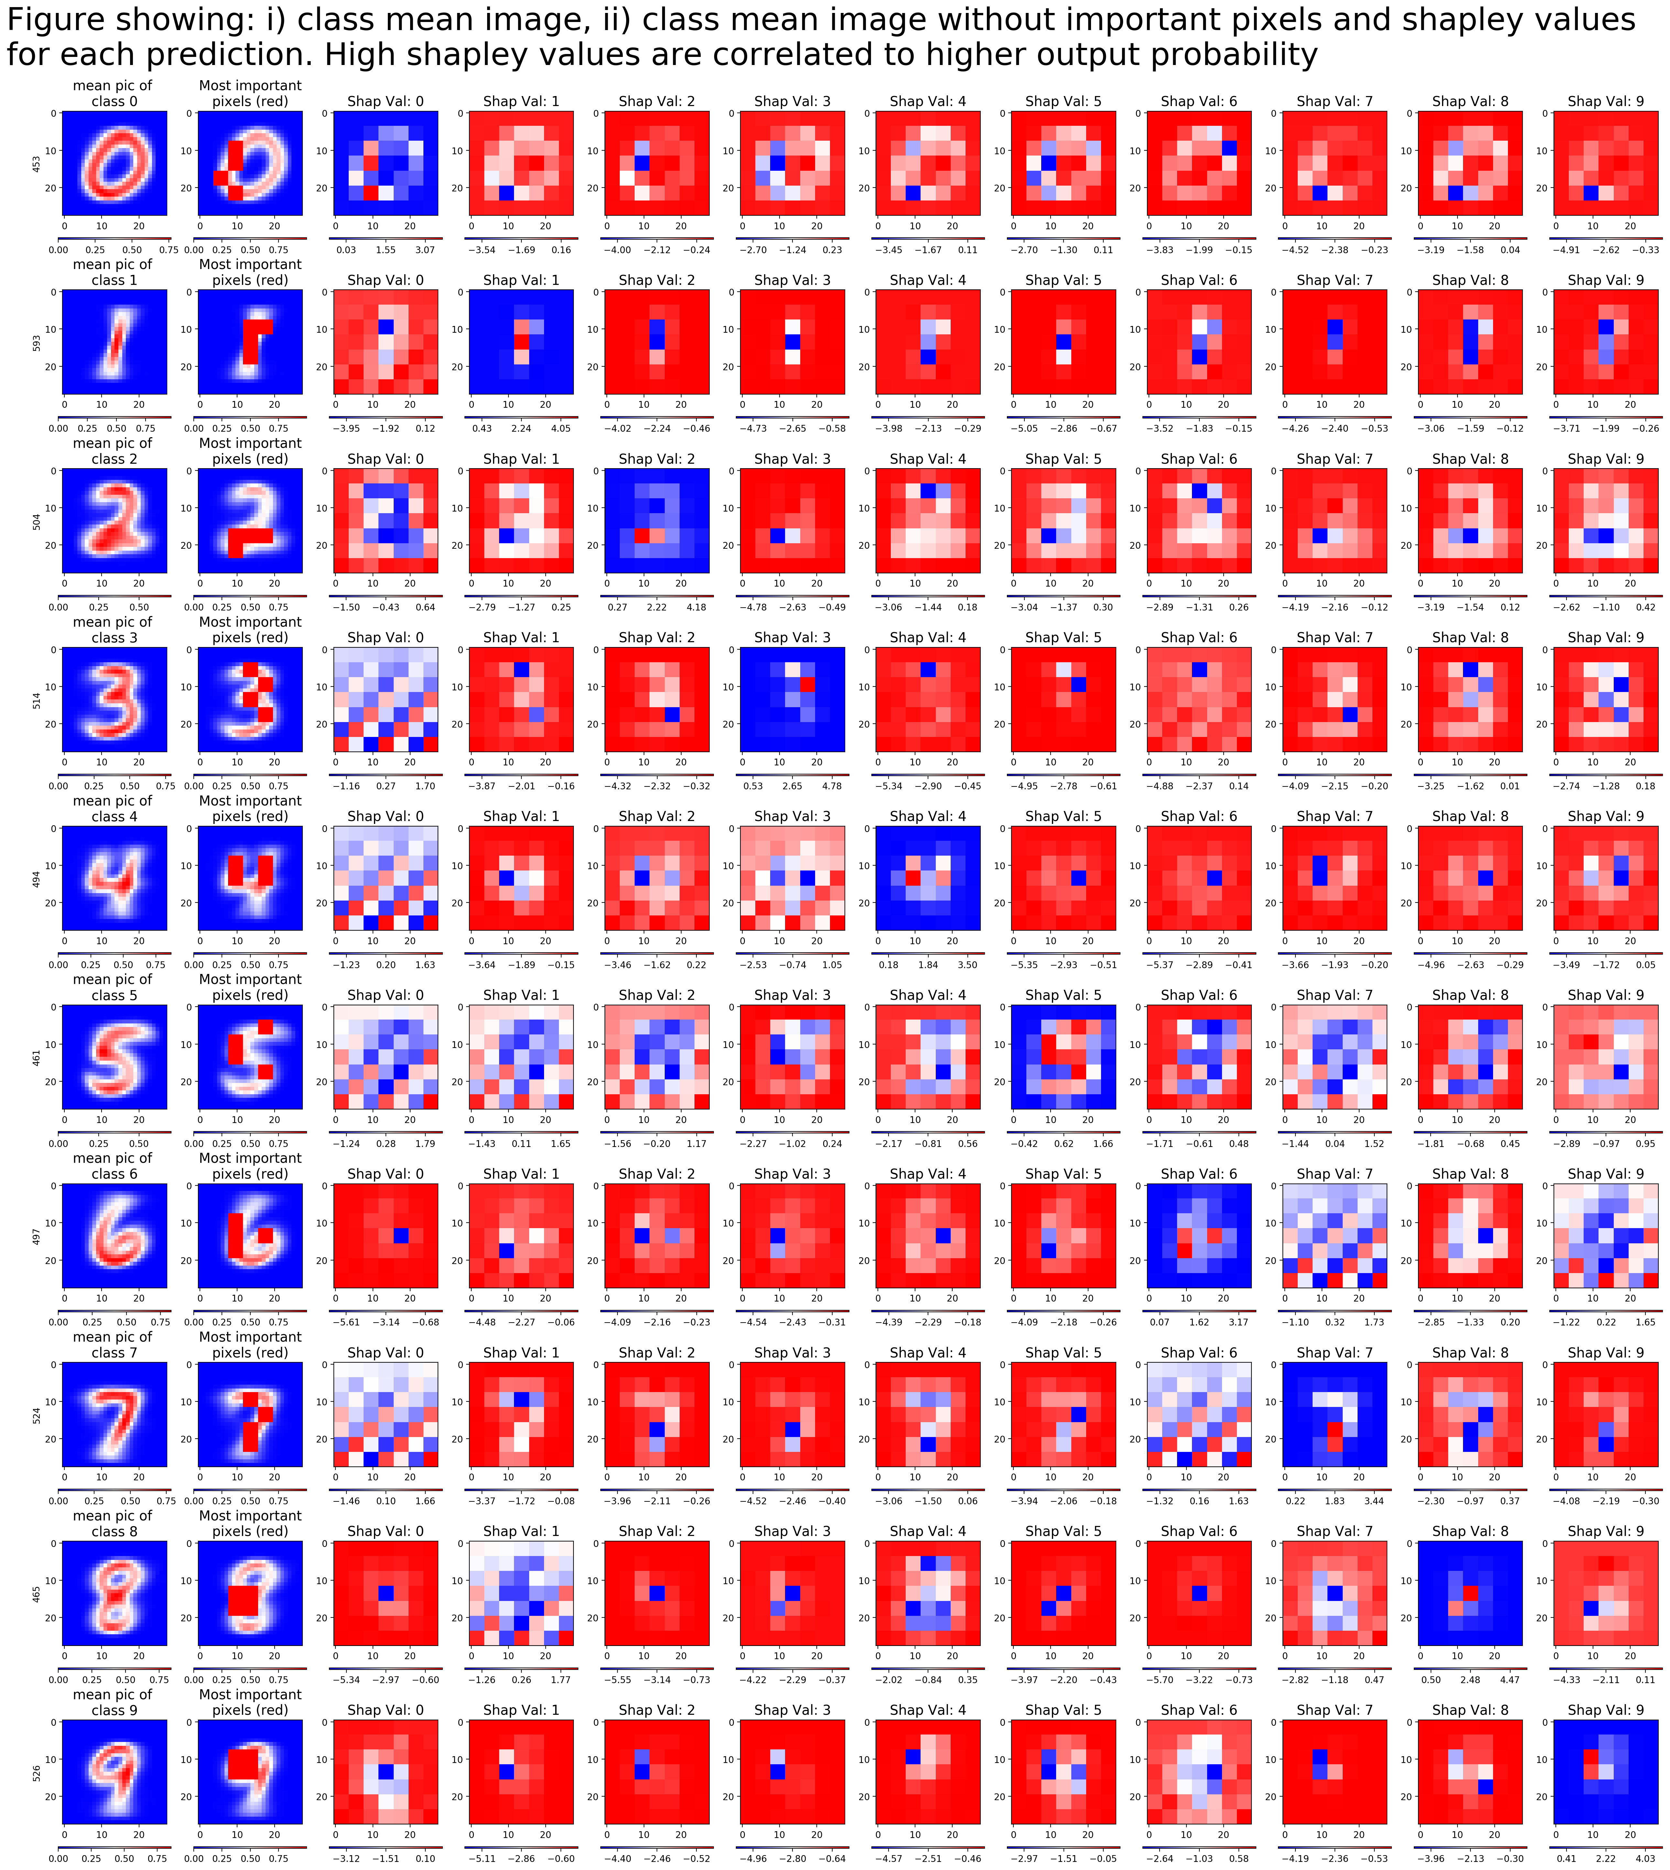
Applying to Mnist (2) – Global analysis

Slide 20
Applying to Mnist (2) – Global analysis

Slide 21
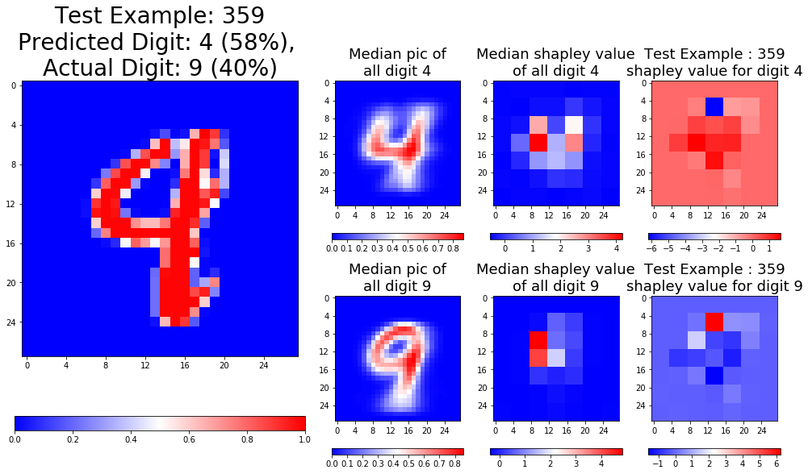
Applying to Mnist (3) – Individual analysis (a)

Slide 22
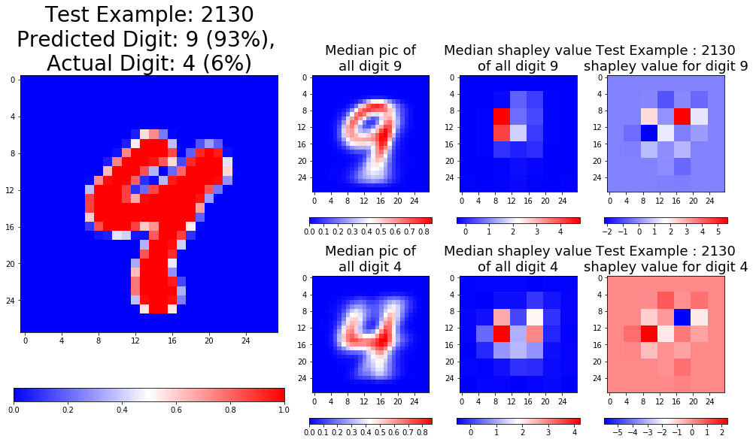
Applying to Mnist (3) – Individual analysis (b)

Slide 23
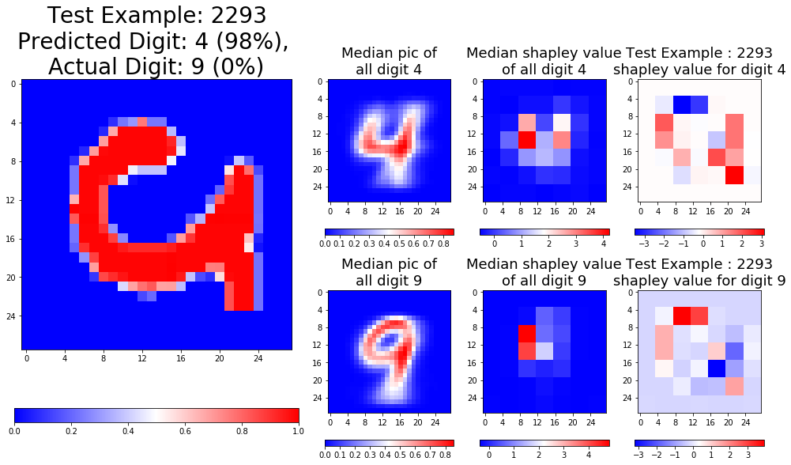
Applying to Mnist (3) – Individual analysis (c)

Slide 24
Drawbacks
Computationally intensive, requires to compute 2^{m} examples for m features followed by inverse of m*m matrix.
~ I only sampled 10³ out of 10¹⁴ combinations
How do you appropriately remove a feature ?
Method does not explain inner workings, rather it is a model upon a model to explain the final output.

Slide 25
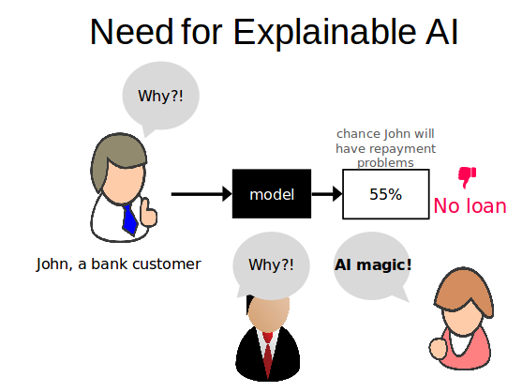
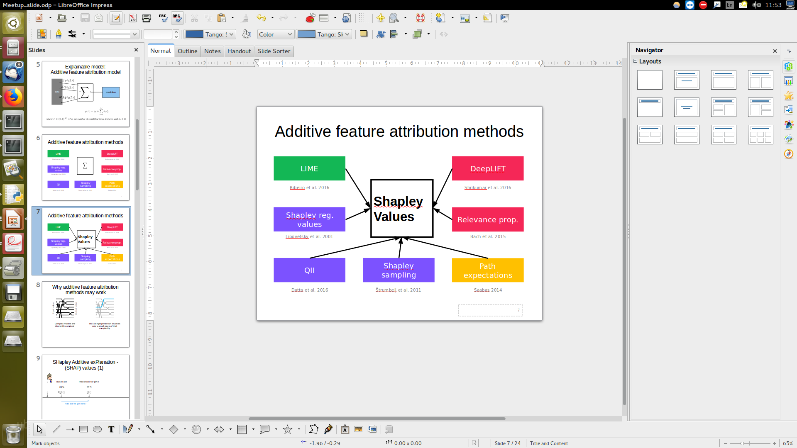

Summary
1. | 2. | 3. Intuition
4. Analysis of global predictions | 5. Analysis of each prediction | 6. Drawbacks
φ_{pink} =
weight_avg( )

Slide 26
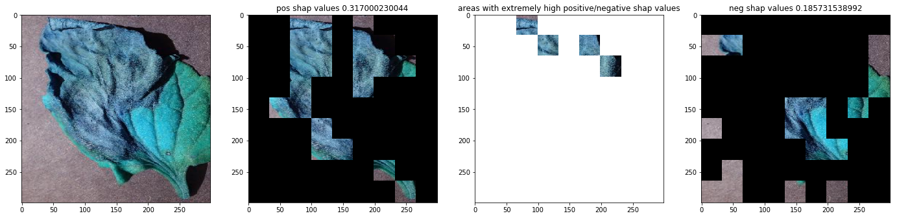
Another application : Transfer-learned Inception3 model

Slide 27
References
Scotts slides
https://github.com/slundberg/shap/blob/master/docs/presentations/NIPS%202017%20Talk.pptx
A Unified Approach to Interpreting Model Predictions(2017), Scott Lundberg, Su-In Lee
Analysis of regression in game theory approach (2001),Stan Lipovetsky, Michael Conklin

