Slide 1
Explainable AI : Shapley Values and other stuff
A Unified Approach to Interpreting Model Predictions
Scott Lundberg, Su-In Lee
https://colab.research.google.com/github/leexa90/Explainable_AI_image_classification/blob/master/colabs_script.ipynb

Slide 2
Background on myself
Graduated from NUS science 2015
Attended Deep Learning Developer Course 2017
Working in A*STAR Bioinformatics Institute, using various methods and analysis on crop analytics

Slide 3
Need for Explainable AI
Why?!
chance John will have repayment problems
model
55%
No loan
John, a bank customer
Why?!
AI magic!
https://github.com/slundberg/shap/blob/master/docs/presentations/NIPS%202017%20Talk.pptx
Notes:
We'll start with a simple motivational example. This is John, a typical bank customer. Like many consumers today, when he applies for a loan, information about him is sent through a predictive model XX.
This model is designed to calculate the risk that John will have repayment problems, XX which, unfortunately for John, is 55%. And because his risk is high, the bank declines his loan application XX.
A natural first question John has XX is “Why?” The bank XX also want to know why, because these are key business decisions. But unfortunately for the data scientist that built this model XX, she used a complex model and so these questions are hard to answer XX …. XX

Slide 4
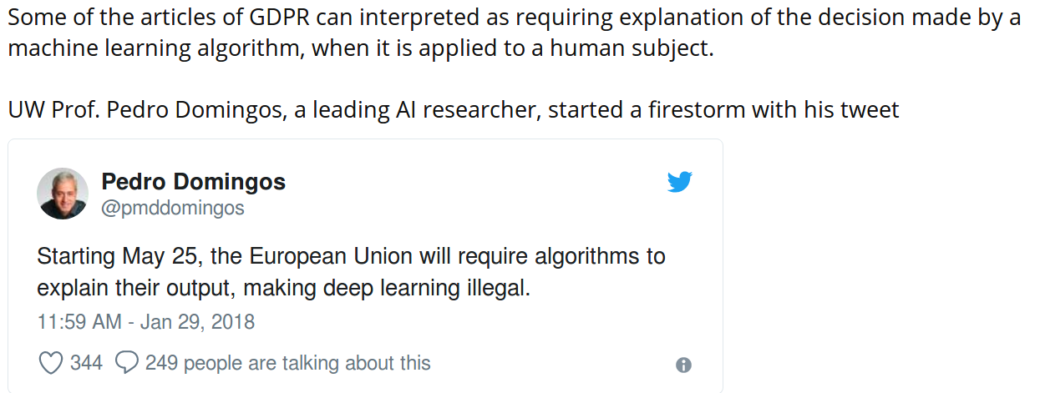
Need for Explainable AI
Cognitive, Human-Like, Empathetic & Explainable Machine-Learning (CHEEM)

Slide 5

Complicated AI Model
data
Output
.
.
.
Notes:
Note that these attributions are specific to the model, f, being explained, and also, x, the input data used for this prediction.
It turns out that this way of explaining a model’s prediction, as a sum of feature attributions, is widely used. XX

Slide 6
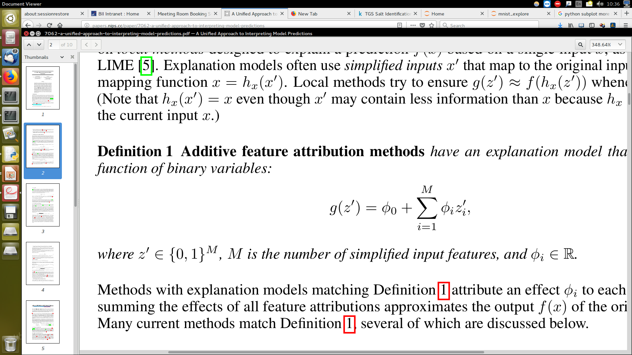
Explainable model:
Additive feature attribution model
data
Output
.
.
.
.
.
.
Output =
Notes:
Note that these attributions are specific to the model, f, being explained, and also, x, the input data used for this prediction.
It turns out that this way of explaining a model’s prediction, as a sum of feature attributions, is widely used. XX

Slide 7
Additive feature attribution methods
DeepLIFT
LIME
DeepLIFT
LIME
Ribeiro et al. 2016
Shrikumar et al. 2016
Shapley reg. values
Shapley reg. values
Relevance prop.
Relevance prop.
Lipovetsky et al. 2001
Bach et al. 2015
QII
QII
Shapley sampling
Shapley sampling
Path expectations
Path expectations
Datta et al. 2016
Štrumbelj et al. 2011
Saabas 2014
Notes:
Path expectations is targeted at tree ensemble methods, while XX DeepLIFT and relevance propagation target neural networks.
Since these methods all produce explanations of the same form, they can be considered part of the same class, which we call XX “additive feature attribution methods”. XX

Slide 8
Additive feature attribution methods
DeepLIFT
LIME
DeepLIFT
LIME
Ribeiro et al. 2016
Shapley Values
Shrikumar et al. 2016
Shapley reg. values
Shapley reg. values
Shapley reg. values
Relevance prop.
Relevance prop.
Lipovetsky et al. 2001
Bach et al. 2015
QII
QII
Shapley sampling
Shapley sampling
Path expectations
Path expectations
Datta et al. 2016
Štrumbelj et al. 2011
Saabas 2014
Notes:
Path expectations is targeted at tree ensemble methods, while XX DeepLIFT and relevance propagation target neural networks.
Since these methods all produce explanations of the same form, they can be considered part of the same class, which we call XX “additive feature attribution methods”. XX

Slide 9
SHapley Additive exPlanation - (SHAP) values (1)
Base rate
Prediction for John
20%
55%
How did we get here?
Notes:
To see, let’s return to John and answer why his loan application was denied. To explain his denial it is important to start with the base rate of loan repayment problems XX, denoted here by the expected value of the model’s output.
To explain John's risk XX, we need to explain how we got from the base rate XX, to his risk of 55%. XX

Slide 10
SHapley Additive exPlanation (SHAP) values (2)
20%
35%
55%
70%
90%
Base rate
Day trader
Open accounts = 1
Age = 20
Married
Notes:
To see, let’s return to John and answer why his loan application was denied. To explain his denial it is important to start with the base rate of loan repayment problems XX, denoted here by the expected value of the model’s output.
To explain John's risk XX, we need to explain how we got from the base rate XX, to his risk of 55%. XX

Slide 11
SHapley Additive exPlanation (SHAP) values (2)
20%
35%
55%
70%
90%
Base rate
Day trader
Open accounts = 1
Age = 20
Married
Notes:
To see, let’s return to John and answer why his loan application was denied. To explain his denial it is important to start with the base rate of loan repayment problems XX, denoted here by the expected value of the model’s output.
To explain John's risk XX, we need to explain how we got from the base rate XX, to his risk of 55%. XX

Slide 12
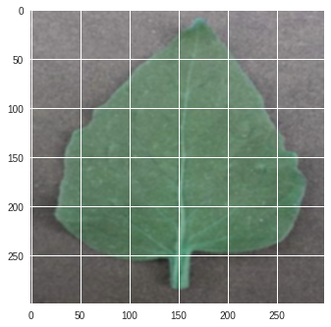
SHapley Additive exPlanation (SHAP) values (3) – Computation
Train AI model
For each picture containing 4 superpixels
{
Explain model :
Output = φ_{pink} + φ_{blue} +φ_{green} + φ_{red}
φ_{i} is the shapley value of the feature
}
Notes:
To see, let’s return to John and answer why his loan application was denied. To explain his denial it is important to start with the base rate of loan repayment problems XX, denoted here by the expected value of the model’s output.
To explain John's risk XX, we need to explain how we got from the base rate XX, to his risk of 55%. XX

Slide 13
SHapley Additive exPlanation (SHAP) values (4) – computation
φ_{pink}=weight_avg(f( ) f( ))
[f( ) f( )]/4
[f( ) f( )]/12
[f( ) f( )]/12
[f( ) f( )]/12
[f( ) f( )]/12
[f( ) f( )]/12
Legend
Blue solid
squared are
mean-filled
super-pixels
[f( ) f( )]/12
[f( ) f( )]/4
Notes:
To see, let’s return to John and answer why his loan application was denied. To explain his denial it is important to start with the base rate of loan repayment problems XX, denoted here by the expected value of the model’s output.
To explain John's risk XX, we need to explain how we got from the base rate XX, to his risk of 55%. XX

Slide 14
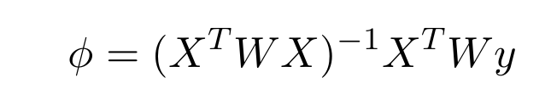
SHapley Additive exPlanation (SHAP) values (5) – solved using weighted linear regression
Refer to proof in paper for details, A Unified Approach to Interpreting Model Predictions
Notes:
To see, let’s return to John and answer why his loan application was denied. To explain his denial it is important to start with the base rate of loan repayment problems XX, denoted here by the expected value of the model’s output.
To explain John's risk XX, we need to explain how we got from the base rate XX, to his risk of 55%. XX

Slide 15
Applying to Mnist (1)
Mnist model with 4 convolutional layers and 2 dense layers, with test accuracy 99.4%
for each test image {
  Split image to 7*7 = 49 superpixels for shapley value computation
  Sample 7367 combinations of pixels
  ~ all images with 1 mean-filled pixel, ⁴⁹C₁ = 49
  ~ all 2 mean with 2-filled pixels, ⁴⁹C₂ = 1176
  ~ 33% of images with 3 mean-filled pixel, ⁴⁹C₃ /3 = 6142
  Calculate shapley values for each pixel
  using weighted regression, with g
  }
Output =

Slide 16
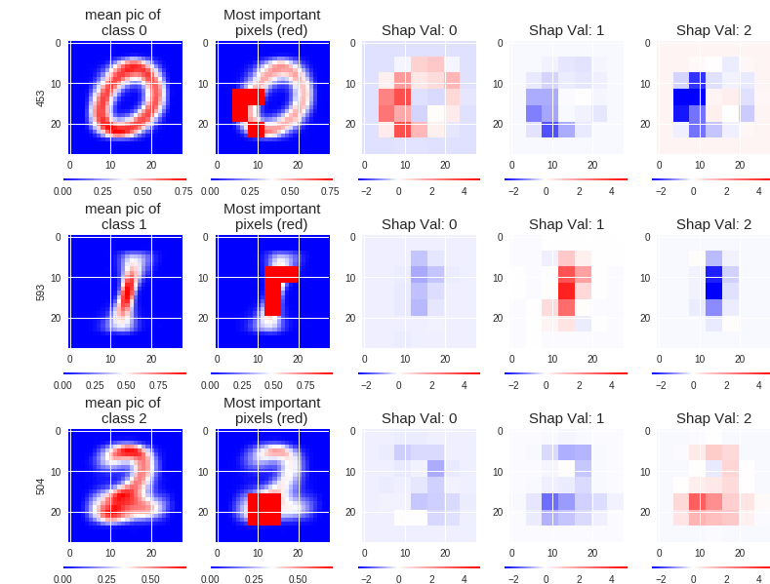
Applying to Mnist (2) – Global analysis

Slide 17
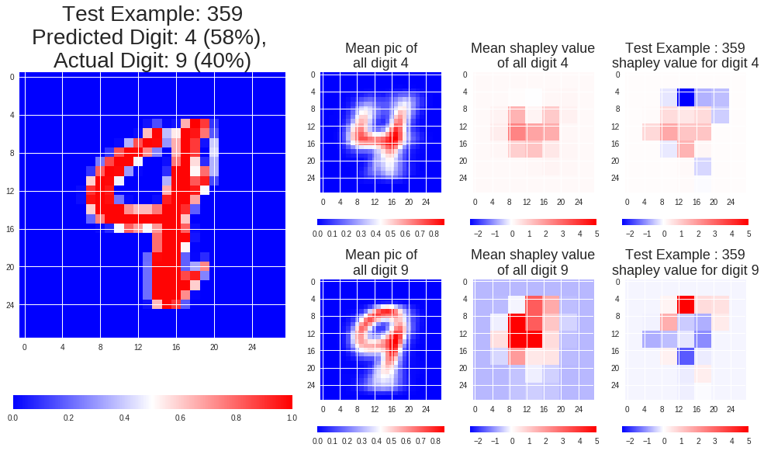
Applying to Mnist (3) – Individual analysis (a)

Slide 18
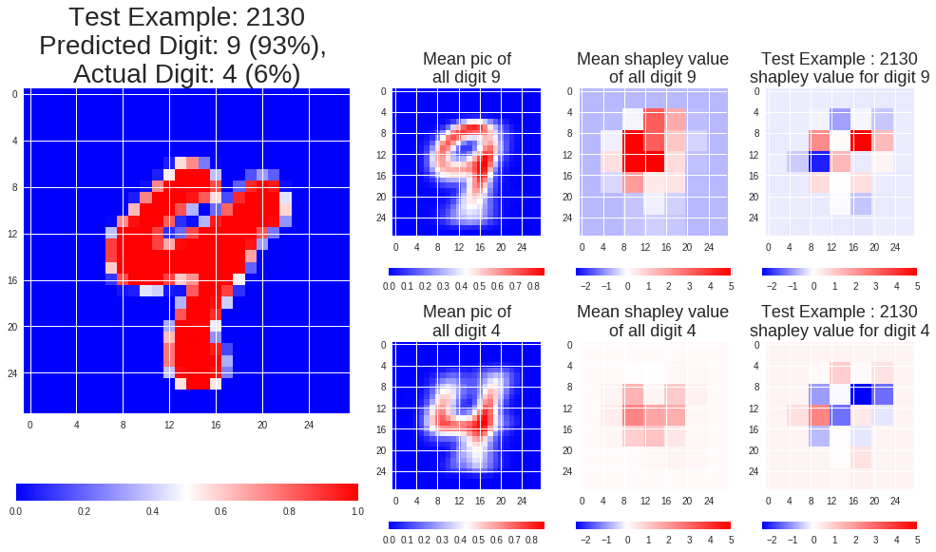
Applying to Mnist (3) – Individual analysis (b)

Slide 19

Drawbacks
Computationally intensive, requires to compute 2^{m} examples for m features
~ I only sampled 10³ out of 10¹⁴ combinations
How do you appropriately remove a feature ?

Slide 20
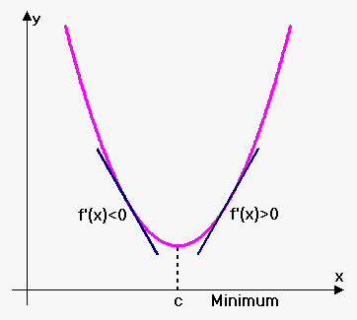
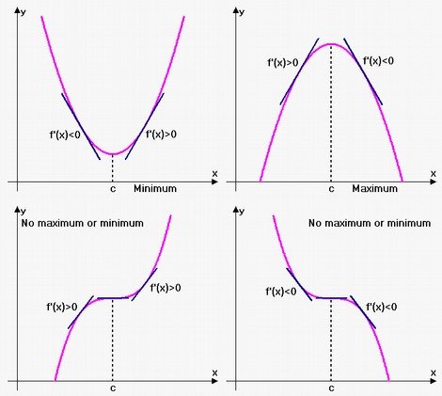
Gradient based methods
The gradient shows sensitivity of outputs to inputs

Slide 21
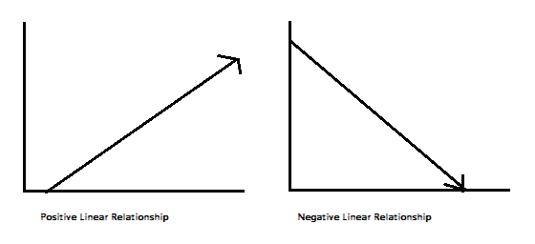
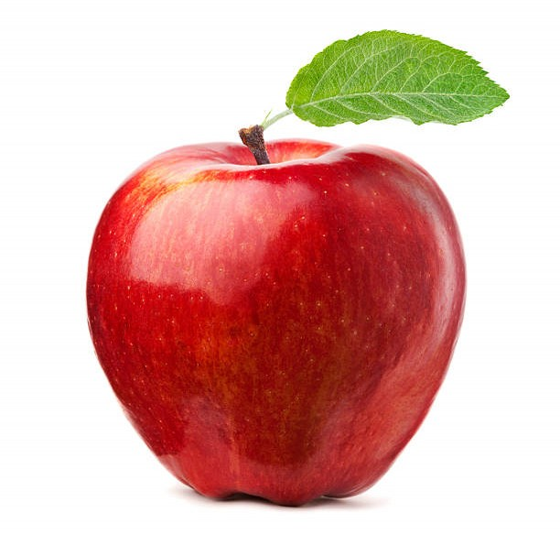

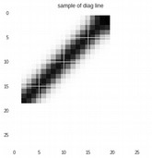
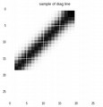
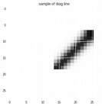
Gradient based methods : concept directional derivative
Interpretability Beyond Feature Attribution: Quantitative Testing with Concept Activation Vectors (TCAV), 2017
n quantitatively measure the sensitivity of model predictions with respect to concepts at any model layer.

Slide 22
Concept activation of mnist model hidden CNN layer
The concept directional derivative measures sensitivity of model predictions with respect to concepts at any model layer
Concept
Digit | 0 | 1 | 2 | 3 | 4 | 5 | 6 | 7 | 8 | 9
Directional derivative | -- | ++ | -- | -- | -- | -- | -- | + | --- | --
ThisSC,k,l(x)can quantitativelymeasure the sensitivity of model predictions with respectto concepts at any model layer.

Slide 23
Draw backs of local methods
Global explanation != local explanation
Example : Young blacks have higher death rates, while old blacks have lower death rates
Explainable AI on insurance premium :
- Because you are black, your premium is higher, all things equal relative to your demographic (young, male)
- Because you are black, your premium is lower,
all things equal relative to your demographic (elderly, male)
Leads to distrust of the system

Slide 24
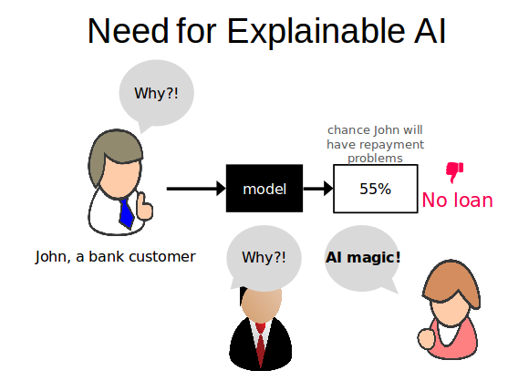
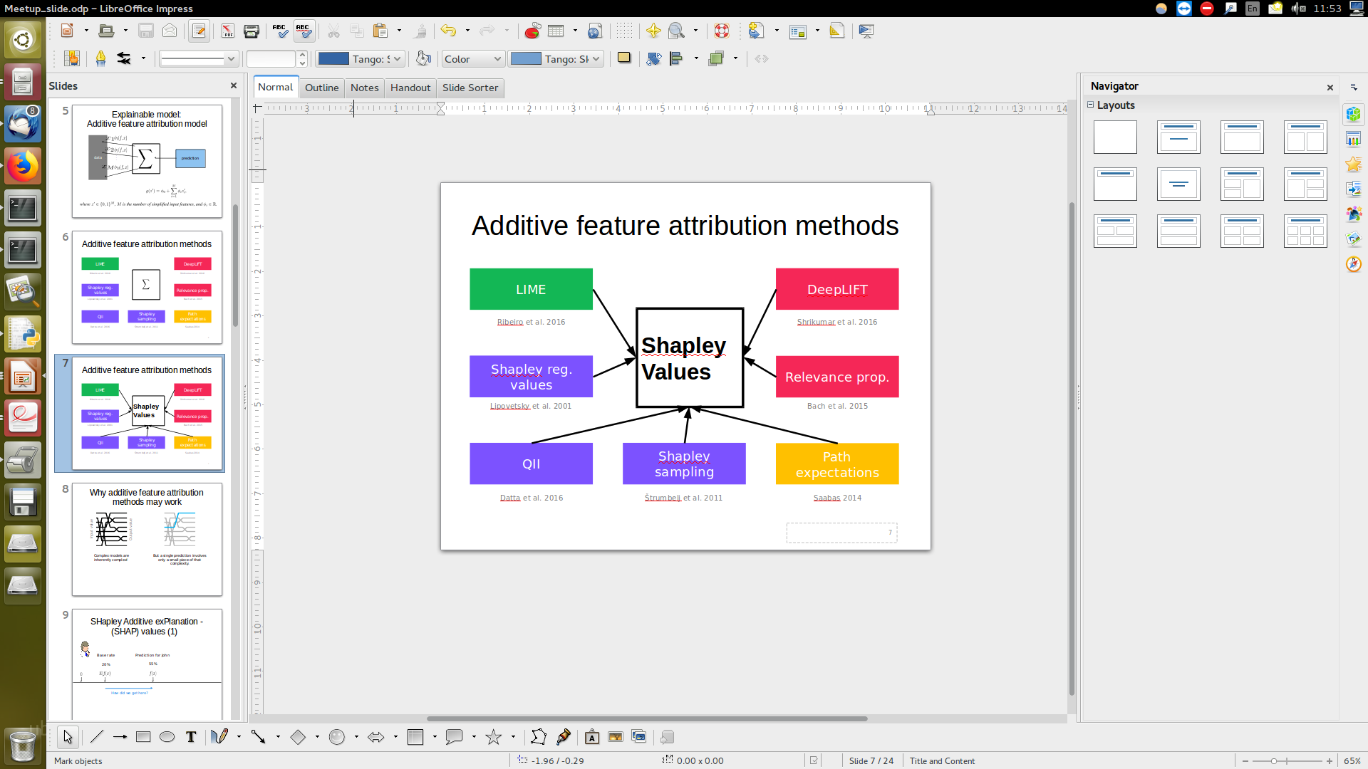

Summary
1. | 2. | 3. Intuition
4. Analysis mnist | 5. Drawbacks | 6. Gradient based methods
φ_{pink} =
weight_avg(f( ) f( ))

Slide 25
References
Scotts slides
https://github.com/slundberg/shap/blob/master/docs/presentations/NIPS%202017%20Talk.pptx
A Unified Approach to Interpreting Model Predictions(2017), Scott Lundberg, Su-In Lee
Analysis of regression in game theory approach (2001),Stan Lipovetsky, Michael Conklin
Interpretability Beyond Feature Attribution: Quantitative Testing with Concept Activation Vectors (TCAV), 2017

