Slide 1
Explainable AI : Shapley Values and other stuff
A Unified Approach to Interpreting Model Predictions
Interpretability Beyond Feature Attribution:
Quantitative Testing with Concept Activation Vectors (TCAV)
https://colab.research.google.com/github/leexa90/Explainable_AI_image_classification/blob/master/colabs_script.ipynb

Slide 2

Background on myself
Graduated from NUS science 2015
Attended Deep Learning Developer Course 2017
Working in A*STAR Bioinformatics Institute, using various methods and analysis on crop analytics in smart urban farms

Slide 3
Need for Explainable AI
John: Why?!
chance John will have repayment problems
model
55%
No loan
John, a bank customer
Manager :
Why?!
Data Scientist:
AI magic!
https://github.com/slundberg/shap/blob/master/docs/presentations/NIPS%202017%20Talk.pptx
Notes:
We'll start with a simple motivational example. This is John, a typical bank customer. Like many consumers today, when he applies for a loan, information about him is sent through a predictive model XX.
This model is designed to calculate the risk that John will have repayment problems, XX which, unfortunately for John, is 55%. And because his risk is high, the bank declines his loan application XX.
A natural first question John has XX is “Why?” The bank XX also want to know why, because these are key business decisions. But unfortunately for the data scientist that built this model XX, she used a complex model and so these questions are hard to answer XX …. XX

Slide 4

Complicated AI Model
data
Output
.
.
.
Notes:
Note that these attributions are specific to the model, f, being explained, and also, x, the input data used for this prediction.
It turns out that this way of explaining a model’s prediction, as a sum of feature attributions, is widely used. XX

Slide 5
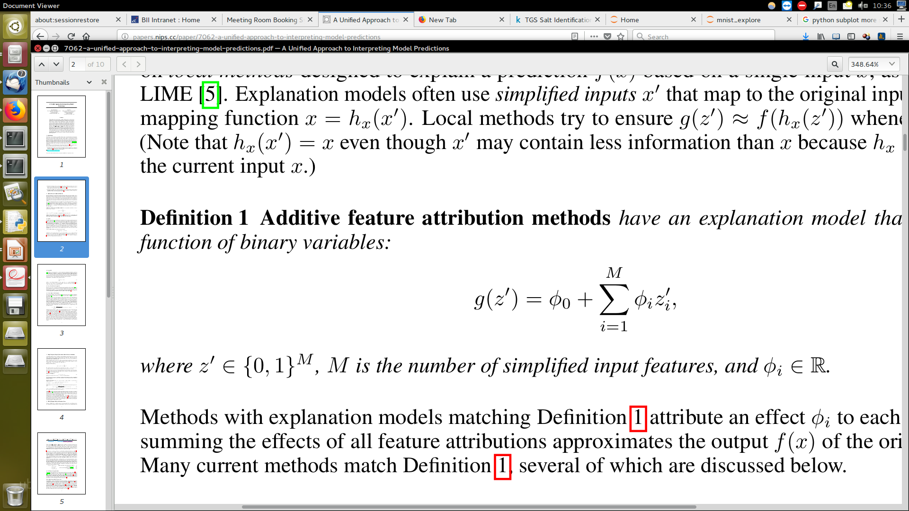
Explainable model:
Shapley Values (1)
Output =
ϕ_{i} is the shapley value of the feature i
Notes:
Note that these attributions are specific to the model, f, being explained, and also, x, the input data used for this prediction.
It turns out that this way of explaining a model’s prediction, as a sum of feature attributions, is widely used. XX

Slide 6
Explainable model:
Shapley Values (2)
55% =
Base rate
Prediction for John
20%
55%
How did we get here?
Notes:
To see, let’s return to John and answer why his loan application was denied. To explain his denial it is important to start with the base rate of loan repayment problems XX, denoted here by the expected value of the model’s output.
To explain John's risk XX, we need to explain how we got from the base rate XX, to his risk of 55%. XX

Slide 7
Explainable model:
Shapley Values (2)
55% =
20%
35%
55%
70%
90%
Base rate
Day trader
Open accounts = 1
Age = 20
Married
Notes:
To see, let’s return to John and answer why his loan application was denied. To explain his denial it is important to start with the base rate of loan repayment problems XX, denoted here by the expected value of the model’s output.
To explain John's risk XX, we need to explain how we got from the base rate XX, to his risk of 55%. XX

Slide 8
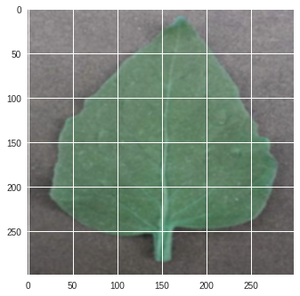
Explainable model: Shapley Values (3) – Computation
Train AI model
For each picture containing 4 superpixels
{
Explain model :
output = ϕ_{pink} + ϕ_{blue} + ϕ_{green} + ϕ_{red}
ϕ is the shapley value of the feature
}
Notes:
To see, let’s return to John and answer why his loan application was denied. To explain his denial it is important to start with the base rate of loan repayment problems XX, denoted here by the expected value of the model’s output.
To explain John's risk XX, we need to explain how we got from the base rate XX, to his risk of 55%. XX

Slide 9
Explainable model: Shapley Values (4) – Computation
ϕ_{pink}=weight_avg(f( ) f( ))
[f( ) f( )]/4
[f( ) f( )]/12
[f( ) f( )]/12
[f( ) f( )]/12
[f( ) f( )]/12
[f( ) f( )]/12
Legend
Green solid
squared are
mean-filled
super-pixels
[f( ) f( )]/12
[f( ) f( )]/4
Notes:
To see, let’s return to John and answer why his loan application was denied. To explain his denial it is important to start with the base rate of loan repayment problems XX, denoted here by the expected value of the model’s output.
To explain John's risk XX, we need to explain how we got from the base rate XX, to his risk of 55%. XX

Slide 10
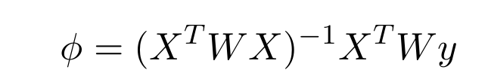
Explainable model: Shapley Values (5) – solved using weighted linear regression
Refer to proof in paper for details, A Unified Approach to Interpreting Model Predictions
Notes:
To see, let’s return to John and answer why his loan application was denied. To explain his denial it is important to start with the base rate of loan repayment problems XX, denoted here by the expected value of the model’s output.
To explain John's risk XX, we need to explain how we got from the base rate XX, to his risk of 55%. XX

Slide 11
Applying Shapley to Mnist (1)
Trained Mnist model
for each test image {
  Split image to 7*7 = 49 super-pixels
  Sampled 7367 permutations of mean-filled super-pixels
  Calculate shapley values for each super-pixel
  using weighted regression
  }
Output =

Slide 12
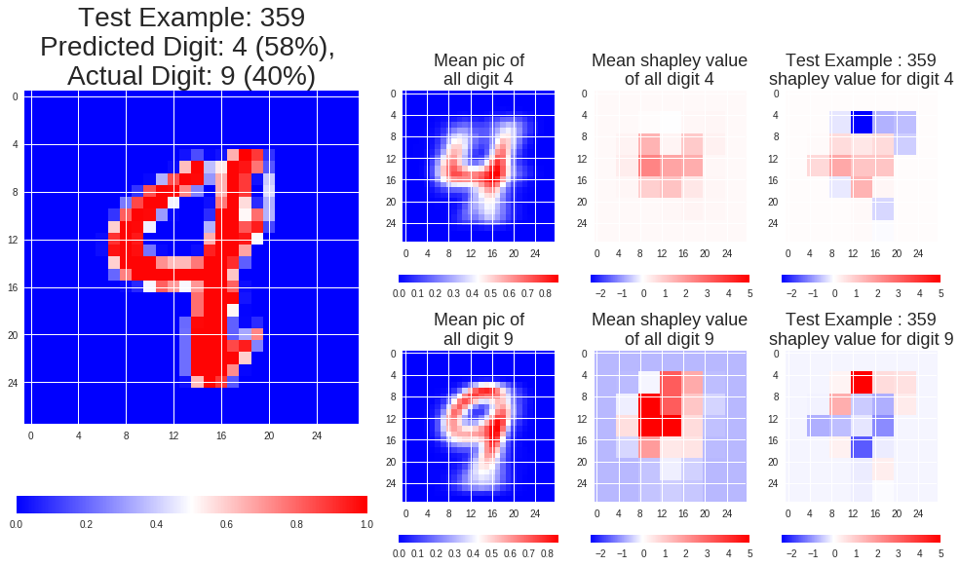
Applying Shapley to Mnist (2) – Individual analysis (a)

Slide 13
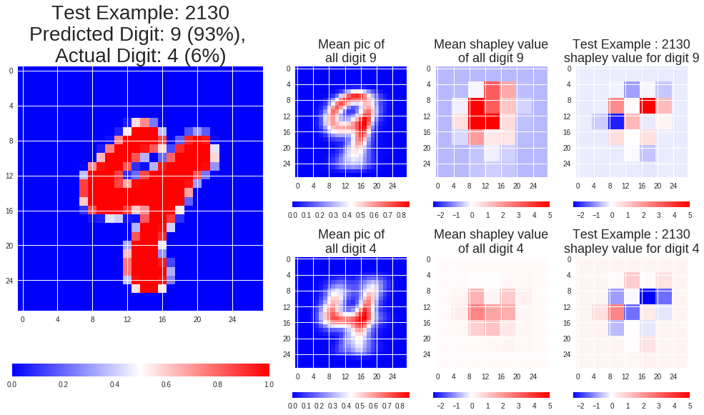
Applying Shapley to Mnist (3) – Individual analysis (b)

Slide 14
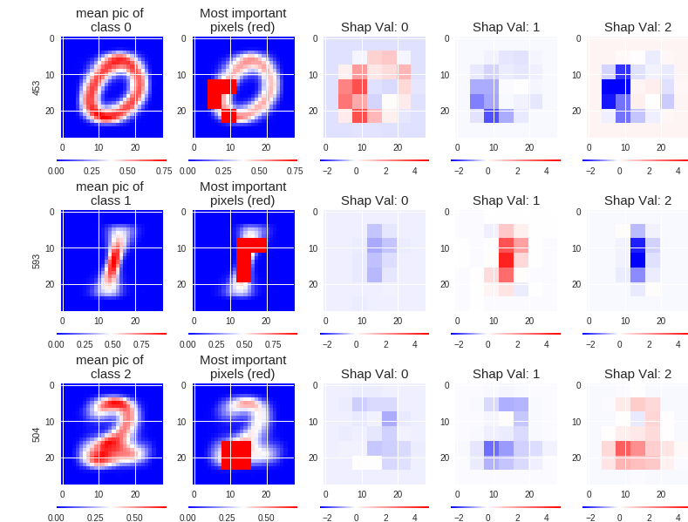
Applying Shapley to Mnist (4) – Global analysis

Slide 15
Shapley : Drawbacks
Computationally intensive, requires to compute 2^{m} examples for m features
~ I only sampled 10³ out of 10¹⁴ combinations
How do you appropriately remove a feature ?
Global explanation != local explanation

Slide 16
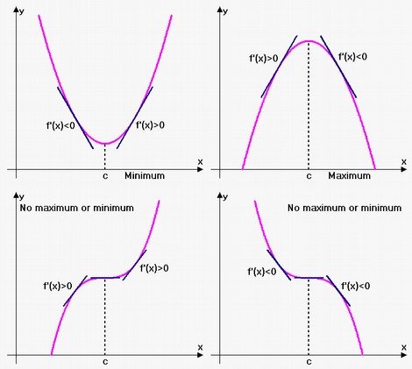
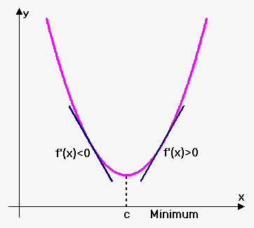
Gradient based methods
The gradient shows sensitivity of outputs to inputs

Slide 17
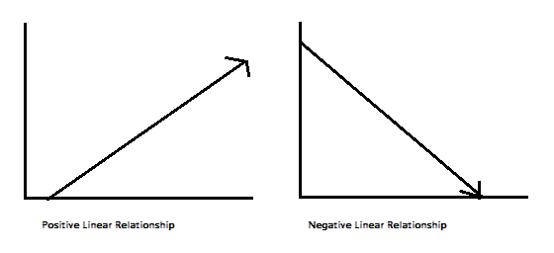


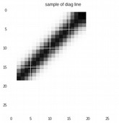
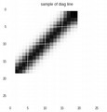
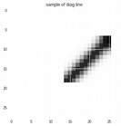
Gradient based methods : concept directional derivative
Interpretability Beyond Feature Attribution: Quantitative Testing with Concept Activation Vectors (TCAV), 2017
n quantitatively measure the sensitivity of model predictions with respect to concepts at any model layer.

Slide 18
Concept activation of mnist model hidden CNN layer : Toy Example
The concept directional derivative measures sensitivity of model predictions with respect to concepts at any model layer
Concept
Digit | 0 | 1 | 2 | 3 | 4 | 5 | 6 | 7 | 8 | 9
Directional derivative | -- | ++ | -- | -- | -- | -- | -- | + | --- | --
ThisSC,k,l(x)can quantitativelymeasure the sensitivity of model predictions with respectto concepts at any model layer.

Slide 19
Concept activation of mnist model hidden CNN layer : Remove model bias
The ‘apron’ predictions was positively correlated with respect to the ‘woman’ concept directional derivative
Interpretability Beyond Feature Attribution: Quantitative Testing with Concept Activation Vectors (TCAV), 2017
ThisSC,k,l(x)can quantitativelymeasure the sensitivity of model predictions with respectto concepts at any model layer.

Slide 20
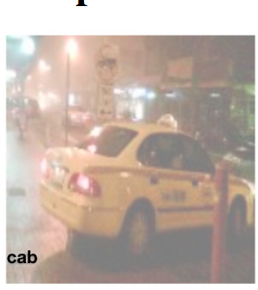
Concept activation of mnist model hidden CNN layer : Inquire about model learning
Train image classifier with captioned
images (right)
Concept directional derivative shows sensitivity of logit output to
i). Image or
ii). Captions
Interpretability Beyond Feature Attribution: Quantitative Testing with Concept Activation Vectors (TCAV), 2017

Slide 21
Draw backs of methods
Indirect – post-processing of model to yields insights
Explain the concept vector– difficult in high D space

Slide 22
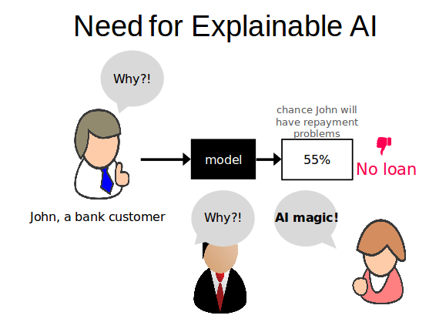
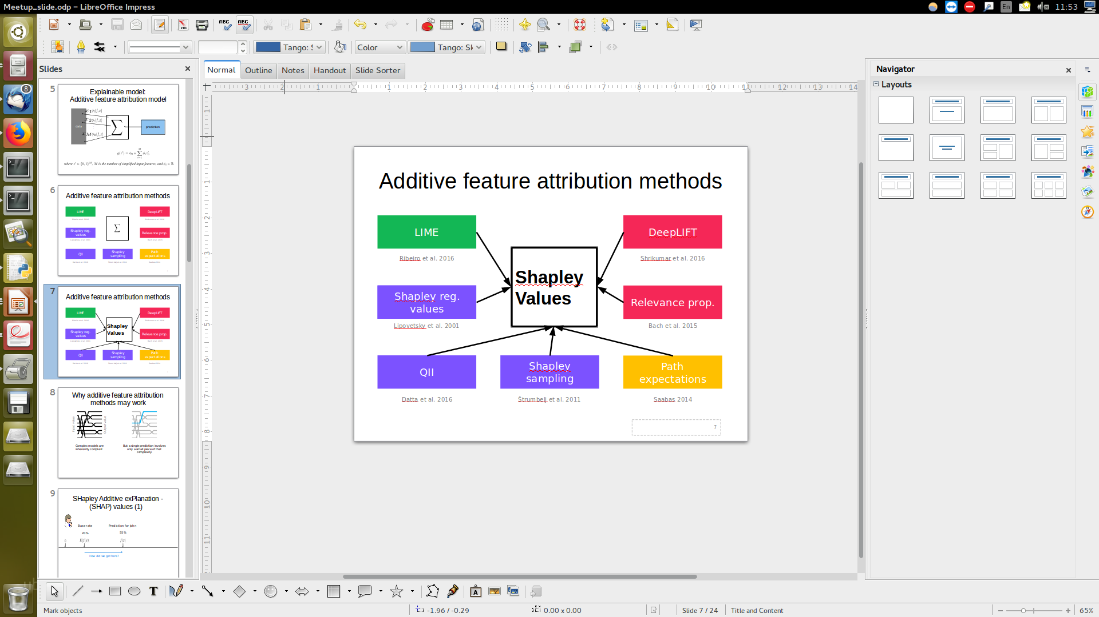

Summary
1. | 2. | 3. Intuition
4. Analysis mnist | 5. Drawbacks | 6. Gradient based methods
φ_{pink} =
weight_avg(f( ) f( ))

Slide 23
References and Questions ?
Scotts slides
https://github.com/slundberg/shap/blob/master/docs/presentations/NIPS%202017%20Talk.pptx
A Unified Approach to Interpreting Model Predictions(2017), Scott Lundberg, Su-In Lee
Analysis of regression in game theory approach (2001),Stan Lipovetsky, Michael Conklin
Interpretability Beyond Feature Attribution: Quantitative Testing with Concept Activation Vectors (TCAV), 2017

