Slide 1
Resale HDB prices

Slide 2
Data sources
https://data.gov.sg/dataset/resale-flat-prices
from year 1990-2017
Google maps API data for geospatial cordinates
Wikipedia for MRT and primary school data

Slide 3
Data processing
Resale data
1990-2017
Google Maps
API
Final dataset
train_mrt.csv.gz

Slide 4
File list
Initial data file
  resale-flat-prices-based-on-approval-date*.csv
MRT/Primary school location files
  Primary_school, mrt_date.csv, where.data_mrt
Preprocessed files
  train_mrt.csv.gz
Scripts
  notebook_preprocess.ipynb
  notebook_analysis.ipynb

Slide 5
Why study HDB prices
HDB is the largest expense in many people’s life
Study how prices of HDB changes over time
Learn about the overall trend of HDB prices over the past 40 years

Slide 6
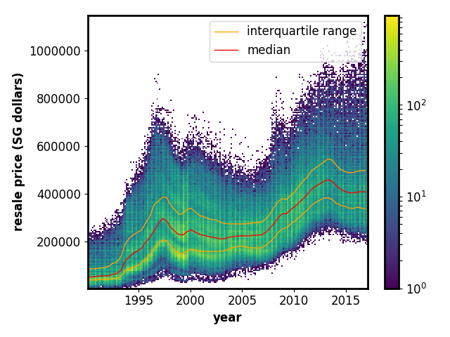
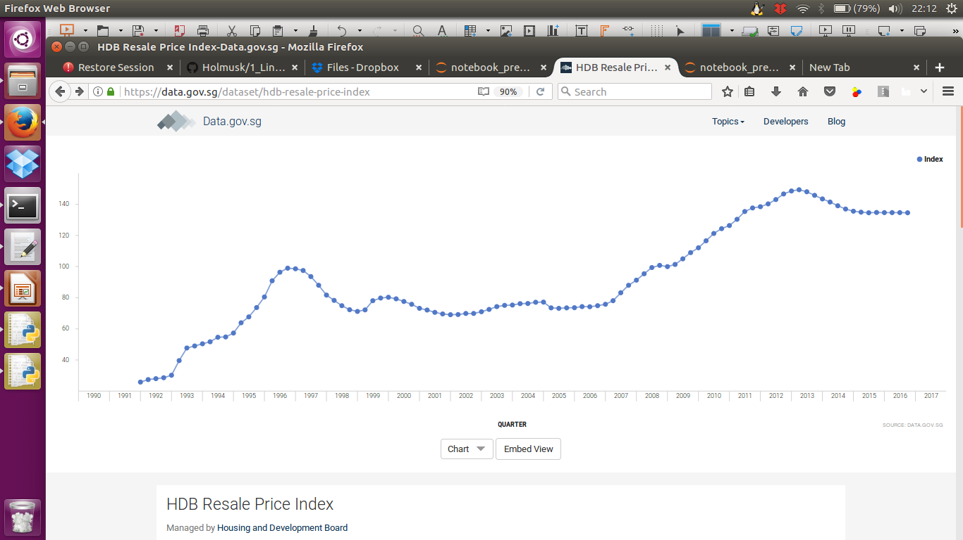
General Prices of HDB
General trend similar to one reported by gov.data.sg (below)

Slide 7
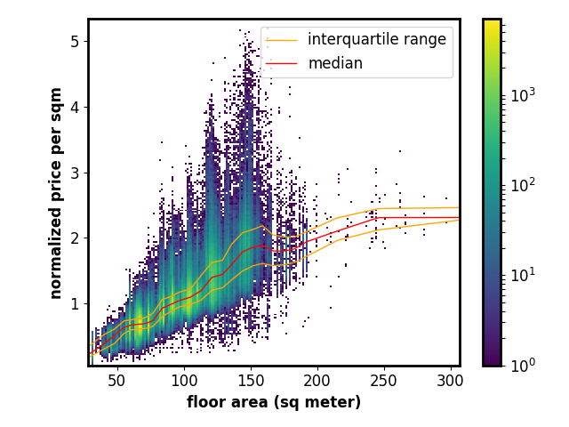
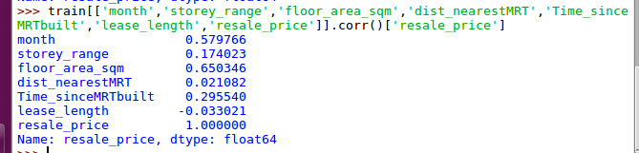

Main predictors of HDB flats
Correlation of numerical variables show that floor area and year are most important factors

Slide 8
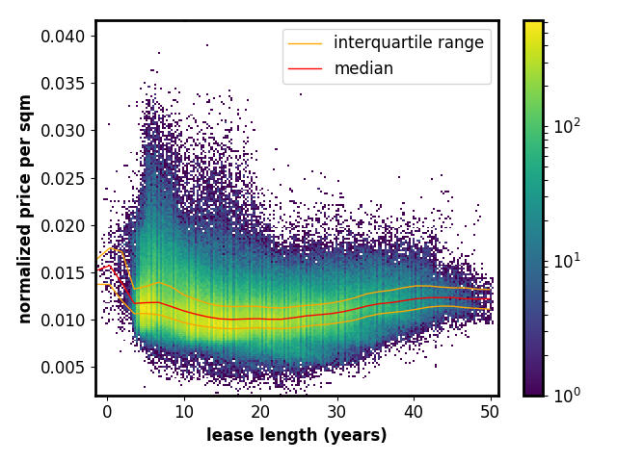
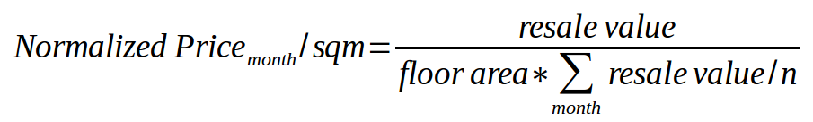
Normalizing the price
Prices are dependent on inflation and economic factors, we need to normalize across different years.
Normalized price by area and median resale price per month to get relative price across years

Slide 9

Normalized price per sqm over time
Peak Prices at 5 year mark and lowest at 20 year mark accounting for inflation and floor area.

Slide 10
Normalized price per sqm over time (by town)

Slide 11
How do BTO flats fare in pricing

Slide 12
General Prices of HDB
General trend similar to one reported by gov.data.sg (below)

