Slide 1
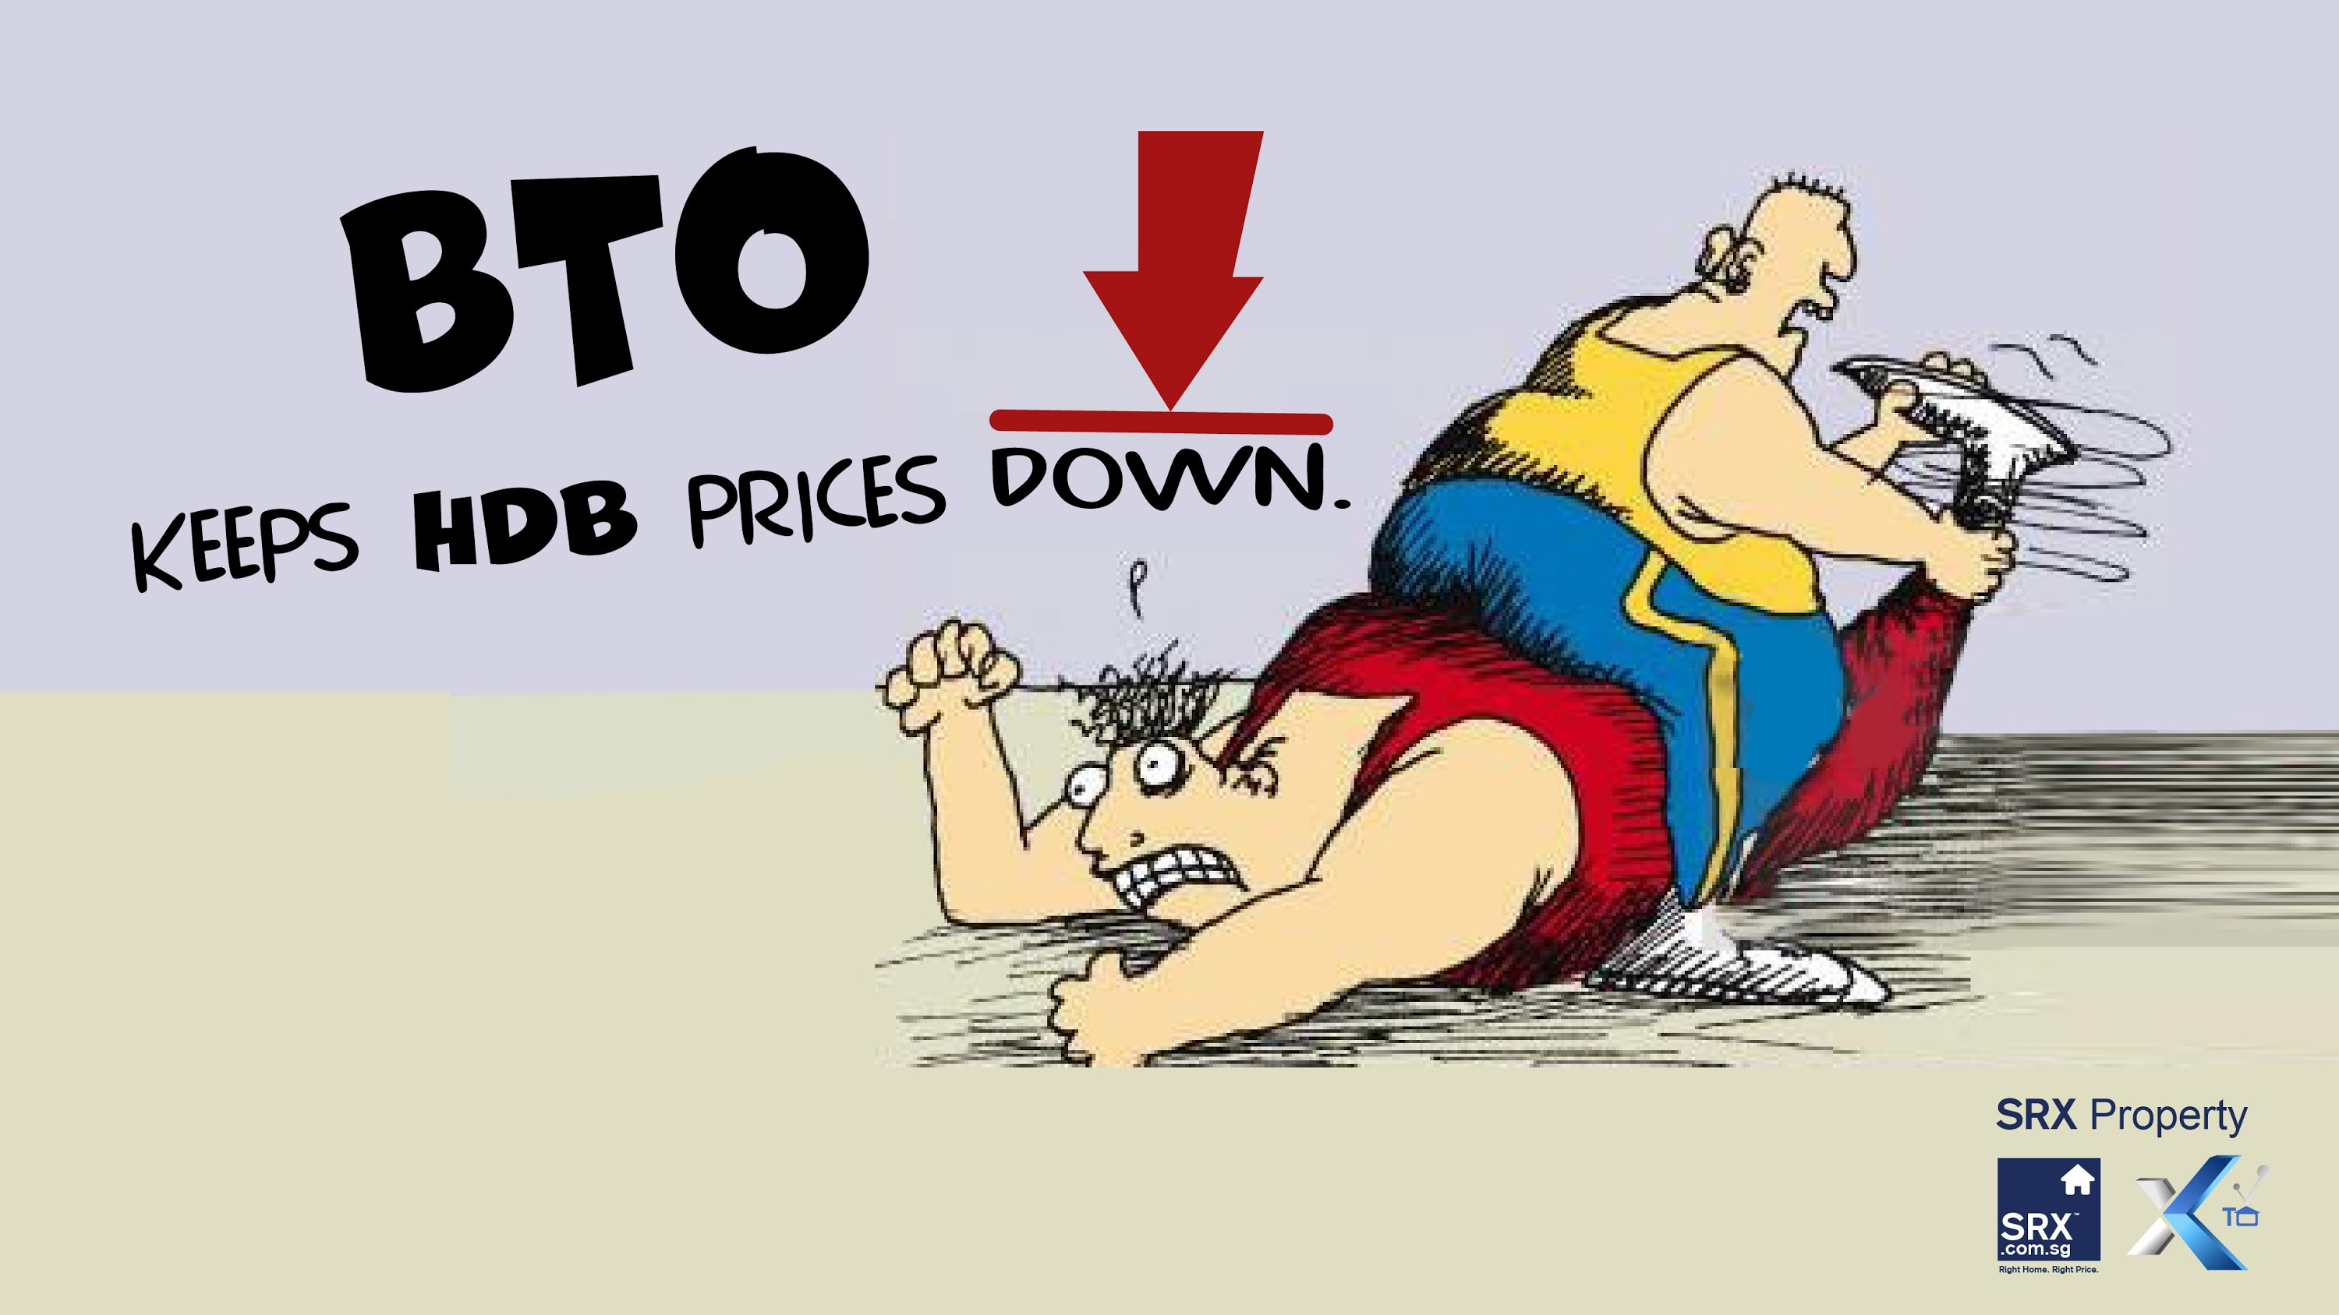
Resale HDB prices
Really?

Slide 2
Why study HDB prices
HDB is the largest expense in many people’s life
Study how prices of HDB changes over time
Learn about the overall trend of HDB prices over the past 40 years

Slide 3
File list
Initial data file
  resale-flat-prices-based-on-approval-date*.csv
MRT/Primary school location files
  Primary_school, mrt_date.csv, where.data_mrt
Preprocessed files
  train_mrt.csv.gz
Scripts
  notebook_preprocess.ipynb
  notebook_analysis.ipynb

Slide 4
Data processing
Resale data
1990-2017
+
BTO
sale prices
Google Maps
API
Final dataset
train_mrt.csv.gz

Slide 5
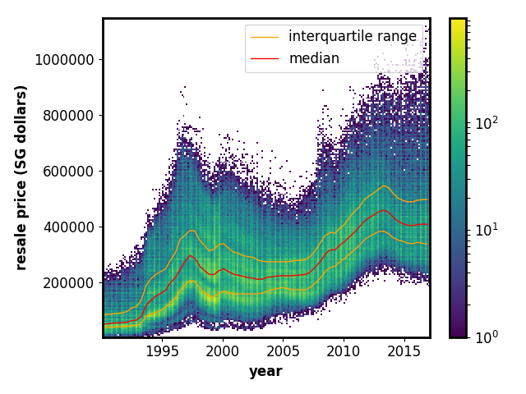
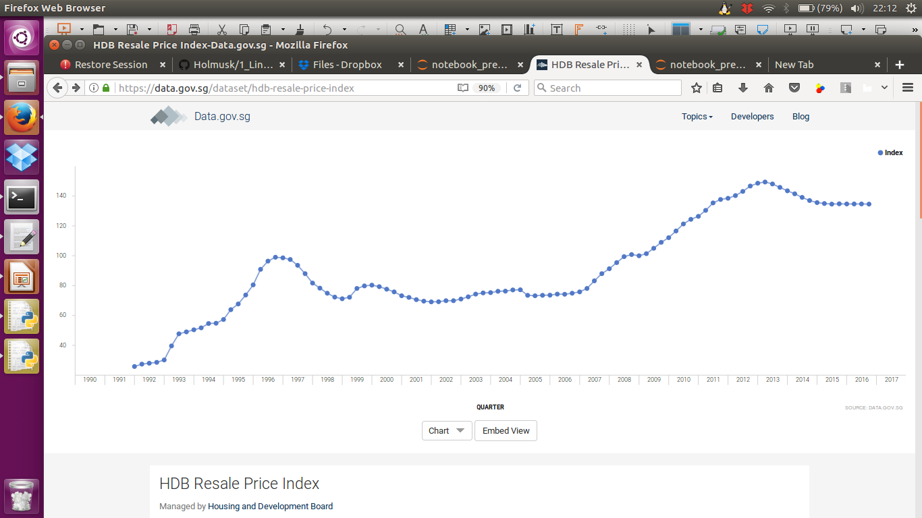
General Prices of HDB
General trend similar to one reported by gov.data.sg (below)

Slide 6
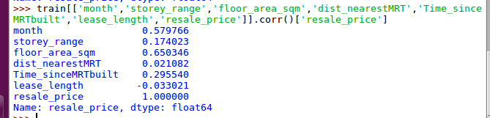
Main predictors of HDB flats
Variables are month of sale, HDB town, flat type, bock, street name, level of flat, floor area, lease commence date, nearest MRT, consumed lease length, distance to MRT, area,
Correlation of numerical variables show that floor area and month of sale are most important numerical factors with pearson coefficient of 0.65 and 0.58 respectively.

Slide 7
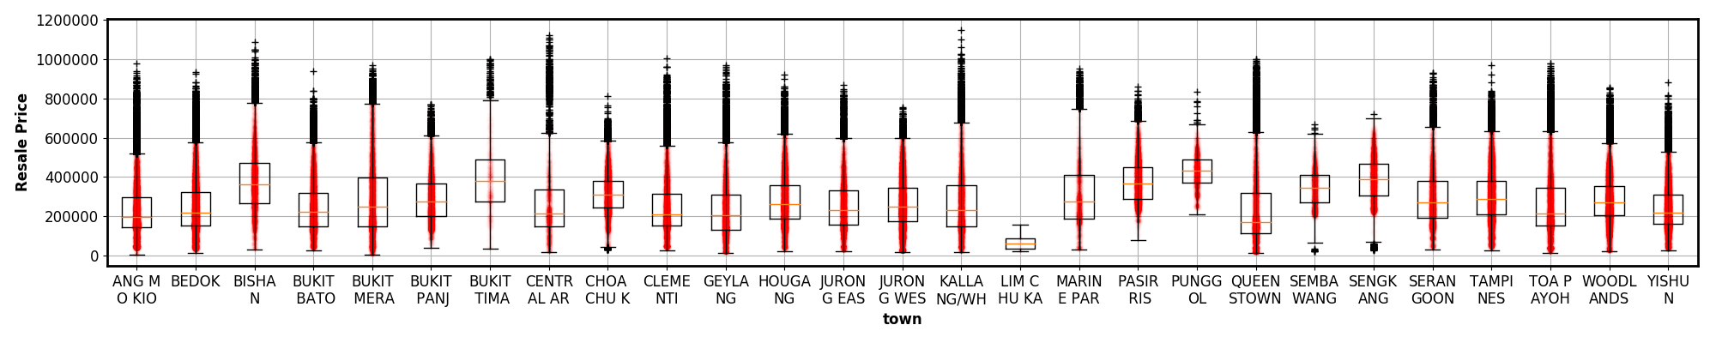
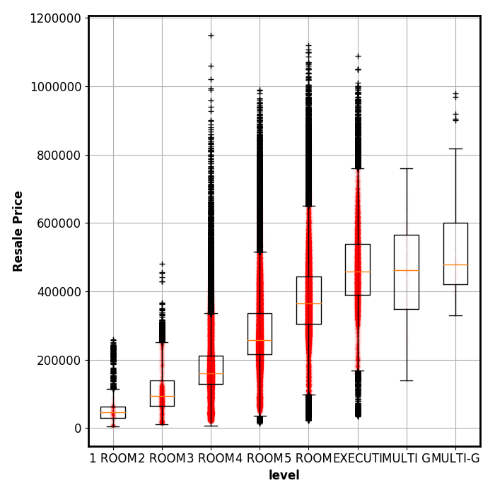
Most important categorical variables
Flat type and town were import variables
I will ignore flat type for this study and focus on town
Flat_type

Slide 8

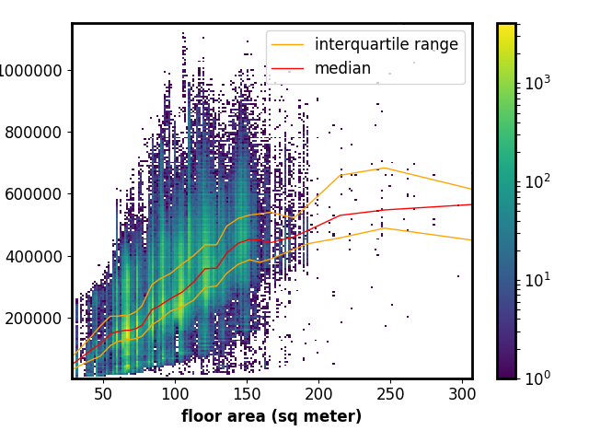
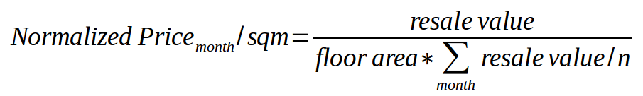
Normalizing the price across years and floor area
Prices are dependent on inflation and economic climates, we need to normalize across different years.
Normalized price by area and median resale price per month to get relative price across years
Average resale price
for Month (or median)

Slide 9
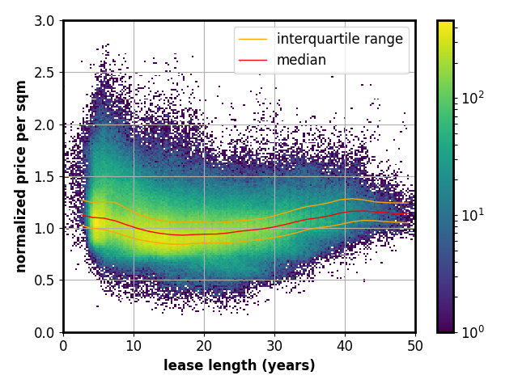
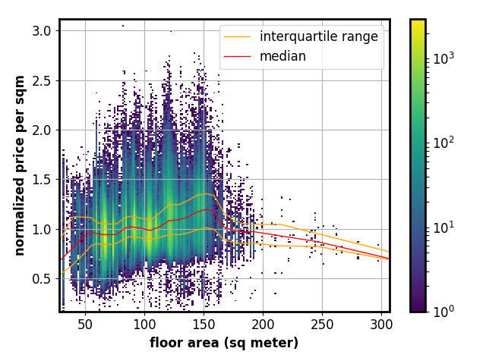
Normalized price per sqm over time
Peak prices : 5 year, lowest prices: 20 year accounting for inflation and floor area.
Older flats above 40 years are sold for higher prices than newer flats
Larger flats are more expensive per sqm, but I have decided to concentrate on other factors instead.

Slide 10
Normalized price per sqm over time (by town)
Legend : 2D histogram plots of normalized price per sqm
and lease length of HDB. Red triangles, blue squares and
green hexagons are median BTO prices for 3, 4, 5 room flats.
Red/orange lines show median/inter-quartile ranges for town
while blue lines show median across entire Singapore.

Slide 11
How do flats fare in pricing
BTOs are lower than most resale flats even comparing with rock bottom prices at 20 year lease.
Newer estates like Punggol and Sembawang Sengkang show much less variability compared to most mature estates like Ang Mo Kio, Toa Payoh and Queenstown.

Slide 12
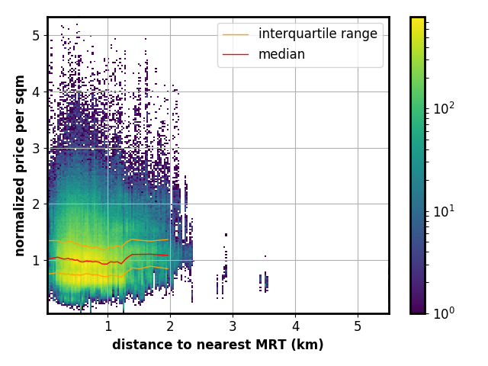
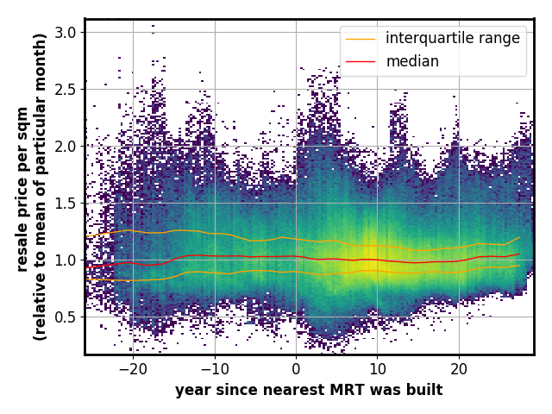
MRT effect on HDB prices
Building of MRT and distance to MRT does not impact prices per sqm.
Houses further from MRT are generally a bit more expensive

Slide 13
Applications of Study
Median/Average resale price can be estimated by experts. This is affected by property market forces
Investigate trends of data using a normalized measure taking account inflation and floor area.
This metric found that relative prices are lowest at twenty years and increases henceforth.
Future resale prices can be forecasted by the formula below after getting an expert to estimate the median resale price in the future.

Slide 14
Forecasting Data
Previous slides give an intuition of prices, now for forecasting.
xgboost model
Train data :1990-2010
Test data :2010-2017
Features:
month_of_sale, town, flat_type, storey_range, floor_area_sqm,lease_commence_date, lat, lng, nearestMRT, dist_nearestMRT, MRTbuilt, Time_sinceMRTbuilt, month_mean, lease_length

Slide 15
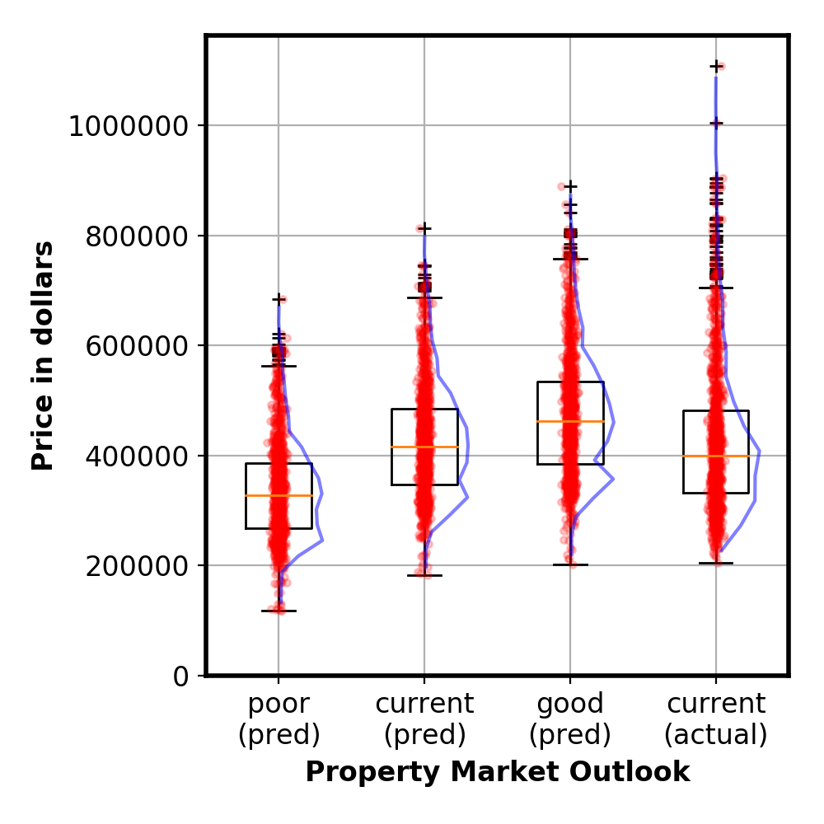
Application:
Forecasting with expert inputs
Expert input based
on property market
outlook
HDB + MRT
data
Final price
avg error : ±28K
Machine Learning
model
We can forecast future prices after experts inputs on the future median price
Legend:
Red Dots : individual data-points
Blue line : histogram of prices

Slide 16
Conclusion
Showed certain trends regarding property prices related to lease, town and MRTs.
Prediction accuracy of machine learning model was in the error of ±28K.
Our model facilitated expert inputs to help predict future prices

Slide 17
Limitations of data
Current data is based on resale data, which is not truly representation of entire HDB data.
Size of BTO flat was estimated using medians since it was not given. The prices per sqm meter are thus also estimates.
It is known that larger HDB flats cost more per sqm meter, this was not taken into account when plotting the prices per sqm per town.
Forecasting uses mean of all flats sold in the period, which might be better represented by a stratified means of different flats.

Slide 18
Appendix: Have HDB sizes shrank ?
HDB flat sizes not shrinking: Khaw Boon Wan
“My comment at that dialogue was in response to a question. I was purely stating that HDB plans (flat sizes) based on certain design norms, and as far as I know, it has not changed for the past 15 years,”
Posted by temasektimes on June 13, 2012

Slide 19
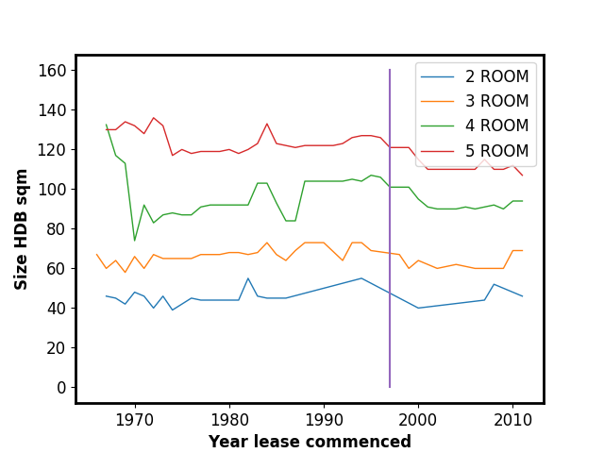
Appendix: HDB resale data
Taking 15 years back, to 1998 (purple line)
Flat sizes have been decreasing since 1998, with the decrease mainly from 1998 to 2001
Flat sizes have not decreased for 10 years since 2001-2012

Slide 20
Appendix : Data sources
https://data.gov.sg/dataset/resale-flat-prices
from year 1990-2017
Google maps API data for geospatial cordinates
Wikipedia for MRT and primary school data

