Slide 1
Machine Learning methods 1
Lee Xiong An

Slide 2
Schedule
Introduction (0900-0915)
Demo using teleco customer churn dataset (0915-0935)
Hands-on practice using Titanic dataset (0935-1015)
Break (1015 - 1030)
Practice using Uber dataset (1030-1145)
Presentation (1145 - 1200)

Slide 3
What should I cover?
I surveyed people about their preferences for the workshop. Here are my findings
  Most preferred practical aspects rather than the theory.
  Due to diverse background generic datasets are preferred
  The various algorithms can be easily learnt outside through youtube, so i will be concentrating on getting insights out of a dataset

Slide 4
What should I cover?
I surveyed people about their preferences for the workshop. Here are my findings
  Most preferred practical aspects rather than the theory.
  Due to diverse background generic datasets are preferred
  The various algorithms can be easily learnt outside through youtube, so i will be concentrating on getting insights out of a dataset
Do you trust my analysis ?

Slide 5
Questions you should ask before doing ML
Data quality is most important
What is the sample size – 3
How is the data collected – Are the three colleagues representative of the population, are there bias in sample collection
How is the data recorded, will it increase error? - I noted down by memory

Slide 6
How should we make the full use of ML?
For most of us here, we want to understand the biology
Making a ML prediction model can hardly tell us about the biology
We need to interpret the model
We will use decision trees for this workshop
  Easy to interpret
  Works for linear, non-linear datasets
  May not fit complicated data as well as other methods like random forest or xgboost

Slide 7
Decision tree example: Partial titanic dataset (891 passengers)
342/891 survived, 38%
Male
109/577, 19% survived
233/314, 74% survived
Class <=2
161/170
95% survived
233/314 survived
233/314, 95%survived
72/144, 50% survived

Slide 8
Decision tree example: Partial titanic dataset (891 passengers)
342/891 survived, 38%
Male
109/577, 19% survived
233/314, 74% survived
Class <=2
% survive | 1nd, 2nd class | 3rd class
Male | 0.19
Female | 0.95 | 0.50
161/170
95% survived
233/314 survived
233/314, 95%survived
72/144, 50% survived

Slide 9
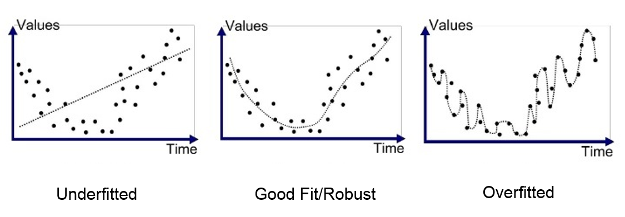
Other ML methods in brief
 | Advantages | Disadvantages | Methods
Simple models | Will not overfit data | May not be able to fit complex patttern | Linear models, decision trees
In the middle | ~ | ~ | SVM, Random forest
Complex models | Can fit complex patterns well | May overfit the noise | Neural networks, gradient boosting methods

Slide 10
Aim of the class
Apply a ML model for your data
Understand and obtain insights from your model

Slide 11
Demo - Telecom churn dataset
Churn – means customer stops buying
It cost money to aquire, setup a new customer and companies want to reduce churn
Dataset
Services that each customer has signed up for – phone, multiple lines, internet, online security, online backup, device protection, tech support, and streaming TV and movies
Customer account information – how long they’ve been a customer, contract, payment method, paperless billing, monthly charges, and total charges
Demographic info about customers – gender, age range, and if they have partners and dependents

Slide 12
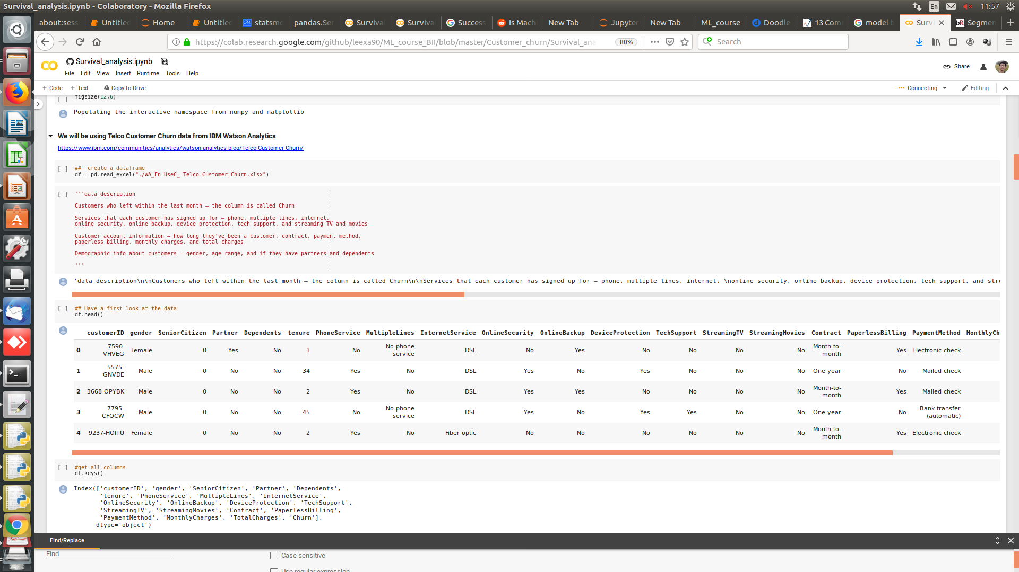
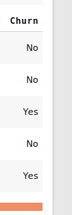
Snapshot of dataset

Slide 13
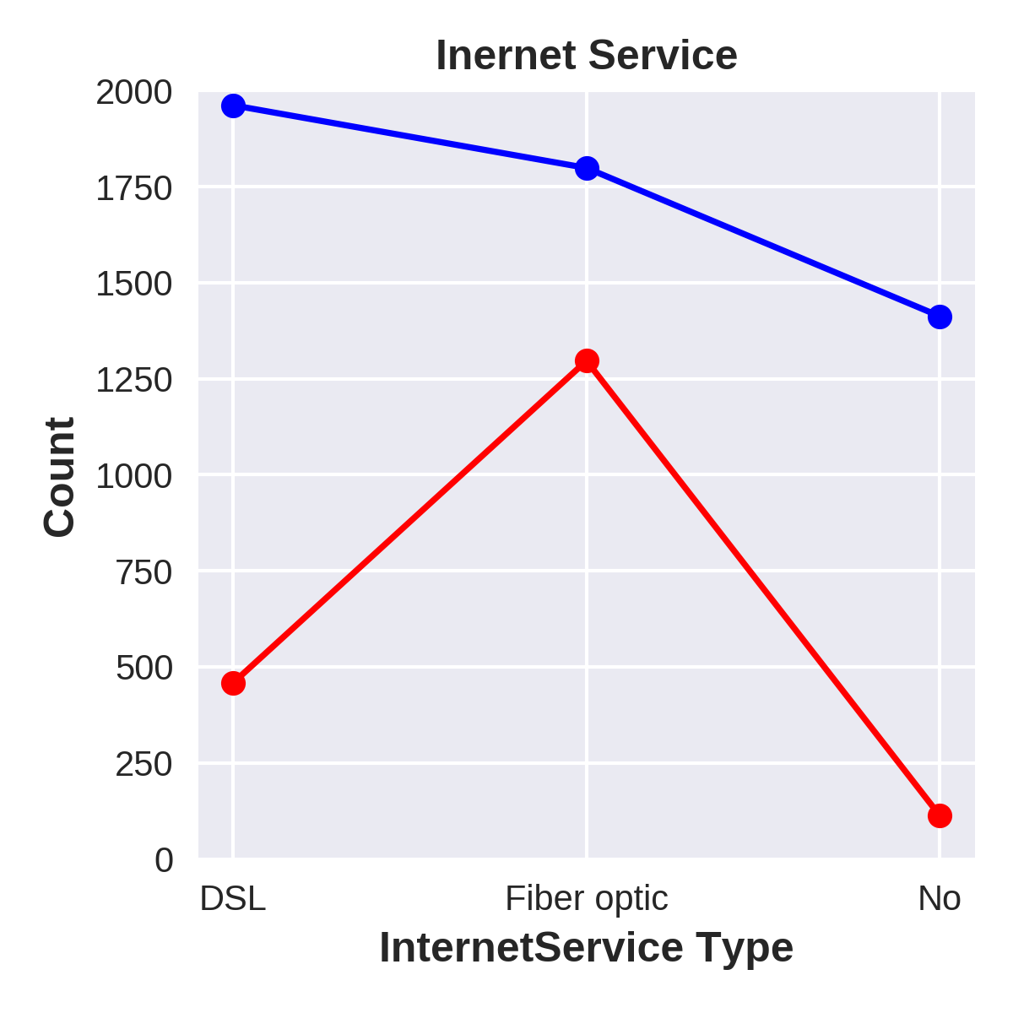
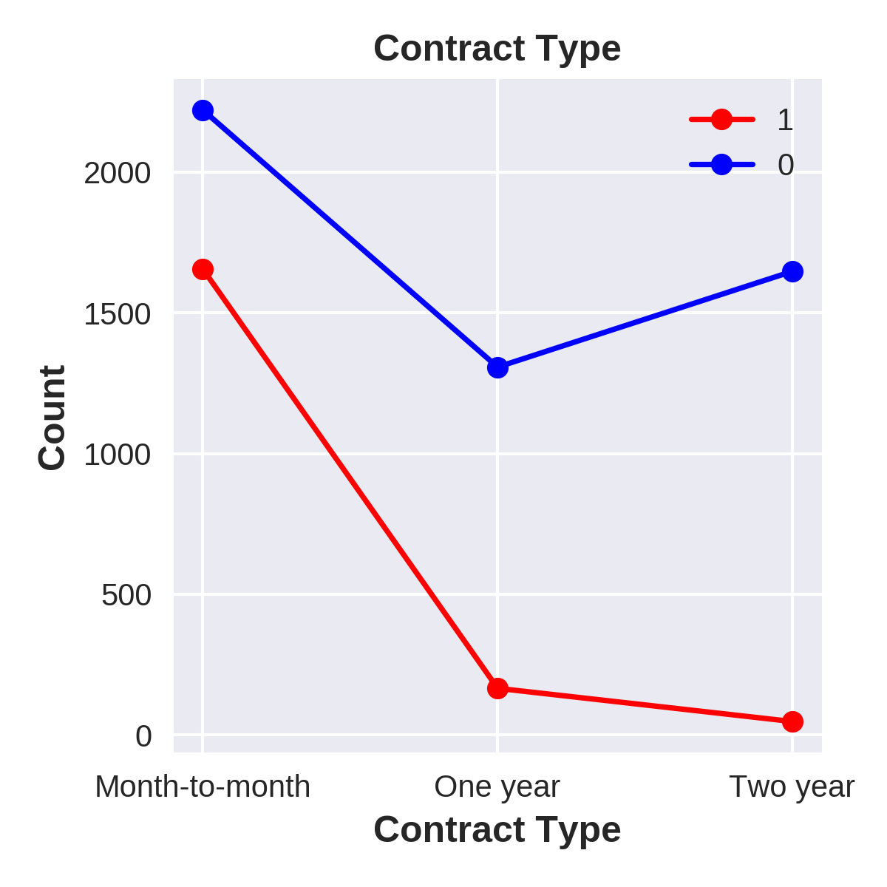
What categorical variables affect churn
Internet service and contract type are likely important factors affecting churn

Slide 14
What categorical variables affect churn
70%
89%
70% of all churn customers use fiber optic and 89% use month-month contracts

Slide 15
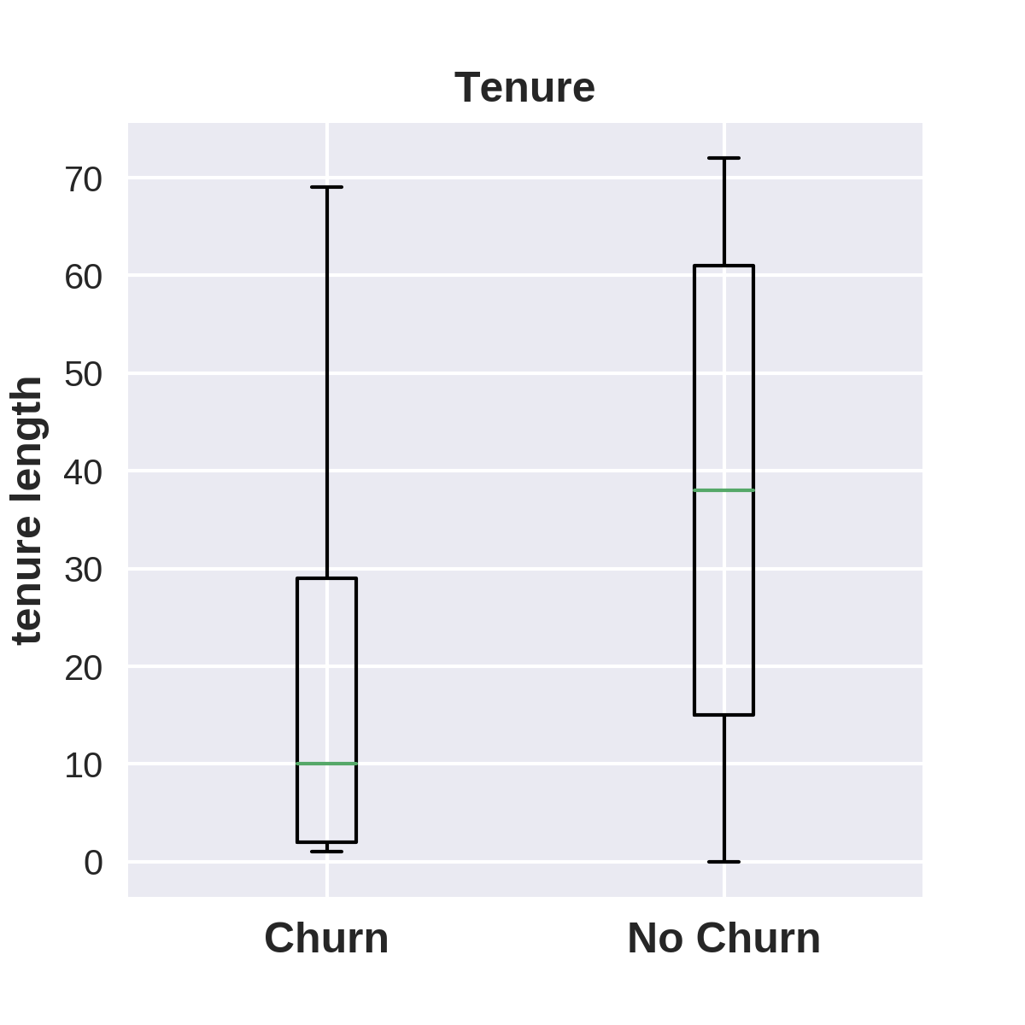
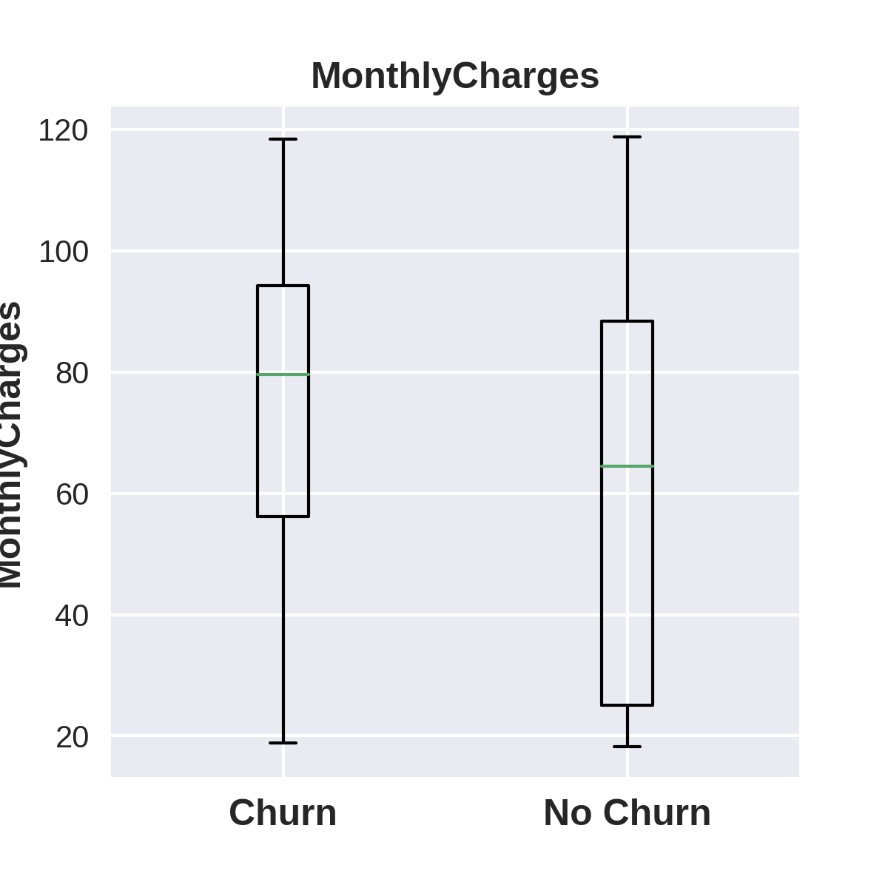
What numerical variables affect churn
Churn customers have much lower tenure
and higher month charges

Slide 16
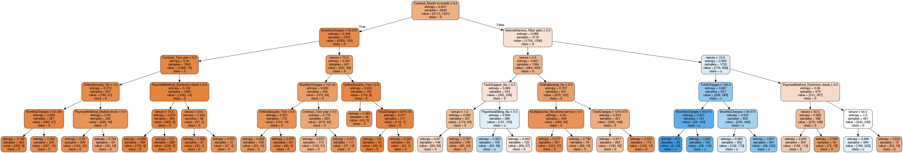
Model
Descision tree model with train/test AUC 0.85/0.82
  Easy to interpret
  Works for linear, non-linear datasets

Slide 17
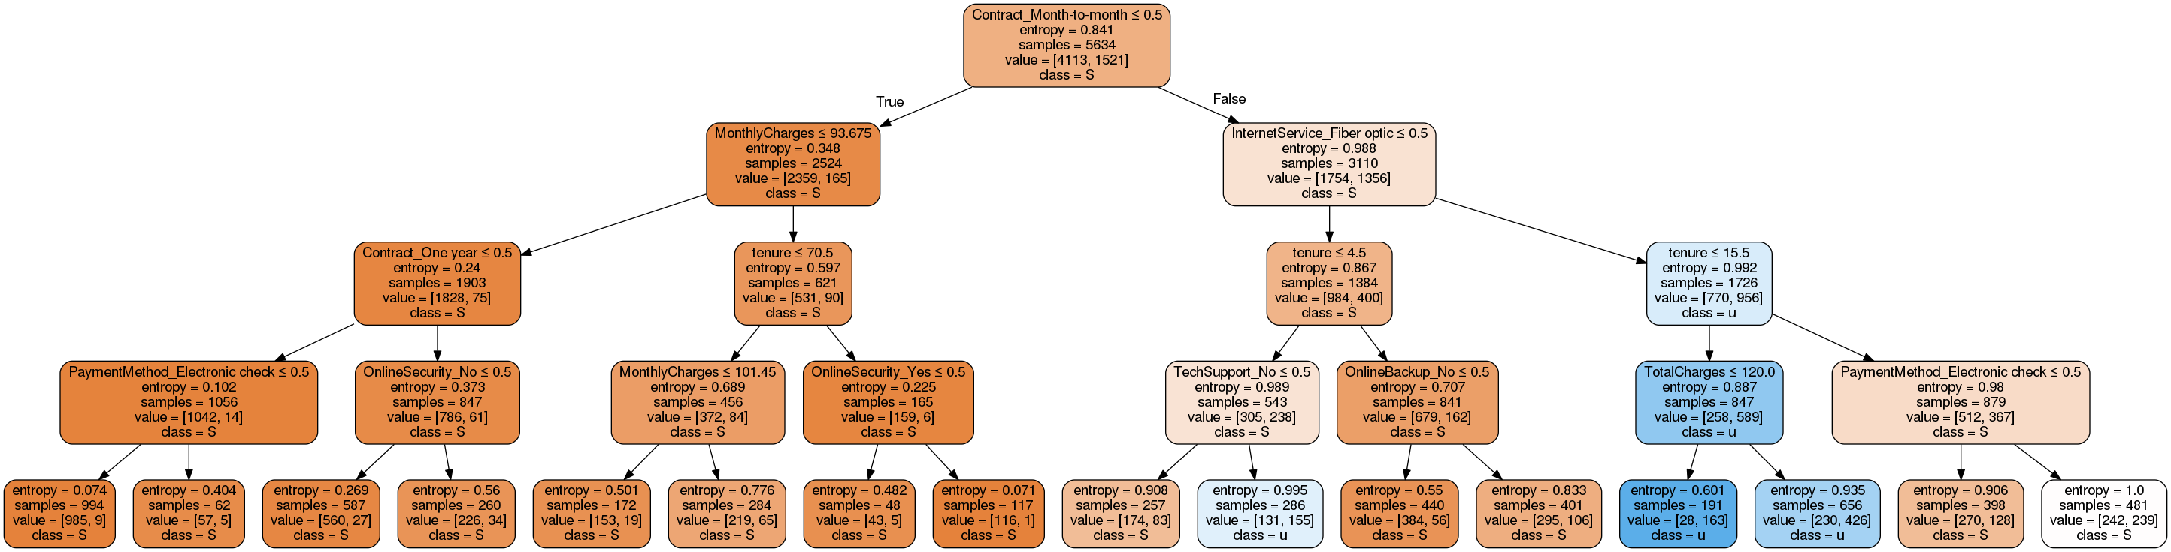
Segments with minimal churn
1-2year plans have 165/(165+2359) churn rate = 6.5%
How to convert month-month to subscription plans
Question – do subscription plan customers generate more revenue all things equal

Slide 18
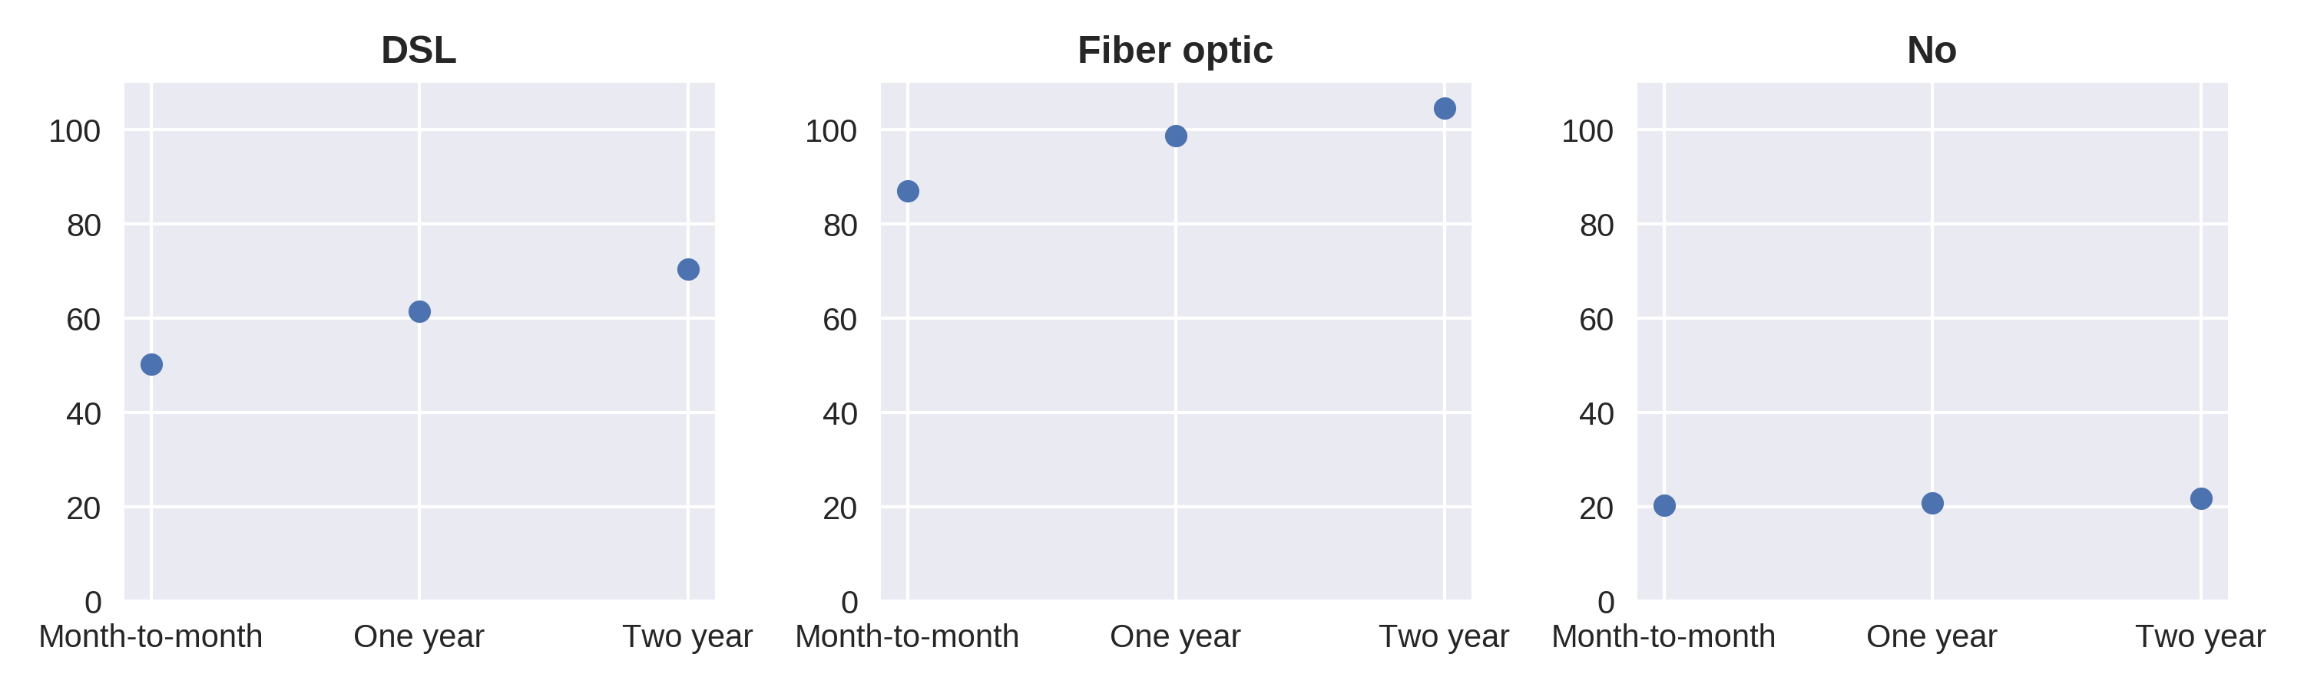
Segments with minimal churn
1-2year plans have 165/(165+2359) churn rate = 6.5%
How to convert month-month to subscription plans
Question – do subscription plan customers generate more revenue all things equal

Slide 19
Segments with highest churn
Month-to-month contract
Fiber optic
Tenure < 15.5
Churn rate is 589/(258+589) = 75%
Contributes to 956/1521 of churned customers
True

Slide 20
Segment : With vs without techsupport
Not month-to-month (1-2yr)
Not Fiber optic (DSL)
Tenure < 4.5
Without techsupport==0:
83/257 = 0.32 churn
Without techsupport==1:
155/286 == 0.54 churn

Slide 21
Demo
Give analysis on teleco churn dataset
Get prediction model and important features in model
Explain how import features affect the model
Insights we can get from the features to decrease churn
https://tinyurl.com/y5ndcsg4

Slide 22
Practice 1 till 1015
Practice 2 1030-1145
Familiarize with basic commands
Can skip to practice 2 if you want
Understand the uber dataset
Understand factors affecting cab pricing and
  Predict fares
  Explain to non-expert
  Give a recommendation to increase revenue

