Slide 1
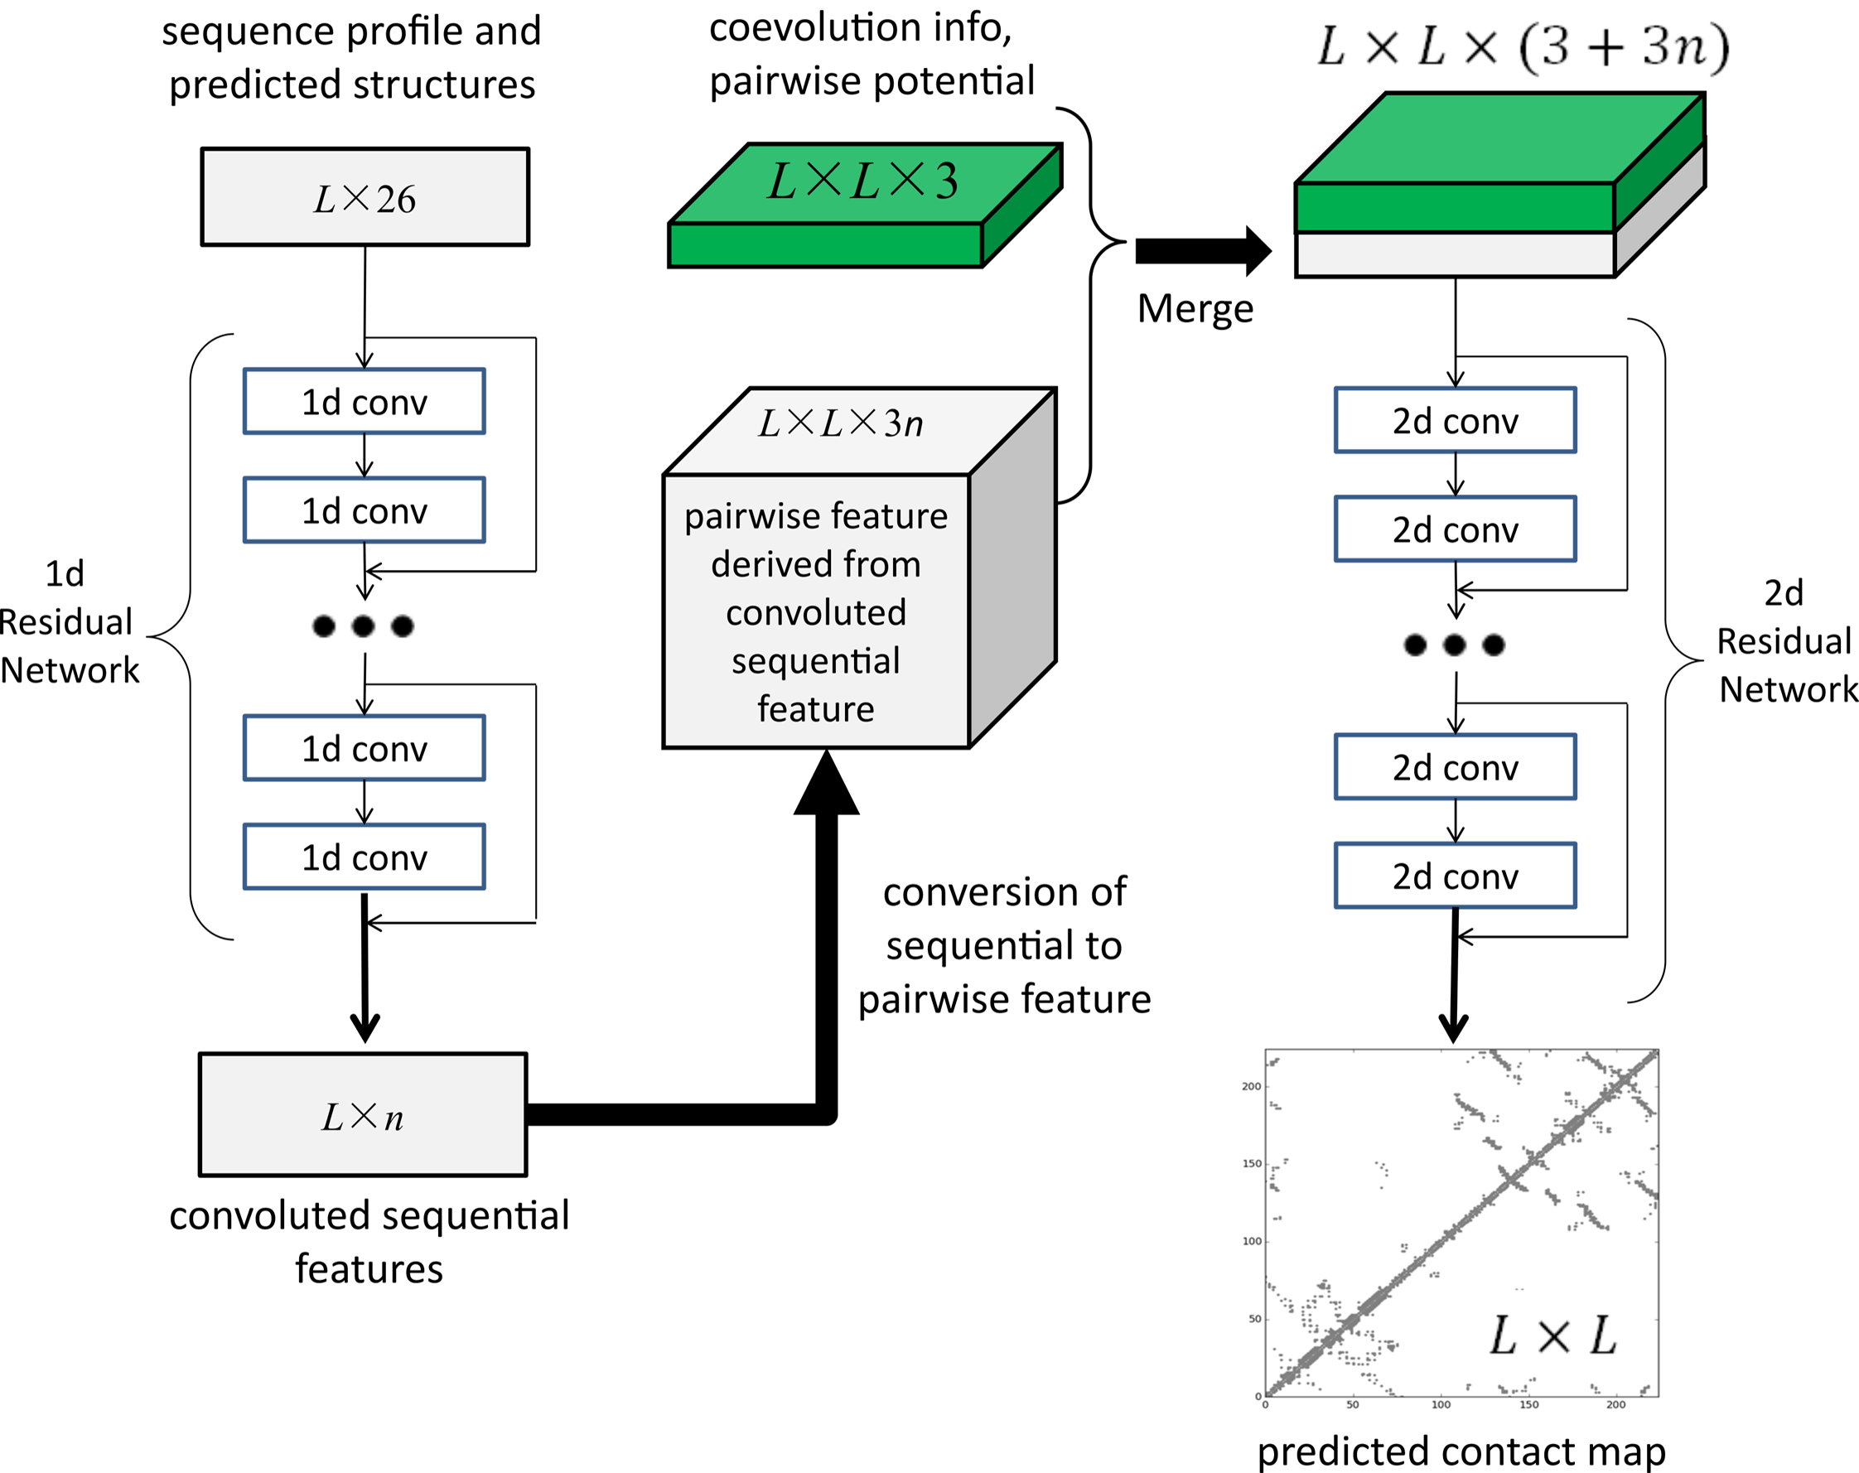
Sequence Profile
?
Pairwise Features
4
?
Additional features
from sequence
?
Pairwise matrix D

