Slide 1
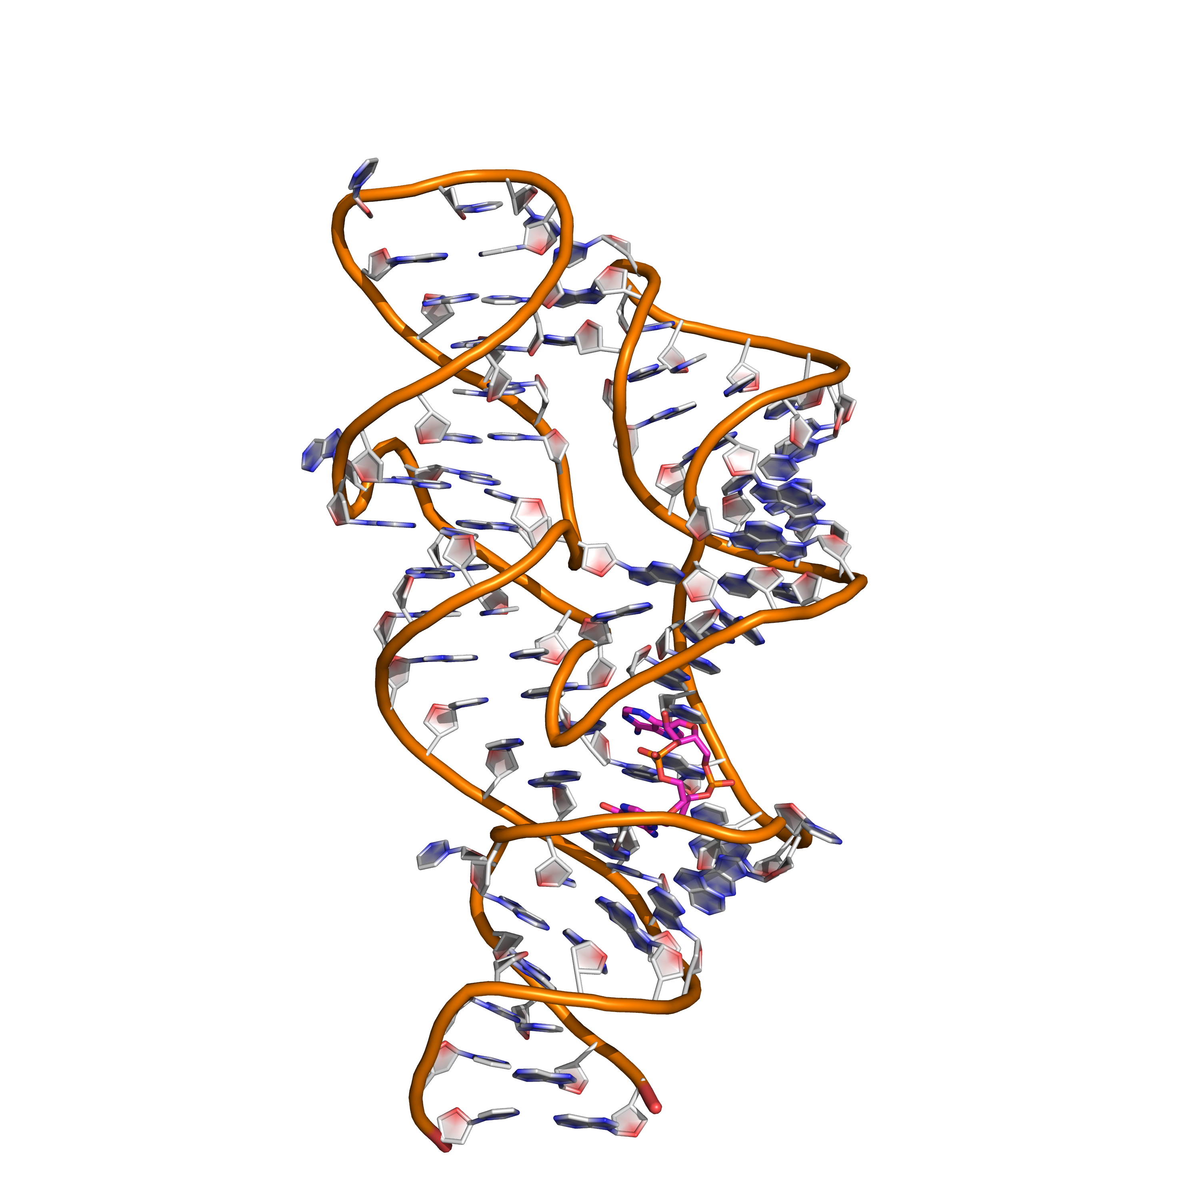
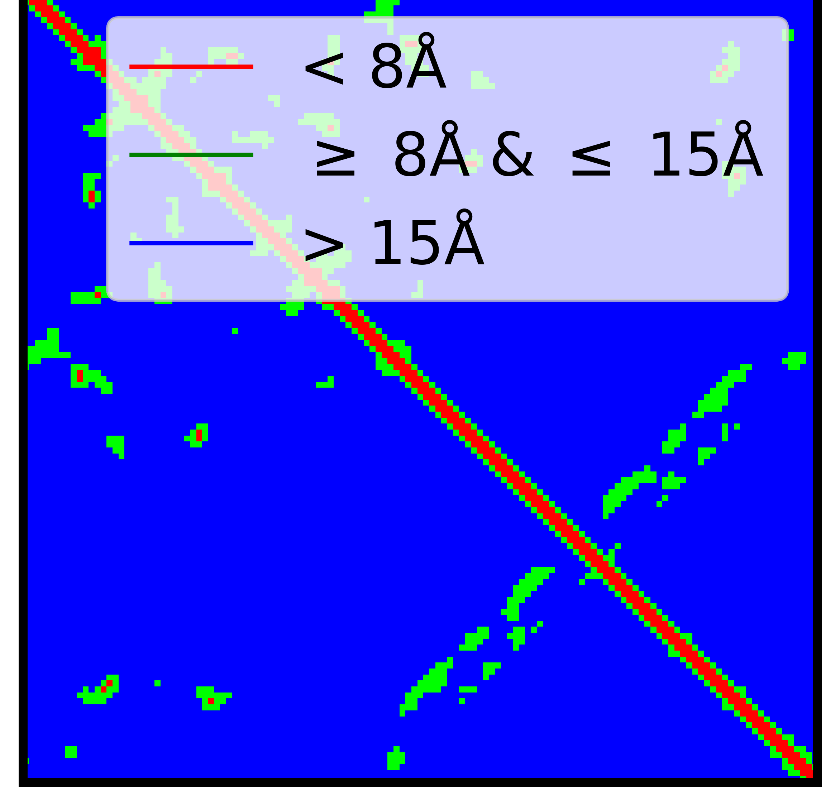
Neural Network Architecture
Residue level features
(15 x Length x 1)
Pairwise Features
(Length x Length
x 1)
1D convolution
merge
(1 x Length
x 64)
(Length x Length x3)
{Length x Length
x (64 + 1) }
2D
convolution
Dot product

