Slide 1
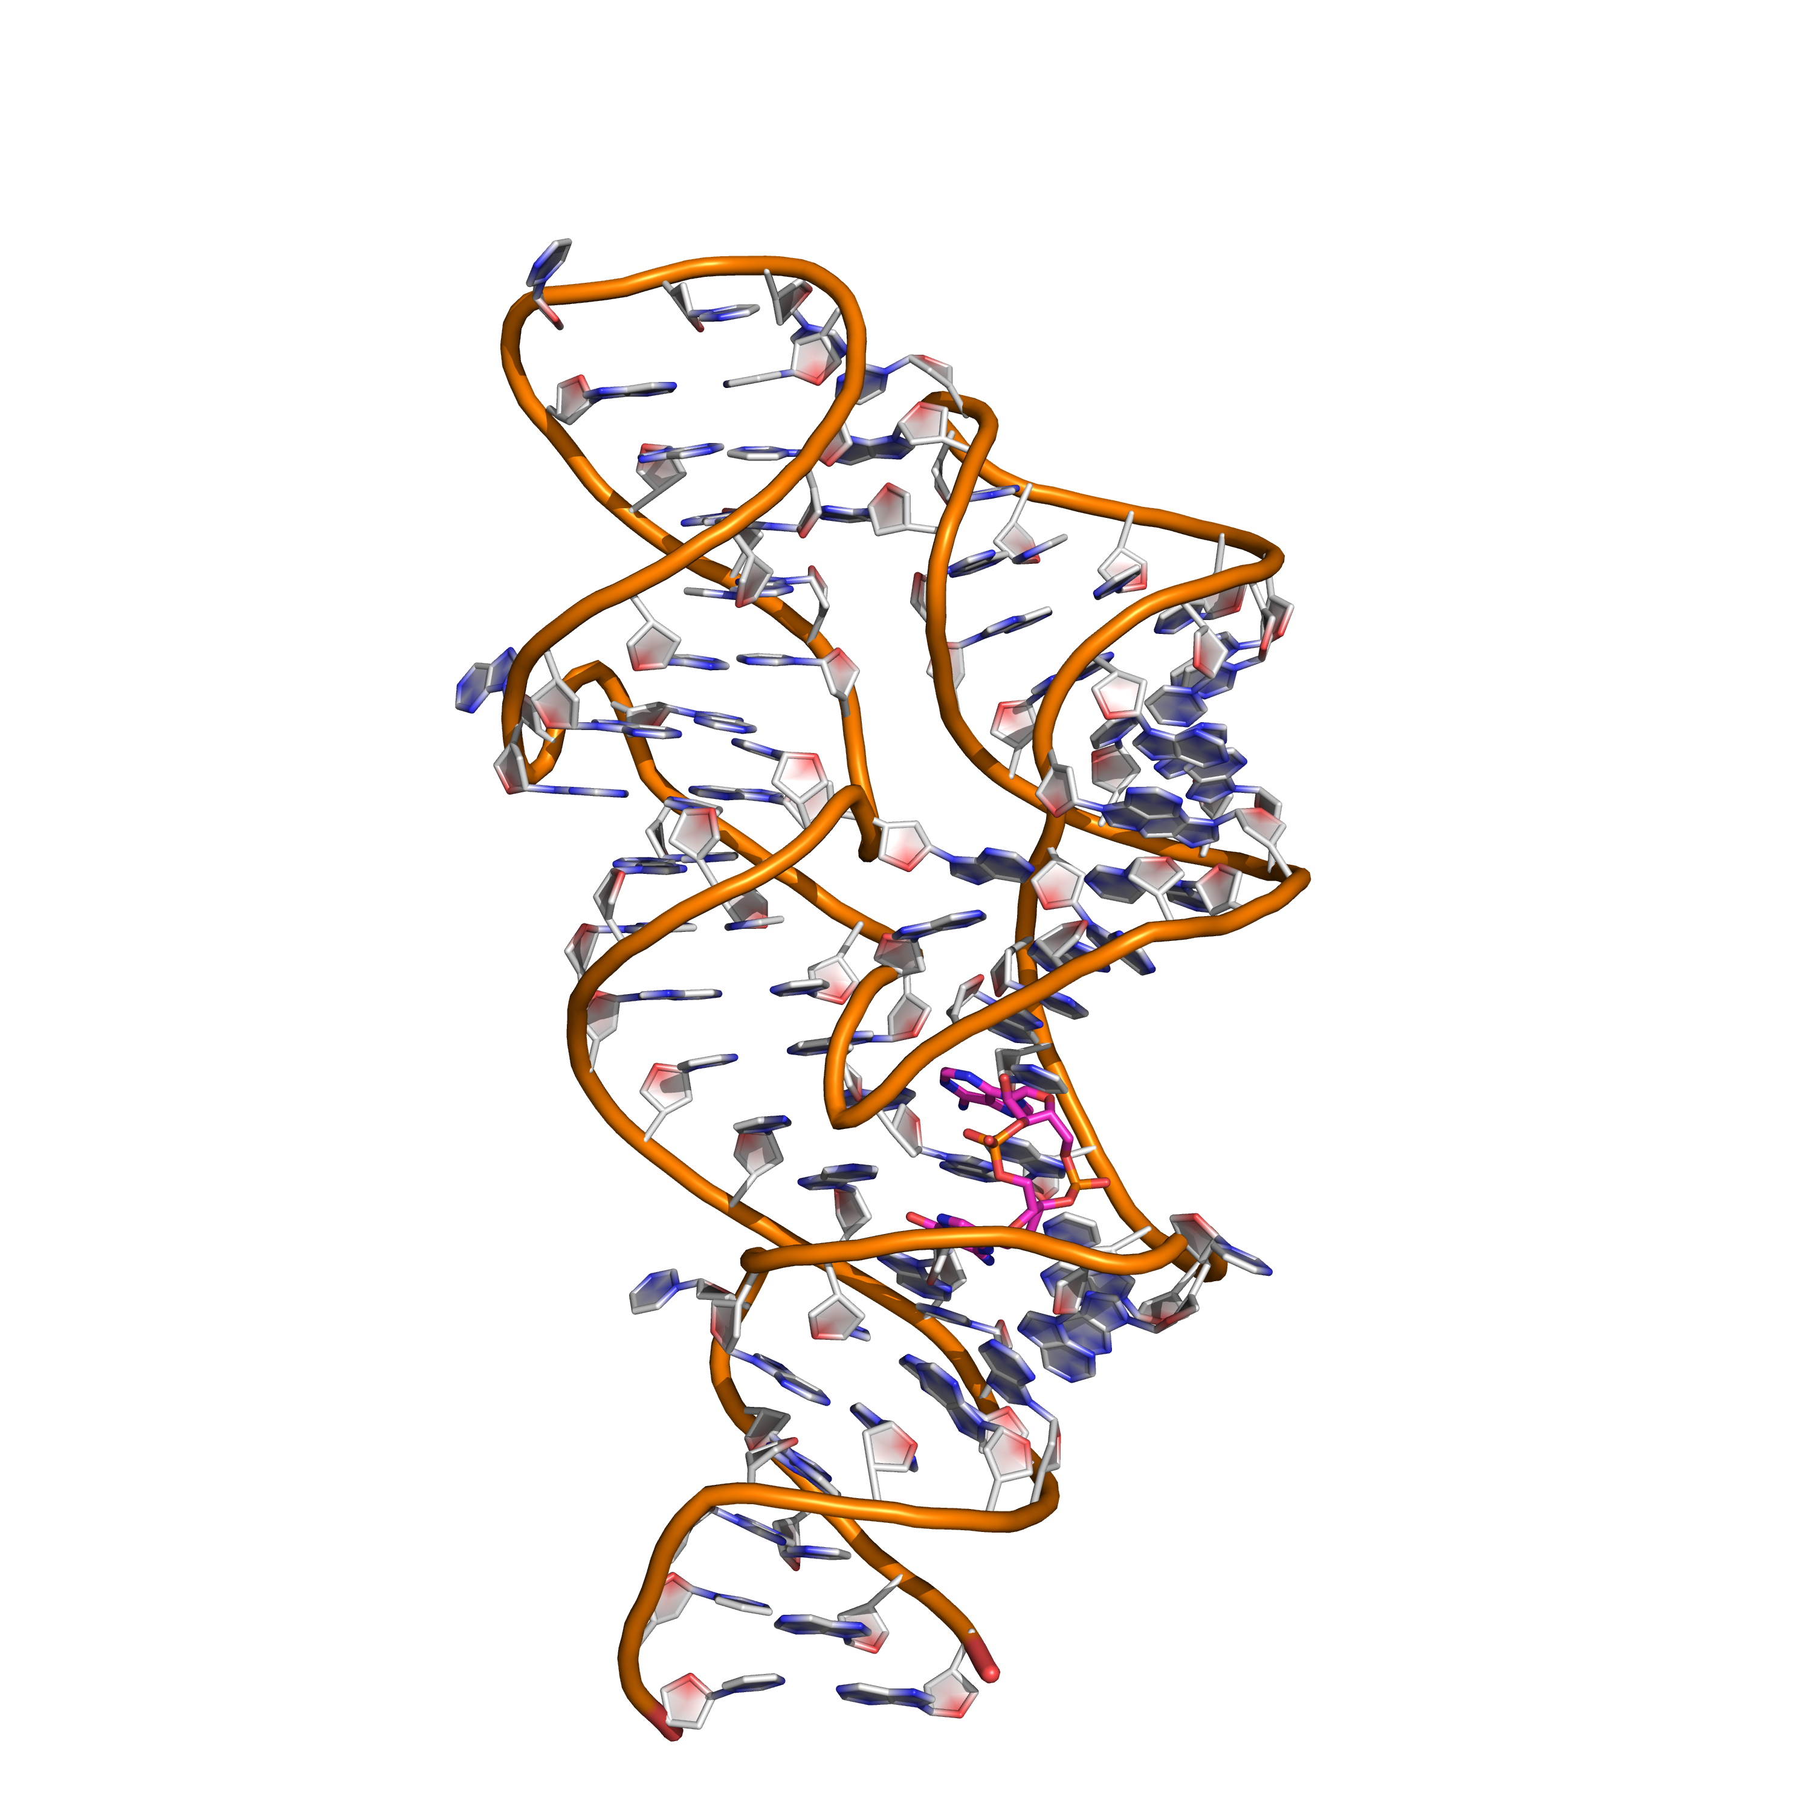
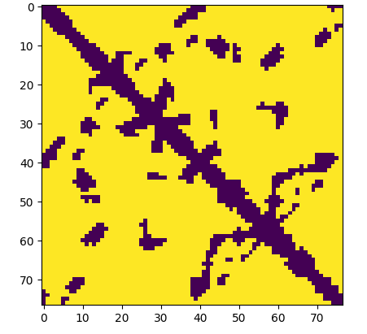
1. RNA contact map – Deep learning
2. Fragment- assembly
Residue level features
(15 x Length x 1)
Pairwise Features
(Length x Length
x 21)
1D convolution
2D convolution + merge
Pairwise residue distances
(1 x Length
x 96)
(Length x Length x 1)
Rosetta modeling with restrains
{Length x Length
x (96 + 64) }
2D
convolution
Inverse SVD

