Slide 1
COCO2 permability
Dataset of 1272 molecules
Train, Test split to 1017, 255
Labels are Log caco2 permability = (-8 to -4)
Training R² = 0.98 , Test R² = 0.80
Data source – chembl, online chemical datase, which they tided up

Slide 2
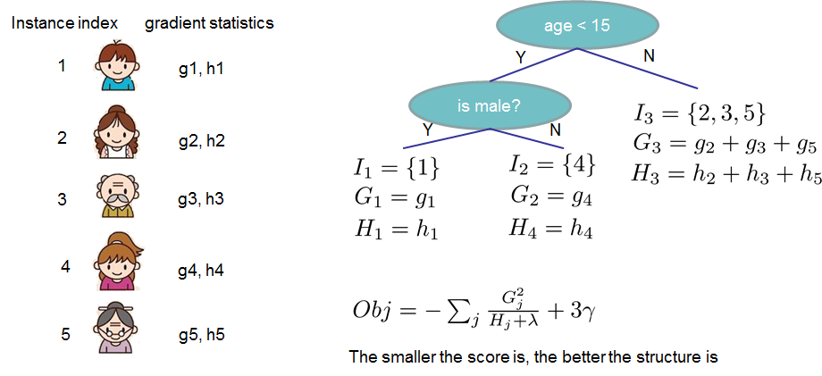
Algorithm Used
Xgboost algorithm
Boosting + tree based algorithm. Boosting is to predict residual errors : (y^{true} - y^{pred}) = tree(X)
For n number of trees:
build tree^{n} that minimizes loss (y^{true –} y^{pred})
update predictions y^{pred} with tree^{n}

Slide 3
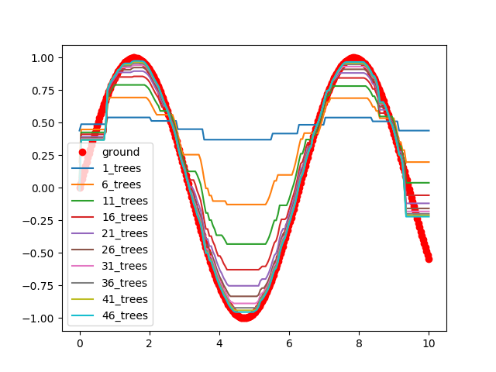
Result
A tree based algorithm that fits non-linearities well

Slide 4
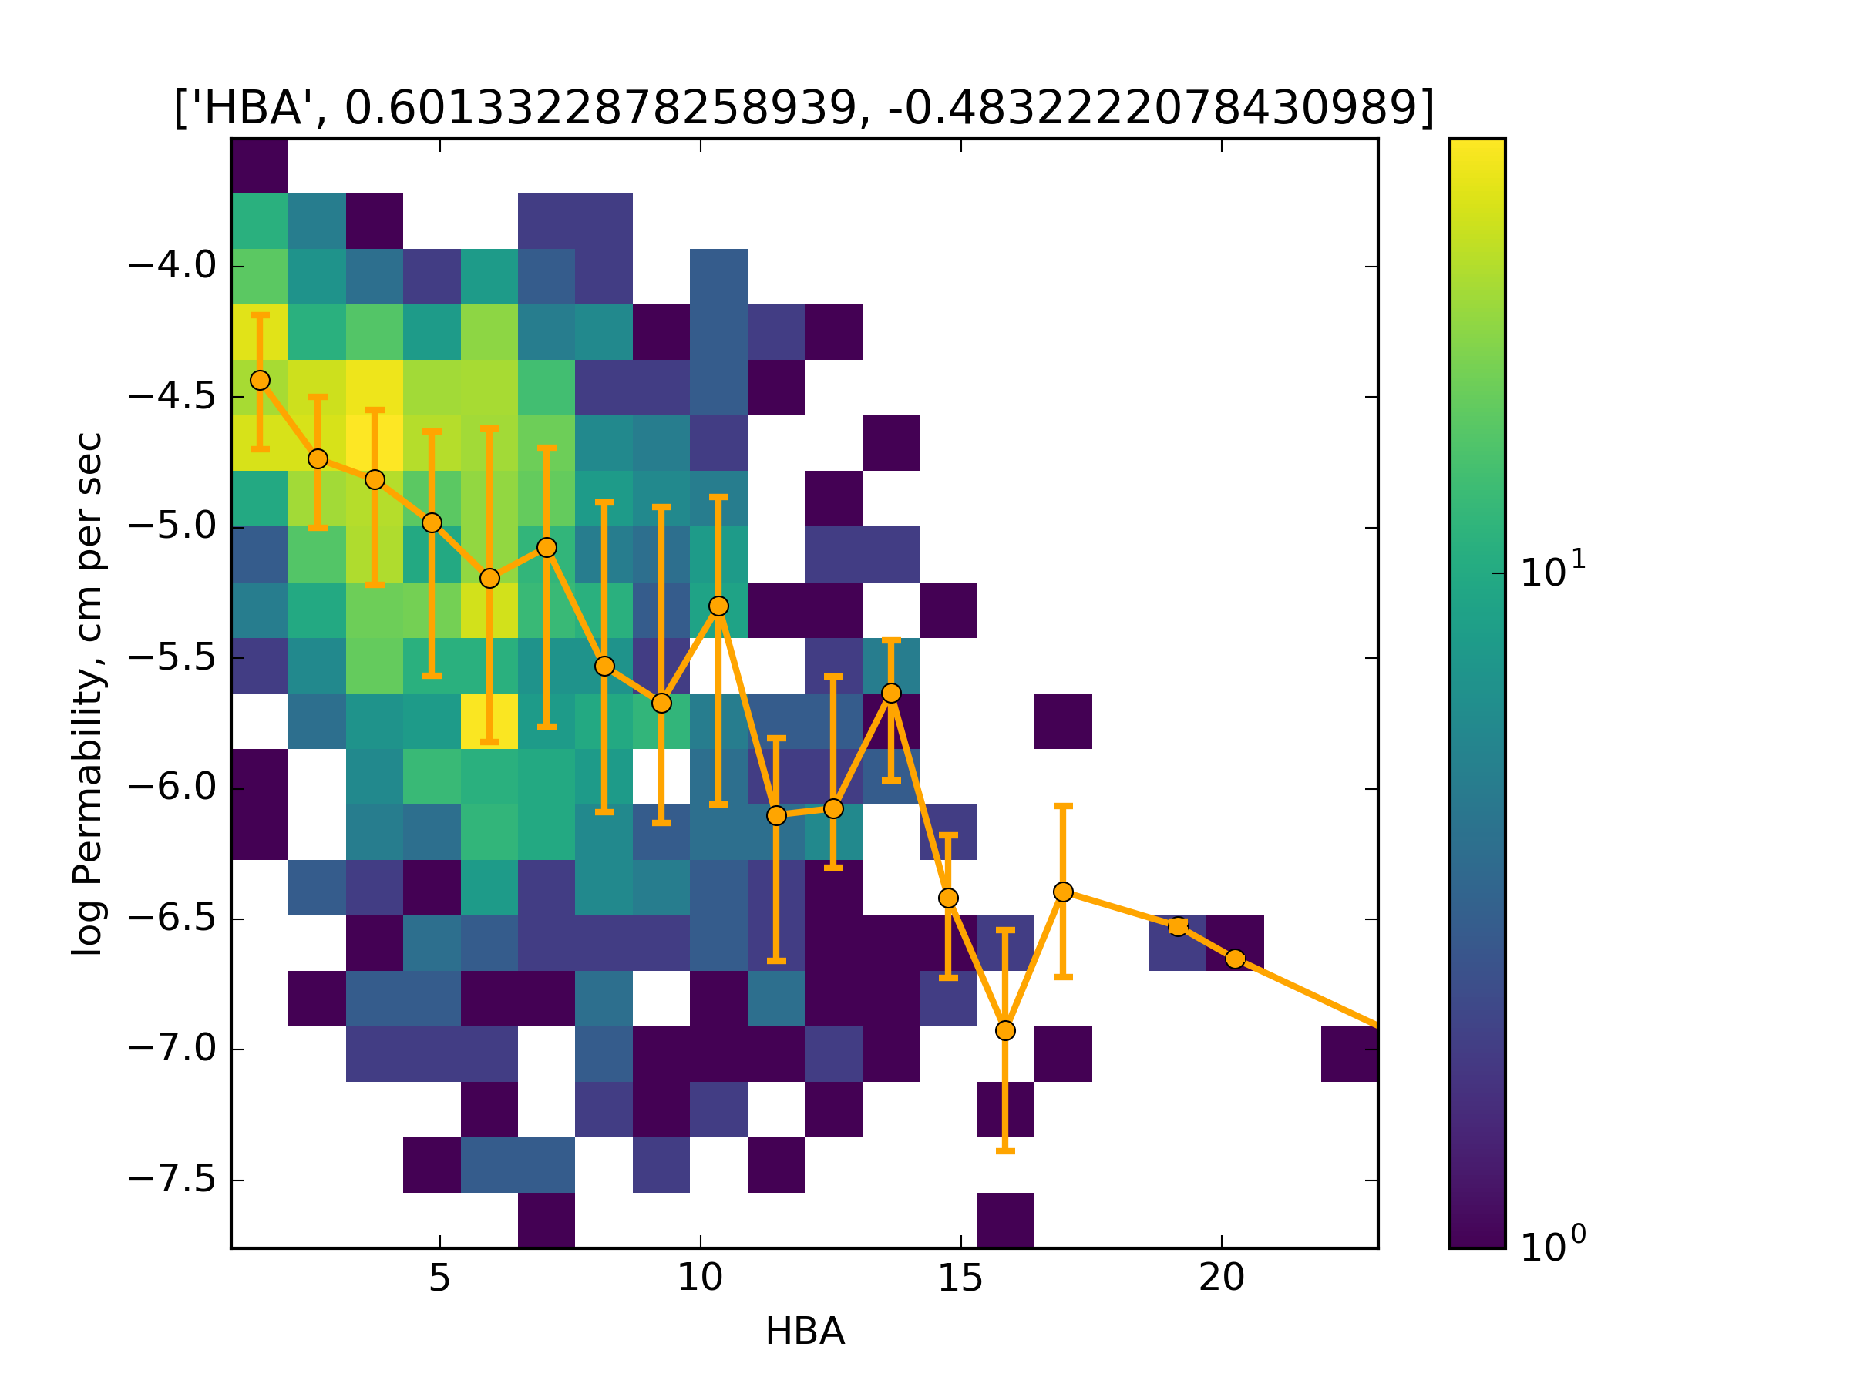
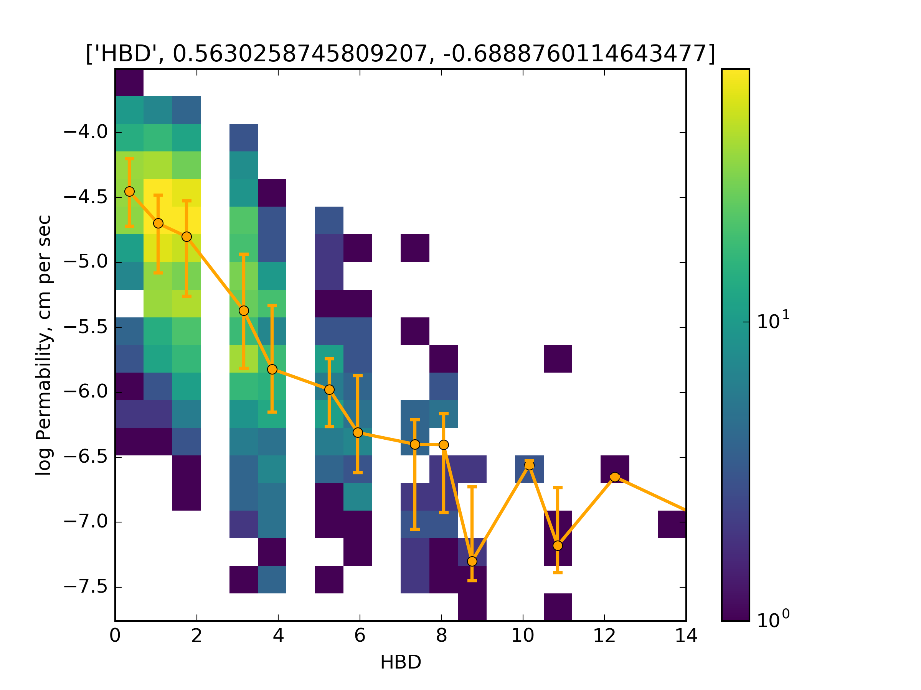
Important Features to predict cell permability
Most important single feature is
Num of Hydrogen Bond Donor (967)
Total Polar surface area (110)
SMR_VSA2 (97)
TPSA_norm(50)
Normalized HBD (46)
* importance given in brackets,
where they are the gain in the loss
function

Slide 5
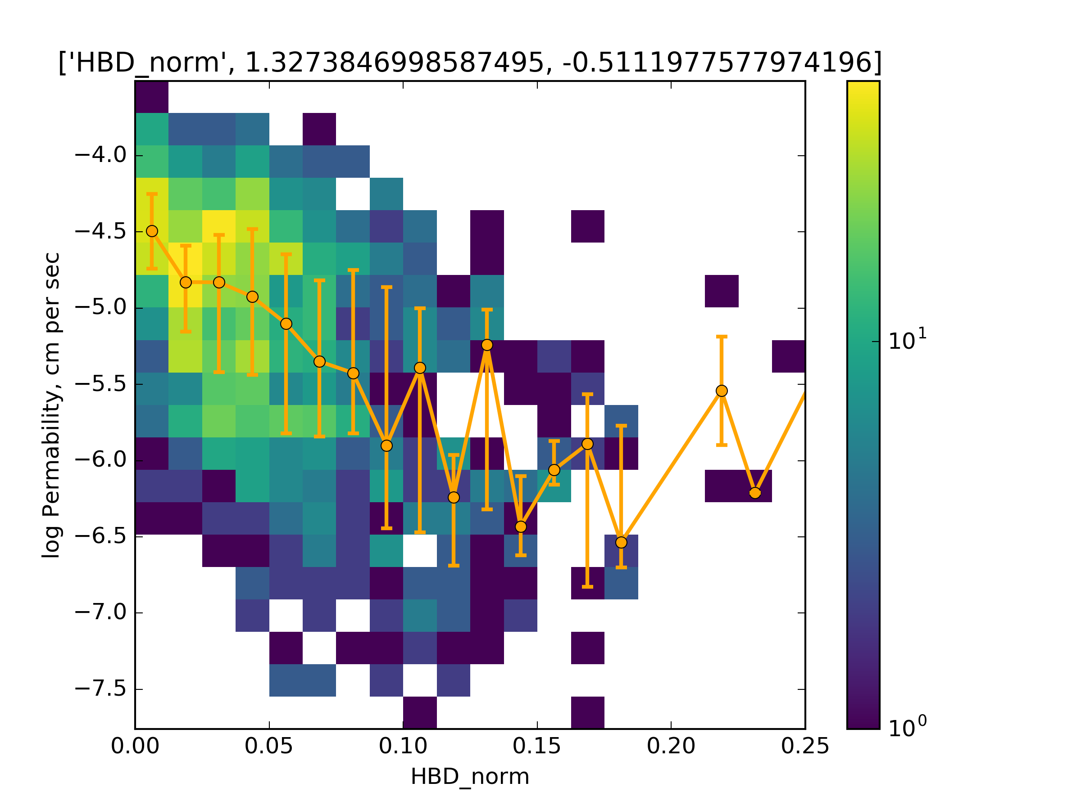
HBD 760
HDB(766) is strongly associated with permability, not HBA(4)

Slide 6
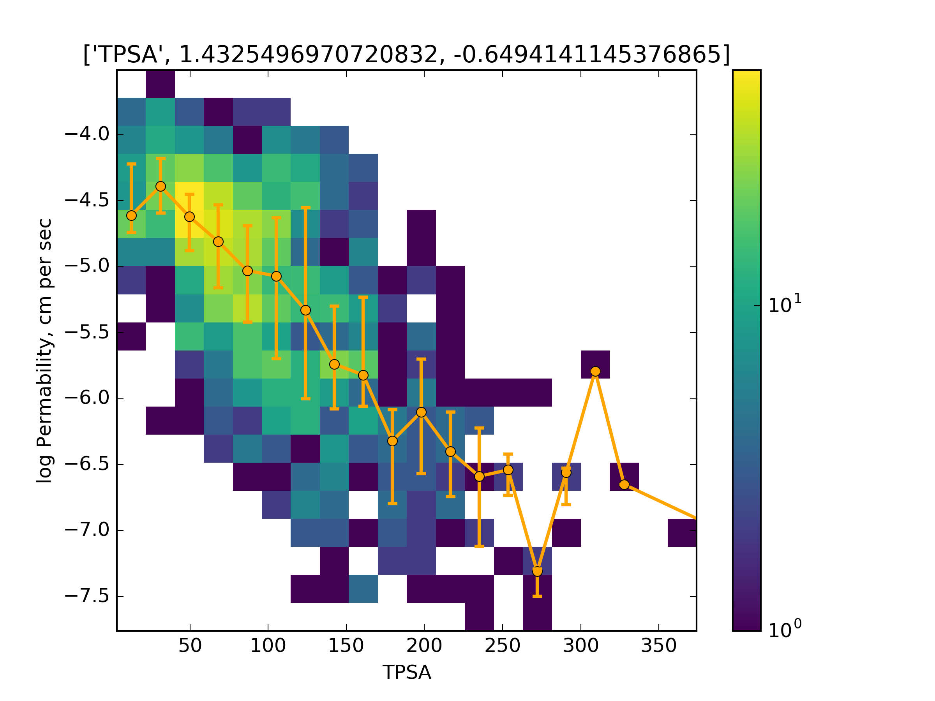
TPSA total polar surface area (110)

Slide 7
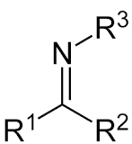
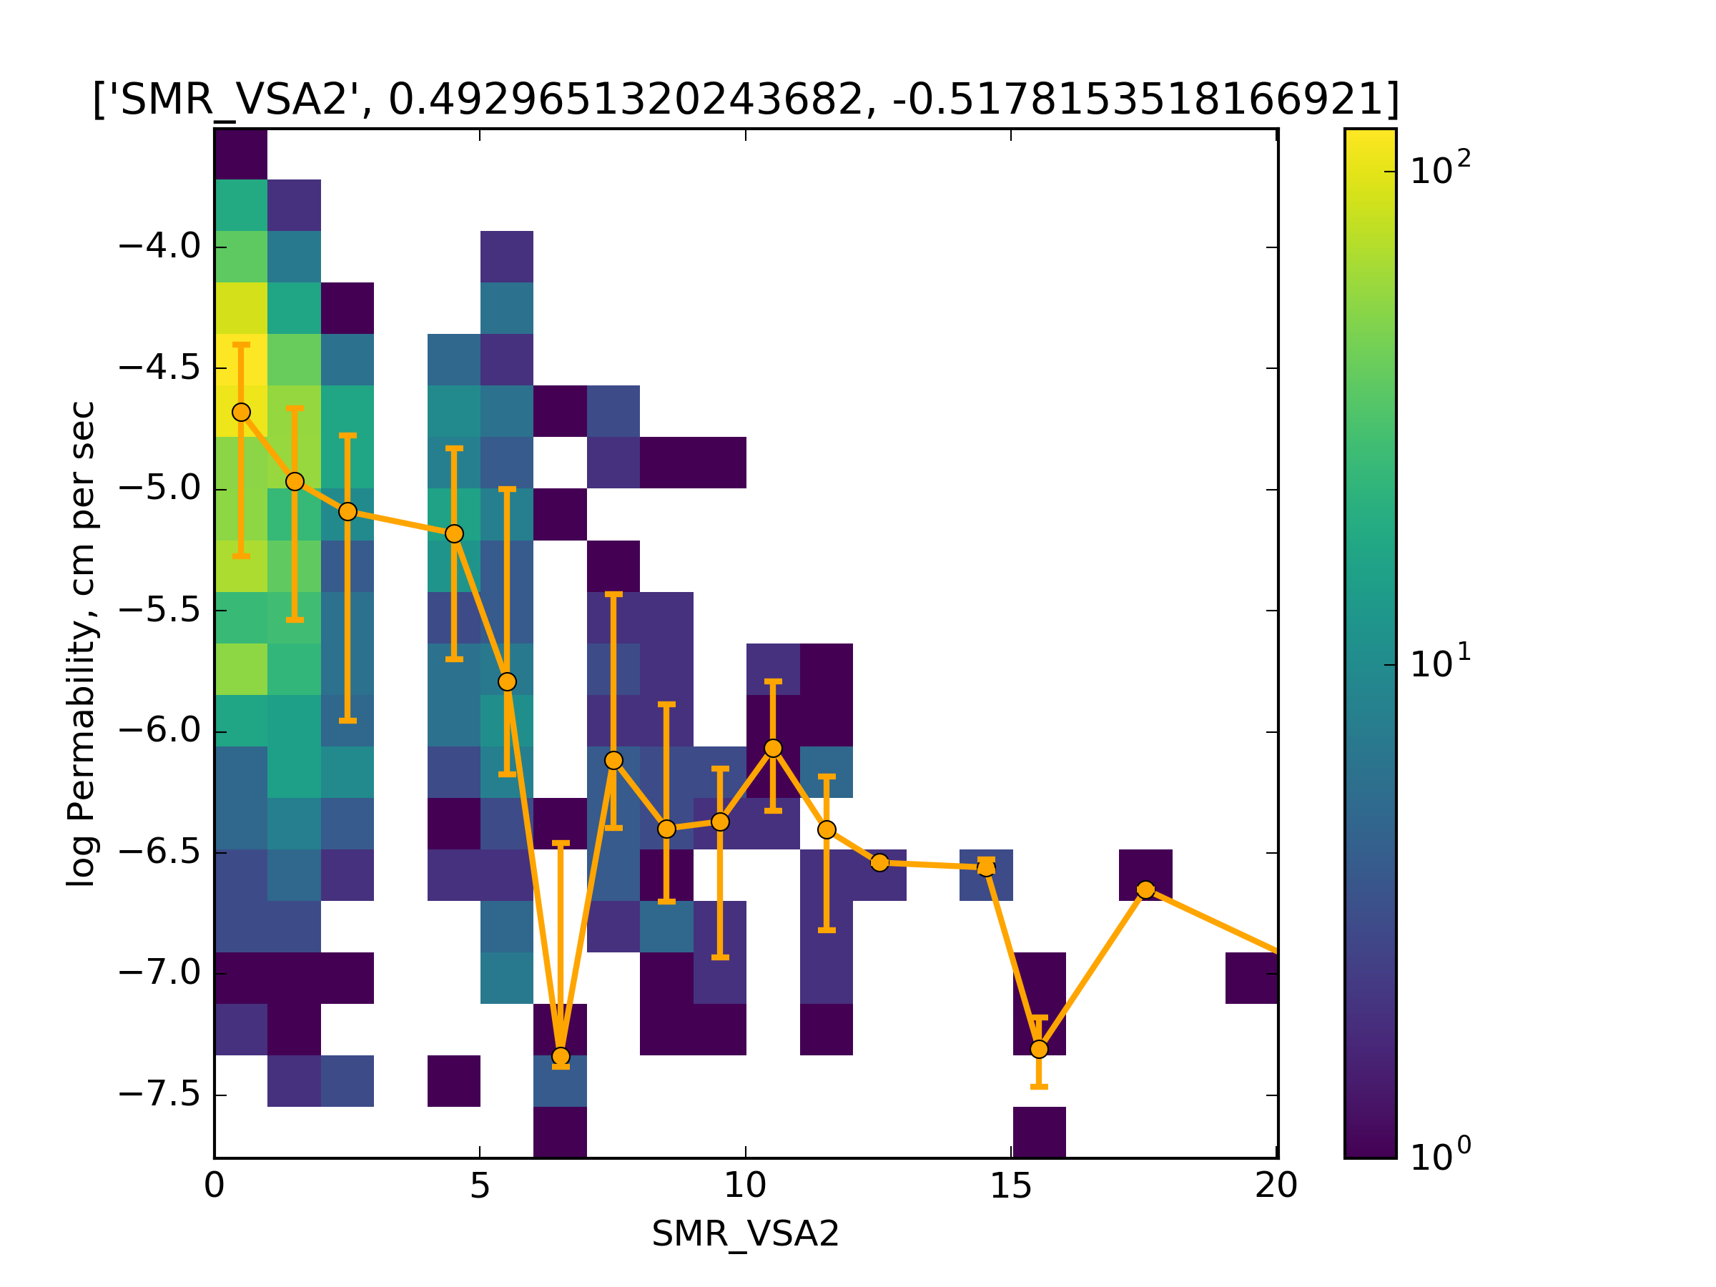
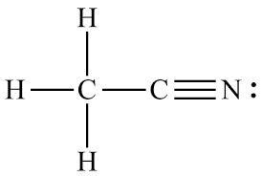
SMR_VSA2 (97)
Surface area occupied by alcohol, acid, imine, nitrile H .

Slide 8
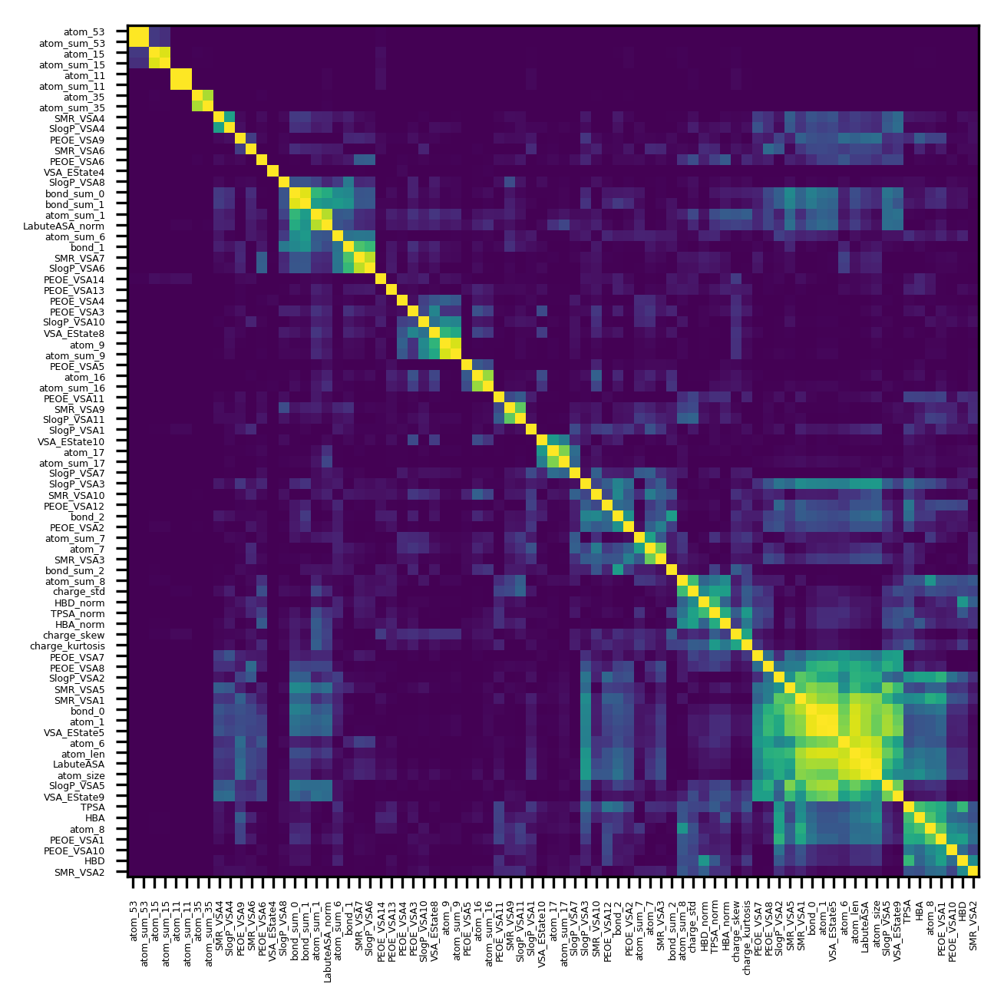
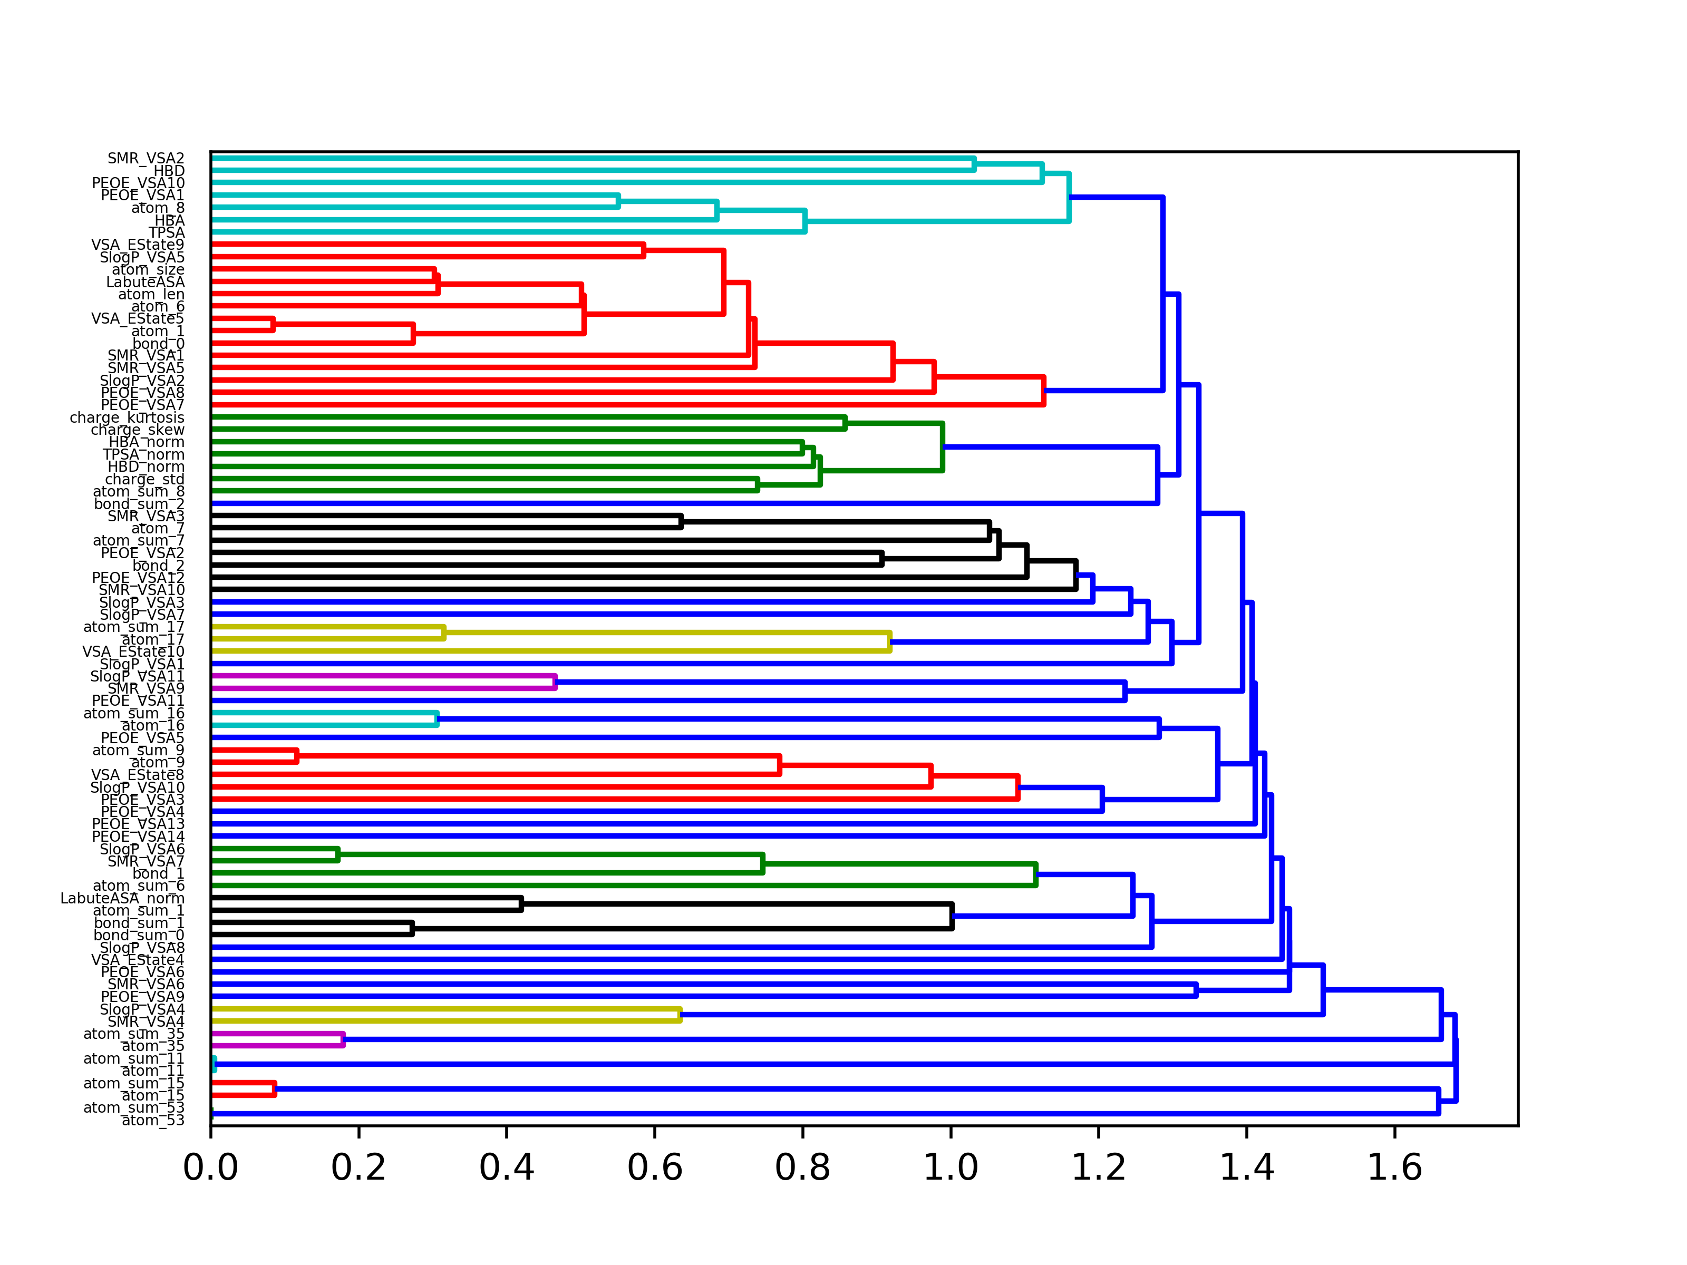
Features are generally correlated, and should be clustered

Slide 9
High level interpretation of features
['TPSA' 'HBA' 'atom_8' 'PEOE_VSA1' 'PEOE_VSA10' 'HBD' 'SMR_VSA2'] , Mean: 175 , Sum: 1229
['bond_sum_2' 'atom_sum_8' 'charge_std' 'HBD_norm' 'TPSA_norm' 'HBA_norm' 'charge_skew' 'charge_kurtosis'] , Mean: 26 , Sum: 210
['PEOE_VSA7' 'PEOE_VSA8' 'SlogP_VSA2' 'SMR_VSA5' 'SMR_VSA1' 'bond_0' 'atom_1' 'VSA_EState5' 'atom_6' 'atom_len' 'LabuteASA' 'atom_size' 'SlogP_VSA5' 'VSA_EState9'] , Mean: 13 , Sum: 194
['SlogP_VSA8' 'bond_sum_0' 'bond_sum_1' 'atom_sum_1' 'LabuteASA_norm' 'atom_sum_6' 'bond_1' 'SMR_VSA7' 'SlogP_VSA6'] , Mean: 12 , Sum: 110
['PEOE_VSA13'] , Mean: 34 , Sum: 34
['PEOE_VSA9'] , Mean: 25 , Sum: 25
['PEOE_VSA4' 'PEOE_VSA3' 'SlogP_VSA10' 'VSA_EState8' 'atom_9' 'atom_sum_9'] , Mean: 6 , Sum: 40

Slide 10
['bond_sum_0' 'bond_sum_1' 'atom_sum_1' 'LabuteASA_norm'] - Hydrophobicity
['atom_sum_6' 'bond_1' 'SMR_VSA7' 'SlogP_VSA6'] -
['PEOE_VSA4' 'PEOE_VSA3' 'SlogP_VSA10' 'VSA_EState8' 'atom_9' 'atom_sum_9']
['PEOE_VSA11' 'SMR_VSA9' 'SlogP_VSA11']
['VSA_EState10' 'atom_17' 'atom_sum_17']
['SlogP_VSA7' 'SlogP_VSA3' 'SMR_VSA10' 'PEOE_VSA12' 'bond_2' 'PEOE_VSA2'
'atom_sum_7' 'atom_7' 'SMR_VSA3']
['atom_sum_8' 'charge_std' 'HBD_norm' 'TPSA_norm' 'HBA_norm' 'charge_skew'
'charge_kurtosis']
['PEOE_VSA7' 'PEOE_VSA8' 'SlogP_VSA2' 'SMR_VSA5' 'SMR_VSA1' 'bond_0'
'atom_1' 'VSA_EState5' 'atom_6' 'atom_len' 'LabuteASA' 'atom_size'
'SlogP_VSA5' 'VSA_EState9']
['TPSA' 'HBA' 'atom_8' 'PEOE_VSA1' 'PEOE_VSA10' 'HBD' 'SMR_VSA2']

