Slide 1
Lee Xiong An
Holmusk Take home Test
15-22 Dec 2021

Slide 2
Problem Statement
Compare the real world efficacy of Drug A vs Drug B using survival analysis
Take into account confounding factors affect treatment as data is EHR and imbalanced
Notes:
The goal of the specific task is to compare the real-world efficacy of the two drugs by comparing the risk of events using a method like survival analysis. Do keep in mind that as this data comes from EHR and not a clinical trial, the two groups may not have balanced patient characteristics which may confound the results of your analysis. You may also have to think about how you would measure and reduce the impact of this confounding in your analysis approach.

Slide 3
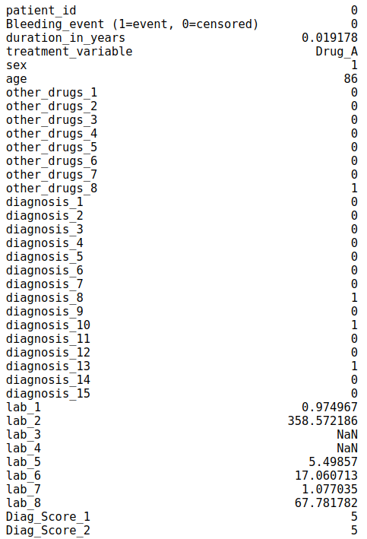
Dataset
Patient_characteristics.csv – contains the information about socio-demographics of patients, diagnosis, lab values, and other existing therapies patients are on
Event_duration.csv – Contains information about if the event happened to a patient or if patient was censored and the durations for each case from the start of therapy

Slide 4
Approach for Problem
Method to detect confounding using decision tree
Obtaining balanced dataset using (I)
Validating that balanced dataset has reduced confounding
Compare efficiency of Drug A & B using univariate KM on balanced dataset
Limitations of method

Slide 5
Confounding factors 101 (for the unfamiliar)
For EHR data, results may be confounded unlike that of a clinical trial where everything is controlled and balanced
If sicker patients were given treatment with drug A, drug A would be associated with poorer outcomes and vice versa
  Drug A is confounded with “sick”, hence analysis is likely invalid
A remedy is to rebalance the dataset such that both drugs have similar profiles of people

Slide 6
Method to Detecting confounding
What is a balanced dataset with respect to drug type?
  A balanced dataset would have drug type indistinguishable
Building a machine learning model with patient profile and predict drug type administered
  If confounding is strong, the model will predict drug type well
  If confounding is small, the model will predict poorly, I.e. patient profile not associated with drug type
  Model evaluated by ROC AUC

Slide 7
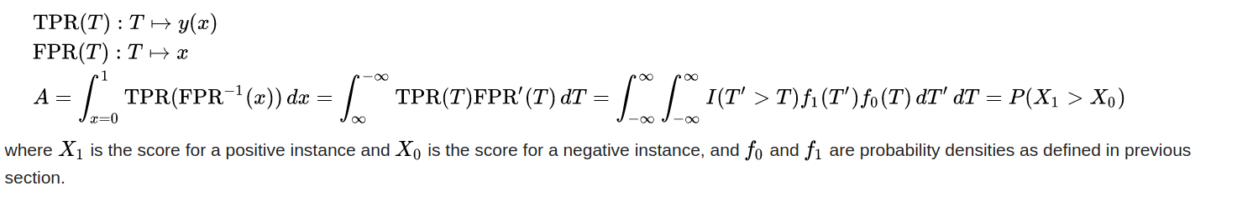
ROC AUC (for unfamiliar)
ROC AUC is a simple metric that is easy to understand, P(X₁ > X₀)^{proof below}
0.5 means model is random, 1 mean model is perfect, 0 means model is perfectly wrong

Slide 8
Results : Confounding Model
DecisionTreeClassifier model used, maximum_ depth = 6 and min samples in final nodes = 15
  Decision Tree is simpl model to split population into subgroups
  Explanatory variable : patient characteristic
  Dependent Variable : Drug Type
  10 fold CV used
  ROC AUC = 0.79
Data is definitely confounded
  Even the presence of null values give RO AUC 0.65

Slide 9
Obtaining balanced dataset
Subsample patients based decision tree predicting drug type

Slide 10
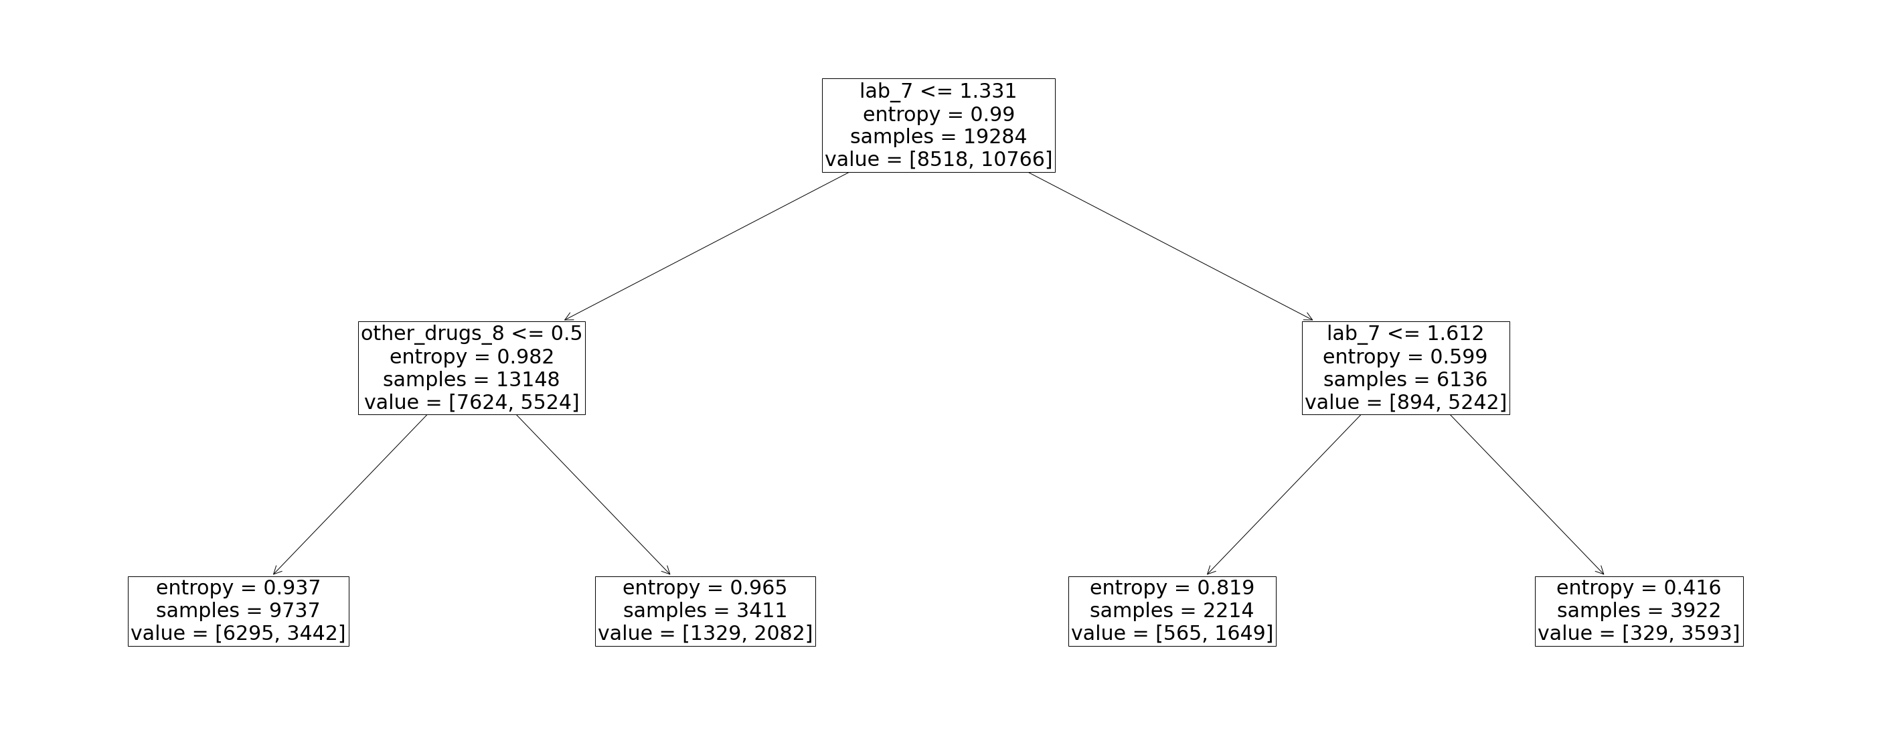
Obtaining balanced dataset
Subsample patients based decision tree predicting drug type from patient features
Subsample balanced dataset from terminal node of decision tree

Slide 11
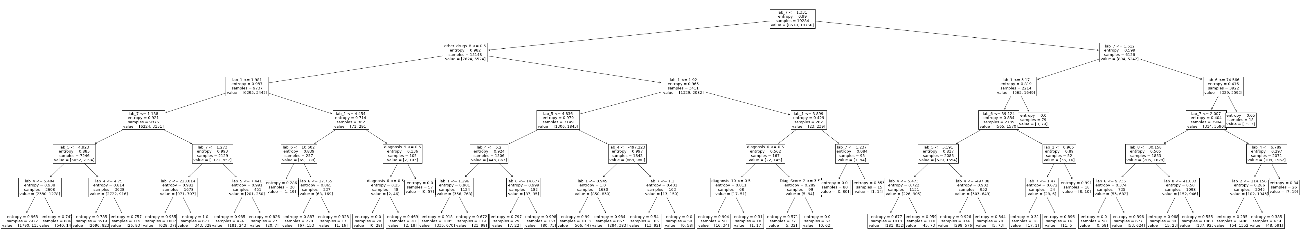
Tree generating balanced dataset
DecisionTreeClassifier model used, maximum_ depth = 6 and min samples in final nodes = 15
  10 fold CV ROC AUC = 0.79
This tree is generated with 100% of data

Slide 12
Characteristics of balanced dataset
Decision tree has profiled patients into 44 nodes of which 37 nodes have both patients with drug A and B
  These 37 nodes make up 98% of the dataset
  The other 7 nodes only have treatment=Drug B and dropped from balanced dataset
A balanced dataset of 10K (53%) is sampled from these patients

Slide 13
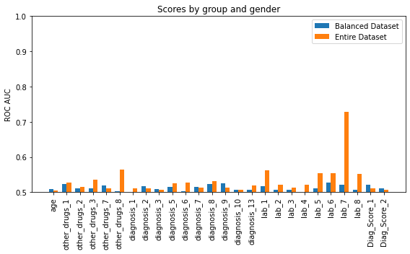
Metrics for Balanced Dataset
Trained univariate decision tree with depth=3, min_leaf=30
  Explanatory variable: X axis
  Target variable: Drug A/B
  10 fold ROC AUC Score plotted
Balanced dataset cannot be predicted by patient characteristics
  Even using all patient information, model performs 0.55 ROC AUC

Slide 14
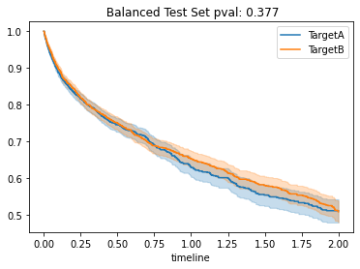
Compare Real World Efficacy of Drug A vs B
Used a Log Rank test to compare efficacy
Dataset is balanced hence test results hold for populations similar to the balanced dataset
Plot shows KM curve and pval for Log Rank test

Slide 15
Limitations
The balanced dataset may not be a true representative of the main population
  Reweighing could be done to account for that
Our balancing method removes the strongest confounders, there are also many weak confounders not accounted for
  Drug type can still be predicted from patient characteristics in balanced dataset at ROC AUC = 0.55

Slide 16
Approach
Method to detect confounding using decision tree
Obtaining balanced dataset using (I)
Validating that balanced dataset has reduced confounding
Compare efficiency of Drug A & B using univariate KM on balanced dataset
Limitations of method

