Slide 1
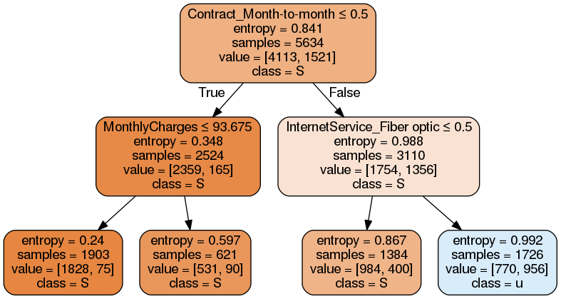
Interpreting the data,
Low entropy = node is homogenous
Contract == Month to month
Contract != Month to month
Contract == Month to month
AND
Month charges < 93.675
Contract == Month to month
AND
Month charges > 93.675
Contract != Month to month
AND
InternetSvc == Fiber Optic
Contract != Month to month
AND
InternetSvc != Fiber Optic

Slide 2
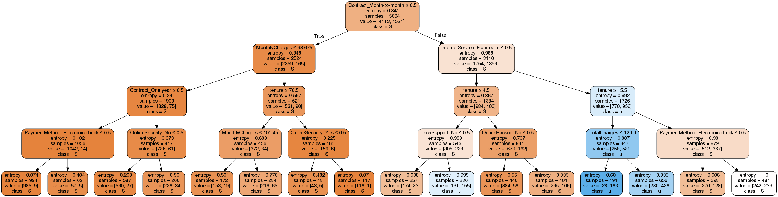

Slide 3
Segments with minimal churn
1-2year plans have 165/(165+2359) churn rate = 6.5%
How to convert month-month to subscription plans
Question – do subscription plan customers generate more revenue

Slide 4
Segments with highest churn
Month-to-month contract
Fiber optic
Tenure < 15.5
Churn rate is 589/(258+589) = 75%
Contributes to 956/1521 of churned customers
True

Slide 5
Segment : With vs without techsupport
Not month-to-month (1-2yr)
Not Fiber optic (DSL)
Tenure < 4.5
Without techsupport==0:
83/(257) = 0.32 churn
Without techsupport==1:
155/286 == 0.54 churn

