Slide 1

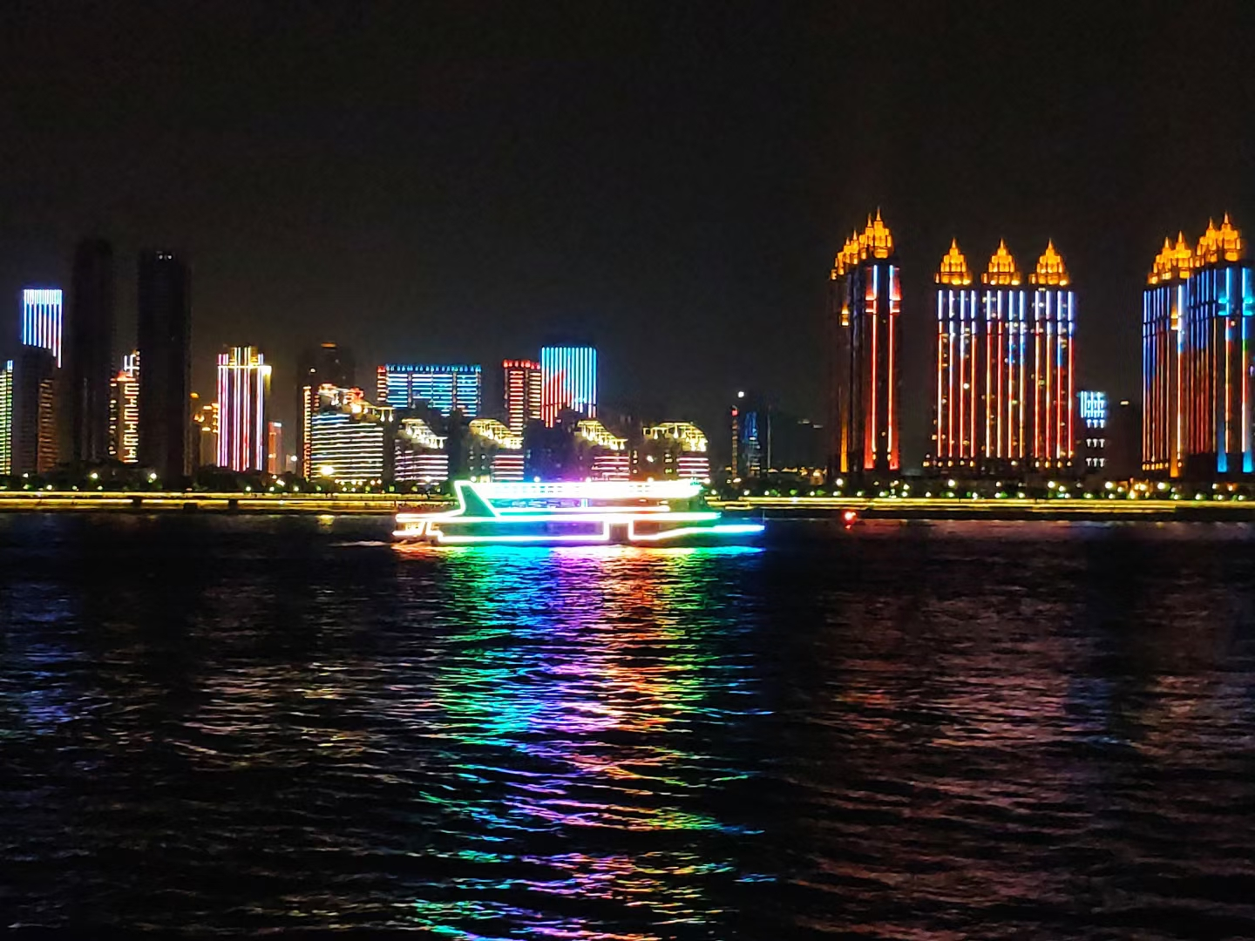
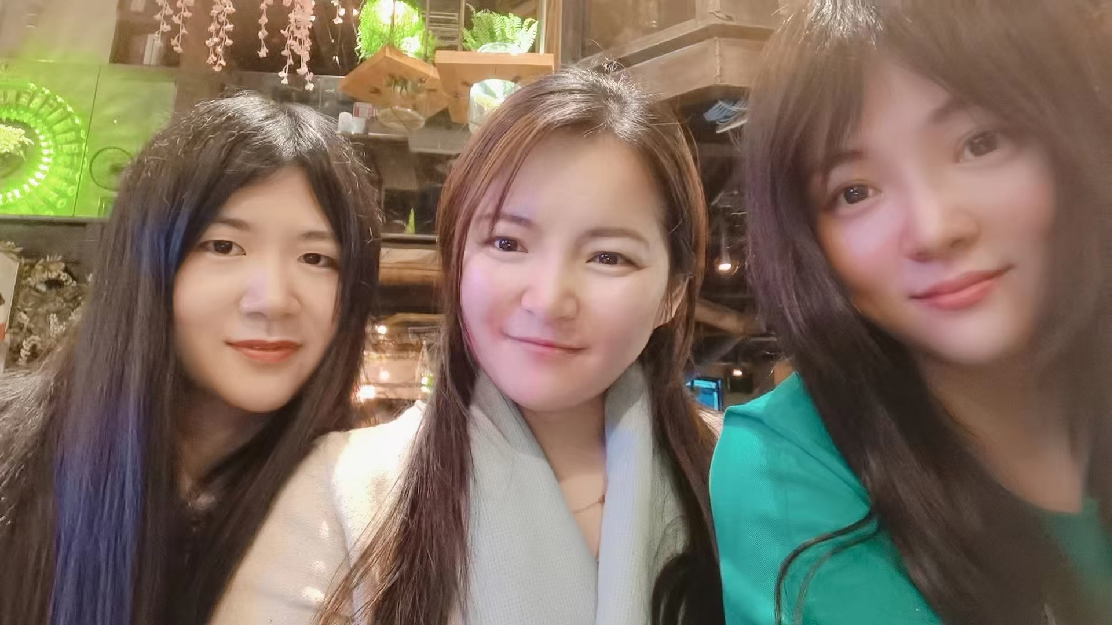
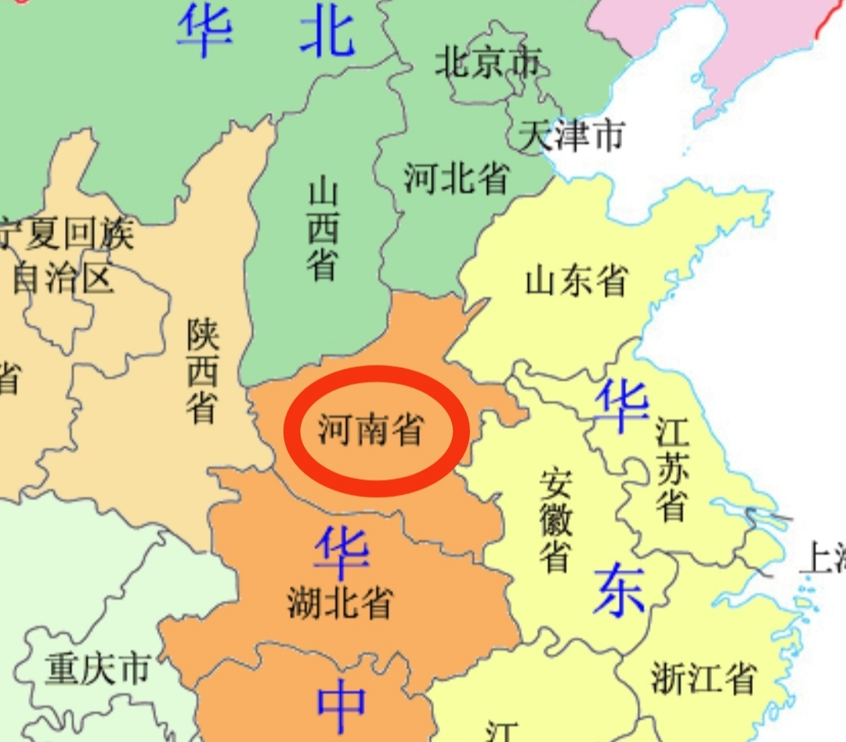

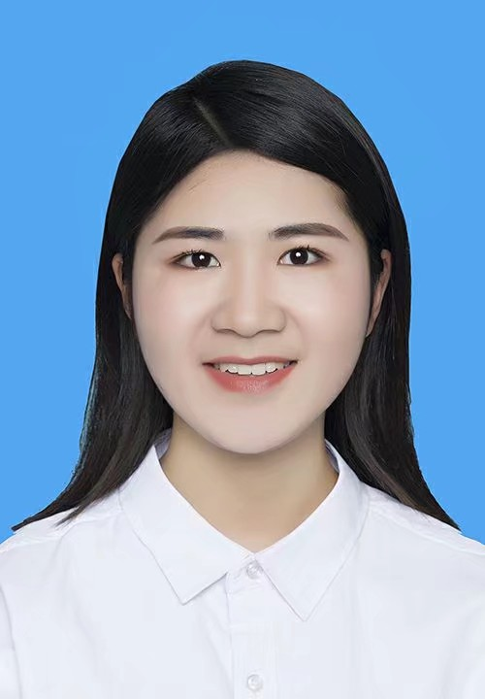
Congfang Zhang - Associate Programmer Analysist
My Hobbies:
Traveling
Running
Cooking
Born and Educated in Henan China
My roommates in Beijing
My Personal Strengths:
Caring
Responsible
Optimistic
Bachelor of Pharmacy in Xinxiang Medical University
The most wonderful thing:
Eating foods cooked by myself

