Slide 1


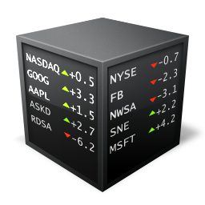

1
2
3
Beginner
Intermediate
Advanced
By learning the statistics behind data science workflows, you know how to reduce market information into individual parts for analysis.
After repeated analyses, you start to achieve some continuity of market research. You can replicate existing strategies at your own rhythm.
Research, strategy, and execution are ingrained in your mind, leaving the brain to its creative powers of tool and knowledge innovation.

Slide 2




1
2
3
Beginner
Intermediate
Advanced
By learning the statistics behind data science workflows, you know how to reduce market information into individual parts for analysis.
After repeated analyses, you start to achieve some continuity of market research. You can replicate existing strategies at your own rhythm.
Research, strategy, and execution are ingrained in your mind, leaving the brain to its creative powers of tool and knowledge innovation.

Slide 3
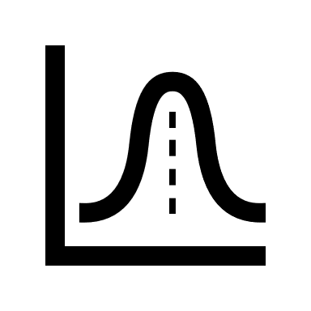



1
2
3
Beginner
Intermediate
Advanced
Learn the basics of the data science workflow and how to extract valuable insights from market data.
Combine data visualization, statistical learning, and trading personality to build effective market analysis tools.
Probe into advanced financial data research and understand the science behind wealth generation.

