Slide 1
New rectal cancer classification by NMF method
student. Yongmin LEE
College of Medicine,
Yonsei Univ.

Slide 2
Sample description
TCGA-READ (Rectal adenocarcinoma) Cohort.
HTSeq-FPKM-UQ (n=177)
downloaded from: https://xenabrowser.net/datapages/?cohort=GDC%20TCGA%20Rectal%20Cancer%20(READ)&removeHub=https%3A%2F%2Fxena.treehouse.gi.ucsc.edu%3A443

Slide 3
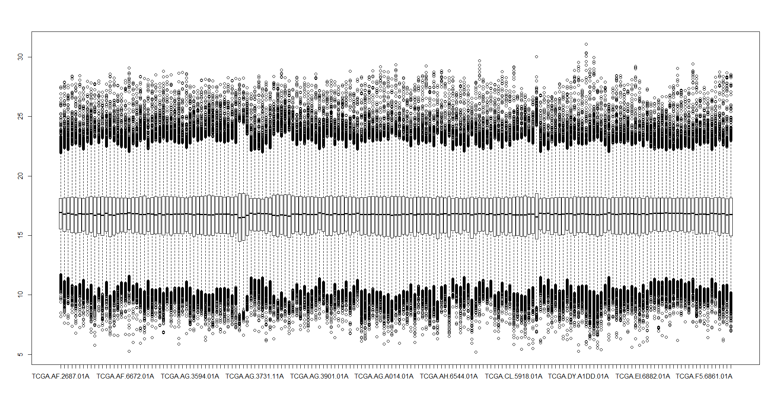

Slide 4
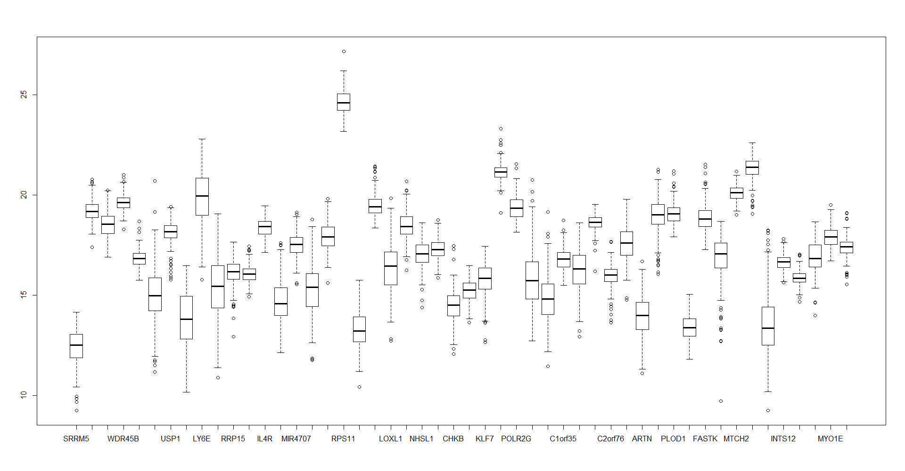
50 genes were chosen randomly.

Slide 5
Workflow
TCGA data
TCGA-READ cohort, n=177
NMF
Find optimal rank
PAM
Identify cluster identifying gene sets
Find metagenes
from UCSC Xena, originally from TCGA data-hub
Validation: NTP
Perform NTP with novel gene sets and Korean rectal cancer data
Survival analysis
Select significant genes

Slide 6
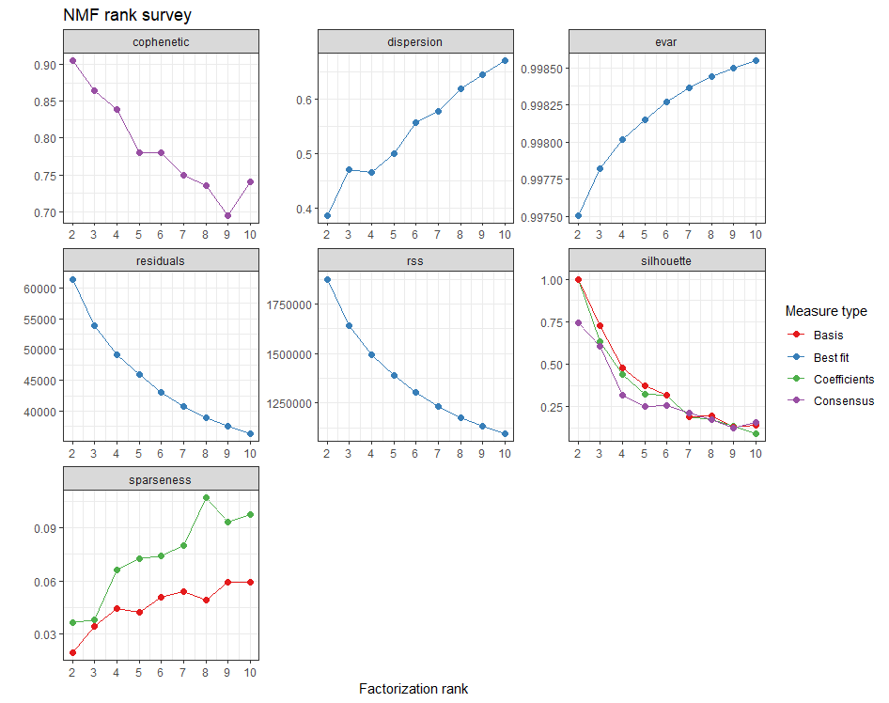
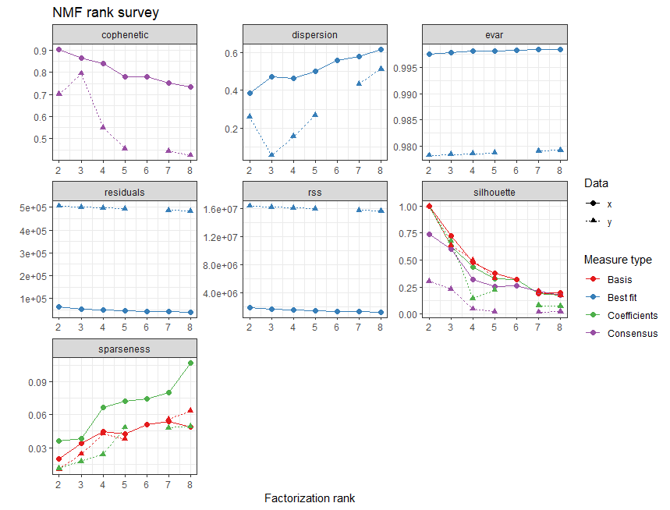
Finding NMF clustering rank
estim.rank <- nmf(expression.data, 2:6, nrun=50, seed=2019)

Slide 7
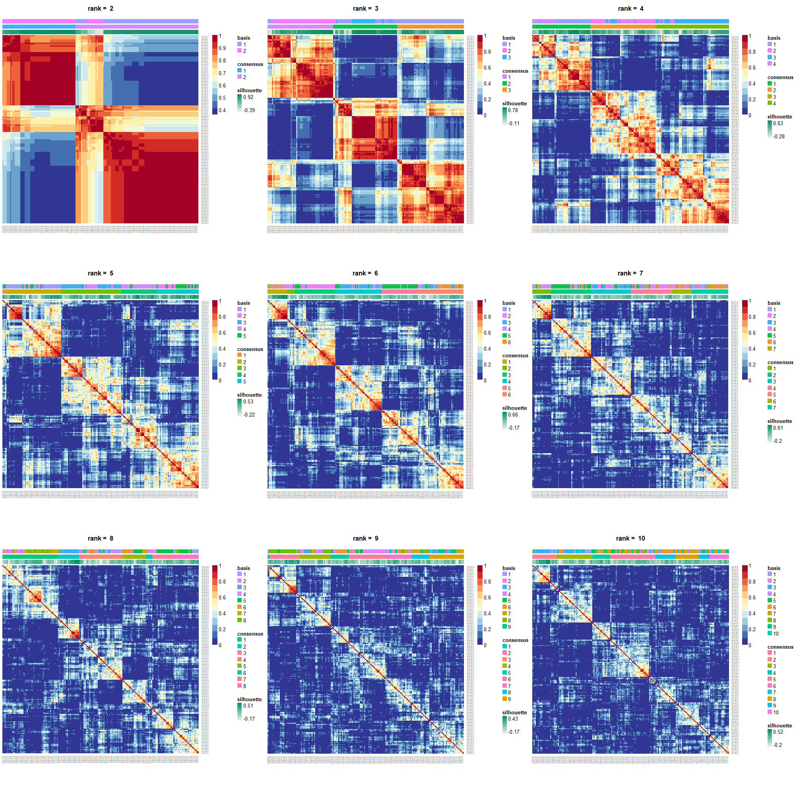

Slide 8
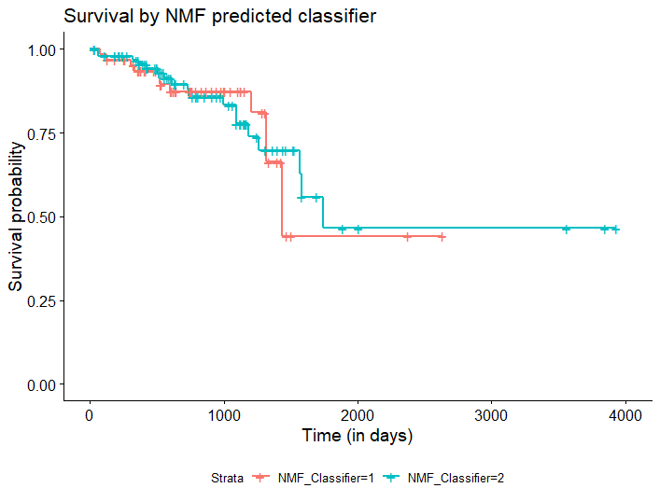
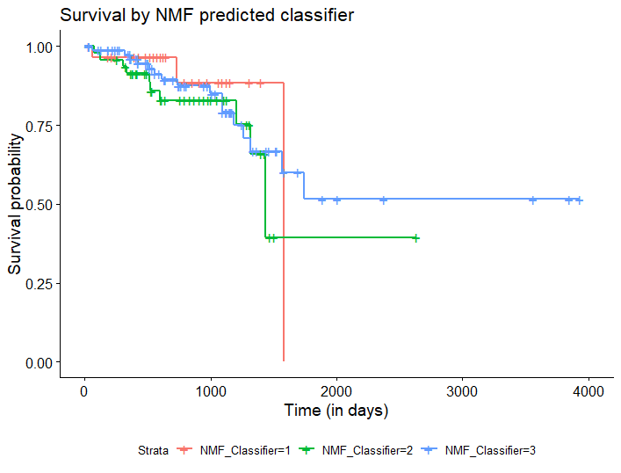
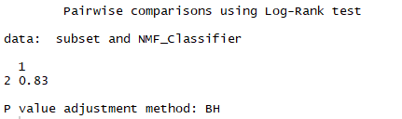
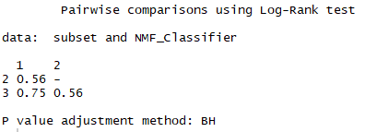
Rank = 2
Rank = 3
Not Significant!
Not Significant!

Slide 9
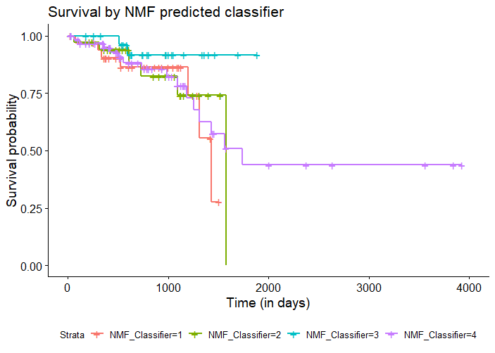
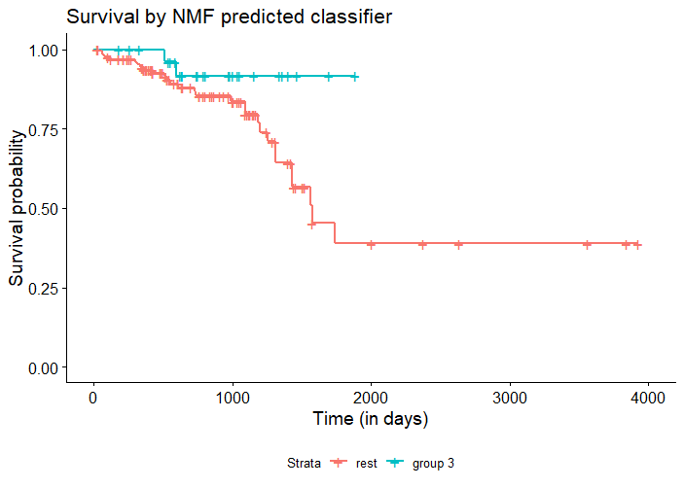
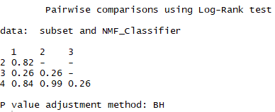
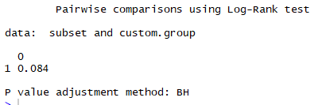
Rank = 4
Classifier 3 versus rest

Slide 10
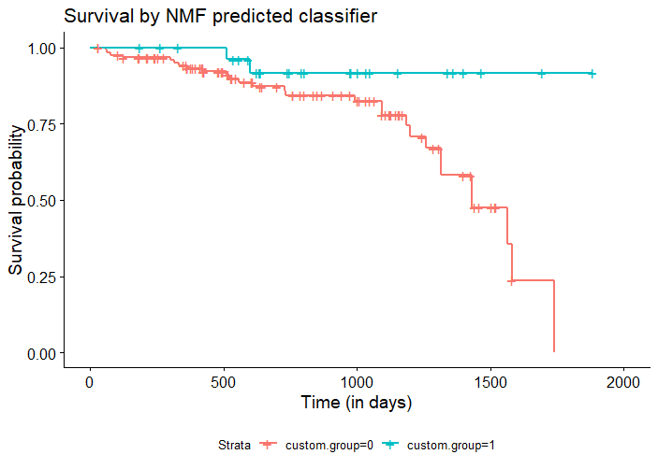
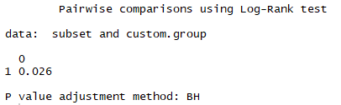
Rank = 4

Slide 11
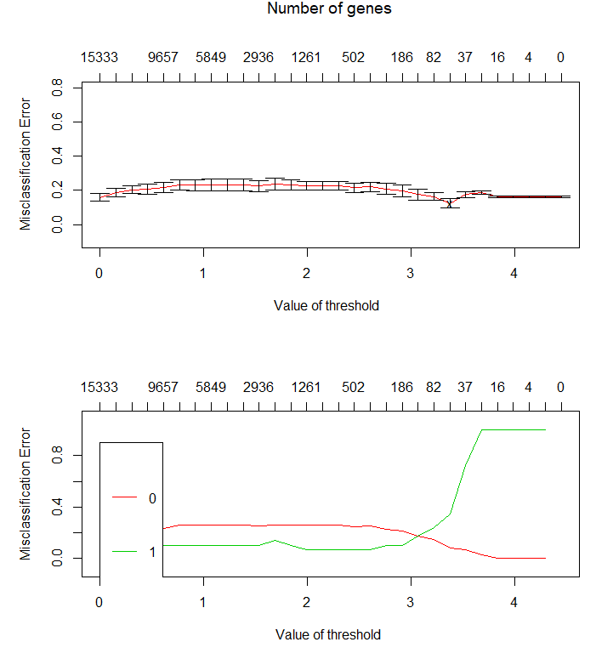
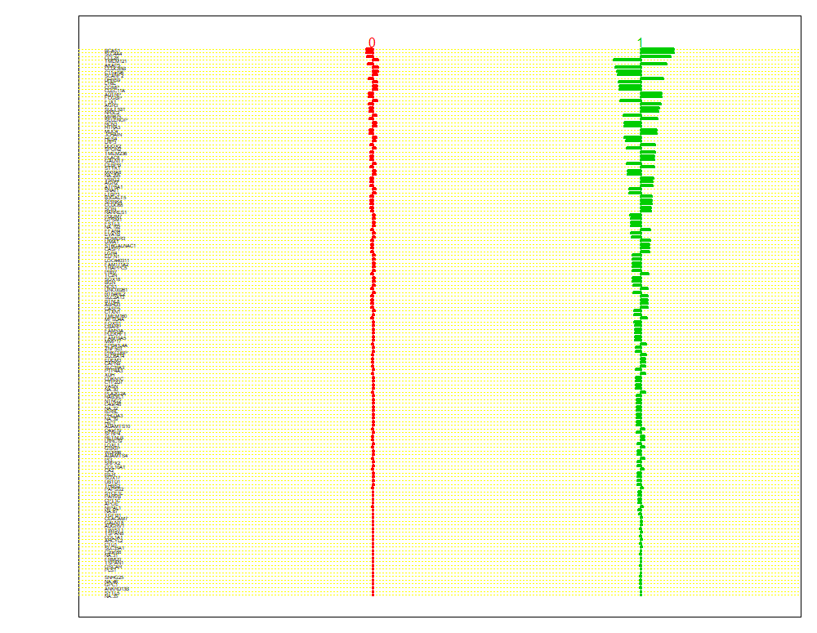
Rank = 4

Slide 12
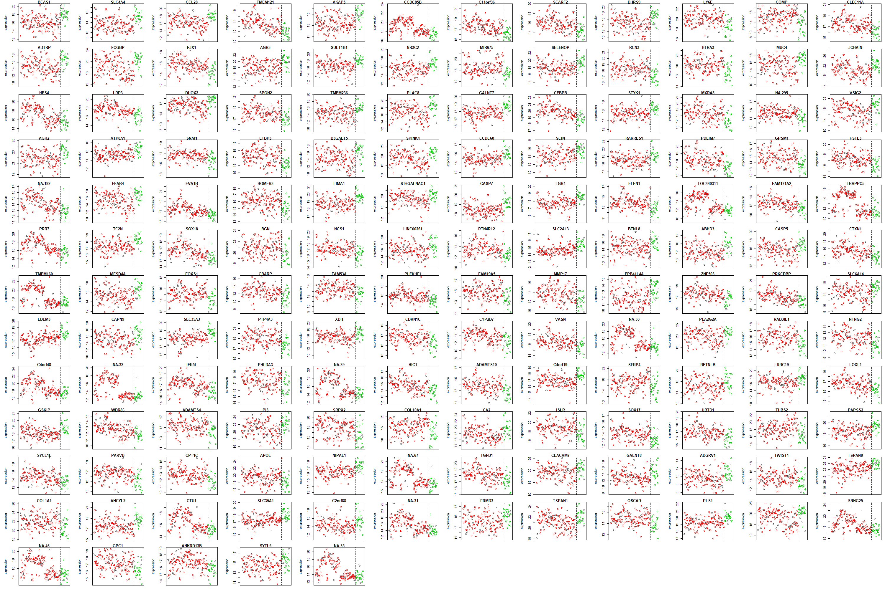
Rank = 4

Slide 13
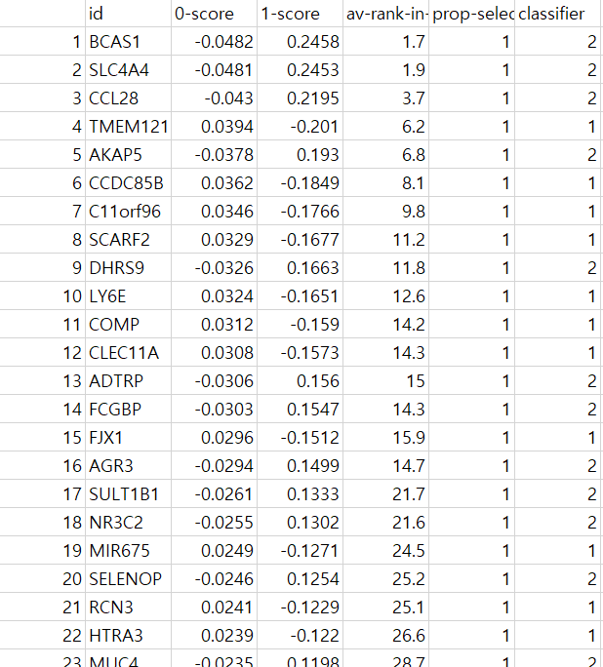
Rank = 4

Slide 14
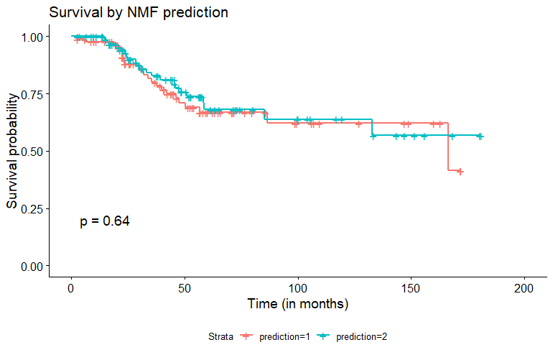

Validation with Korean rectal cancer data
Rank = 4

Slide 15
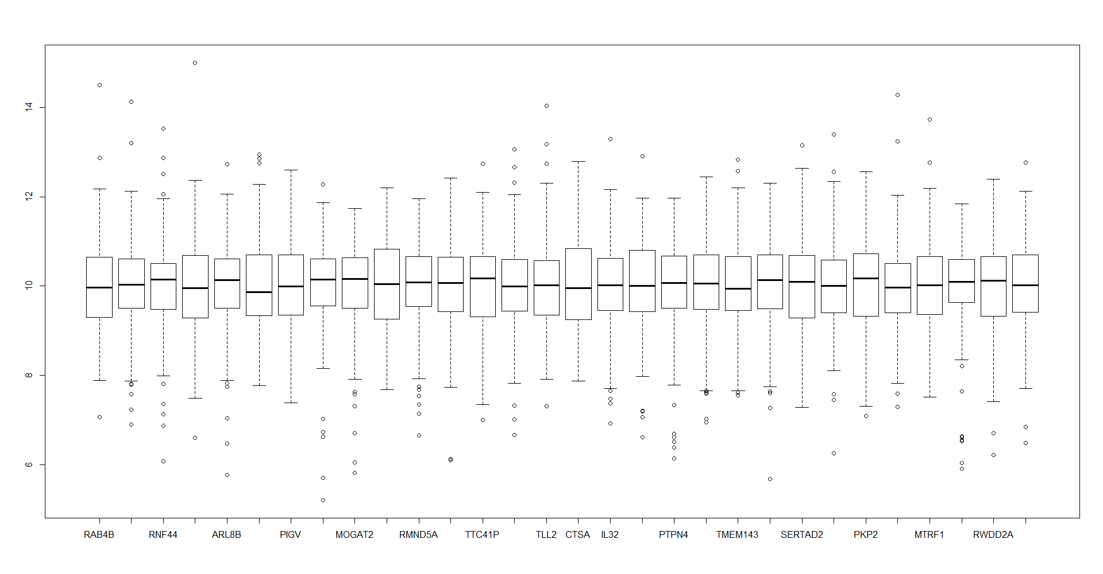
When gene expression is normalized

Slide 16
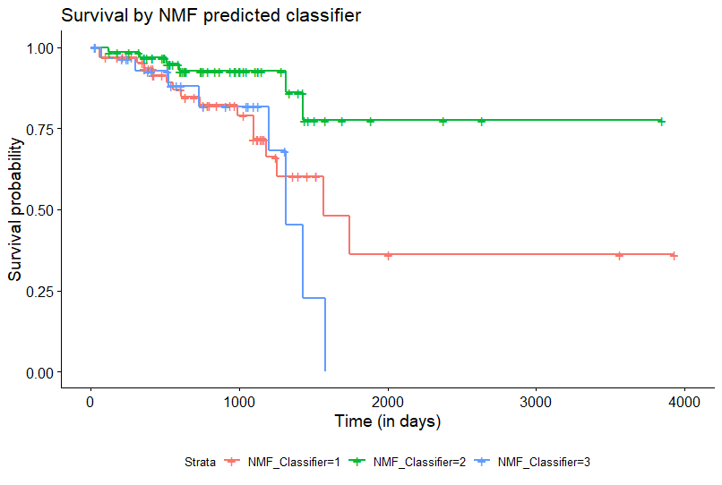
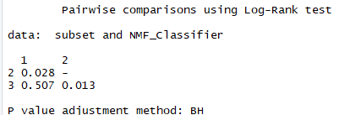

Slide 17
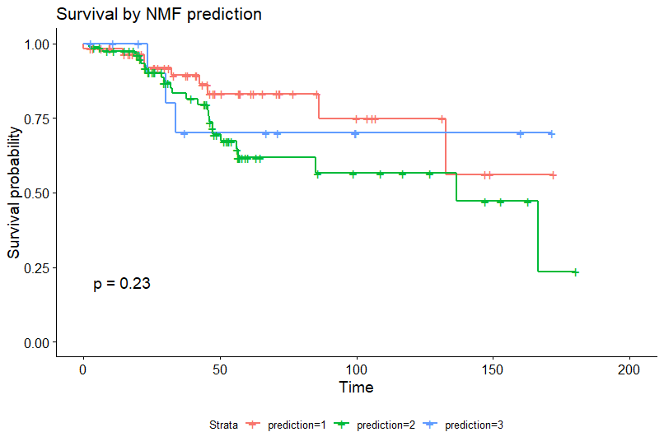
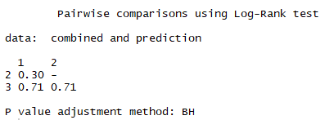
Validation - Failed

