Slide 1
1_1setting_dataset.R
1_2_data_property_analysis.R
TCGA-READ-HTSEQ-COUNT
TCGA-READ-HTSEQ-FPKM-UQ
8_DESeq2_for_count_data.R
NMF
2_Find_NMF_rank.R
3_perform_NMF.R
DeSeq2
Membership
8_DESeq2_for_count_data.R
Normalized Count
DEG
NMF
GSEA
9_DESeq2_norm_count_to_NMF.R
10_GSEA_analysis.R
3_find_genesets.R
Validation with Yonsei data
6_class_by_using_CMScaller.R
7_survival_validation.R
7_1_pCR_validation.R
Notes:
Flowchart of data analysis.

Slide 2
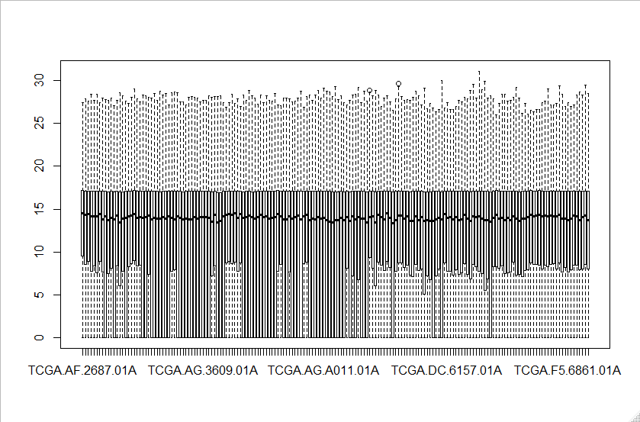
TCGA-READ.htseq_fpkm-uq
Notes:
Data property of TCGA-READ.htseq_fpkm-uq. The data is upper-quantile normalized. Any 0 values are treated as 0.001

Slide 3
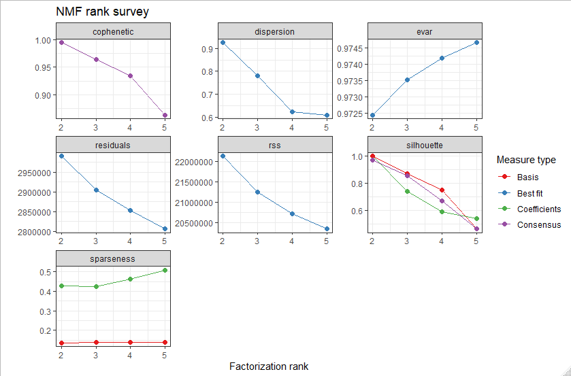
NMF Rank estimation
Notes:
NMF rank estimation with TCGA-READ.htseq_fpkm-uq data.

Slide 4
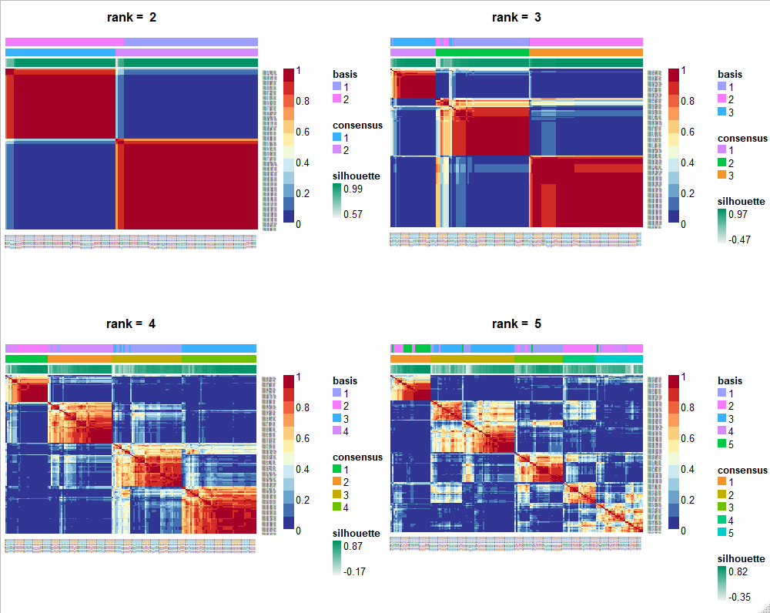
NMF Rank estimation
Notes:
Consensus map of NMF rank estimation.

Slide 5
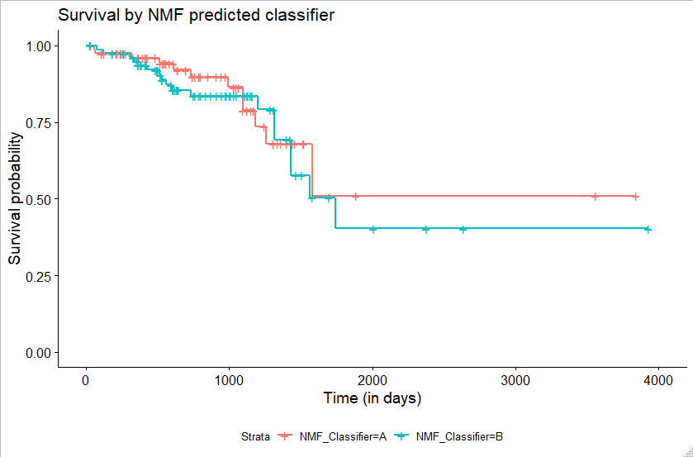
Survival by NMF – TCGA-READ data
P=0.56
Notes:
Survival difference by NMF-predicted classifier. (p=0.56)

Slide 6
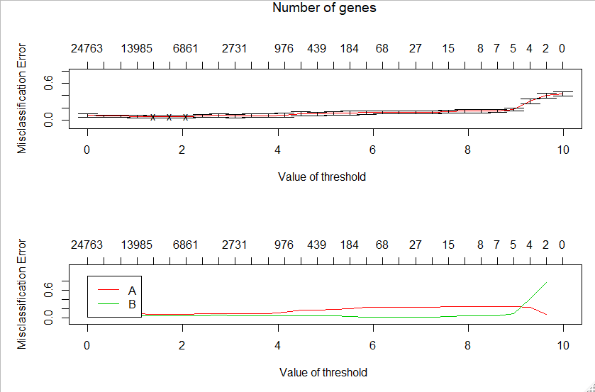
PAMR
Threshold = 4.4로 결정.
Notes:
PAM cross-validation error curves. We set threshold as 4.4, considering misclassification error and number of genes needed for classification

Slide 7
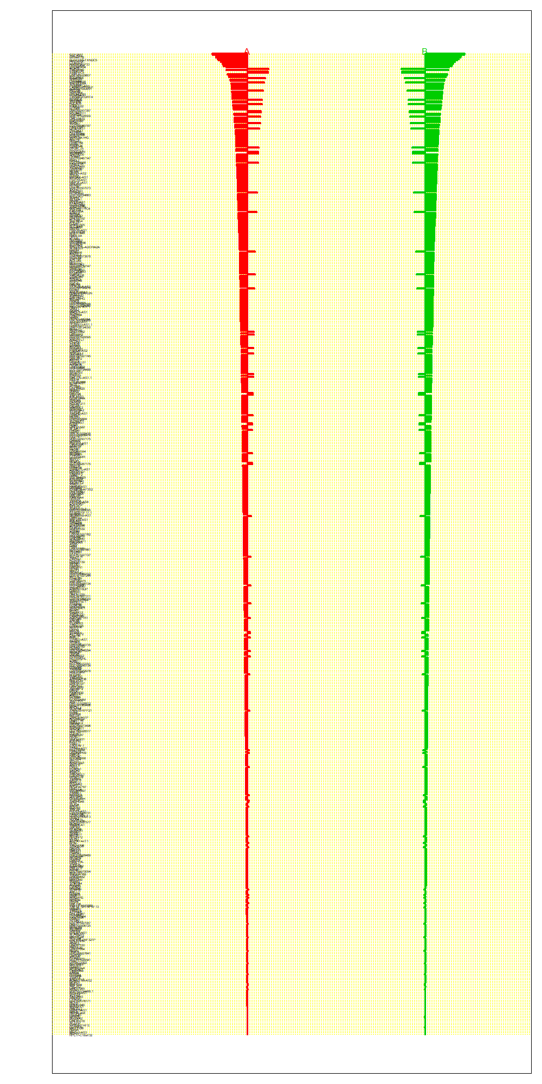
Centroid plot
Gene sets… (Only a part is shown, total 698 genes)
1 | GTF2IP1 | 2
2 | TBC1D3L | 2
3 | MIR4477B | 2
4 | BLOC1S5-TXNDC5 | 2
5 | HIST2H3C | 2
6 | CTAGE8 | 2
7 | HNRNPA1P33 | 2
8 | GOLGA8K | 2
9 | LOC440434 | 2
10 | ACADL | 2
11 | TMEM160 | 1
12 | C10orf131 | 2
13 | TRAPPC5 | 1
14 | FEZF2 | 1
15 | LOC101929607 | 2
16 | KRT222 | 2
17 | KIAA0408 | 2
18 | SNHG25 | 1
19 | PLGLB2 | 2
20 | LOC644838 | 2
21 | SNORD38A | 1
22 | TCEAL2 | 2
23 | PGM5P3-AS1 | 2
24 | FAM47E-STBD1 | 2
25 | ADAMTS9-AS1 | 2
26 | MIR186 | 2
27 | C4orf48 | 1
28 | SLITRK4 | 2
29 | LOC642131 | 2
30 | PGM5-AS1 | 2
31 | TVP23C-CDRT4 | 2
32 | LONRF2 | 2
33 | SEMA3E | 2
34 | MIR3661 | 1
35 | ZNF676 | 2
36 | PLCXD3 | 2
37 | PRR7 | 1
38 | KIAA2022 | 2
39 | EPHA6 | 2
40 | NLGN1 | 2
Notes:
PAM centroid plot of 2 clusters
Conducted gene sets for each cluster. First column represents the gene symbol, and the second column is which cluster the gene belongs to.

Slide 8
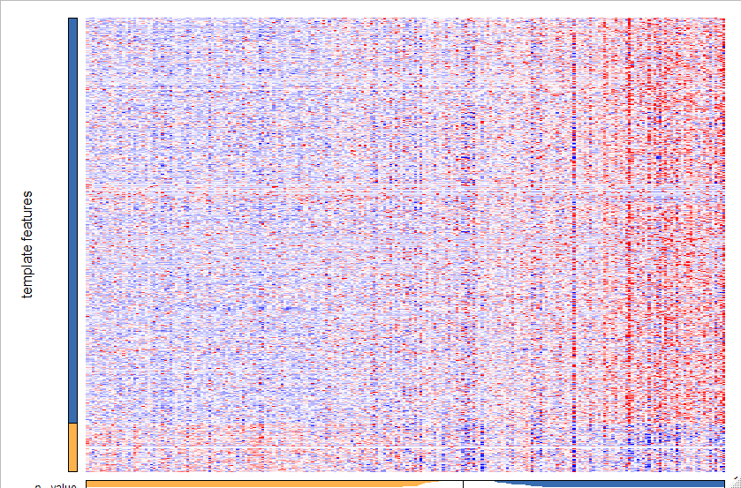
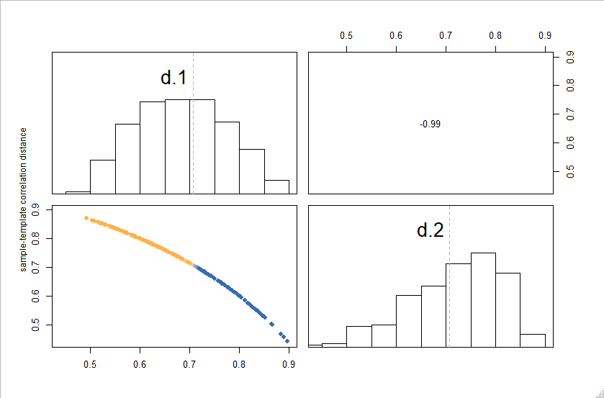
Yonsei data validation: NTP analysis(CMS caller)
Notes:
NTP analysis (by CMScaller package) using gene sets from NMF analysis of TCGA-READ.htseq_fpkm-uq data.

Slide 9
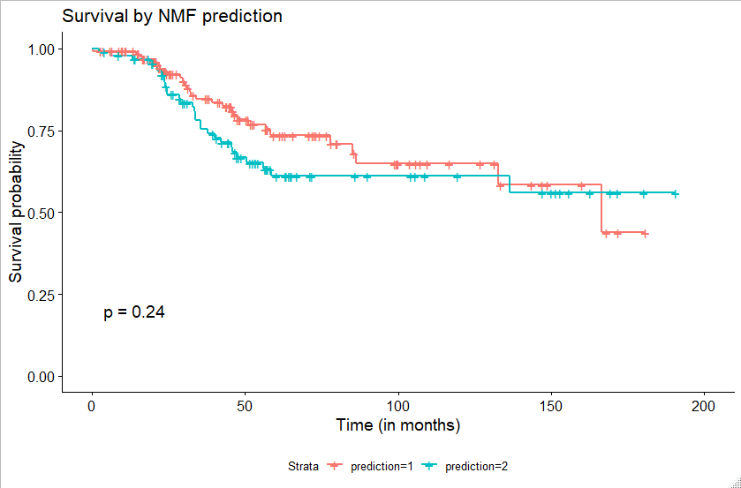
Yonsei data validation: Survival / DFS / pCR
FDR not filtered

Slide 10
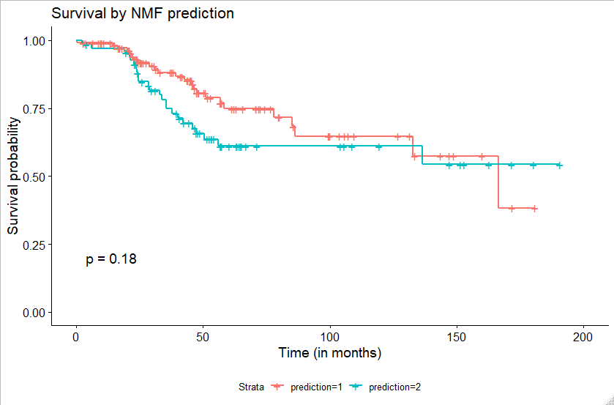
Yonsei data validation: Survival / DFS / pCR
FDR < 0.2

Slide 11
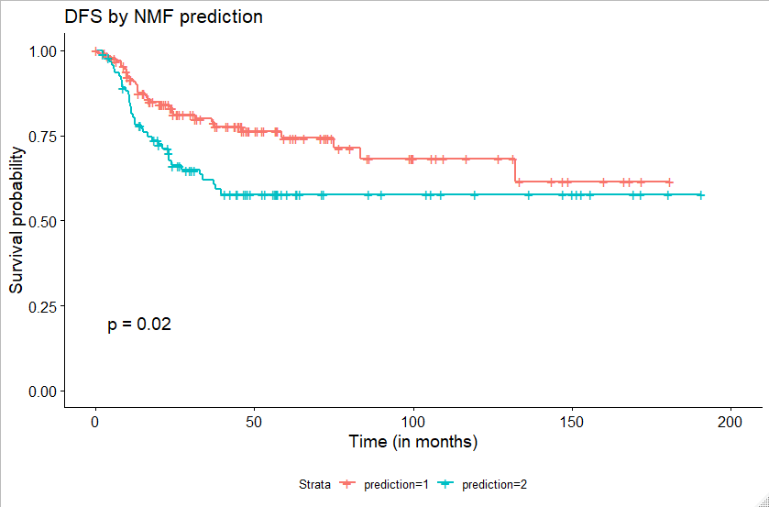
Yonsei data validation: Survival / DFS / pCR
FDR not filtered

Slide 12
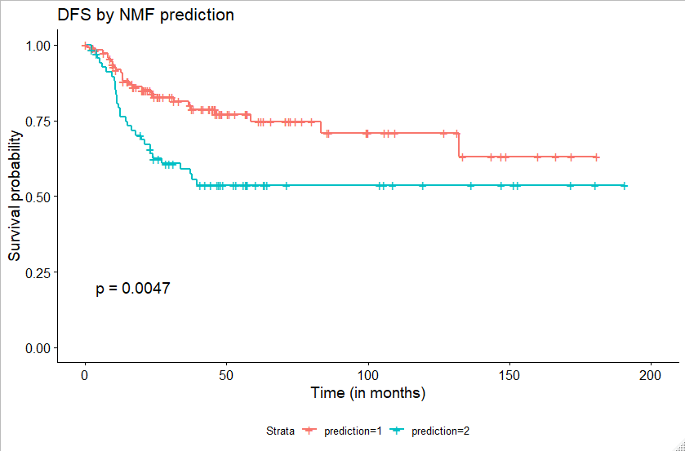
Yonsei data validation: Survival / DFS / pCR
FDR < 0.2

Slide 13
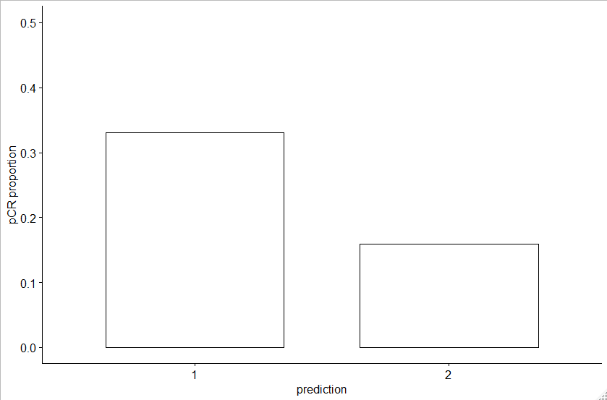
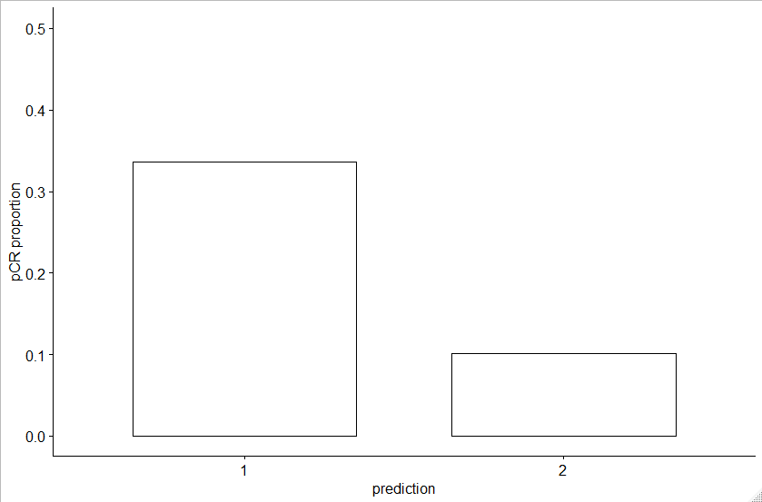
Yonsei data validation: Survival / DFS / pCR
FDR not filtered
P=0.005855
FDR < 0.2
P=0.0006822

Slide 14
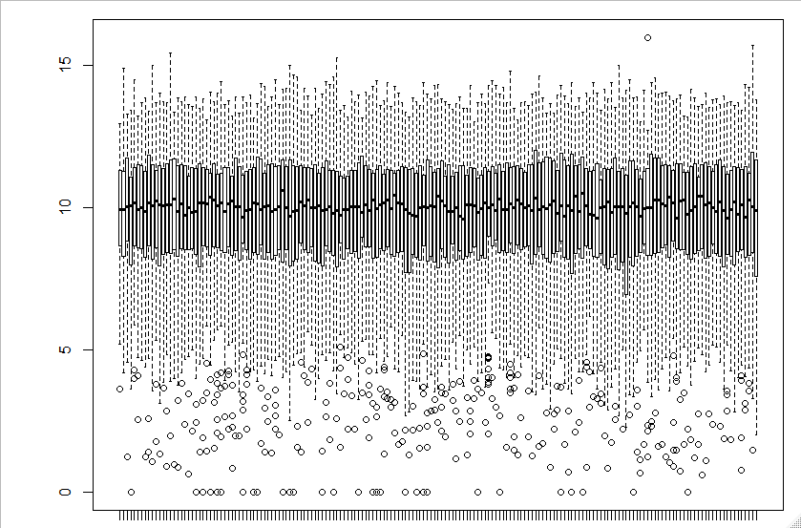
Normalization
Differential gene expression by DESeq2

Slide 15
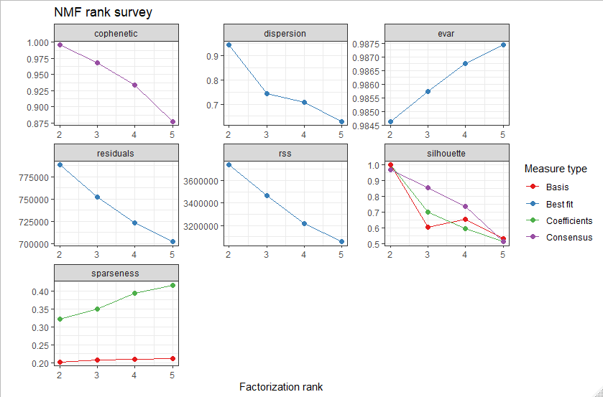
DESeq2 normalized TCGA-READ count data -> NMF clustering rank estimation

Slide 16
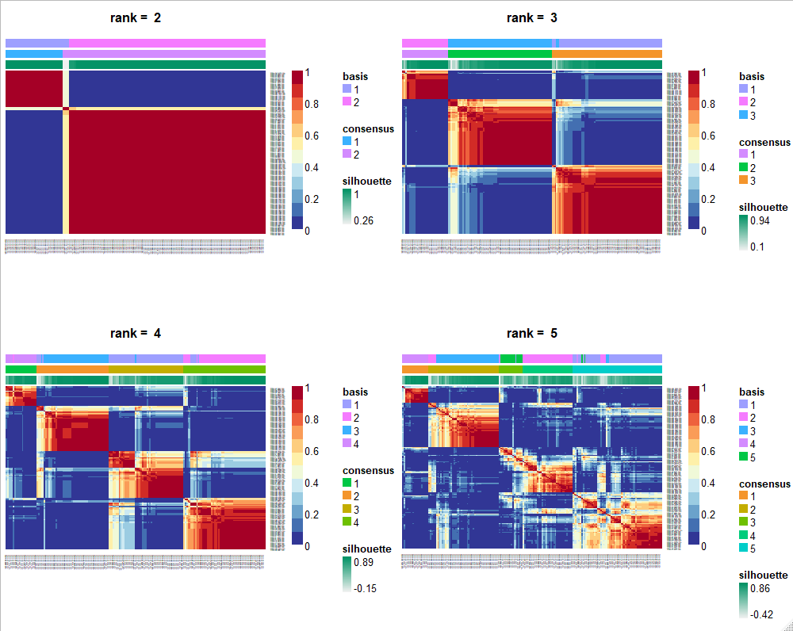
DESeq2 normalized TCGA-READ count data -> NMF clustering rank estimation

Slide 17
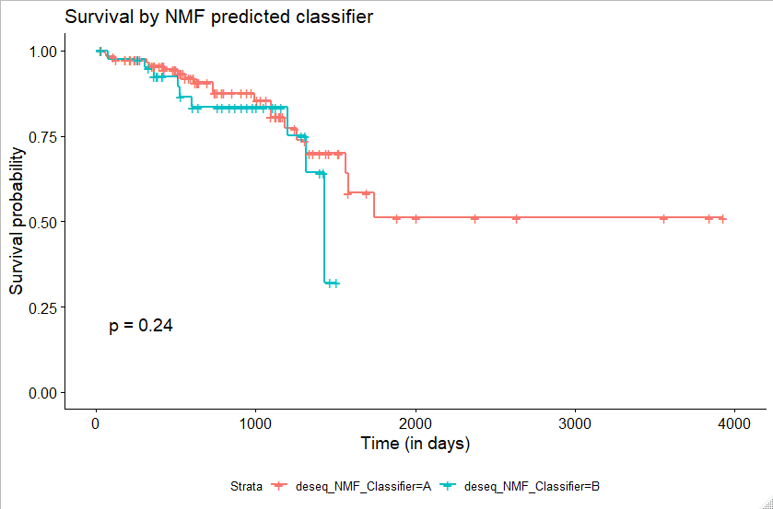
DESeq2 normalized TCGA-READ count data -> NMF clustering

Slide 18
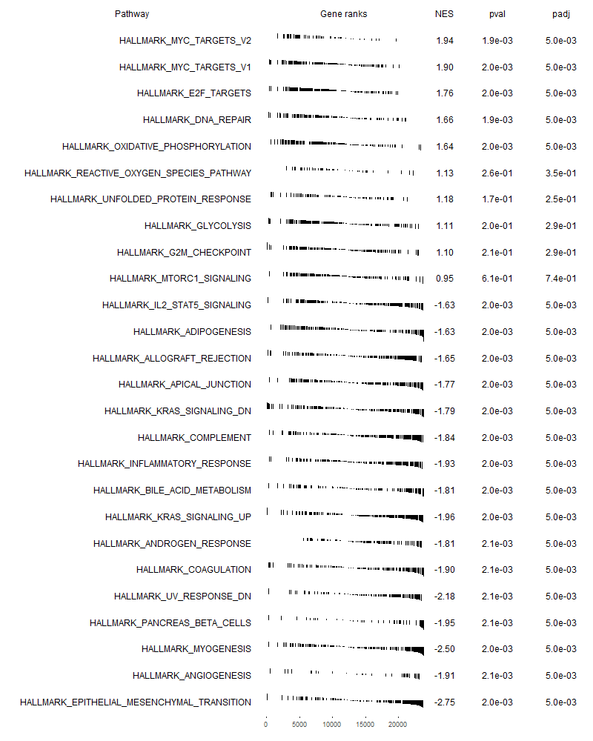
GSEA analysis: Hallmarks
GSEA analysis: Top & Bottom 10 pathways
(by p.adj)

