Slide 3
Controller
Model
View

Slide 5
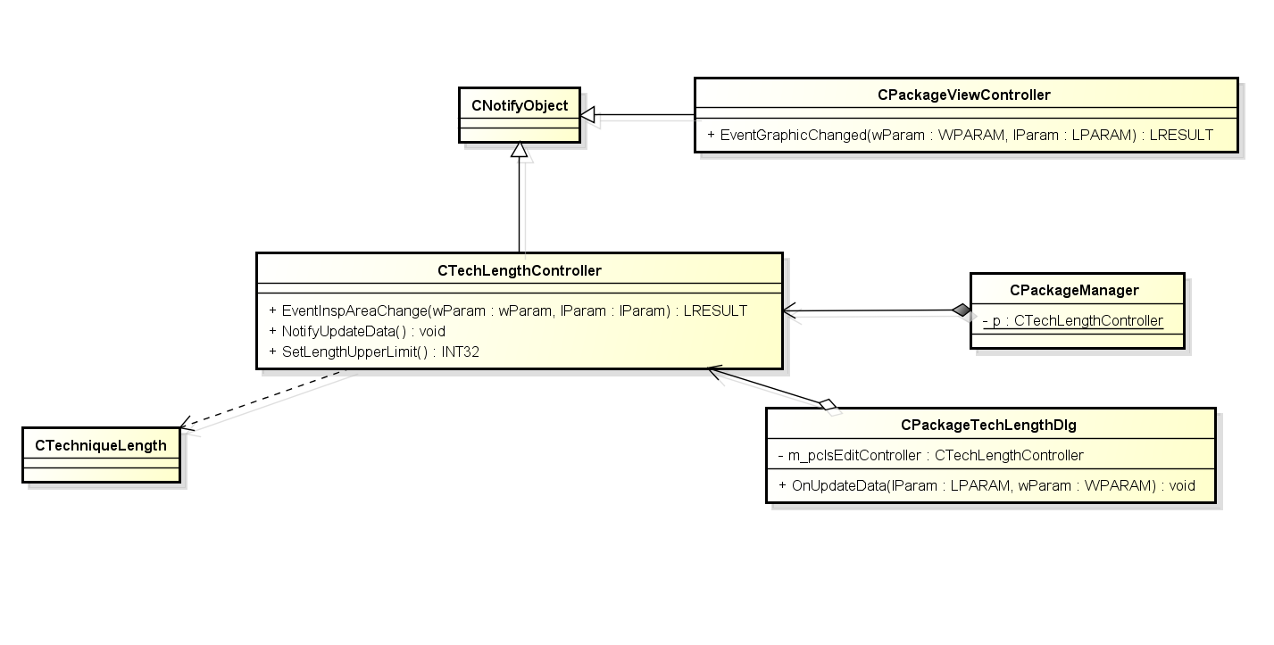
4
2
3
1

