Slide 2
Controller
Model
View

Slide 4
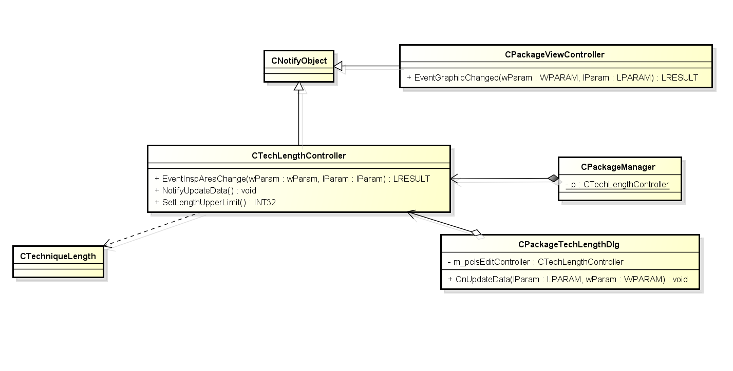
4
2
3
1

