Slide 1
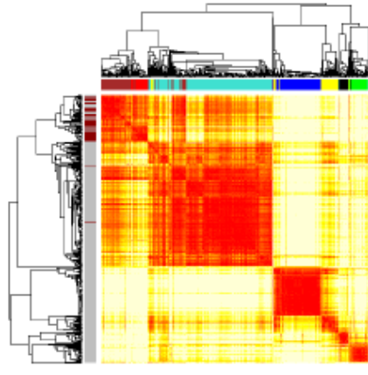
The Generalized Topological Overlap Matrix in Biological Network Analysis
Andy Yip, Steve Horvath
Email: shorvath@mednet.ucla.edu
Depts Human Genetics and Biostatistics,
University of California, Los Angeles

Slide 2
Contents
Dissimilarity measures in undirected networks
Dissimilarities based on shared neighbors
Generalized topological overlap matrix
Applications
Simulation

Slide 3
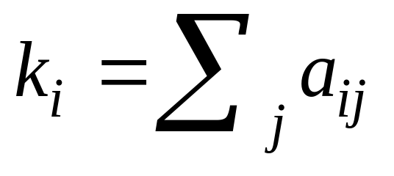
Network Terminology
Unweighted Network=adjacency matrix A=[a_{ij}], that encodes whether a pair of nodes is connected.
  A is a symmetric matrix with entries in [0,1]
  a_{ij}=1 nodes i and j are connected else 0
HERE WE CONSIDER AN UNWEIGHTED NETWORKS
Gene connectivity K= row sum of the adjacency matrix=number of direct neighbors
Network Module=Subset of highly interconnected nodes

Slide 4
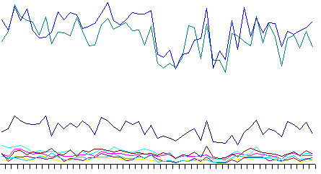
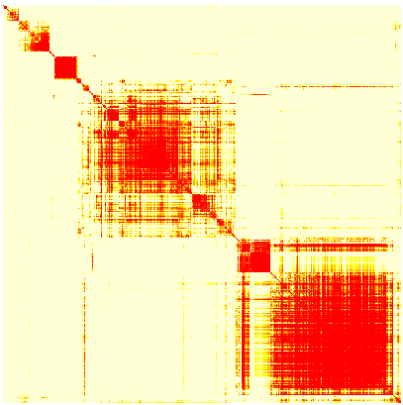
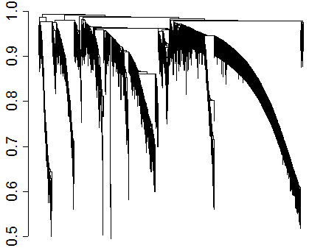
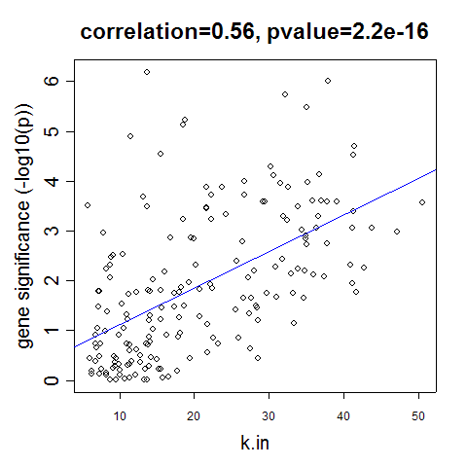
Basic Steps in Many
Biological Network Analyses
Define an Adjacency Matrix
Measure of Node Dissimilarity
Identify Network Modules (Clustering)
Understand the biological meaning
of modules and network concepts

Slide 5
What is a node dissimilarity?
And why do we need it?
Mathematical Definition of a Dissimilarity measure
  1) Symmetry: G(u,v)=G(v,u)
  2) Non-negative G(u,v)>=0
  3) G(u,u)=0
Major application: module detection
  Module=cluster of “similar” nodes
Implementation: use the dissimilarity measure as input of a clustering procedure,
    e.g. average linkage hierarchical clustering,
    or partitioning around medoid clustering
Aside: node dissimilarities have many other uses, e.g. to study how a node dissimilarity between 2 interacting genes changes across conditions…

Slide 6
Possible measures of node dissimilarity
Simply use 1 minus the adjacency matrix
Length of shortest path connecting 2 nodes
Our focus: measures based on number of shared neighbors
  Intuition: if 2 people share the same friends they are close in a social network

Slide 7
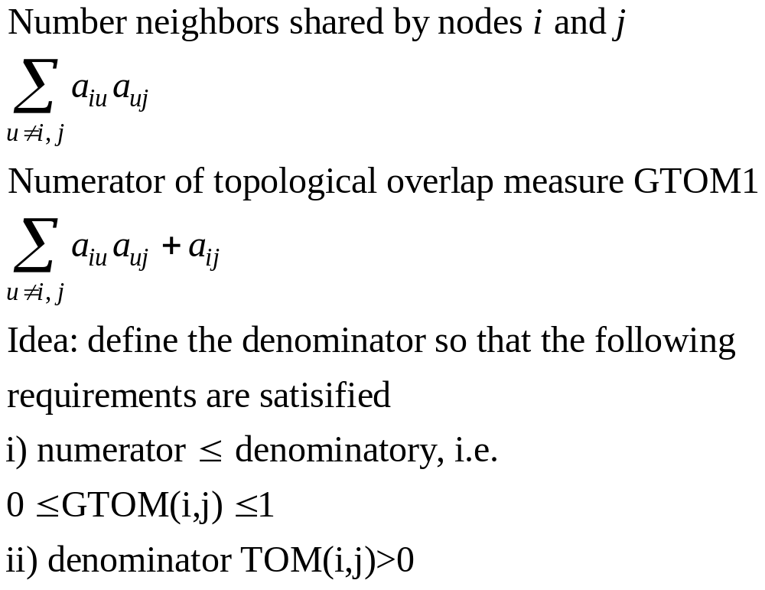
Similarity based on number of shared neighbors

Slide 8
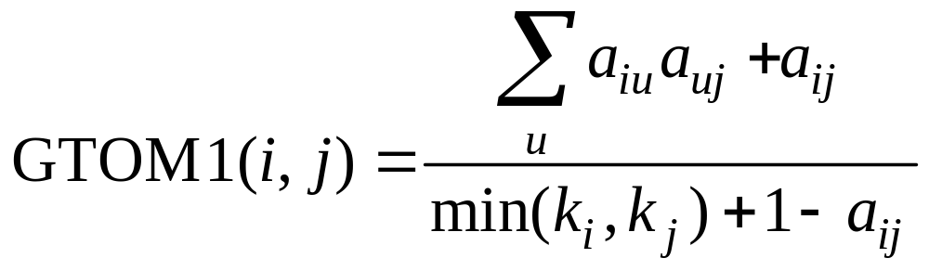
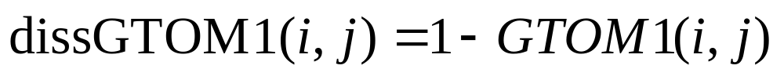
Standard Topological Overlap measure
(Ravasz et al 2002)
Generalization to unweighted networks discussed in Zhang and Horvath (2005).
Generalization to multiple nodes defined in Ai Li, S Horvath (2006) Multinode topological overlap matrix.

Slide 9
The topological overlap measures interconnectedness
for an unweighted network, one can show that the topological overlap=1 only if the node with fewer links satisfies two conditions:
  (a) all of its neighbors are also neighbors of the other node, i.e. it is connected to all of the neighbors of the other node and
  (b) it is linked to the other node.
In contrast, top. overlap=0 if i and j are unlinked and the two nodes don't have common neighbors.

Slide 10
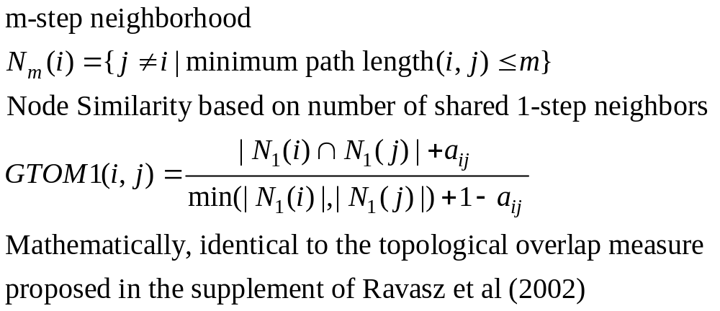
Our set theory interpretation of the topological overlap matrix

Slide 11
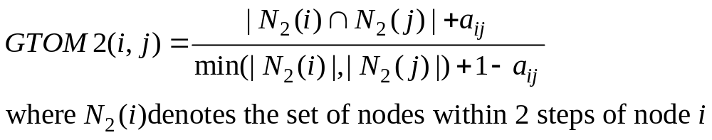
Generalizing the topological overlap matrix to 2 step neighborhoods etc
Simply replace the neighborhoods by 2 step neighborhoods in the following formula
Reference: Andy M. Yip and SH (2006) The Generalized Topological Overlap
Matrix For Detecting Modules in Gene Networks.
www.genetics.ucla.edu/labs/horvath/GTOM

Slide 12
Computationally simple calculation of GTOMm
GTOMm can be directly calculated from A+A*A+A*A*A+A…..A
where * denotes matrix mutiplication
Computation time driven by m matrix multiplications of A

Slide 13
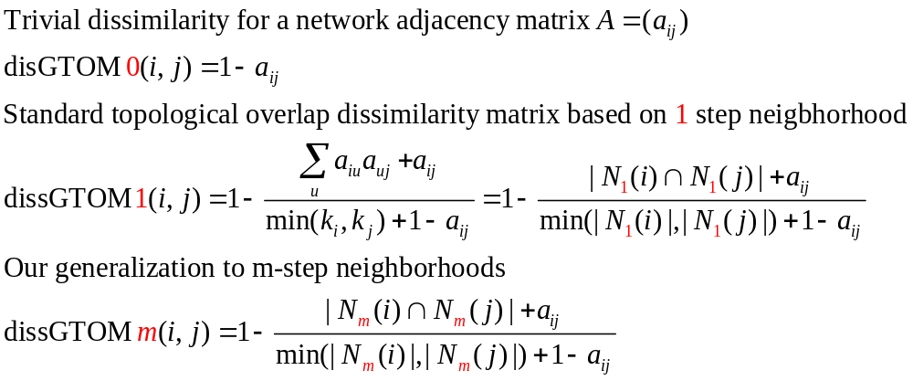
Summary: dissimilarity measures based on an adjacency matrix A

Slide 14
Defining Gene Modules
=sets of tightly co-regulated genes

Slide 15
Module Identification based on the notion of topological overlap
An important aim of metabolic network analysis is to detect subsets (modules) of nodes that are tightly connected to each other.
We adopt the definition of Ravasz et al (2002): modules are groups of nodes that have high topological overlap.

Slide 16
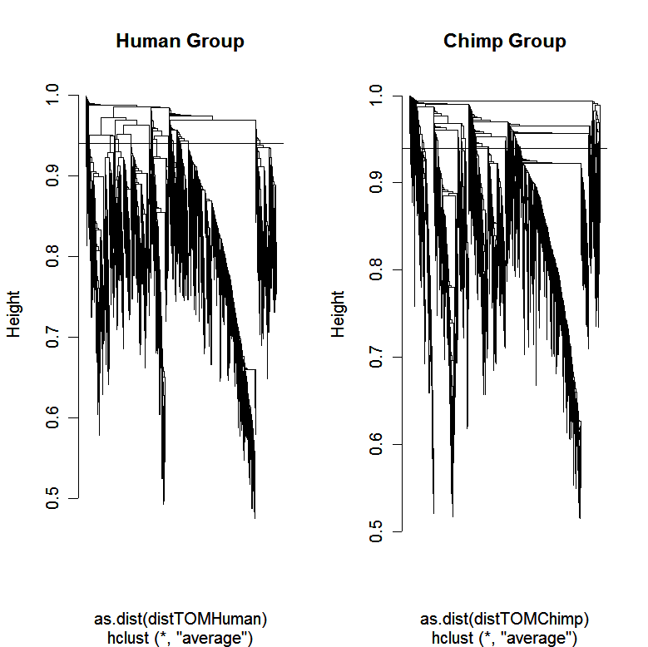
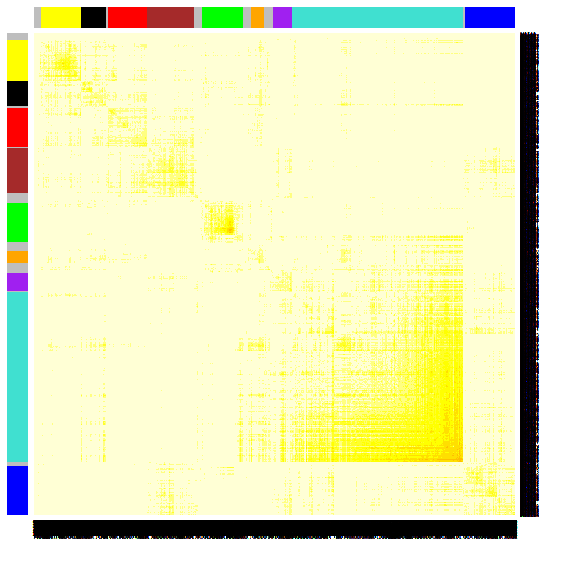

Using the TOM matrix to cluster genes
To group nodes with high topological overlap into modules (clusters), we typically use average linkage hierarchical clustering coupled with the TOM distance measure.
Once a dendrogram is obtained from a hierarchical clustering method, we choose a height cutoff to arrive at a clustering.
  Here modules correspond to branches of the dendrogram
TOM plot
Genes correspond to rows and columns
TOM matrix
Hierarchical clustering
dendrogram
Module:
Correspond
to branches

Slide 17
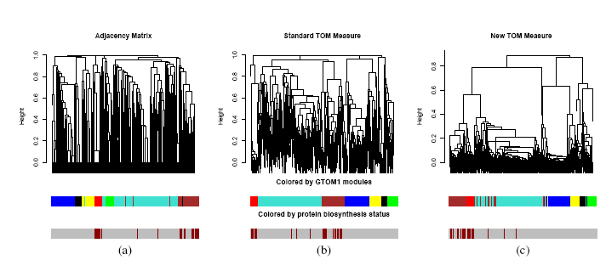
Comparison of 3 different similarities in capturing the functional class `protein biosynthesis'.
(a) ADJ=GTOM0 (b) GTOM1 (c) GTOM2
The middle row shows the color bar ordered by the corresponding dendrogram but colored by the module assignment with respect to the TOM measure in (b), the bottom shows the color bar ordered by the corresponding dendrogram where genes belong to the class `protein biosynthesis' are colored in dark red.
Almost all protein biosynthesis genes are grouped together by the GTOM2 measure whereas the other two measures tend to distribute the class over two modules.

Slide 18
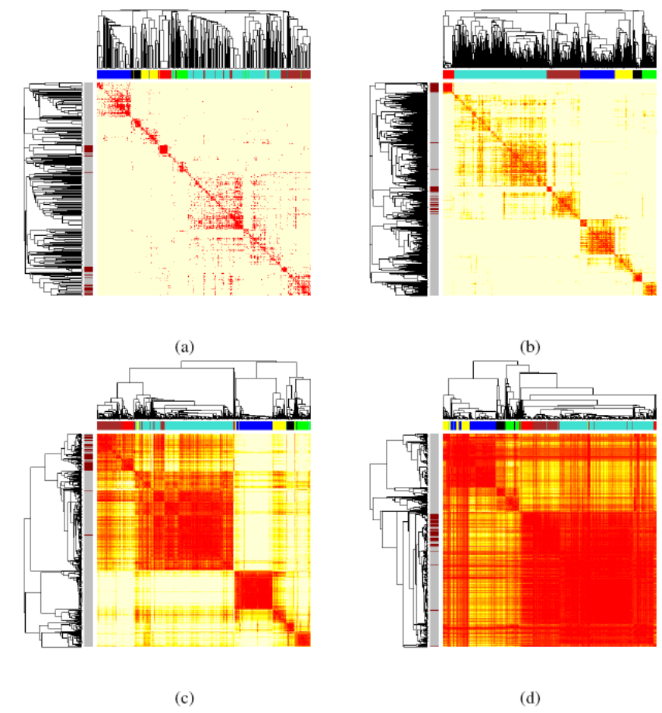
Topological Overlap Matrix Plots for different GTOM measures,
yeast
Overall, modules are quite robust with respect to the GTOM measure.
Smaller modules are more visible in GTOM0 and GTOM1 plots
Larger modules are more pronounced in GTOM2 and GTOM3 plots
ADJ=GTOM0 GTOM1
GTOM2 GTOM3

Slide 19
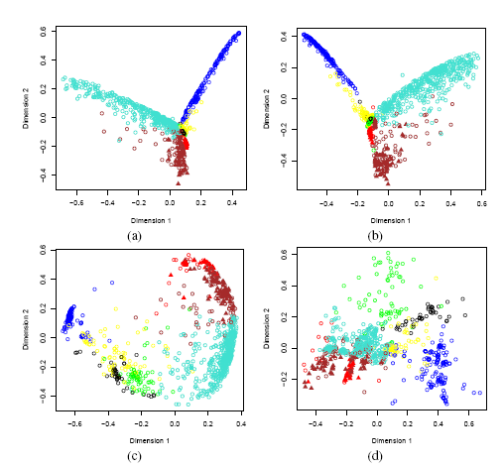
Multidimensional Scaling Plots involving different GTOMs
ADJ=GTOM0 GTOM1
GTOM2 GTOM3

Slide 20
Simple simulated example where GTOM2 is better than GTOM1 and GTOM0

Slide 21
Example, when GTOM2 is superior to GTOM1 or GTOM0
Top 8 GTOM2 neighbors of Node 1 are exactly Node 1 – Node 8.
TOM1 neighbors of Node 1 are Node 1,4,5,8,9,18.
13
16
12
10
14
15
11
17
5
7
9
3
1
8
2
18
4
6
21
19
23
24
20
26
22
25
Black circles: 8 closest GTOM1 neighbors of node 1

Slide 22
Predicting essential proteins in a fly network
Idea: start with a single highly connected essential protein and consider its closest neighbors based on a dissimilarity measure
One would hope that the most similar (closest) neighbors are also essential since they may be part of the same pathway
Data protein-protein interaction data from Biogrid
Essentiality: determined by knock-out experiments

Slide 23
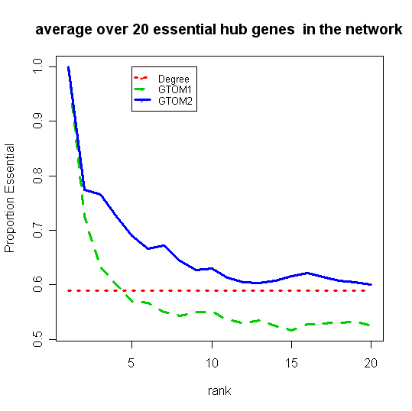
GTOM2 outperforms GTOM1 and GTOM0 in the fly protein-protein network
Y-axis proportion of essential genes amony the closest neighbors
X-axis size of closest neighborhood

Slide 24
Discussion
Since the topological overlap matrix considers shared neighbors, it tends to be more robust to spurious connections.
Limitation of GTOM: it rquires an unweighted network (binary adjacencies)
GTOM is based on pairwise overlap.
  In contrast, MTOM is based on multi-node overlap.
Overall, GTOM0, GTOM1 and GTOM2 lead to similar clusters (modules).
Our experience
In most applications, we find that GTOM1 is better than GTOM0
Often GTOM1 performs better than GTOM2
But in the fly network GTOM2 is better than GTOM1
GTOMm with m>2 tends to lump nodes together→ loss of resolution

Slide 25
Acknowledgement
Biostatistics/Bioinformatics
Ai Li, doctoral student UCLA (MTOM software)
Jun Dong, Postdoc UCLA
Wei Zhao, Postdoc UCLA
Lin Wang
Bin Zhang
Collaborators
Marc Carlson, Dan Geschwind, Paul Mischel, Stan Nelson, Mike Oldham, and many more

Slide 26
Webpages and References
This talk and relevant R code
  Yip A, Horvath S (2006) The Generalized Topological Overlap Matrix For Detecting Modules in Gene Networks Proceedings Volume Gene Networks: Theory and Application Workshop at BIOCOMP'06, Las Vegas http://www.genetics.ucla.edu/labs/horvath/GTOM/
  Ai Li, Steve Horvath (2006) The Multi-Point Topological Overlap Matrix for Gene Neighborhood Analysis. Proceedings Volume Gene Networks: Theory and Application Workshop at BIOCOMP'06, Las Vegas http://www.genetics.ucla.edu/labs/horvath/MTOM/
  Bin Zhang and Steve Horvath (2005) "A General Framework for Weighted Gene Co-Expression Network Analysis", Statistical Applications in Genetics and Molecular Biology: Vol. 4: No. 1, Article 17. www.bepress.com/sagmb/vol4/iss1/art17
Yeast Co-Expression Network
  MRJ Carlson, B Zhang, Z Fang, PS Mischel, S Horvath, SF Nelson, Gene connectivity, function, and sequence conservation: predictions from modular yeast co-expression networks", BMC Genomics 2006, 7:40 (3 March 2006). http://www.biomedcentral.com/1471-2164/7/40/

Slide 27
Appendix

