Slide 1
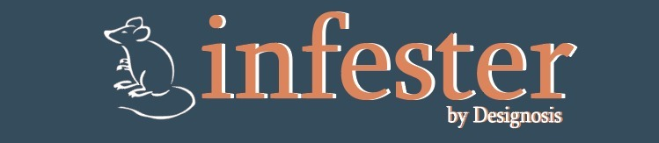
What are your project aims?
Our project aims to spread the Black Death all around the Europe.
The Black Death was responsible for killing thousands of people in medieval Europe.
What is unique about your project?
Our project is unique because the focus and the theme of it is different in the videogames industry. We are talking about of a different point of view of one of the most terrible events of the human being history.
What skills/plans do you have to overcome hurdles?
The skills that you have in the game are the mobility that a rat can have to avoid humans, obstacles and whatever hurdle you can find while you are playing.

