Slide 1
TP 3
Mathieu Lefebvre – Adel Chebani

Slide 2
Technologie
React - https://reactjs.org/
React-Bootstrap - https://react-bootstrap.github.io/
Tensoflow - https://www.tensorflow.org/
Node.js - https://nodejs.org/en/blog/release/v14.10.0/

Slide 3
Langue
HTML via ReactDOM
CSS
Javascript

Slide 4

Node.js
Windows 64-bit Installer
node version
npm version

Slide 5
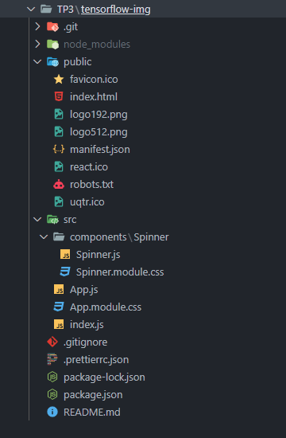
React
npx create-react-app tensorflow-img
index.html
package.json
index.js
App.js

Slide 6
React-Bootstrap
package.json
css – index.js
importation - App.js

Slide 7
Tensorflow
Lien - Doc
Models - Doc
Importation - Tensorflow - App.js
Importation - Backend WebGL - App.js
package.json

Slide 8
Importer, Installer, Démarrer et Arrêter l'Application
https://github.com/lef013/inf1001-tp3/blob/master/README.md
Powershell – cli :
cd Desktop
md tensoflow-img
cd tensoflow-img
git clone https://github.com/lef013/inf1001-tp3.git
cd .\inf1001-tp3\
npm install
npm start
ctl+c
y + enter
Pour Windows seulement (désolé)

Slide 9

Démonstration local
http://localhost:3000/

