Slide 1


Flight Cancellation Prediction Model

Slide 2
Dataset Characteristics
Historical Flight Delay and Weather Data USA
Data set size (5512903 rows, 35 columns)
Year : 2019
Used Features | Not Used Features
Carrier Code | Departure Delay
Origin Airport | Arrival Delay
Destination Airport | Carrier Delay
Scheduled Elapsed Time | Weather Delay
Month | National Aviation System Delay
Day | Security Delay
Weekday | Late Aircraft Arrival Delay
Temperature | Cancellation Code
Precipitation | Year
Station Pressure | Tail Number
Visibility | Flight ID
Wind Speed | Actual Departure/Arrival Information
Weather measurements from both airport/weather locations

Slide 3

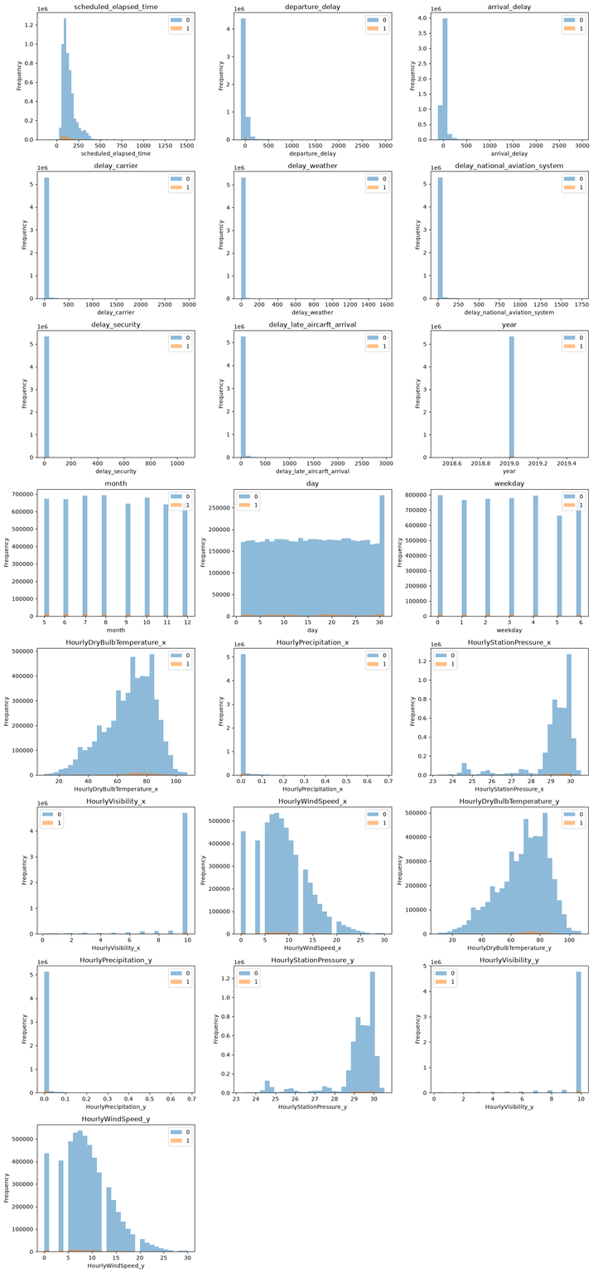



Exploratory Data Analysis
Class imbalance is severe – across virtually every panel the orange bars are barely visible against the 10^6-scale blue bars
No monthly/day-of-week skew – month, day, and weekday distributions for class 1 roughly track class 0's shape, implying cancellations aren't concentrated in a specific month or weekday but occur at a fairly steady background rate.

Slide 4
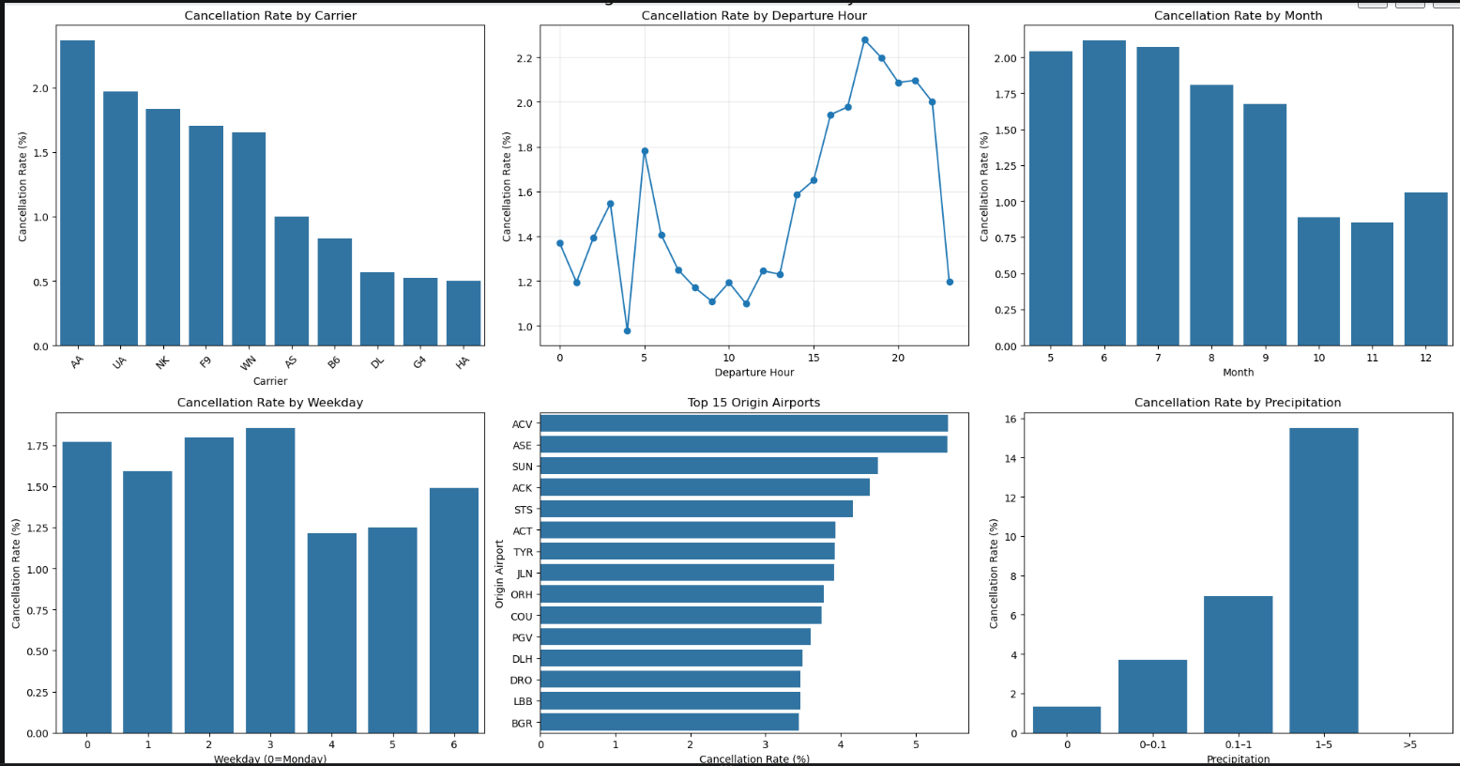
Exploratory Data Analysis
Carrier matters a lot: Some airlines (like AA) cancel flights much more often than others (like HA and G4), suggesting airline-specific operations or scheduling practices play a big role.
Time of day matters: Cancellations are lowest in the early morning and climb steadily through the day, peaking in the evening.
Weather is the biggest driver: Cancellation rates rise sharply as precipitation increases
Small airports look riskier: The airports with the highest cancellation rates tend to be small

Slide 5
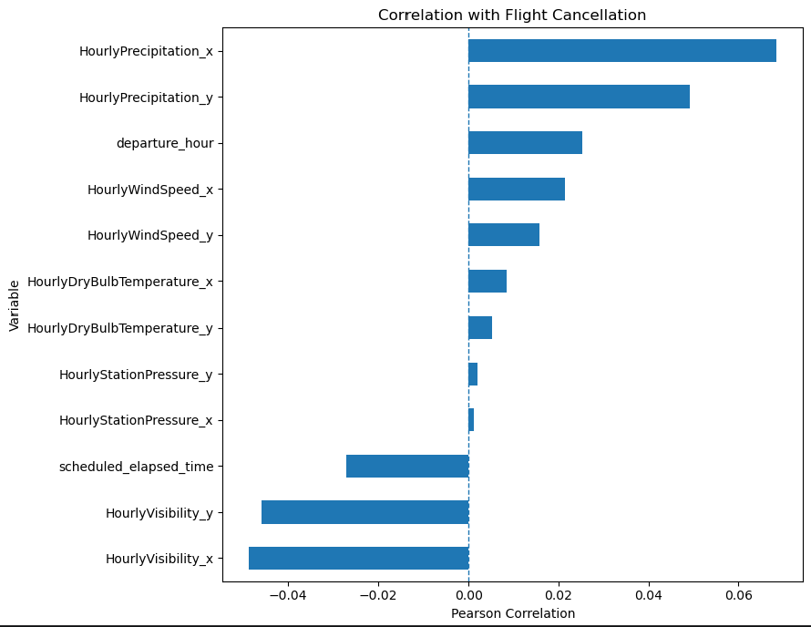
Exploratory Data Analysis
Weather-related variables dominate: more rain/wind line up with more cancellations.
Visibility has the strongest negative relationship: Lower visibility is clearly tied to higher cancellation rates, making it one of the most important warning signs.
Time of day still shows up: Later departure times are linked with more cancellations, matching the earlier finding that evenings are riskier.

Slide 6
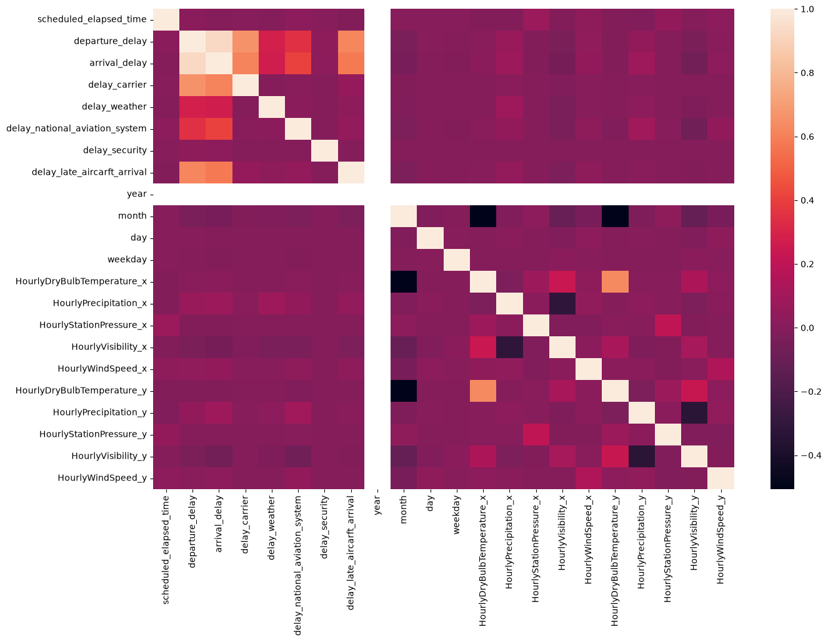
Heatmap

Slide 7
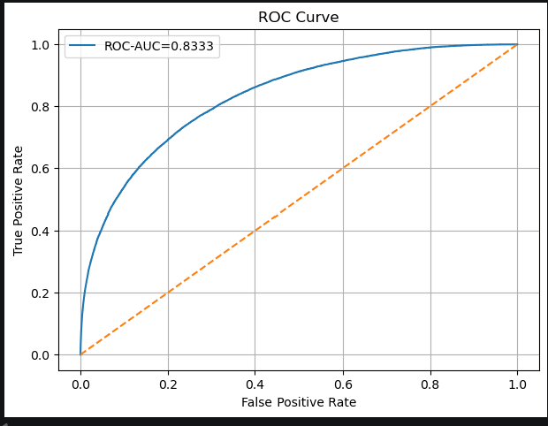
Model Selection
XGBClassifier

Slide 8
Results
Target | Percentage
Out of all flights, how often does the model make the correct prediction? | 98%
When the model warns that a flight will be cancelled, how often is that warning correct? | 24%
Of all the flights that actually get cancelled, how many does the model successfully identify? | 21%
When the model predicts that a flight will not be cancelled, how often is that prediction correct? | 99%
Overall, the model performs well at identifying flights that are not cancelled, but its ability to identify actual cancellations is limited. The main reason is that cancellations are relatively rare and are influenced by many operational factors that are not available in the dataset.

