Slide 1
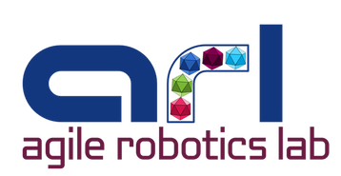

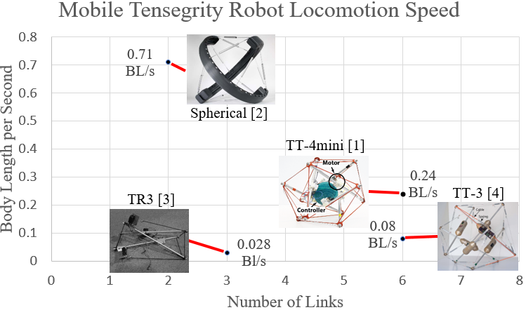
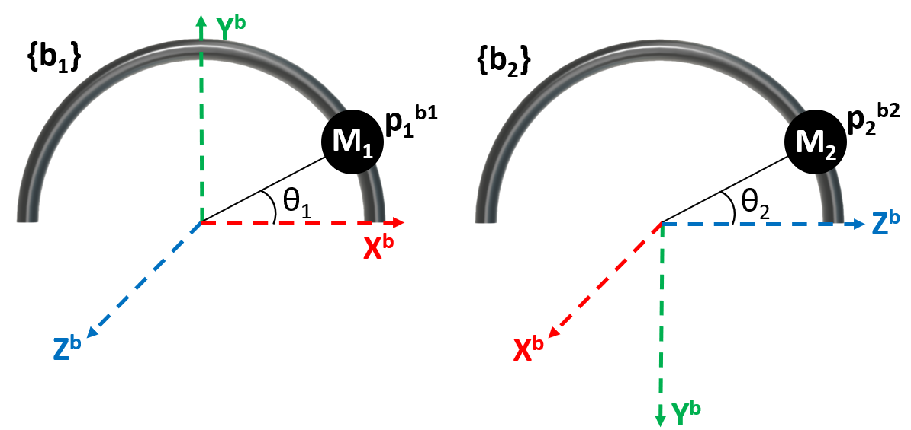
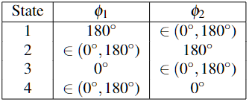
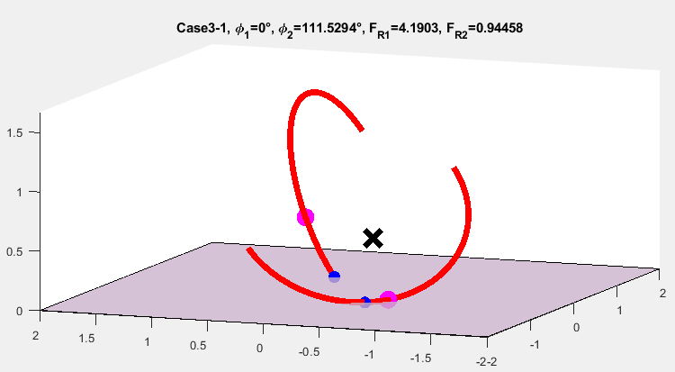

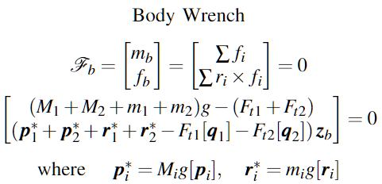
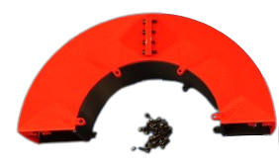
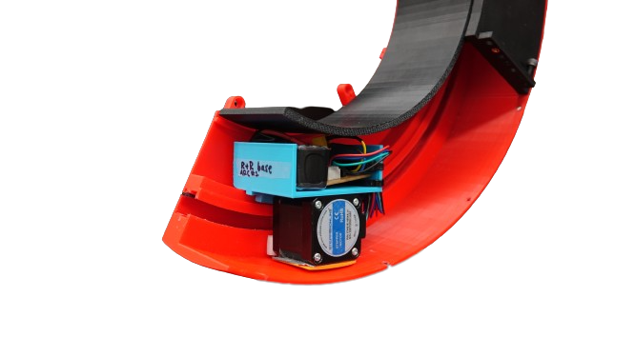
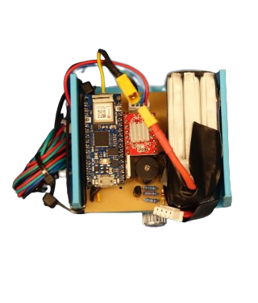
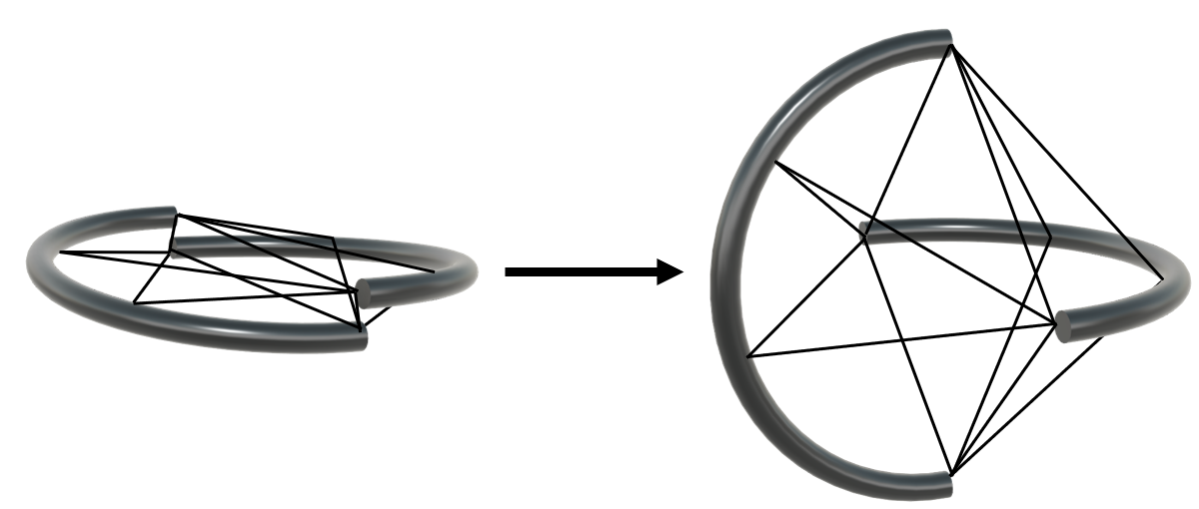
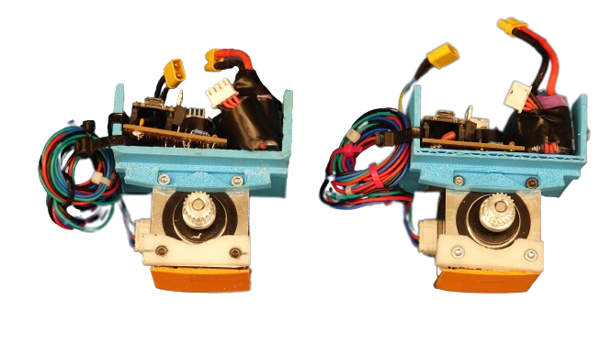
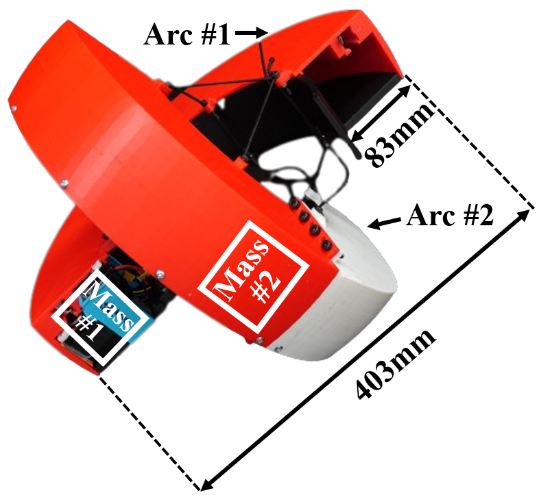
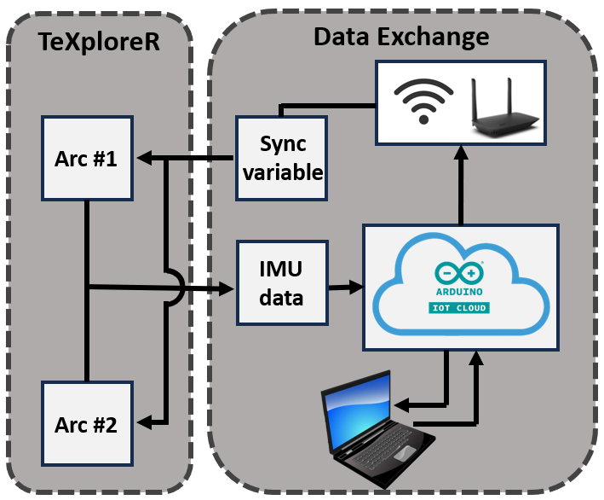
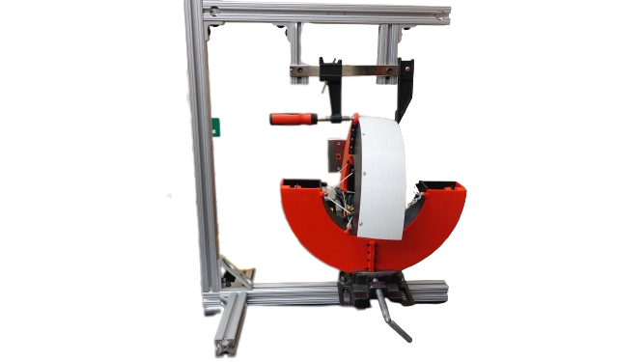
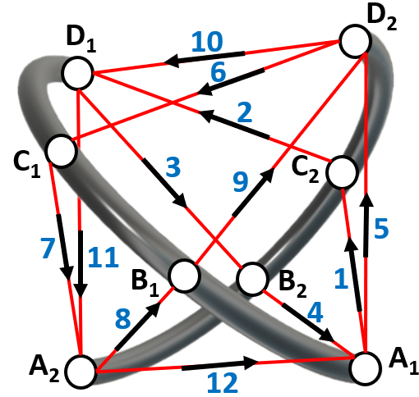





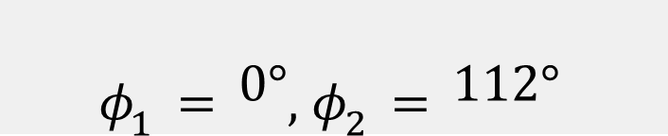
Design and Modeling of Mobile
Tensegrity eXploratory Robot (TeXploreR)
Lauren Ervin, Chase Fortin, and Vishesh Vikas
Agile Robotics Lab, The University of Alabama
Introduction and Motivation
Hybrid System and Static Modeling
A tensegrity structure is comprised of rigid struts under compression with prestressed members held in tension to achieve structural integrity. Tensegrity structures are lightweight, packable, impact resistant, and internally stable making them ideal candidates for locomotion in unstructured environments such as search and rescue and space scenarios. Substantial research effort has been placed on designing robots that utilize tensegrity structures due to these benefits. These robots generally have two to twelve rods and a comparison of the
The unique design of the hybrid system TeXploreR poses static and dynamic modeling challenges; this is due to:
The discontinuous nature of the semi-circular, curved links requiring switching between states
Two changing points of contact with the surface
Instantaneous movement of the masses along the links
Tensegrity robots generally move by one of two methods. The first is the shortening of cable lengths, effectively altering the robot’s configuration space. The second method is shifting one or more internal masses, instantaneously changing the robot’s overall center of mass. TeXploreR takes advantage of the second method for locomotion. A geometrical representation of the two TeXploreR arcs is shown in Fig. 5. There is an internal mass, $M_{i},$ with position, $p_{i}^{b}$in the $\{b_{i}\}$ coordinate frame attached to each arc and controlled by a stepper motor. The angle of rotation from the center arc base is represented by $θ_{i}.$ Similarly, a point of contact $q_{i}^{b}$ exists for each arc with angle of rotation $φ_{i}$. As a motor assembly runs along an arc, the internal mass, and therefore the entire robot, shifts.
Table 1: Hybrid System States
$$φ_{1}=0°, φ_{2}=112°$$
Fig. 5: TeXploreR Geometric Representation
An example of TeXploreR in a stable, static position is shown in Fig. 6. The research models the TeXploreR as a hybrid system comprised of four states represented in Table 1. As soon as one internal mass reaches an end point along an arc, the internal mass attached to the other arc begins its traversal. This oscillatory motion results in a piecewise continuous trajectory with four distinct traversal states. A set of holonomic constraints confirm the observed hybrid system by constraining $z_{b}$ for a given $φ_{i}$ value. The wrench of all the forces acting on the body, $ℱ_{b}$, is comprised of the total force and moment acting on the body that sums to zero about $O_{b}$ shown in Eq. 1. This results in a closed form solution depending on the hybrid system state. A set of non-holonomic constraints reduce the solutions space from six degrees-of-freedom to two explicit parameters, greatly simplifying future dynamic modeling. The geometric representation using Lie Groups and Screw Theory is crucial for simpler representation of non-holonomic constraints.​
Fig. 1: Tensegrity Robot Locomotion Speed
speed of recent mobile tensegrity robots
is shown in Fig. 1. The spherical link robots demonstrates three times the speed of the fastest straight-link counterpart. One of the contributing factors being that the continuous curved arcs are morphologically closer to wheels. The reality gap of real-time movement in a non-lab setting remains an unsolved problem from perspective of mobility, controls, and design.
Contributions: We present TeXploreR, the Tensegrity eXploratory Robot comprised of the following:
Two semi-circular curved links with shifting internal masses; this design provides balance between efficient rolling locomotion and stability (e.g., tip-over on an incline). The curved nature of the links enables fast locomotion, narrowing the reality gap.
This is the first time a non-spherical two-point contact system is kinematically and dynamically modeled.
The static solutions are closed-form and do not require numerical exploration of the solution.
Fig. 6: TeXploreR Static Position
(1)
Design, Mechatronics, and Fabrication
Future Works
3D printed TeXploreR prototype shown in Fig. 2
400 mm diameter
~150 cm³ storage endcaps for internal science payloads
The two arcs are held in tension with a continuous elastic cable
TeXploreR is mobilized via an internal motor assembly running along each arc
Each arc contains a separate PCB to control each motor
The robot is made tetherless with two LiPo batteries
The motor circuits are controlled and synced together for precise timing over-the-air through variable sharing on Arduino IoT Cloud - communication framework is shown in Fig. 3
Accelerometer and gyroscope data from a 6-axis on-board IMU is recorded for additional monitoring and control in the future
Mechanical Design: Curved arcs and endcaps for payload storage were 3D printed with tough PLA filament shown in Fig. 4a. A GT2 timing belt was adhered to the inside of each arc.
Electrical Design: All electrical components including NEMA17 stepper motor, Arduino Nano33 IoT, A4988 motor driver, 1,100mAh LiPo battery, and PCB were attached to 3D printed storage cups shown in Fig. 4b. This was then mounted to the top of a stepper motor. The wires were routed to minimize potential snags. The PCB and LiPo battery were secured to the 3D printed mount to ensure minimal shifting of components during movement sequences.
Mechanical Assembly: The 80/20 assembly jig is shown in Fig. 4c. One arc was attached to the ground vice and the other arc was attached to the clamp suspended in air. The distance between the two arcs was modified as necessary to provide the correct spacing.
Cable Routing with Graph Theory: An elastic cable was routed through each arc hole of which there are four sets on each arc. All vertices in the graph shown in Fig. 4d are even, thus a single cable followed the Euler’s path through all vertices. The cable segments were tightened as necessary until the arcs were properly tensioned.
(a)
Shifting mass
Active shape morphing visualized in Fig. 7
Complex movements including jumping and slipping
Dynamic modeling
Using accelerometer + gyroscope data in closed-loop system
(b)
Fig. 7: 2D to 3D Shape Reconfiguration
References
Chen, L.-H., Cera, B., Zhu, E. L., Edmunds, R., Rice, F., Bronars, A., Tang, E., Malekshahi, S. R., Romero, O., Agogino, A. K.; Agogino, A. M. (2017). Inclined surface locomotion strategies for spherical Tensegrity Robots. 2017 IEEE/RSJ International Conference on Intelligent Robots and Systems (IROS). https://doi.org/10.1109/iros.2017.8206380
Bohm, V., Kaufhold, T., Schale, F., & Zimmermann, K. (2016). Spherical mobile robot based on a tensegrity structure with curved compressed members. IEEE/ASME International Conference on Advanced Intelligent Mechatronics, AIM, 2016-09,1509–1514. https://doi.org/10.1109/AIM.2016.7576984
Paul, C., Valero-Cuevas, F. J., &amp; Lipson, H. (2006). Design and control of Tensegrity robots for Locomotion. IEEE Transactions on Robotics, 22(5), 944–957. https://doi.org/10.1109/tro.2006.878980
Kim, K., Chen, L.-H., Cera, B., Daly, M., Zhu, E., Despois, J., Agogino, A. K., SunSpiral, V.; Agogino, A. M. (2016). Hopping and rolling locomotion with spherical Tensegrity Robots. 2016 IEEE/RSJ International Conference on Intelligent Robots and Systems (IROS). https://doi.org/10.1109/iros.2016.7759643
Fig. 2: TeXploreR Prototype
Fig. 3: Communication Framework
(c)
(d)
Fig. 4: TeXploreR Fabrication Process
This work is supported in part by NASA grant #80NSSC20M0044 awarded to the Alabama Space Grant Consortium.

