Slide 1

Exploratory Data Analysis
G2M Case Study
Name: Mantas Eleftherios
Location: Greece, Patras
Team Data and Analytics
Date: 11-March-2021

Slide 2
Go-to-Market (G2M) Case study description
Problem description: XYZ is a private firm in the US. Due to remarkable growth in the Cab Industry in last few years and multiple key players in the market, it is planning for an investment in Cab industry.
Goal: Provide actionable insights to help XYZ infer the right company to make their investment.

Slide 3
Data overview
Data refer to the time period from 31/01/2016 to 31/12/2018
4 data sets are given:
Cab data: main data set with all transactions for the Pink and the Yellow Cab Companies.
Customer ID: contains customer data.
Transaction ID: contains transaction data.
City: contains population data of all cities/states that transactions take place.

Slide 4
Hypothesis 1: Total Income, Rides & Average
 | Pink Cab | Yellow Cab
Total Income | 5.307.328 | 44.020.373
Total rides | 84.711 | 274.681
Average price per ride | 62,65 | 160,26

Slide 5
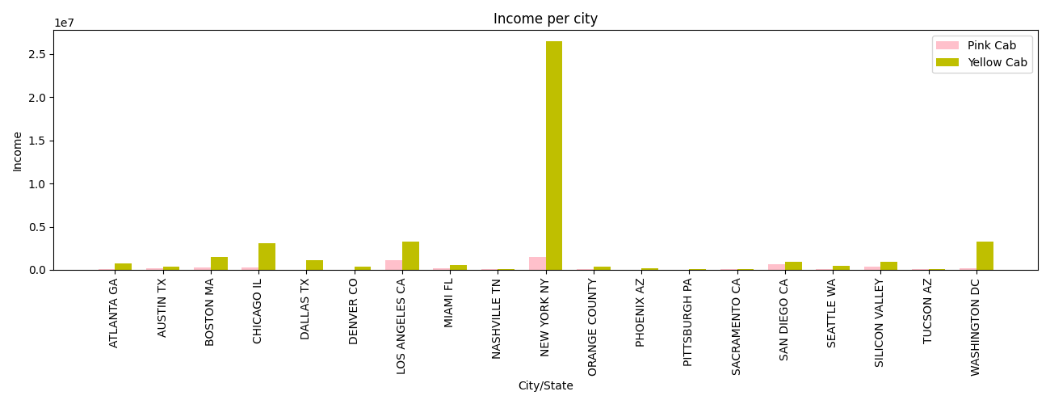
Hypothesis 2: Total Income per City/State

Slide 6
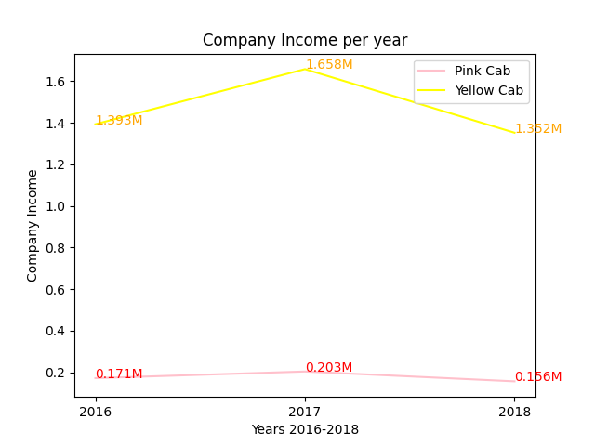
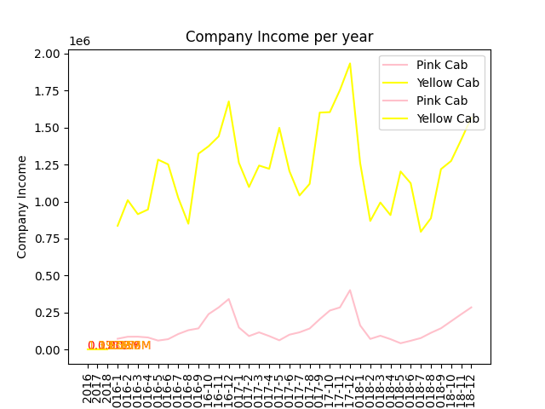
Hypothesis 3: Income rate in time matter

Slide 7
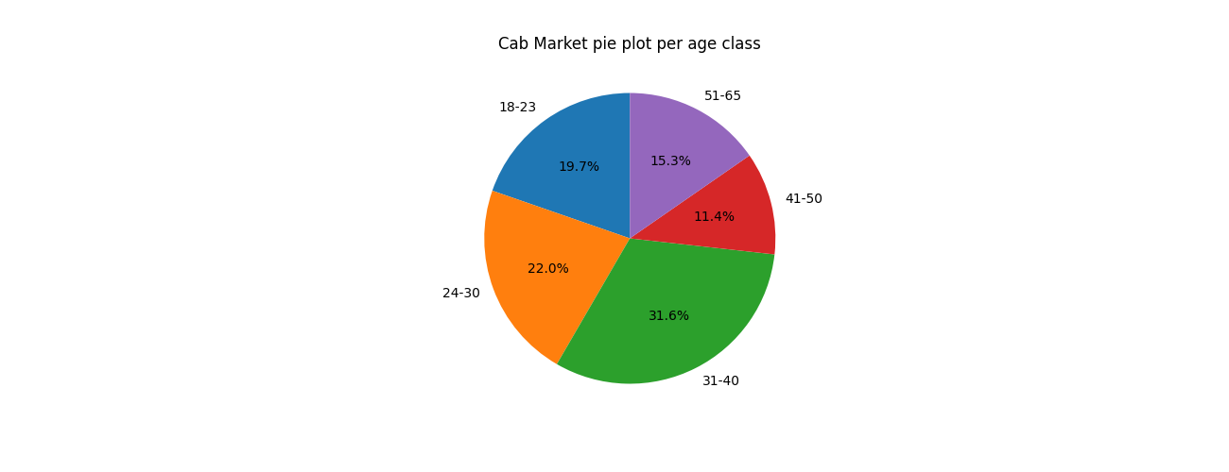
Hypothesis 4: Profile Analysis
Pie plot for age class

Slide 8
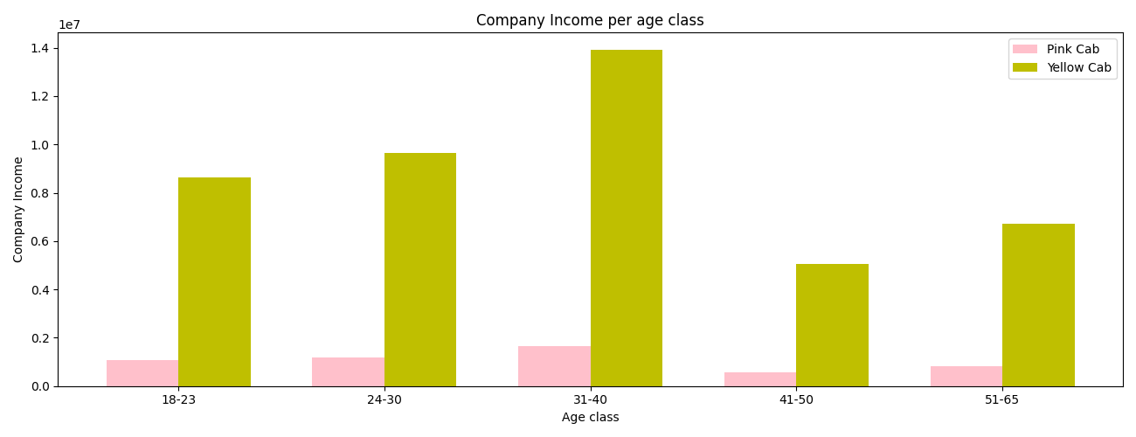
Hypothesis 4: Profile Analysis
Company Income per age class

Slide 9
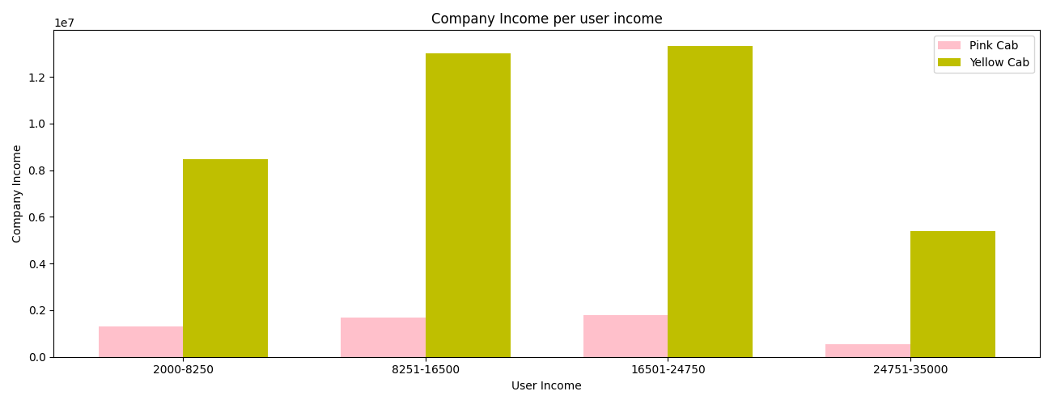
Hypothesis 4: Profile Analysis
Company Income per user income

Slide 10
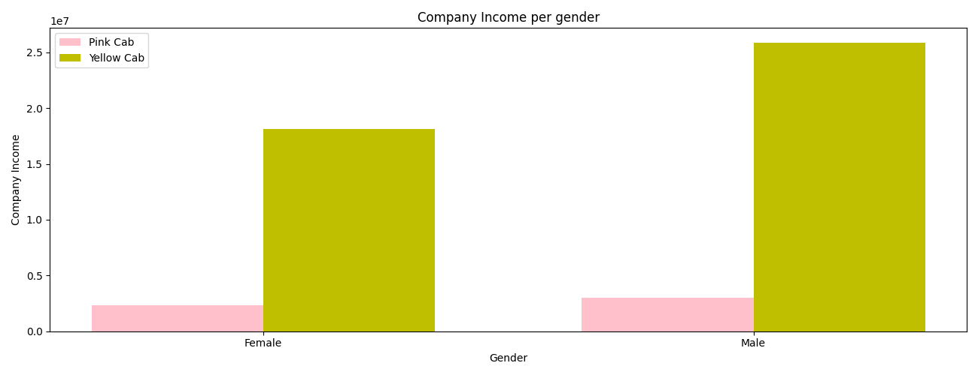
Hypothesis 4: Profile Analysis
Company Income per gender

Slide 11
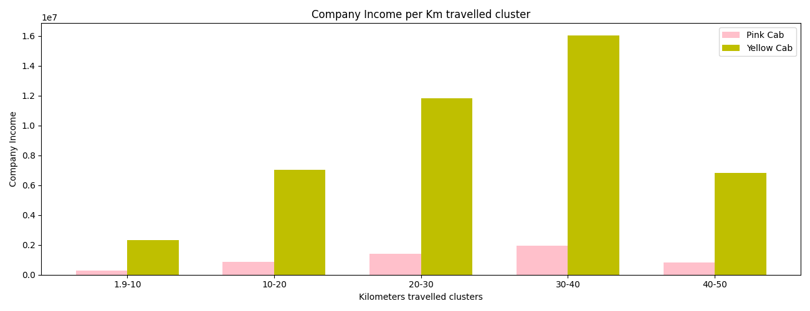
Hypothesis 5: Kilometers Analysis
 | Pink Cab | Yellow Cab
Average income per ride | 268,47 | 2.233,13

Slide 12
Results & Conclusion
In all hypotheses the Yellow Cab company appears dominant in comparison to the Pink Cab company.
Yellow Cab's total income is profoundly higher.
In all states/cities involved in the market, the Yellow Cab has the largest percentage of profit.
During the high season (September-January) the profit of Yellow Cab is higher.

Slide 13
Results & Conclusion
In terms of customer's profile (age, income and gender) Yellow Cab clearly dominates the market.
Yellow Cab evidently covers more kilometers and simultaneously the average income of each ride is much higher than the one of Pink Cab.
With full clarity we acknowledge the correctness of XYZ company to invest in the most profitable, dominating and with most future prospects for expansion and development.
XYZ company ought to invest in Yellow Cab company.

