Slide 2
What is R
R is an integrated suite of software facilities for data manipulation, calculation and graphical display.

Slide 3
Why R
Used by millions of data practitioners, researchers, academics, and the industry
A vibrant open-source community, producing a wealth of resources and advancements
Free
Open source

Slide 4
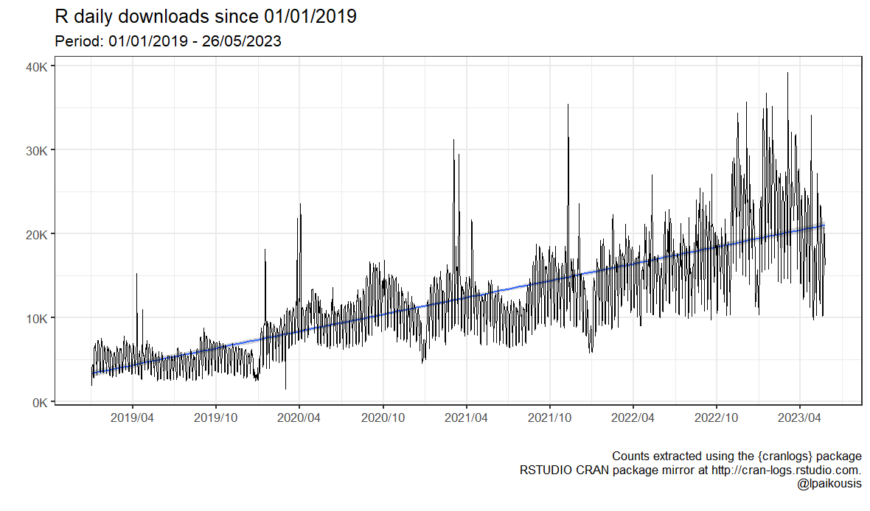
Why R

Slide 5
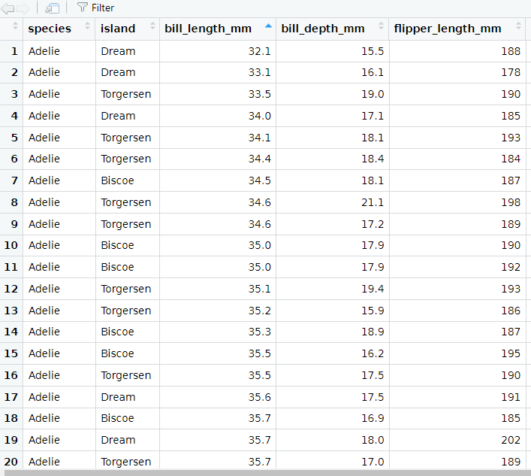
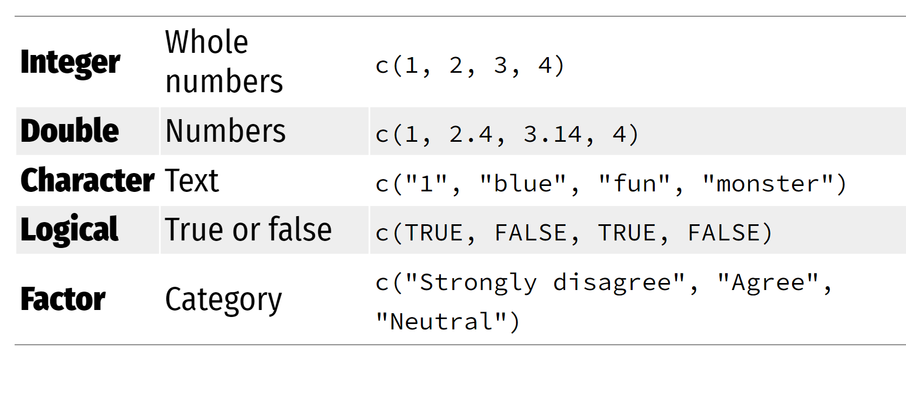
Objects in R (we will mostly use)
Data frame
Vectors

Slide 6
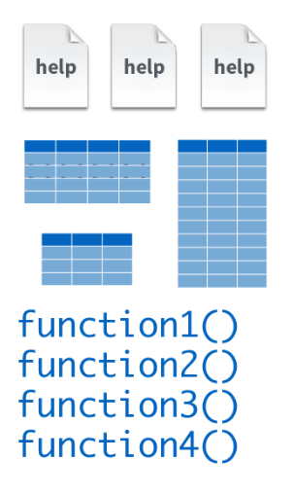
Base R

Slide 7
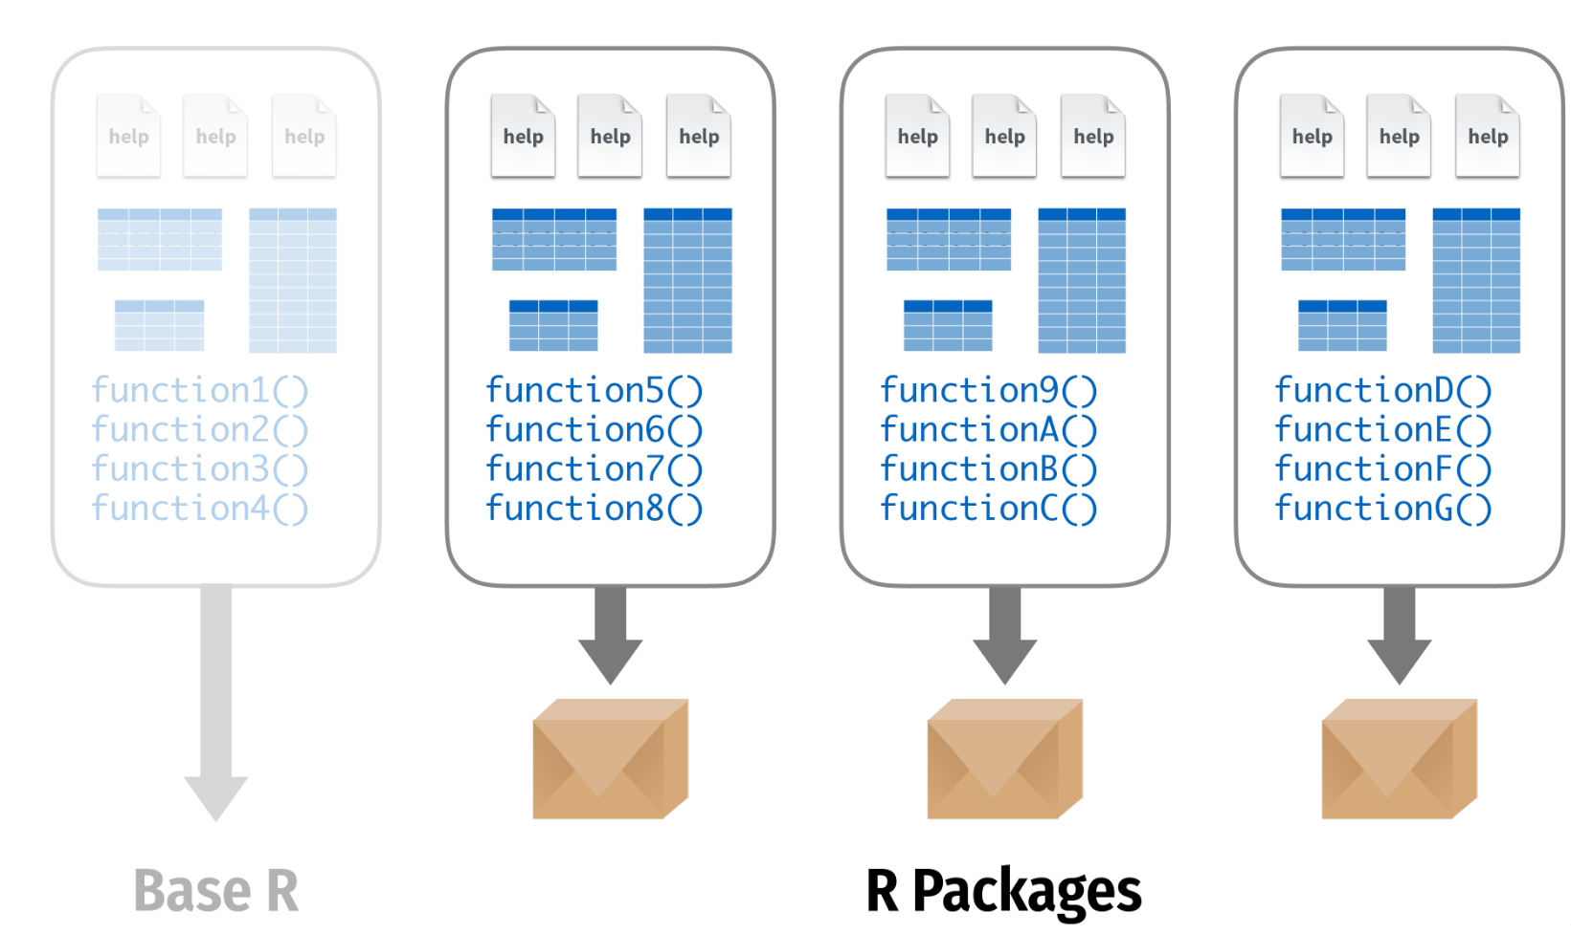
R packages
Credit: https://www.andrewheiss.com/
@andrewheiss

Slide 8
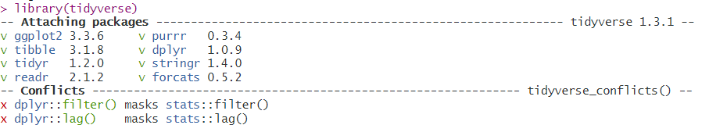
Tidyverse
The tidyverse is an opinionated collection of R packages designed for data science. All packages share an underlying design philosophy, grammar, and data structures.
Install the complete tidyverse with:
install.packages("tidyverse")
Load the Tidyverse with `library(tidyverse)`

Slide 9
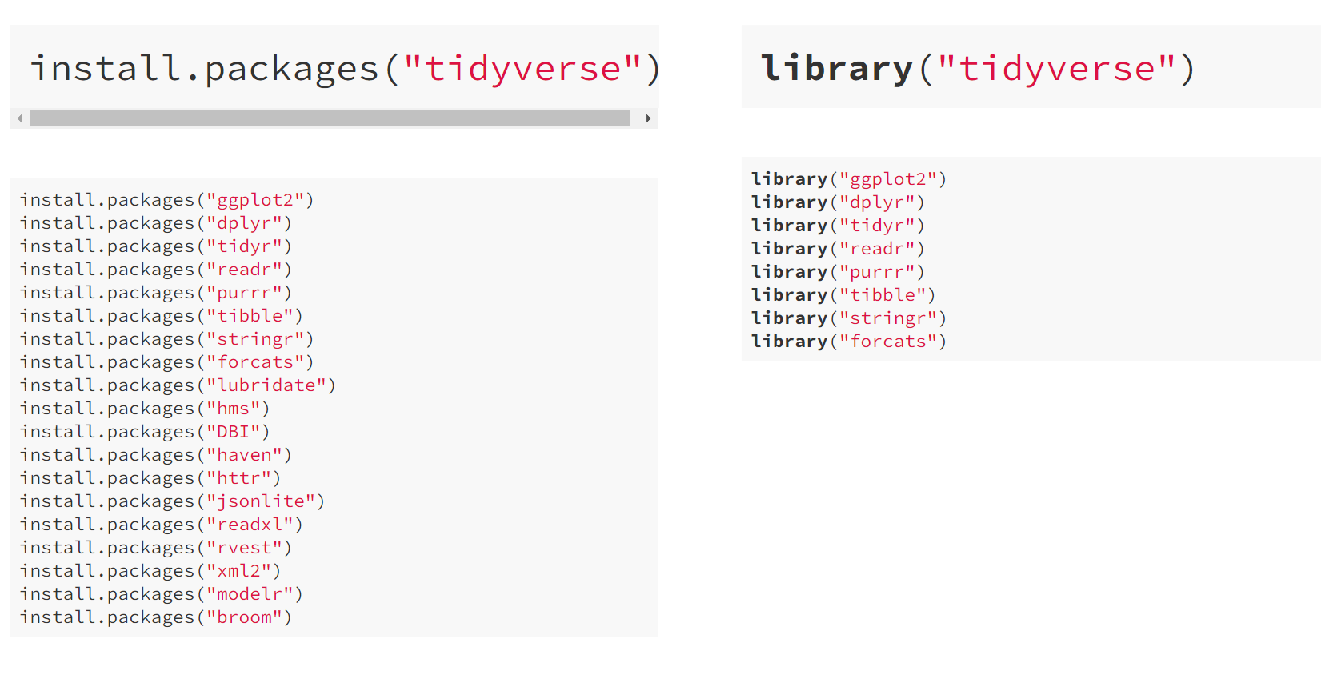
Tidyverse

Slide 10
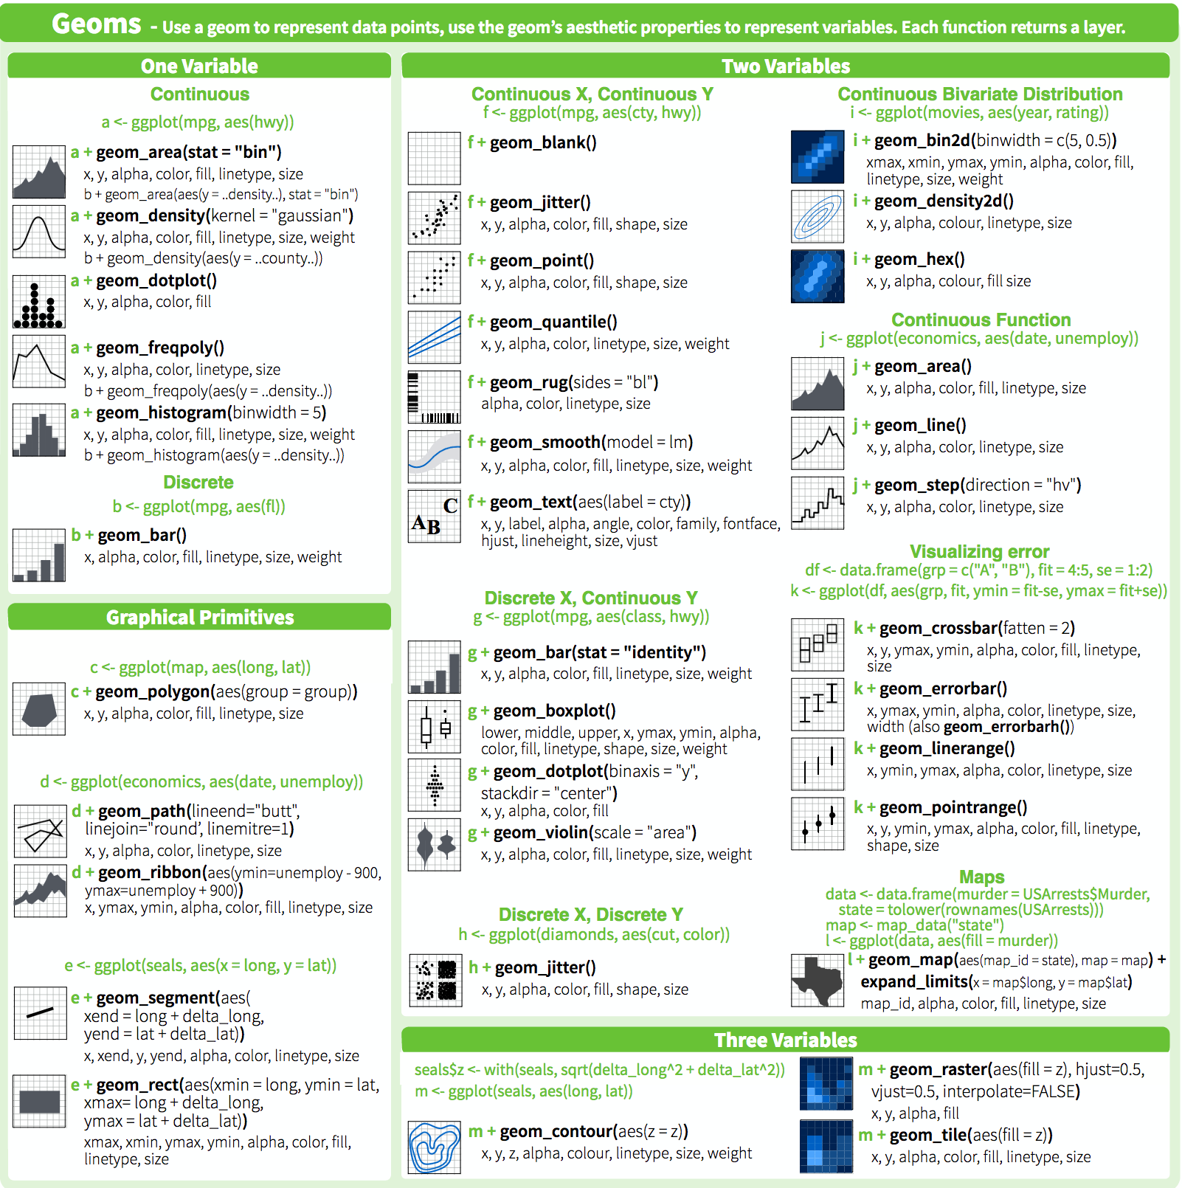
Ggplot geoms

Slide 11
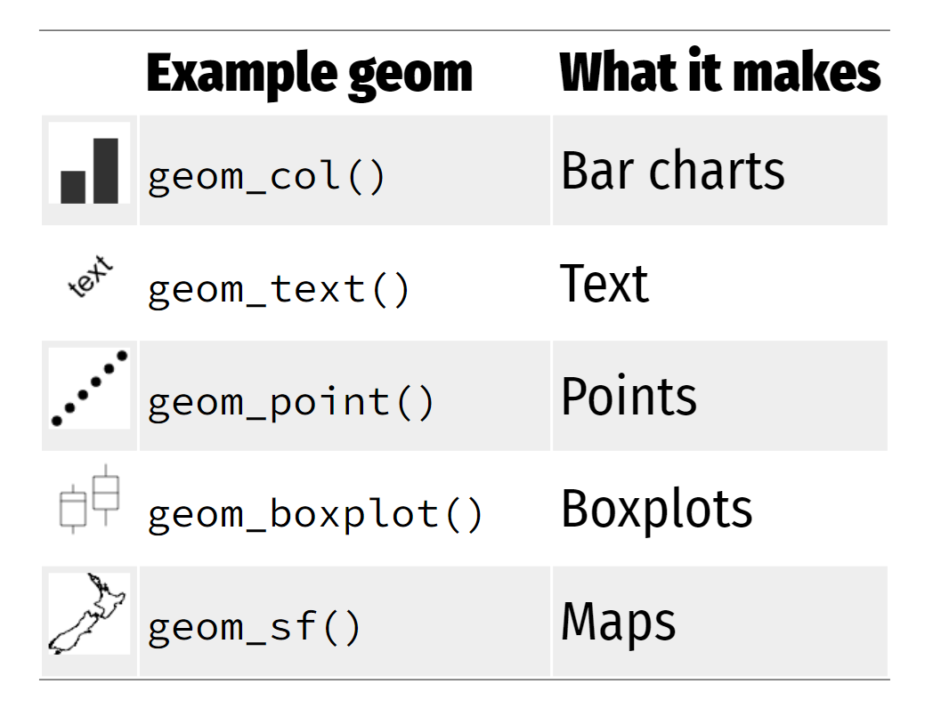
Ggplot geoms
Credit: https://www.andrewheiss.com/
@andrewheiss

Slide 13
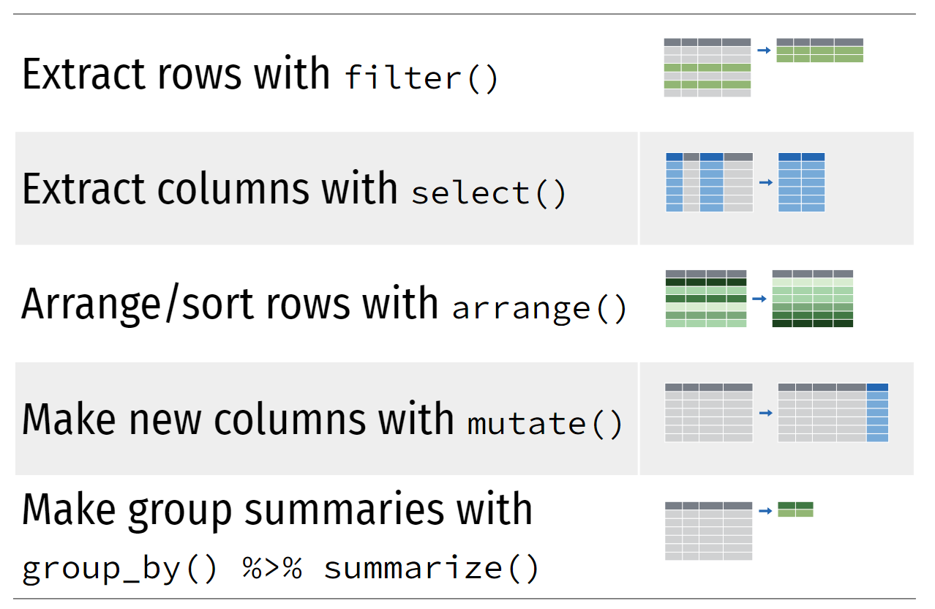
{Dplyr} basic verbs (the ones we will mostly use)
Credit: https://www.andrewheiss.com/
@andrewheiss

Slide 14
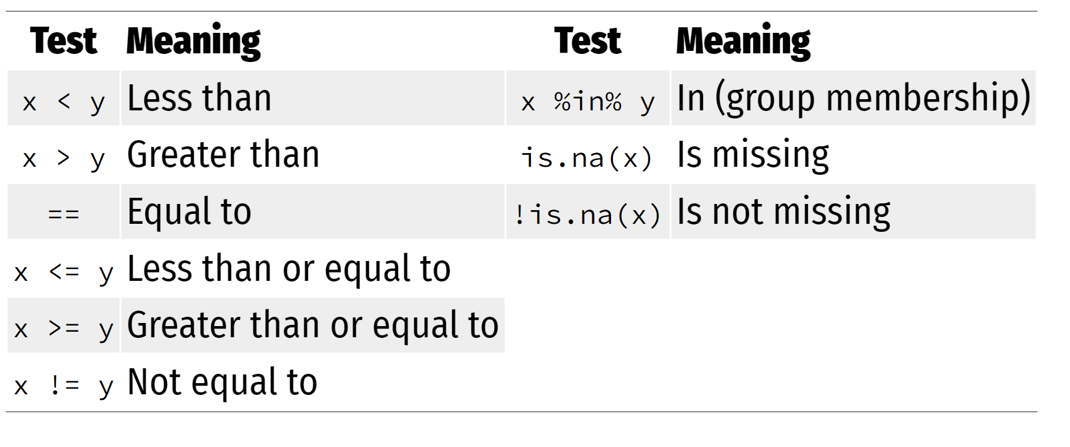
Boolean operators for filtering
Credit: https://www.andrewheiss.com/
@andrewheiss

Slide 16
Resources
R Markdown
R Markdown the definitive guide https://bookdown.org/yihui/rmarkdown/
R Markdown Cookbook https://bookdown.org/yihui/rmarkdown-cookbook/

