Slide 1
Simulation of backgrounds for particle astrophysics experiments
Simulation de bruit de fond pour des expériences d’astrophysique de particules
V. A. Kudryavtsev
Department of Physics and Astronomy
University of Sheffield
for the UK Dark Matter Collaboration and ILIAS
13/12/2004
Vitaly Kudryavtsev - LRT2004

Slide 2
Outline
ILIAS - European Programme: Integrated Large Infrastructures for Astroparticle Science.
Sources of background in underground experiments.
Neutrons from radioactivity and their suppression by passive shielding - code comparison.
Neutrons from cosmic-ray muons - code comparison.
Gamma background and its suppression.
Suppression of backgrounds by active veto.
Conclusions.
13/12/2004
Vitaly Kudryavtsev - LRT2004

Slide 3
ILIAS
ILIAS is funded by EU within the 6th framework programme: cooperation of many EU institutions involved in Astroparticle physics - http://ilias.in2p3.fr.
ILIAS was proposed under the coordination and review of APPEC - Astroparticle Physics European Coordination).
7 Networking activities (N), 3 Joint Research Initiatives (JRA), 1 Transnational Access (TA):
  Networking activity - meetings and other contacts between researchers;
  JRA - joint R&D projects between institutions on common subjects;
  TA - support the access of research teams to the major EU research infrastructures - underground labs.
N3 - Direct Dark Matter Detection (DMD) and JRA1 (Underground Laboratories) have working groups dealing with background studies - joint working group has been formed. (Another WG on low radioactivity materials).
One of the objectives of ILIAS: to disseminate a new knowledge as widely as possible through the participation in international workshops and conferences, publication of scientific papers.
13/12/2004
Vitaly Kudryavtsev - LRT2004

Slide 4
Aims of the working group
Simulations of various types of background in underground laboratories (in particular, for dark matter detectors), comparing the results from different MC codes with each other and with available experimental data (testing MC codes) - N3, JRA1.
Measurements of neutron and gamma fluxes (and spectra) in underground laboratories (Gran Sasso, Modane, Canfranc, Boulby) - one of the main objectives of JRA1 - can be used to check Monte Carlos.
Investigation of methods of background suppression and rejection (passive shielding, active vetoes etc.); formulation of requirements for shieldings and veto systems - mainly N3.
Calculation of background rates in dark matter detectors -N3.
13/12/2004
Vitaly Kudryavtsev - LRT2004

Slide 5
Backgrounds for dark matter experiments
Several large-scale (~ 1 tonne) experiments are planned for WIMP dark matter searches down 10⁻¹⁰ pb: SuperCDMS (Ge), EURECA (Edelweiss + CRESST), XMASS (Xe), XENON, ZEPLIN IV/MAX (Xe), CLEAN (Ne), DRIFT, WARP etc.
Interest for dark matter experiments including future experiments with the UKDMC participation - ZEPLIN IV/MAX, DRIFT. We have to know the background, be able to calculate it (measure if possible) and suppress/reject it:
  Neutrons and gammas from rock - suppression of >10⁶ should be achieved - passive shielding;
  Neutrons, gammas, alphas and betas from detector components - ultra-pure materials, veto (?);
  Neutrons from cosmic-ray muons - large depth, veto;
  Radon - gammas, neutrons and alphas (?) - gas-tight sealing and/or ventilation with radon-free nitrogen.
13/12/2004
Vitaly Kudryavtsev - LRT2004

Slide 6
Sources of background
Neutrons and gammas from radioactivity in rock: U/Th/K.
Neutrons, gammas, alphas and betas from radioactivity in detector components (including shielding).
Neutrons produced by cosmic-ray muons.
Background from radon (special case).
Cosmogenic activation.
13/12/2004
Vitaly Kudryavtsev - LRT2004

Slide 7
Neutron production by U/Th
SOURCES-4A (Wilson et al. SOURCES4A, Technical Report LA-13639-MS, Los Alamos, 1999) - code to calculate neutron flux and energy spectrum arising from U/Th contamination in various materials.
Problems:
  Alphas below 6.5 MeV only;
  Some cross-sections are missing (because the energy threshold for these reactions is higher than 6.5 MeV);
  Cross-sections needed updating;
Modifications to SOURCES:
  6.5 MeV upper limit removed;
  Cross-sections already present in the code library extended to higher energies using available experimental data;
  Some cross-section updated according to recent experimental results (Na);
  New cross-sections added (³⁵Cl, Fe, Cu);
  Probability of transitions to the excited states at high energies of alphas are as at 6.5 MeV (overestimate neutron energy);
  For new cross-sections - all transitions to the ground state only.
13/12/2004
Vitaly Kudryavtsev - LRT2004

Slide 8
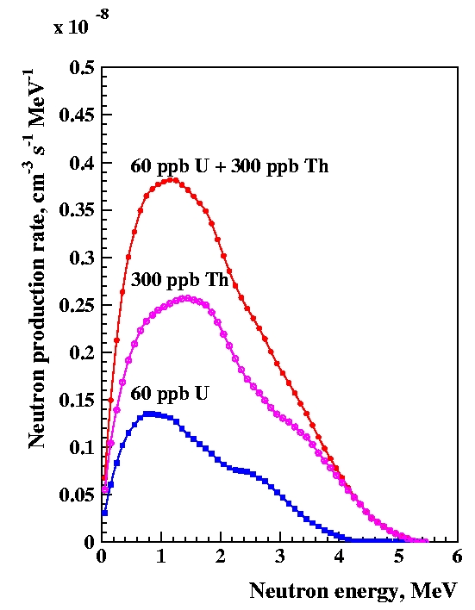
Neutron production spectra
Neutron production spectrum in NaCl (from modified SOURCES-4A): 60 ppb U, 300 ppb Th - mainly (α,n).
Neutron production rate in NaCl - 1.05×10⁻⁷ cm⁻³ s⁻¹ agrees with other calculations.
Major problem: neutron energy spectrum in the laboratory (after propagation) is softer than measured at Modane (Chazal et al. Astropart. Phys. 9 (1998) 163; revised recently - Gerbier et al. TAUP2003), Gran Sasso (Arneodo et al. Nuovo Cimento A112 (1999) 819) and CPL (Korea) (Kim et al. Astropart. Phys. 20 (2004) 549) and also softer than other simulations. But - different types of rock make direct comparison difficult.
13/12/2004
Vitaly Kudryavtsev - LRT2004

Slide 9
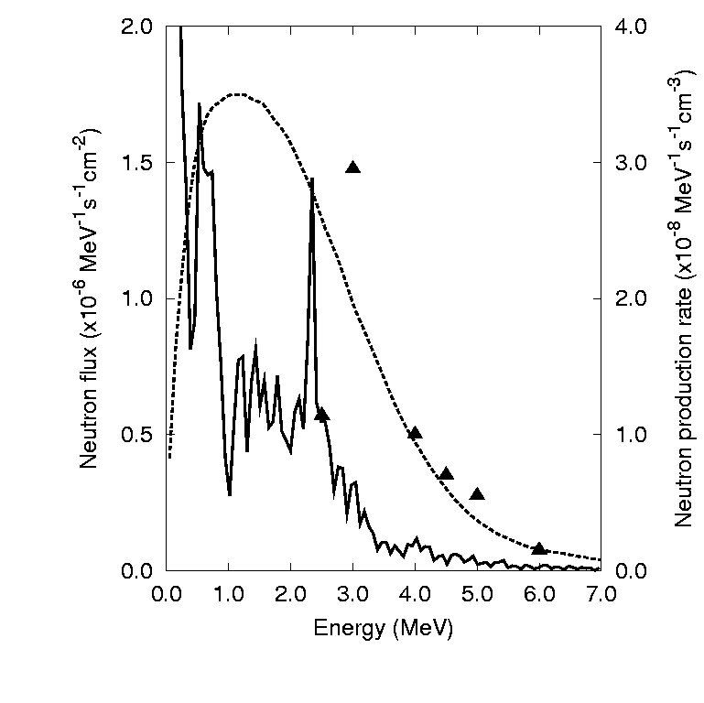
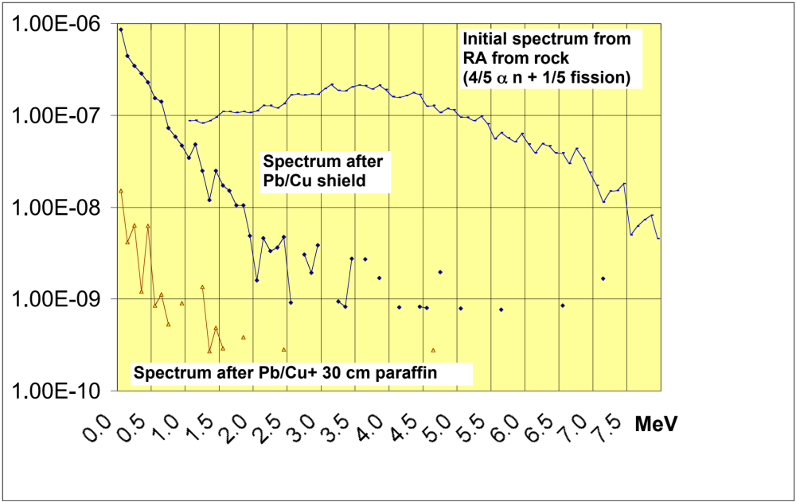
Neutron production spectra
SOURCES and GEANT4: Carson et al. Astropart. Phys. 21 (2004) 667 - simulation for Modane rock; triangles show the measurements (from concrete?) from Chazal et al. Astropart. Phys. 9 (1998) 163 (flux revised recently - Gerbier et al. TAUP2003).
Neutron spectrum (Modane calculation) and its suppression in paraffin (propagation with MCNP) - Gerbier et al. Talk at TAUP2003: http://www.int.washington.edu/talks/
WorkShops/TAUP2003/Parallel/
13/12/2004
Vitaly Kudryavtsev - LRT2004

Slide 10
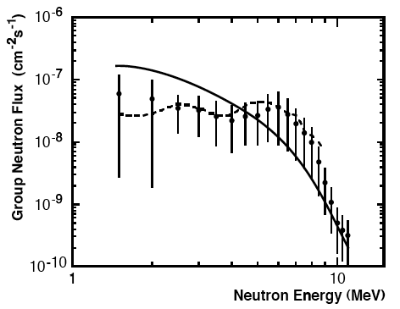
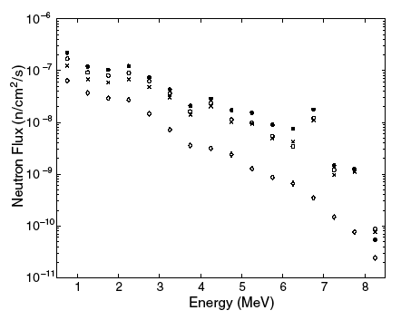
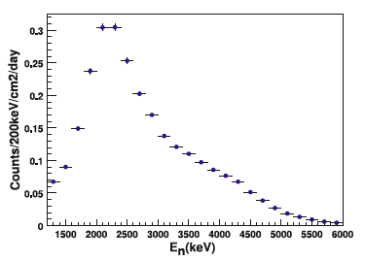
Neutron spectra from rock
Neutron propagation through rock and shielding: MCNP - Briesmeister (Ed.), MCNP - Version 4B (and later), LA-12625-M, LANL, 1997; GEANT4 - GEANT4 Collab., NIMA, 506 (2003) 250.
Neutron spectrum at Gran Sasso - Arneodo et al. Nuovo Cimento, A112 (1999) 819.
Neutron spectrum at CPL - Kim et al. Astropart. Phys. 20 (2004) 549.
Neutron spectra calculated for Gran Sasso (different halls and water contents in concrete) after propagation - MCNP - Wulandari et al. Astropart. Phys. 22 (2004) 313.
13/12/2004
Vitaly Kudryavtsev - LRT2004

Slide 11
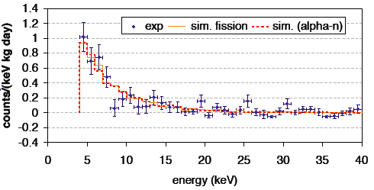
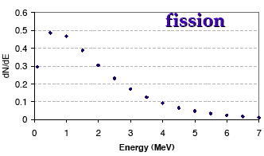
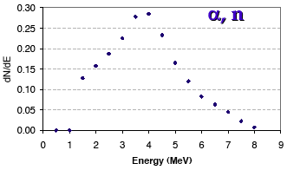
Neutron spectra from rock
Measured and simulated (GEANT4 propagation) neutron spectra for IGEX (Ge dark matter detector - Canfranc laboratory) - no significant difference was found between simulations for soft (fission) and hard (α,n) spectra - Carmona et al. Astropart. Phys. 21 (2004) 523.
Neutron spectra from fission and (α,n) reactions assumed in the simulations - Carmona et al. Astropart. Phys. 21 (2004) 523.
13/12/2004
Vitaly Kudryavtsev - LRT2004

Slide 12
Neutron spectra from rock
Main feature in SOURCES absent (probably) in other calculations:
  Accounting for transitions of the final nucleus to the excited states (GNASH calculations of probabilities) - reduces neutron energies.
Are these cross-sections, transition probabilities and other features correct? The code was tested against measured spectra from various sources, but need more accurate measurements in underground labs (including neutron spectra).
Main problems: cross-sections on many isotopes have not been measured; transition probabilities: what is the accuracy of calculations?
Is there any other code available?
Similar problems when calculating neutron production rate in detector components (including shielding).
13/12/2004
Vitaly Kudryavtsev - LRT2004

Slide 13
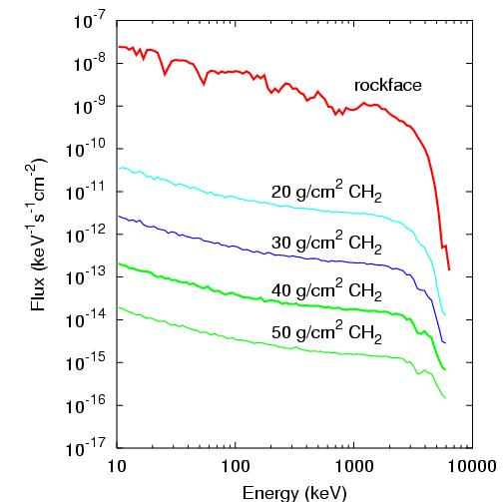
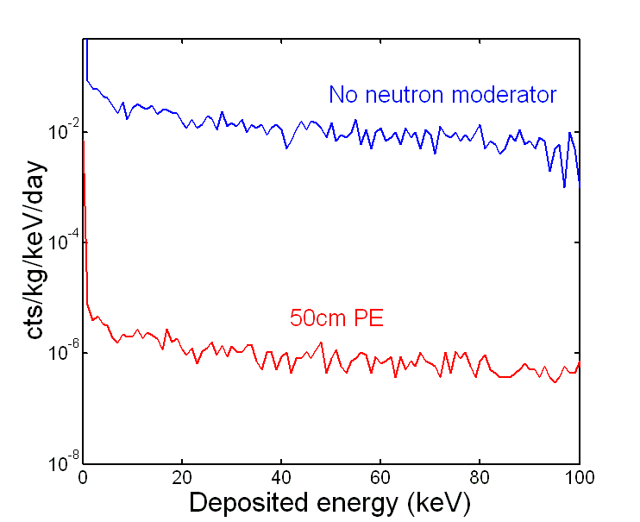
Neutron propagation and detection
MCNP and GEANT4: substantial difference, probably (partly) due to the difference in initial neutron spectra (and geometry).
GEANT4: Carson et al. Astropart. Phys. 21 (2004) 667 - >10⁵ suppression after 50 g/cm² of PE.
MCNP (detection in CRESST): Wulandari et al. Talk at IDM2004 (10⁴ suppression): http://www.shef.ac.uk/physics/idm2004.html
13/12/2004
Vitaly Kudryavtsev - LRT2004

Slide 14
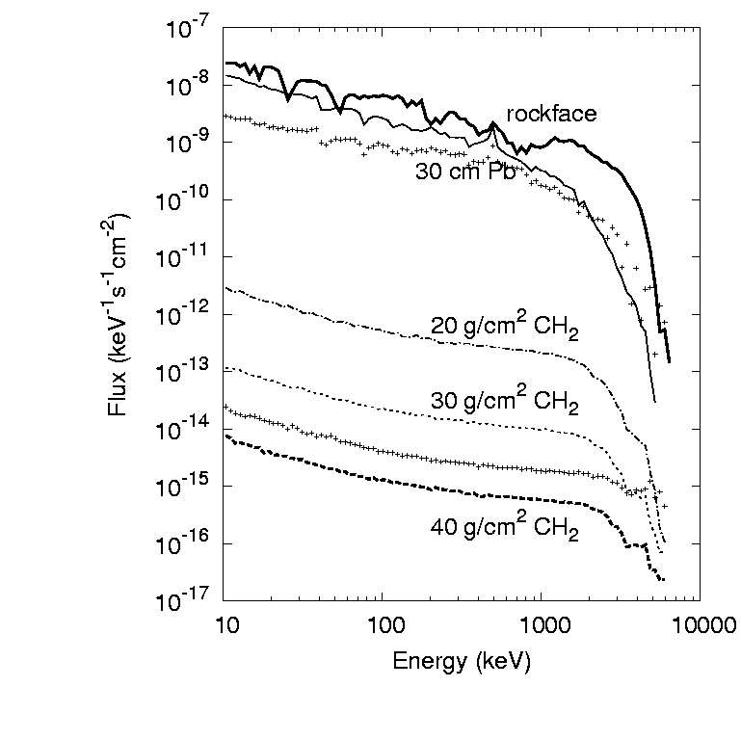
Neutron propagation and detection
Neutron spectrum suppression - MCNP: Gerbier et al. Talk at TAUP2003: http://www.int.washington.edu/talks/WorkShops/TAUP2003/Parallel/
Effect of initial neutron spectrum - GEANT4: Carson et al. Astropart. Phys. 21 (2004) 667.
Neutron propagation through the shielding with the two codes is needed using the same geometry and the same input neutron spectrum - ongoing.
13/12/2004
Vitaly Kudryavtsev - LRT2004

Slide 15
Muon-induced neutrons
Inputs:
  Muon rate - measurements at a particular underground site.
  Muon spectrum and angular distribution (normalised to the total rate) - simulations or measurements (if available) - not a problem (we are using MUSUN code - Kudryavtsev et al. NIMA, 505 (2003) 688).
  Neutrons from muons - production, propagation, detection together with all other particles (muon-induced cascades): GEANT4 (GEANT4 Coll. NIMA, 506 (2003) 250) or FLUKA (Fasso et al. Proc. MC2000 Conf., Lisbon, 2000, p. 159; ibid. p. 995).
Important: all particles should be produced, propagated and detected with one code to look for simultaneous detection of neutrons and other particles, such as photons, electrons, muons, hadrons.
For dark matter experiments: FLUKA does not generate nuclear recoils in a realistic way.
13/12/2004
Vitaly Kudryavtsev - LRT2004

Slide 16
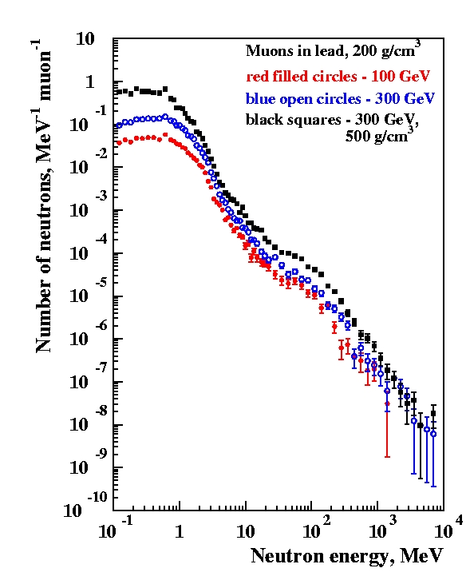
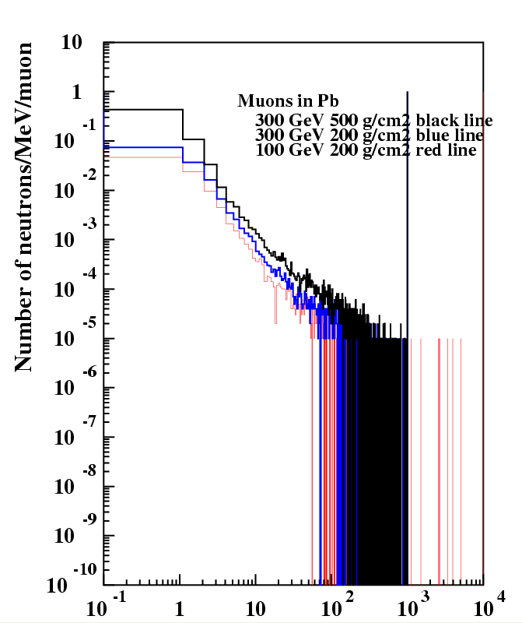
Modified GEANT3 and FLUKA
Modified GEANT3 - correct calculation of muon inelastic scattering (Karlsruhe group).
Good agreement between GEANT3 (Gerbier, talk at IDM2004) and FLUKA, although GEANT3 does not simulate photoproduction.
13/12/2004
Vitaly Kudryavtsev - LRT2004

Slide 17
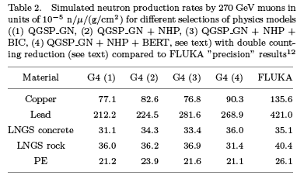
Muon-induced neutrons: GEANT4 vs FLUKA
Comparison between different models in GEANT4 and FLUKA - Bauer et al. Proc. IDM2004, http://www.shef.ac.uk/physics/idm2004.html
13/12/2004
Vitaly Kudryavtsev - LRT2004

Slide 18
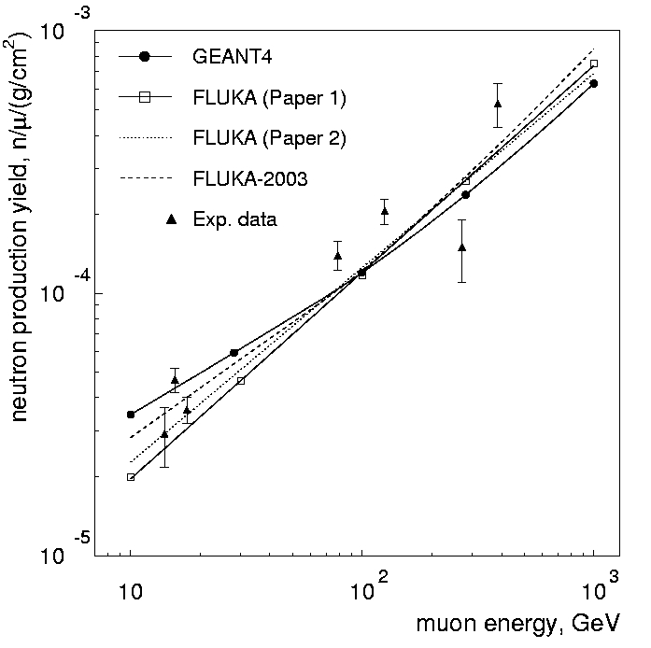
Muon-induced neutrons: GEANT4 vs FLUKA
Neutron production rate in (CH₂)_{n} (liquid scintillator):
Araujo et al., hep-ex/0411026;
FLUKA (Paper 1) - Kudryavtsev et al. NIMA, 505 (2003) 688;
FLUKA (Paper 2) - Wang et al. Phys. Rev. D, 64 (2001) 013012.
13/12/2004
Vitaly Kudryavtsev - LRT2004

Slide 19
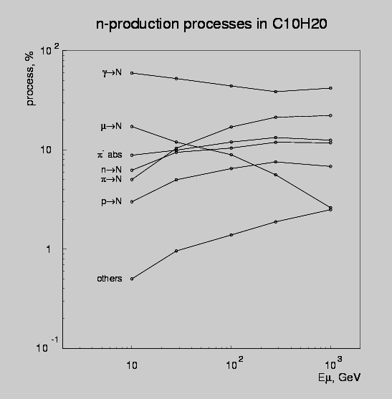
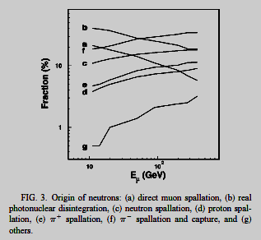
Muon-induced neutrons: processes
GEANT4: Araujo et al.
FLUKA: Wang et al.
Contribution of different processes: real photonuclear disintegration dominates in GEANT4 at all energies and for (almost) all materials.
13/12/2004
Vitaly Kudryavtsev - LRT2004

Slide 20
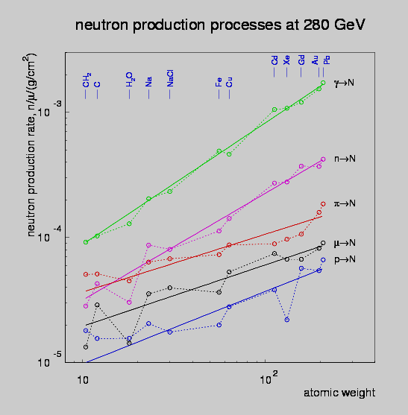
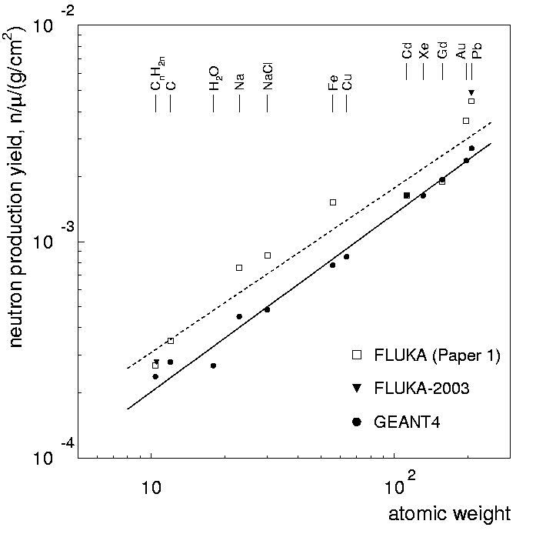
Muon-induced neutrons: A-dependence
Contribution of different processes in various materials - GEANT4: Araujo et al.
A-dependence of neutron production rate - GEANT4: Araujo et al., FLUKA: Kudryavtsev et al. FLUKA gives twice as many neutrons compared to GEANT4 in most materials tested.
13/12/2004
Vitaly Kudryavtsev - LRT2004

Slide 21
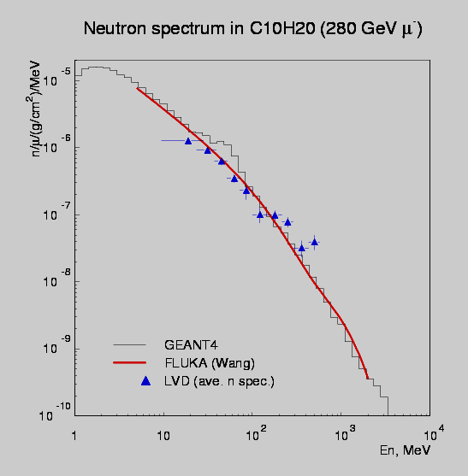
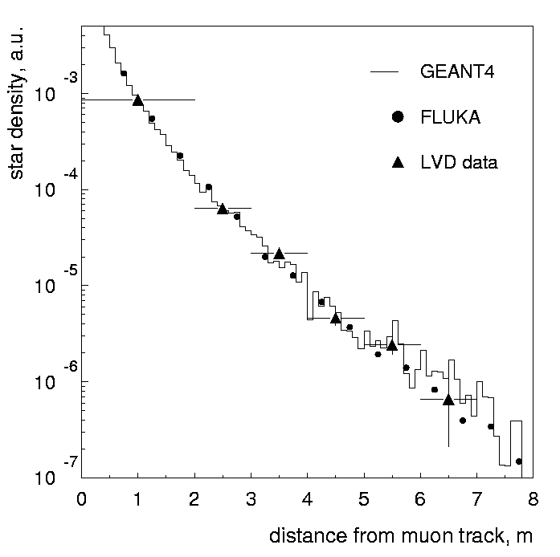
Muon-induced neutrons: spectrum and lateral distribution
Neutron production spectrum - GEANT4: Araujo et al., FLUKA: Wang et al. ; data - LVD: LVD Collab., Proc. 26 ICRC (Salt Lake City, 1999), vol. 2, p. 44; hep-ex/9905047.
Neutron lateral distribution (from muon track) - GEANT4: Araujo et al., FLUKA: Kudryavtsev et al. ; data - LVD: Proc. 26 ICRC; hep-ex/9905047. Simulations did not include detector specific features.
13/12/2004
Vitaly Kudryavtsev - LRT2004

Slide 22
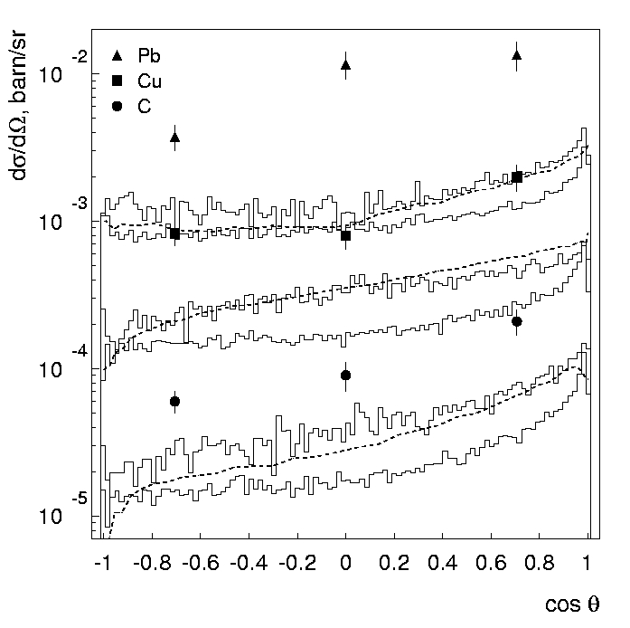
Muon-induced neutrons: problems
Differential cross-section of neutron production in thin targets for 190 GeV muons (E_{n}>10 MeV) Upper (thick) histograms - GEANT4; dashed line - FLUKA (Araujo et al.); data - NA55 (Chazal et al. NIMA, 490 (2002) 334).
Other data for lead (Bergamasco et al. Nuovo Cim. A, 13 (1973) 403; Gorshkov et al. Sov. J. Nucl. Phys., 18 (1974) 57; see Wulandari et al., hep-ex/0410032 for analysis) do not show so large discrepancy with simulations.
13/12/2004
Vitaly Kudryavtsev - LRT2004

Slide 23
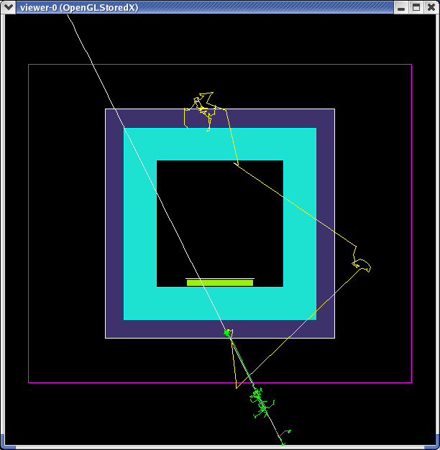
Geometry
salt
μ
lead
n
xenon
C₁₀H₂₀
air
13/12/2004
Vitaly Kudryavtsev - LRT2004

Slide 24
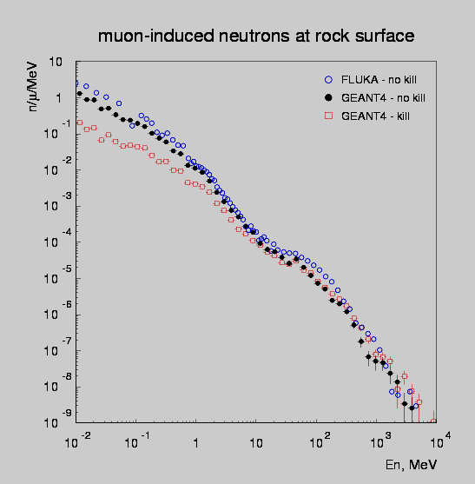
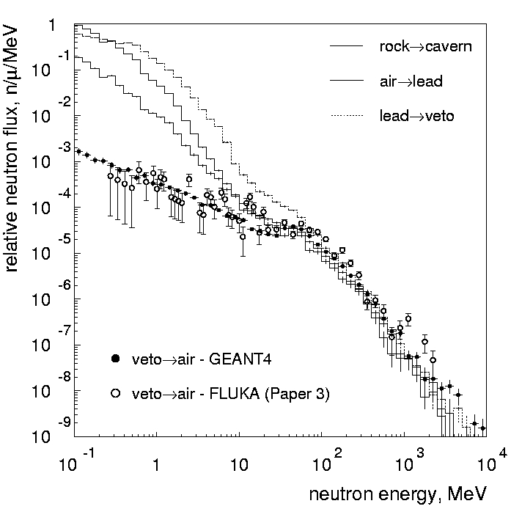
Spectra in the laboratory
Neutron spectra in the lab before and after shielding - GEANT4: Araujo et al.; also Araujo&Kudryavtsev, talk at IDM2004; FLUKA: Kudryavtsev et al. - good agreement for all energies of interest (within 50%).
13/12/2004
Vitaly Kudryavtsev - LRT2004

Slide 25
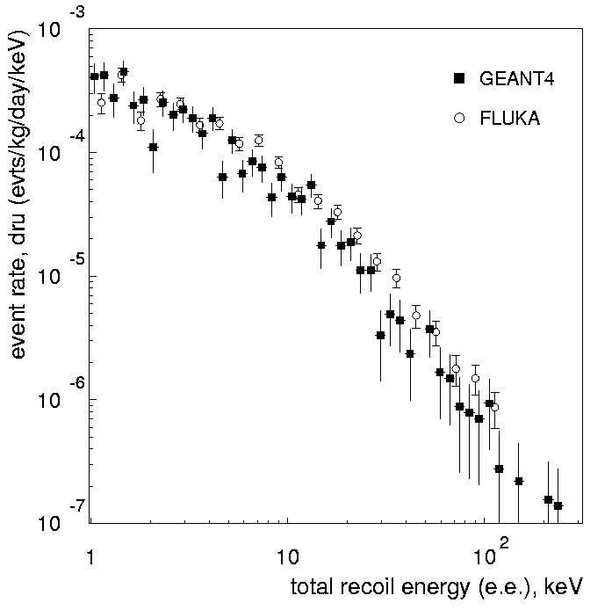
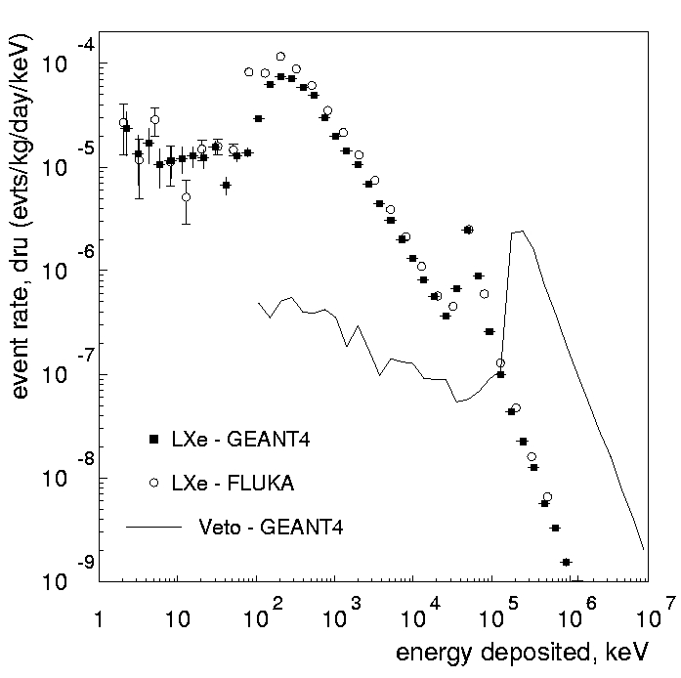
Events in xenon detector
Nuclear recoil event rate as a function of measured energy (quenching = 0.2 for xenon) - GEANT4 and FLUKA: Araujo et al. - good agreement (within 30%).
Energy spectrum of all events - GEANT4 and FLUKA: Araujo et al.
Only <10% of nuclear recoil events contain nuclear recoils only; others have large energy deposition from other particles. To estimate the background from nuclear recoils only, all particles should be produced, propagated and detected.
13/12/2004
Vitaly Kudryavtsev - LRT2004

Slide 26
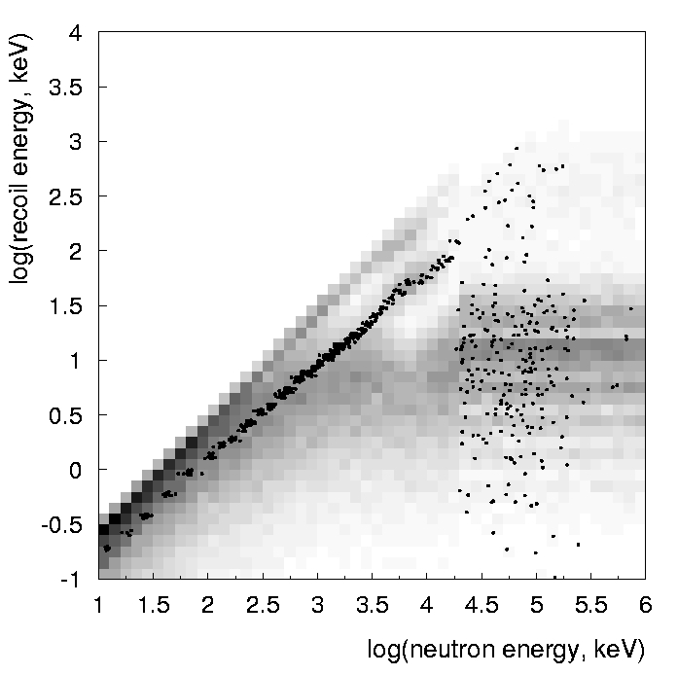
Problems with FLUKA
FLUKA does not treat low-energy nuclear recoils realistically.
Kerma factors (equivalent to the average energy deposition) are used to generate an energy deposition at the neutron interaction point.
This may be ok for statistical analysis (good agreements with GEANT4 even for nuclear recoil rates and spectra) but potentially may be a problem.
More data (with simulations) are welcome, in particular from LVD.
Can SNO contribute to this?
13/12/2004
Vitaly Kudryavtsev - LRT2004

Slide 27
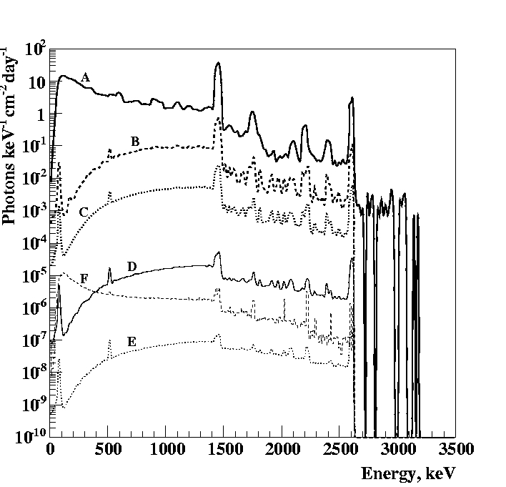
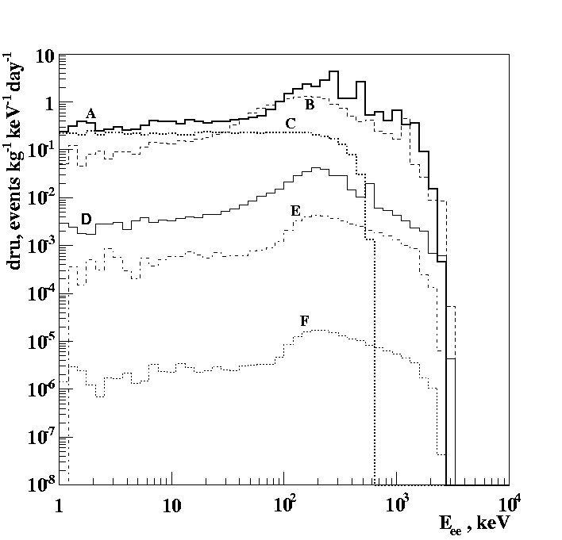
Gamma background
Gamma fluxes from radioactivity in rock (NaCl: 60 ppb U, 300 ppb Th, 1300 ppm K) simulated with GEANT4: Carson et al., submitted to NIMA; see also talk at IDM2004: A - rock/cavern interface;
B, C, D, E - after 5, 10, 20, 30 cm of lead;
F - after 20 cm of lead and 40 g/cm² of CH₂
Energy deposition spectra in 250 kg xenon from gammas simulated with GEANT4: Carson et al.: A -from ²²²Rn (10 Bq/m³); B-ultra-low background PMTs - Hamamatsu R8778; C - ⁸⁵Kr (5 ppb); D - copper vessel (0.02 ppb, 350 kg); E (F) - from rock after 10 (20) cm of lead and 40 g/cm² of CH₂.
13/12/2004
Vitaly Kudryavtsev - LRT2004

Slide 28
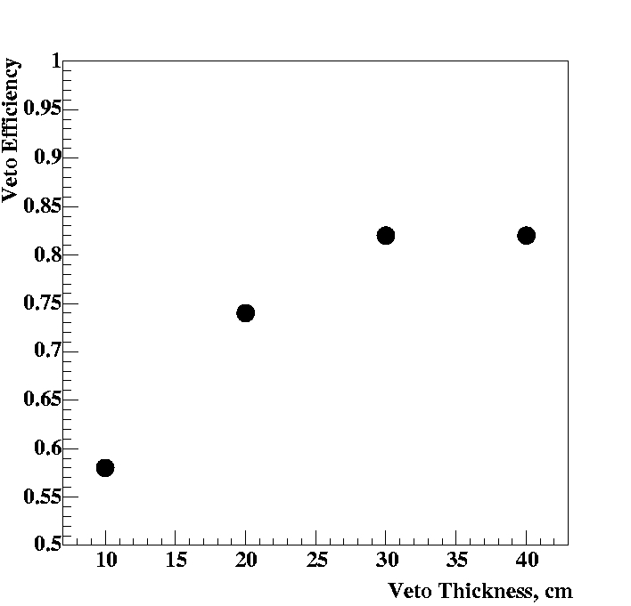
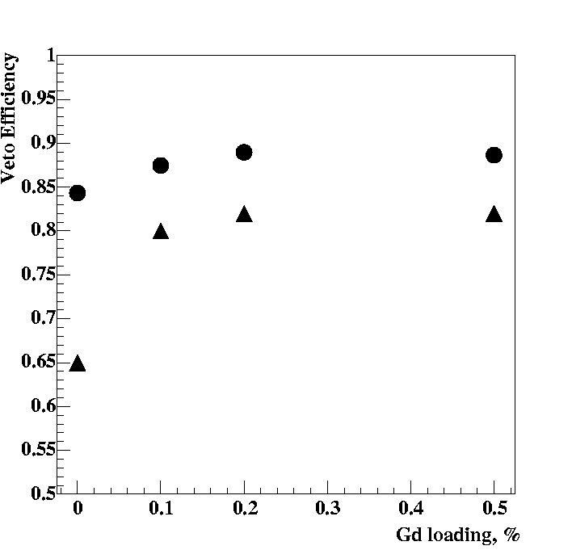
Veto performance
Veto efficiency for neutron rejection (from detector components) as a function of veto thickness. Detector - 250 kg of xenon; measured energy - 2-10 keV; veto - Gd loaded (0.2%) liquid scintillator; gammas from n-capture only.
GEANT4: Carson et al. Submitted to NIMA.
Veto efficiency for neutron rejection (from detector components): 250 kg of xenon; measured energy - 2-10 keV; veto - Gd loaded liquid scintillator (40 g/cm²); GEANT4: Carson et al. Submitted to NIMA. Circles - detection of proton recoils + neutron capture; triangles - gammas from n-capture only.
13/12/2004
Vitaly Kudryavtsev - LRT2004

Slide 29
Conclusions
Neutron production:
  large uncertainties in the neutron energy spectrum. More measurements underground are needed.
  Better knowledge of (α,n) cross-sections and transition probabilities to the excited states is required.
  Is there any other code (not SOURCES) publicly available?
Low-energy neutron propagation and detection:
  MCNP vs GEANT4 - need more tests with the same geometry, same initial neutron spectra etc.
Muon-induced neutrons:
  FLUKA and GEANT4 (also modified GEANT3) agree within a factor of 2 (or even better).
  Most experimental data (although with large uncertainties) are also in agreement with simulations within similar factor.
  Some data show significantly larger neutron production rate in heavy materials.
Gammas:
  Physics is very well known and surprises are not expected but…
13/12/2004
Vitaly Kudryavtsev - LRT2004

