Slide 1


Slide 2

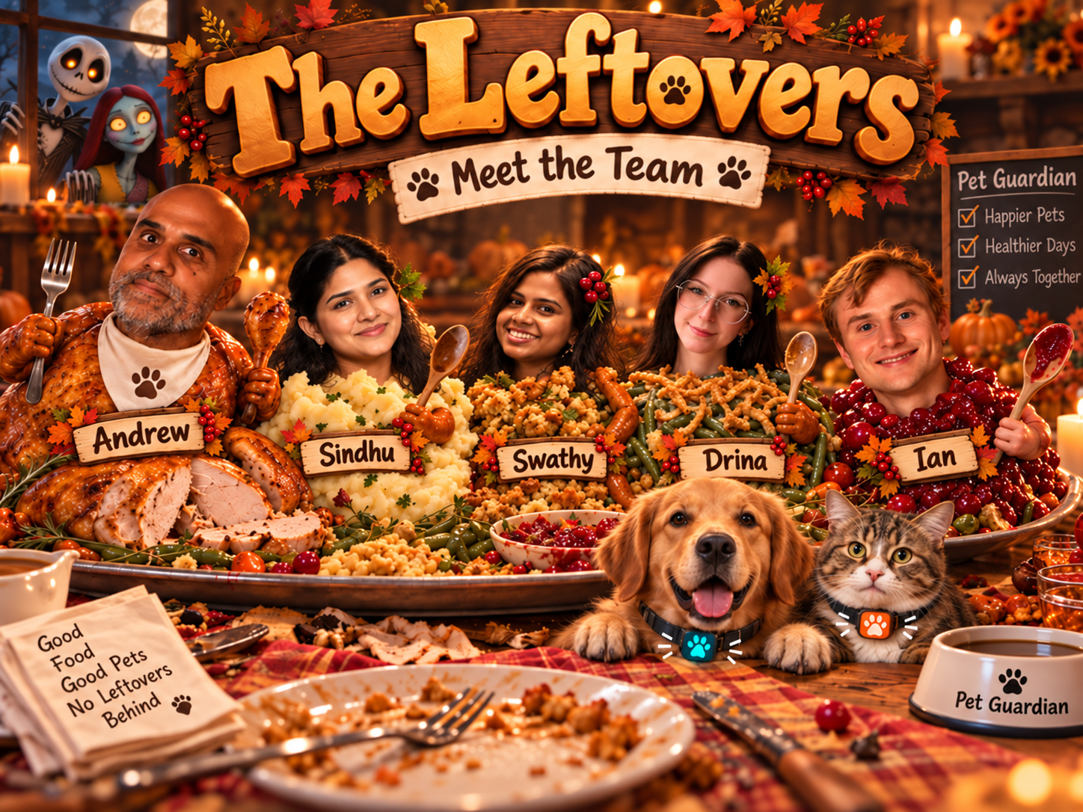

Slide 3
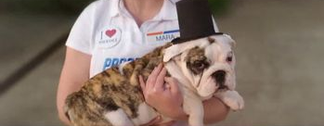
Motivation
At CRM Elevate, we heard business leaders discuss the impact of the unexpected growth of Progressive's Pet Insurance.
How can we capture more of this growing market?

Slide 4







When You’re Away, Who’s Watching?
Is the room too hot or cold?
Where is my pet?
Can I check in?
Is my pet safe?
Has my pet eaten?
Notes:
With motivation slide, we probably don't need this slide – pretty similar to next slide

Slide 5
Meet Pet Guardian
A Raspberry Pi powered pet safety and monitoring system for when owners are away.
Environment Monitoring
Pet Proximity
Monitor Temperature and Humidity
Estimate how close your pet is to the HUB
Feeding Awareness
Live check-in!!
Track whether food was dispensed or eaten
See and hear your pet in real-time
Peace of Mind
Better awareness when pets are home alone
Notes:
Replace Pet Proximity with Pet Location (since that's more what we care about even though demo is measuring proximity)
Replace middle photo with some sort of sensor/Pi icon with a pet?
Add icon for pet movement/step tracker
Add note about how we intend to package this (application that we package to people with Pis or other edge computing devices with sensors)

Slide 6
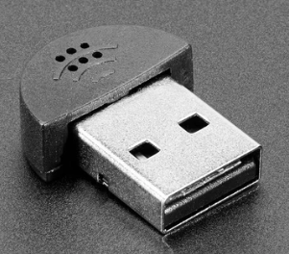
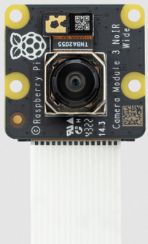
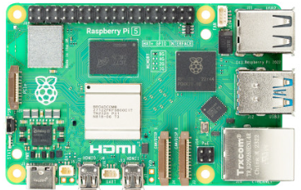
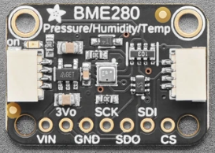
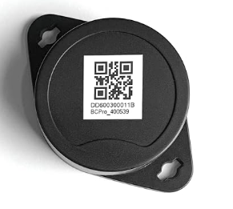
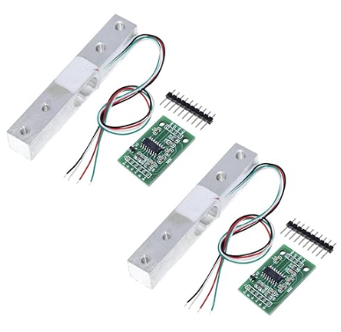
Building Pet Guardian
Microphone
Audio Monitoring
The hardware powering pet safety, monitoring, and awareness
Camera Module
Live Video
Central Hub
BME 280 Sensor
Temp/Humidity
BLE Pet Tag
Pet Proximity
Load Cell
Feeding awareness

Slide 7
Dashboard
Two Approaches
Create customized dashboard "from scratch"
  Start from blank code repository, use CoPilot to generate PGR-themed dashboard based on input specifications
Use Node-RED – low-code solution with native support for Arduino/Raspberry Pi inputs
  Leverage pre-existing dashboard framework and use Node-RED documentation alongside AI to implement each sensor reading and visualization
Notes:
Mention that AI has sped up development greatly, which afforded us the chance to look at two different dashboard approaches

Slide 8





Dashboard Concept 1 – Tech Stack
Flask backend to serve the dashboard
OpenCV captures and prepares live camera feed
Read BME280 environmental data through I2C (inter-integrated circuit) bus with RaspPi OS packages bme280 and smbus2
BLE Scanning with Bleak python library
YAMNet TensorFlow Lite model for audio classification
Notes:
Maybe have AI clean up this slide a bit

Slide 9
Demo 1

Slide 10
How it works, add dashboard, alerts, etc?????

Slide 11
Embed video demo here??

Slide 12
Future enhancements???

Slide 13
Insurance tie-in…closing impact???

