Slide 1


Slide 2



Slide 3


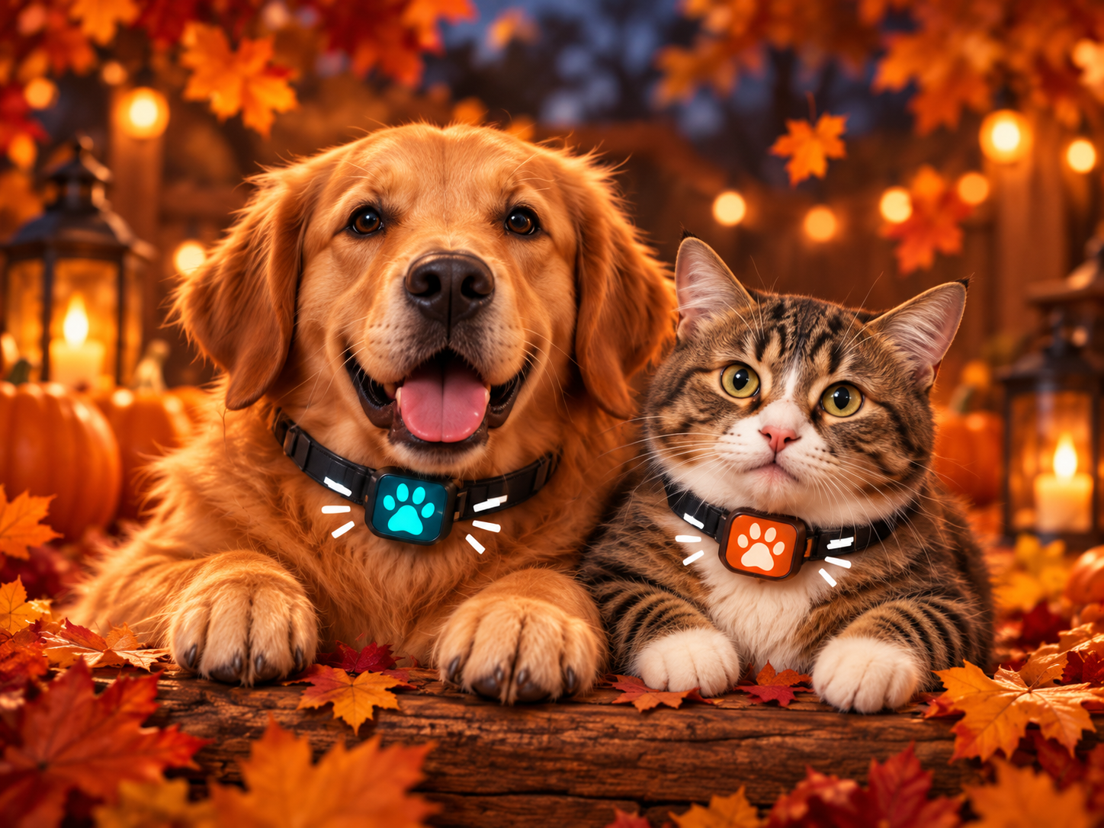




When You’re Away, Who’s Watching?
Is the room too hot or cold?
Where is my pet?
Can I check in?
Is my pet safe?
Has my pet eaten?

Slide 4
Meet Pet Guardian
A Raspberry Pi powered pet safety and monitoring system for when owners are away.
Environment Monitoring
Pet Proximity
Monitor Temperature and Humidity
Estimate how close your pet is to the HUB
Feeding Awareness
Live check-in!!
Track whether food was dispensed or eaten
See and hear your pet in real-time
Peace of Mind
Better awareness when pets are home alone

Slide 5
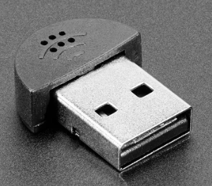
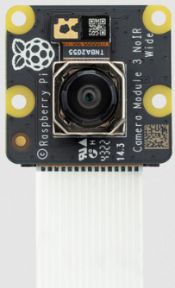
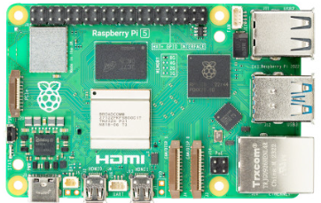
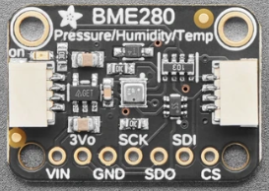
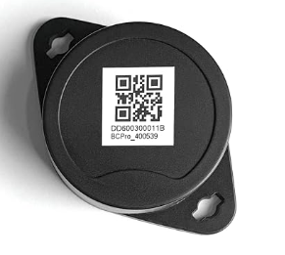
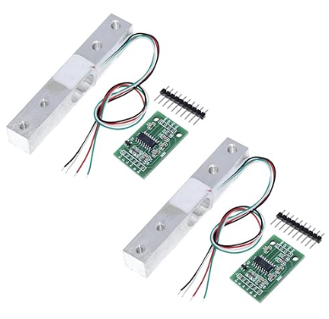
Building Pet Guardian
The hardware powering pet safety, monitoring, and awareness
Microphone
Audio Monitoring
Camera Module
Live Video
Central Hub
BME 280 Sensor
Temp/Humidity
BLE Pet Tag
Pet Proximity
Load Cell
Feeding awareness

Slide 6
How it works, add dashboard, alerts, etc?????

Slide 7
Embed video demo here??

Slide 8
Future enhancements???

Slide 9
Insurance tie-in…closing impact???

