Slide 1

ANGULARJS 1.X

Slide 2
AGENDA
Introduct about AngularJS
Environtment Setup
MVC Architecture – AngularJS
Controller - AngularJS
Services - AngularJS
Directives - AngularJS
Model View - AngularJS
Routing - AngularJS
Scope and rootScope - AngularJS
Data-binding - AngularJS
Custom Directives - AngularJS

Slide 3
Introduct about AngularJS 1.X
AngularJS is an open-source web application framework
AngularJS is a structural framework for dynamic web applications. It lets you use HTML as your template language and lets you extend HTML's syntax to express your application components clearly and succinctly
General Features
AngularJS is a efficient framework that can create Rich Internet Applications (RIA).
AngularJS provides developers an options to write client side applications using JavaScript in a clean Model View Controller (MVC) way.
Applications written in AngularJS are cross-browser compliant. AngularJS automatically handles JavaScript code suitable for each browser.
AngularJS is open source, completely free, and used by thousands of developers around the world. It is licensed under the Apache license version 2.0.

Slide 4
Advantages of AngularJS
It provides the capability to create Single Page Application in a very clean and maintainable way.
It provides data binding capability to HTML. Thus, it gives user a rich and responsive experience.
AngularJS code is unit testable.
AngularJS uses dependency injection and make use of separation of concerns.
AngularJS provides reusable components.
With AngularJS, the developers can achieve more functionality with short code.
In AngularJS, views are pure html pages, and controllers written in JavaScript do the business processing.
Notes:
Nó cung cấp khả năng tạo ứng dụng Trang Đơn một cách rất sạch sẽ và dễ bảo trì.
Nó cung cấp khả năng ràng buộc dữ liệu đến HTML. Vì vậy, nó mang lại cho người dùng một trải nghiệm phong phú và đáp ứng.
Mã AngularJS là đơn vị có thể kiểm tra.
AngularJS sử dụng tiêm phụ thuộc và sử dụng sự tách biệt các mối quan tâm.
AngularJS cung cấp các thành phần tái sử dụng. Với AngularJS, các nhà phát triển có thể đạt được nhiều chức năng hơn với mã ngắn.
Trong AngularJS, các chế độ xem là các trang html thuần túy, và bộ điều khiển được viết bằng JavaScript để xử lý nghiệp vụ.

Slide 5
Disadvantages of AngularJS
Not secure: Being JavaScript only framework, application written in AngularJS are not safe. Server side authentication and authorization is must to keep an application secure.
Not degradable: If the user of your application disables JavaScript, then nothing would be visible, except the basic page.

Slide 6
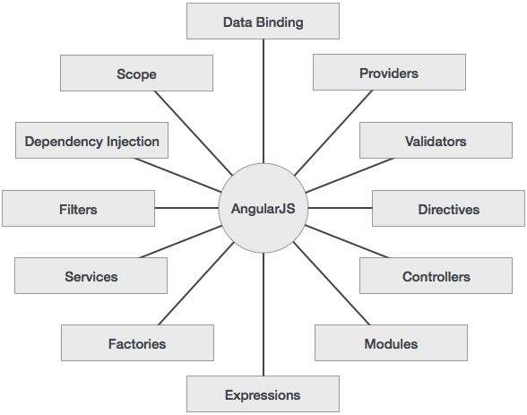
Introduct about AngularJS 1.X
Core Features:
Data-binding
Scope
Controller
Services
Filters
Directives
Templates
Routing :
Model View Whatever
Deep Linking
Dependency Injection
Notes:
Data-binding: It is the automatic synchronization of data between model and view components.
Scope: These are objects that refer to the model. They act as a glue between controller and view.
1
Angular JS
Controller: These are JavaScript functions bound to a particular scope.
Services: AngularJS comes with several built-in services such as $http to make a XMLHttpRequests. These are singleton objects which are instantiated only once in app.
Filters: These select a subset of items from an array and returns a new array.
Directives: Directives are markers on DOM elements such as elements, attributes, css, and more. These can be used to create custom HTML tags that serve as new, custom widgets. AngularJS has built-in directives such as ngBind, ngModel, etc.
Templates: These are the rendered view with information from the controller and model. These can be a single file (such as index.html) or multiple views in one page using partials.
Routing: It is concept of switching views.
Model View Whatever: MVW is a design pattern for dividing an application into different parts called Model, View, and Controller, each with distinct responsibilities. AngularJS does not implement MVC in the traditional sense, but rather something closer to MVVM (Model-View-ViewModel). The Angular JS team refers it humorously as Model View Whatever.
Deep Linking: Deep linking allows to encode the state of application in the URL so that it can be bookmarked. The application can then be restored from the URL to the same state.
Dependency Injection:AngularJS has a built-in dependency injection subsystem that helps the developer to create, understand, and test the applications easily.

Slide 7
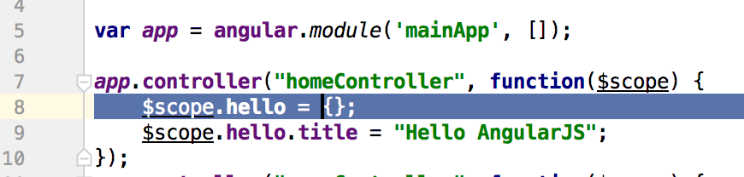
Environtment Setup
Open the link https://angularjs.org/ and download AngularJS 1 (or install AngularJS using bower or NPM framework).
Ex:
Step 1: Create file homeController with content.

Slide 8
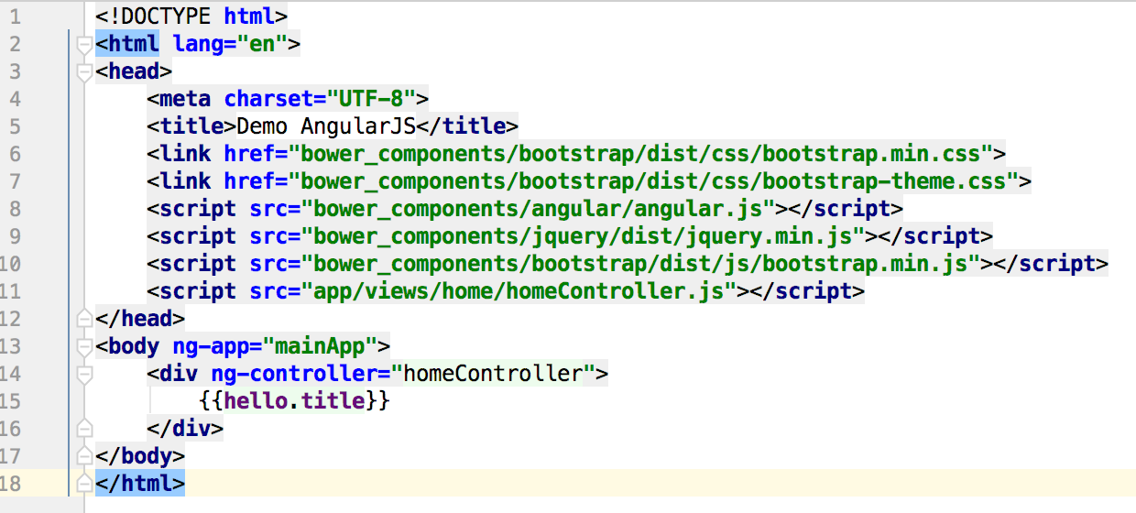
Environtment Setup
Step 2: Create file index.html with content.

Slide 9
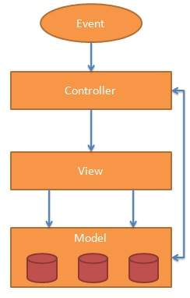
MVC Architecture
Model View Controller or MVC as it is popularly called, is a software design pattern for developing web applications.
Model − It is the lowest level of the pattern responsible for maintaining data.
View − It is responsible for displaying all or a portion of the data to the user.
Controller − It is a software Code that controls the interactions between the Model and View.
Notes:
Model − Đây là tầng thấp nhất chịu trách nhiệm tương tác với dữ liệu
View − Chịu trách nhiệm hiển thị dữ liệu được lấy từ model.
Controller − Chịu trách nhiệm điều khiển để tầng view tương tác được với model.

Slide 10
Controllers
AngularJS application mainly relies on controllers to control the flow of data in the application.
A controller is defined using ng-controller directive. A controller is a JavaScript object containing attributes/properties and functions.
Each controller accepts $scope as a parameter which refers to the application/module that controller is to control.
Syntax:
<div ng-app = "" ng-controller = "studentController">
...
</div>
Notes:
Nên sử dụng Controller trong Angular khi:
Controller trong Angular dùng để thiết lâp giá trị, trạng thái ban đầu cho đối tượng $scope
Thêm các hàm, hành vi vào đối tượng $scope
Không nên sử dụng Controller trong Angular khi:
Thao tác với DOM, nghĩa là dùng Controller để thay đổi giá trị của DOM (nội dung, thuộc tính). Trong trường hợp này thì có cơ chế data-binding rồi, bởi vậy không nên sử dụng Controller.
Validate form, nghĩa là không dùng controller để kiểm tra định dạng dữ liệu input của form. Trong trường hợp này sử dụng Angular Form Controls để thay thế.
Lọc dữ liệu, nghĩa là chuyển đổi định dạng dữ liệu, trong trường hợp này thì dùng đối tượng Filter trong Angular.
Chia sẽ dữ liệu, trường hợp này dùng Angualar Service
Quản lý thời gian sống của các component

Slide 11
DIRECTIVES
AngularJS directives are used to extend HTML. They are special attributes starting with ng-prefix. Let us discuss the following directives:
ng-app - This directive starts an AngularJS Application.
ng-init - This directive initializes application data.
ng-model - This directive defines the model that is variable to be used in AngularJS.
ng-repeat- This directive repeats HTML elements for each item in a collection.

Slide 12
EXPRESSIONS
Expressions are used to bind application data to HTML.
Expressions are written inside double curly braces such as in {{ expression}}. Expressions behave similar to ng- bind directives.

Slide 13
EXPRESSIONS
Using numbers:
Ex: <p>Expense on Books : {{cost * quantity}} Rs</p>
Using String:
Ex: <p>Hello {{student.firstname + " " + student.lastname}}!</p>
Using Object:
Ex: <p>Roll No: {{student.rollno}}</p>
Using Array:
Ex: <p>Marks(Math): {{marks[3]}}</p>

Slide 14
FILTERS
Filters are used to modify the data. They can be clubbed in expression or directives using pipe (|) character. The following list shows the commonly used filters.
Name | Description
uppercase | converts a text to upper case text.
lowercase | converts a text to lower case text.
currency | formats text in a currency format.
filter | filter the array to a subset of it based on provided criteria.
orderBy | orders the array based on provided criteria.

Slide 15
FILTERS
Ex:
Enter name: <input type="text" ng-model="student.name”> Display UpperCase: {{student.name | uppercase}}
Ex filter:
<ul>
<li ng-repeat="subject in student.subjects | filter: subjectName">
{{ subject.name + ', marks:' + subject.marks }}
</li>
</ul>

Slide 29



