Slide 1
A CONTAINERS STATE OF MIND
Chris Van Tuin
Chief Technologist, West
cvantuin@redhat.com
Notes:
GOOD MORNING, THANK YOU, IT’s GREAT TO BE HERE
My name is Chris Van Tuin
CHIEF TECHNOLOGIST at Red Hat,
I’ve been with Red Hat for 10 YEARS
Working with PARTNERS and CUSTOMERS who are adopting RED HAT’s EMERGING TECHNOLOGIES.
BEYOND LINUX - 1) Middleware, 2) Software-Defined-Storage, 3) Cloud Mgmt, and 4)Virtualization
Hot Topic with customers is Containers,
Linux containers have emerged as a key open source technology for application runtime, packaging and delivery
7. In today’s presentation, I’m going to talk about the Why, What, and How of Containers along with a brief walk thru of Docker and Kubernetes

Slide 2

THERE ARE THE WINDS OF CHANGE
AND THEN THERE IS ACCELERATING CHANGE
“…every strategic inflection point [is] characterized by a ’10x’ change…There’s wind and then there is a typhoon”
        -Andy Grove
Notes:
There are the Winds of Change and then there is accelerating change
Andy Grove of Intel had stated that “every strategic inflection point is characterized by a 10x change…There’s wind and there is a typhoon”
3) This quote is certainly reflective of the current period in the history of Enterprise IT.

Slide 3
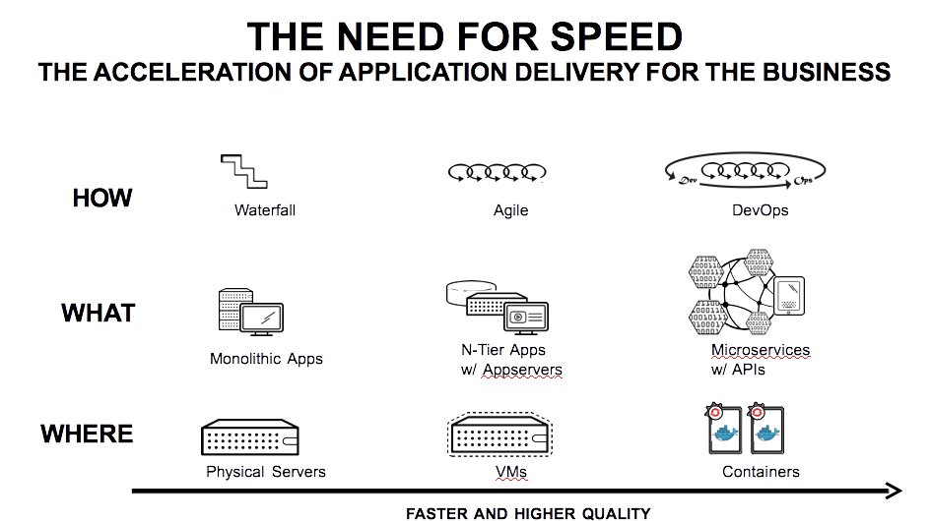
Notes:
Because once again, Enterprise IT is at one these inflection points
With the movement to Cloud and Mobile applications
the How, What, Where for Application development, architecture, and infrastructure is changing as well
There is movement to DevOps, Microservices, and Containers
to Accelerate Application Delivery for the Business
along with the promise of Higher Product Quality
This is not incremental change but the 10x change that Andy Grove speaks of
An Typhoon moment is happening right now in Enterprise IT

Slide 4
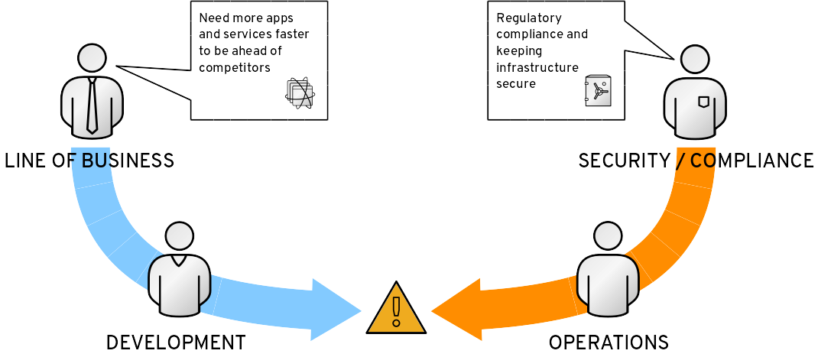
THE PROBLEM: FRICTION
Notes:
Containers are a BIG PART of this shift
CONTAINERS ARE POPULAR BECAUSE IT IS IN MIX OF A CRITICAL PROBLEM FACING TODAY’S ENTERPRISE IT
2) FRICTION BETWEEN 2 SIDES OF HOUSE
3) On the Left side, Business and Developers, DIFFERENTIATING WITH BETTER APPS AND SERVICES to STAY AHEAD OF COMPETITION
4) On the right side you have OPERATIONS AND SECURITY TEAMS they are all about AVAILABILITY, SECURITY, COMPLIANCE.
5) Typically, friction, between 2 groups, developers want to MOVE FAST & have FREEDOM OF CHOICE
6) But typically typically this has meant, ops and security teams have to limit choices for the developers
8) They have to impose processes for change management and long lead times
9) DEVELOPERs and BUSINESS perceived IT as a BOTTLENECK and has led to SHADOW IT in some cases, with the BUSINESS Going directly to Public cloud for IT services
10) This Friction has been happening for a long time
11) it’s gotten a lot worse as IT becomes a key strategic differentiator for more and more businesses

Slide 5
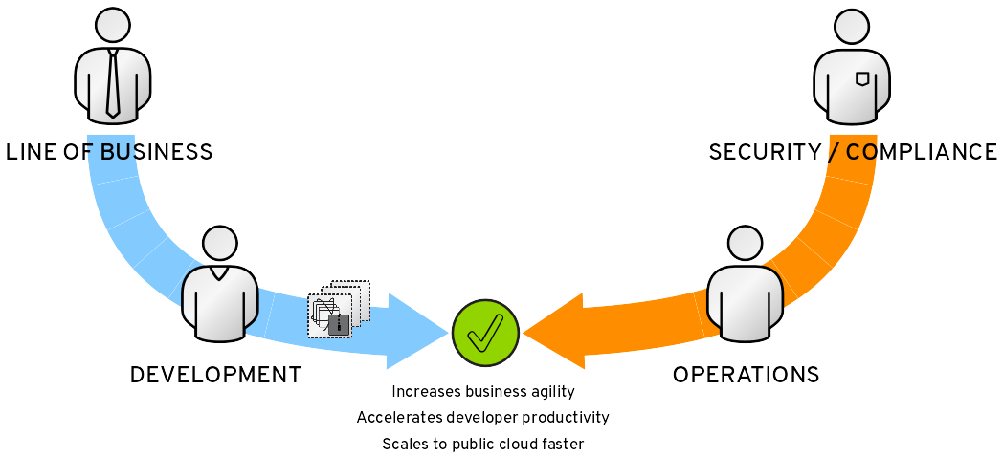
APPLICATION DELIVERY VIA CONTAINERS
Notes:
1) CONTAINERS HAVE COME TO RESUCE by IMPROVING APPLICATION DELIVERY
2) CONTAINERS CAN DRIVE REVOLUTIONARY CHANGE INTO HOW 2 SIDES OF IT WORK TOGETHER
3) ALLOW DEVELOPERS AND LOB TO OWN THEIR APP IN THE FORM OF A CONTAINER
4) CAN BE DEPLOYED, MAINTAINED, AND OPERATED
5) ON TOP of INFRASTRUCTURE that OPS TEAM PROVIDES
6) WITHOUT COMPROMISING SECURITY OR COMPLIANCE
7) THE PROMISE OF CONTAINERS
8) IS THAT EVERYBODY’s NEEDS ARE FULFILLED and these TEAMS can WORK TOGETHER IN BETTER WAYS
9) THAN PREVIOUSLY were ABLE TOO
In the eyes of many inside the organization, containers really come to the rescue. Containers can drive a revolutionary change into how these two sides of an IT organization work together; they allow developers and the line of business to own their applications in the form of containers that then can be deployed, maintained, and operated on top of infrastructure that the Ops team provides, without compromising security or compliance. The promise of containers is that everybody’s needs are fulfilled, and these teams can work together in better ways than previously they were able to.

Slide 6
WHAT ARE LINUX CONTAINERS?
Used to create containers for software applications / microservices
Containers provide lightweight isolation of process, network, filesystem spaces
Package Once Deploy Anywhere
Docker builds on Linux containers, adds an API, image format, runtime, and a delivery and sharing model
CONTAINER
APP
LIBS
HOST OS
SERVER
Notes:
WHAT ARE LINUX CONTAINERS?
1) Used to create containers for software applications
2) Containers provide lightweight isolation of process, network, filesystem spaces
This gives the appearance to the application that it has it’s own dedicated system and enables multi-tenancy to run many containers on a single host
3) Package once deploy anywhere
4) Containers are not new, many years ago Solaris had Zones, Linux has had containers for years in the form of OpenVZ, LXC, and now Libcontainer,
5) However, it was when Docker came along that there popularity took off.
6) Docker builds on Linux Containers, adds an API, standardized runtime, an image format and a delivery and sharing model for the images

Slide 7
TRADITIONAL OS VS CONTAINERS
Traditional OS
Containers
CONTAINER
CONTAINER
APP A
APP B
APP A
APP B
LIBS A
LIBS B
LIBS
LIBS
LIBS
LIBS
HOST OS
HOST OS
HARDWARE
HARDWARE
Notes:
TRADITIONAL OS:
1) Hardware
2) Runtime
3) Libraries
CONTAINERS:
1) Libraries and Runtime in container
2) Runs as an isolated process in userspace on the host OS
3) Kernel shared with host and other containers,
4) Unlike Virtualization, Hardware continued to be provided by host OS,
5) Enjoys resource isolation and allocation benefits of VMS, but much more portable and efficient

Slide 8

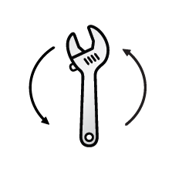




MANY SEE CONTAINERS AS THE UTOPIA OF APPLICATION DELIVERY
“What top benefits do you see with containers?”
Containers potentially offer the ability to encapsulate a lot of manual processes and make it little or no touch.
- IT Operations Engineer, Financial Services
54%
51%
38%
30%
FASTER APP
DELIVERY
OPERATIONAL
EFFICIENCY
DEPLOYMENT
FLEXIBILITY
LOWER
DEPLOYMENT
COSTS
Source: TechValidate survey of 79 IT professionals
Containers transform the way you
deliver applications to accelerate innovation.
Notes:
WHAT ARE THE TOP BENEFITS DO YOU SEE WITH CONTAINERS?
FASTER APP DELIVERY - go to Dev to Production in Minutes
OPERATIONAL EFFICIENCY - eliminate manual processes
DEPLOYMENT FLEXIBILITY - eliminate environment lock-in and enable to run arun across wide range of environments
LOWER DEPLOYMENT COSTS - simplify and automate deployment processes
These benefits are all well aligned with enabling the business to accelerate application delivery

Slide 9
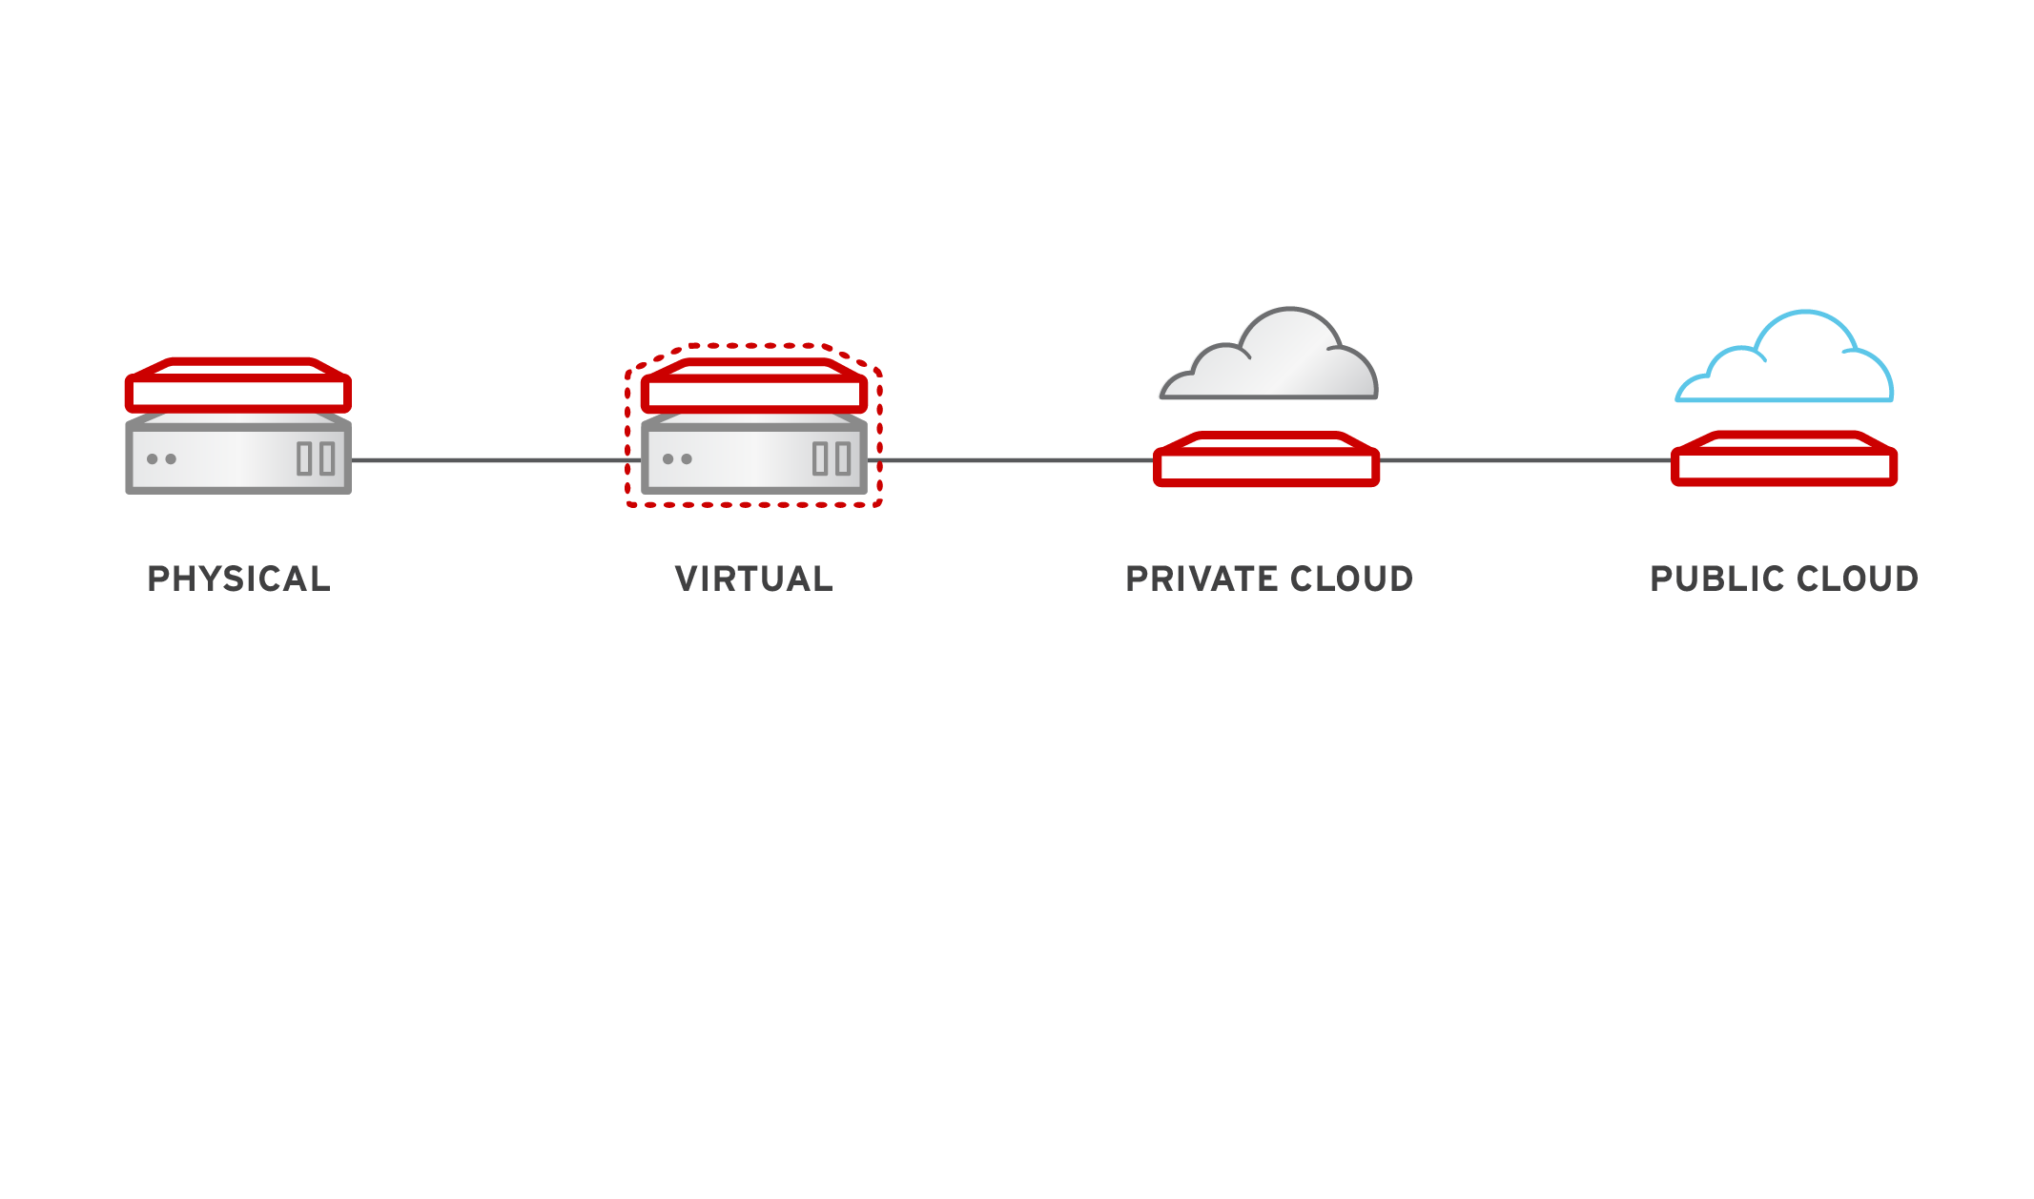
PORTABILITY and FLEXIBILITY
Notes:
Containers provide application Portability and Flexibility
Linux containers are available and compatible across a wide range of platforms whether it is Linux running on a physical, virtual, private, or public cloud
Providing FLEXIBILITY to choose platform which makes most sense for the Application workload and use case

Slide 10


FASTER APP DELIVERY and EFFICIENCY
APP
HOST OS
SERVER
LIBS
CONTAINER
CONTAINER
APP
LIBS
HOST OS
DEVELOPMENT FOCUS
CODE
APPLICATIONS
LIBRARIES AND OTHER DEPENDENCIES
DATA STORE
SERVER
OPERATIONS FOCUS
HARDWARE
OPERATING SYSTEM
NETWORKING
MONITORING
Notes:
Containers enable delivery of SOFTWARE to PRODUCTION in MINUTES not DAYS or WEEKS
Application can be packaged once and deployed anywhere with a simple command
The container includes all application DEPENDENCIES, so it’s easy to install
There’s a clean separation between the Application and OS, enabling operations and developers to work better together

Slide 11
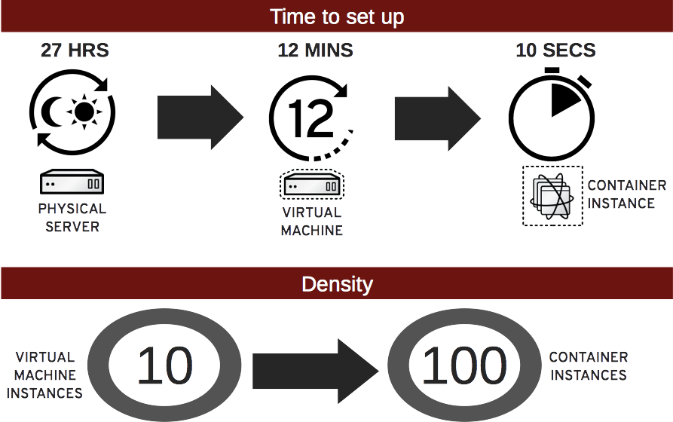
VELOCITY and DENSITY
Notes:
Containers are very lightweight and can startup up quickly, in a matter of seconds vs. minutes from VMs or even hours to provision a new physical server
Because a container is lightweight, and consumes fewer resources than a VM, some use cases see 10x great density per host when compare to VMs

Slide 12
BENEFITS OF CONTAINERS (cont)
Portability
Faster app deployment
Velocity
Density
Isolation
Snapshotting
Security sandbox
Limit resource usage
Simplified dependency
Sharing
Notes:
We talked about Faster Deployments, Portability, Velocity, and Density. Other benefits include…
1) Isolation - applications side by side with different libraries or even OSes e.g. RHEL 6v7
2) Snapshotting - saves container image file, tag it start up again
3) Security sandbox - - isolate application
4) Limit resource usage - - cpu, memory, disk
5) Simplified dependency - app containers includes dependencies,
6) Sharing - is easier, it’s a text file, images stored in a repository, private and public registry
————
1) Faster Deployments - docker image (txt representation), container (runtime representation), share spin up fast,
2) Portability - physical, virtual, public, private cloud
3) Velocity - containers startup in seconds vs. minutes for VMs
4) Density - 10x application density vs. VMs and 100x density vs. physical

Slide 13


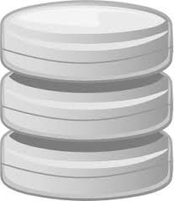
UNDERLYING TECHNOLOGY
Containers
Containers
Containers
DOCKER CLI
Docker Image
SYSTEMD
Unit File
RHEL Kernel
Cgroups
Namespaces
SELinux
Drivers
Hardware (Intel, AMD) or Virtual Machine
Notes:
Control groups - for Resource management, so you can share/limit hardware resources for a container including CPU, MEMORY, DISK, and NETWORK
Namespaces - provides PROCESS ISOLATION from each other, enabling multi-tenancy of containers on a host
SELinux - provides additional security to containers
assure separation between the host and the container
and also between the individual containers, and reducing the potential for security exploits
Other technologies include
libcontainer - standard container library
union file system - layered file system format for container images

Slide 14
IMAGE -BASED CONTAINERS WITH DOCKER TECHNOLOGY
App A
SCL 1
RHEL 7
Runtime
App B
SCL 2
RHEL 6.5
Runtime
App C
SCL3
RHEL6.6
Runtime
Layered
Image 2
App
Layer
Layered
Image 1
Platform
Image
Platform
Image
RHEL Container Host
RHEL 7 Container Host provides the capability to run images built with Docker format for content distribution
Notes:
Docker containers leverage a Union File System which is layered.
1) For example, You have the read only platform image, such as RHEL, with additional layers for the application platform, application, and then a READ-WRITE file system layered on top which starts out empty but as changes are made are layered container within this RW layer
2) The image provides flexibility to run different OS Runtimes within a container on the same host, e.g. RHEL 6 and RHEL 7 based containers running on a RHEL7 host

Slide 15
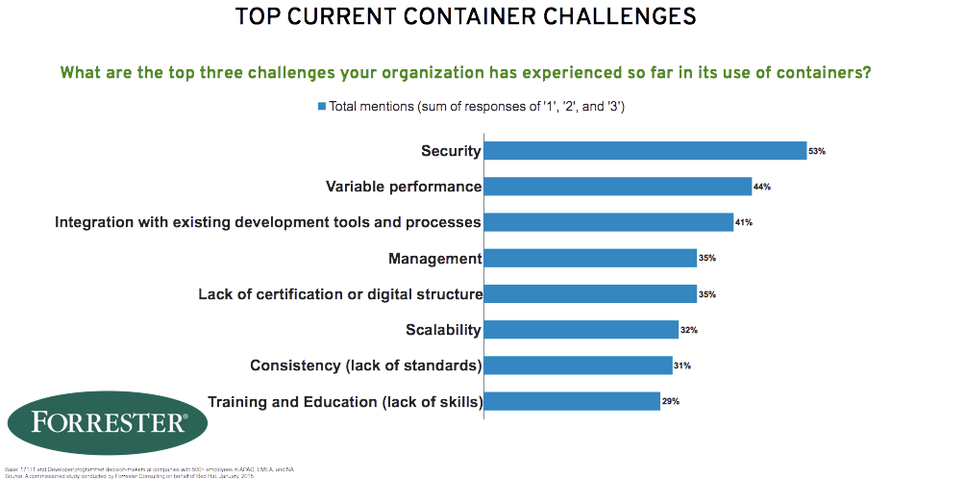
Notes:
1) SECURITY - how do you know where a Docker Image came from? who built it? is it patched?
2) VARIABLE PERFORMANCE - work being done
3) INTEGRATION WITH EXISTING DEV PROCESSES - containers are also associated with DevOps
4) MANAGEMENT - tools like kubernetes, to manage containers at Scale

Slide 16
CONTAINERS

Slide 17




BUILD, SHIP, RUN
Dockerfile
Image
Container
FROM fedora:latest
CMD echo “Hello”
docker.io
Registry
Private Registry
Physical, Virtual, Cloud
Red Hat Certified
Build
Ship
Run
“docker build or commit”
“docker push or pull
<IMAGE_ID>”
“docker run
<IMAGE_ID>”
Notes:
DOCKER WORK FLOW
BUILD, SHIP, RUN
STEP 1: BUILD a Docker image that echo Hello
Create A dockerfile text file, this specifies how to build a Docker image, making repeatable and shareable with others
Example, Use the latest Version of Fedora Linux and echo “Hello” as the launch command
Next, you would build the image with “docker build”
3) STEP 2: Push a Docker image to a Registry such as Docker Hub so it can be shared
1) You would run docker push <image> and the image you just created would be pushed to the central Dockerhub, which makes it accessible to others and other systems
4) STEP 3: To launch a Container based on this Docker Image that you just created
1) You would run Docker run <image>
2) This would pull down the image from Docker hub or another registery
3) It would then create a container and run on the host system

Slide 18

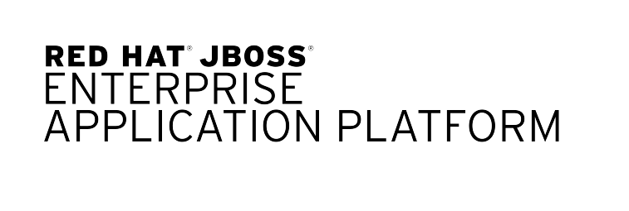

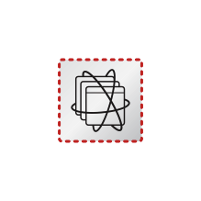

Containers provide a discrete package mechanism for application components or microservices
Notes:
Containers provide Discrete Packaging mechanism for application components or micro services
If you have an application that requires JBoss or Chef,
you can put them in a container
and wire them together
and there’s your application a set of containers

Slide 19

Several containers can live on a virtual or bare metal system
Notes:
Just like VMs, several containers can live on the same VM or physical server,
so it gives you the flexibility to choose depending on your use case and workload requirements

Slide 20


These containers are easily created and controlled by Docker tools
Notes:
Containers are Easily controlled using the Docker tools
Docker provides a very easy to use set of CLI tools and API

Slide 21

Finding and running containers is easy
-bash-4.2# docker run -P fedora/apache
Unable to find image 'fedora/apache:latest' locally
Pulling repository registry.access.redhat.com/fedora/apache
Pulling repository fedora/apache
2e11d8fd18b3: Download complete
511136ea3c5a: Download complete
ff75b0852d47: Download complete
0dae8c30a0b2: Download complete
84f33df93401: Download complete
24b116bb2956: Download complete
a7f290a6f21d: Download complete
eb86e2be11d4: Download complete
c06d2cba0d4a: Download complete
f0b140ef8cdd: Download complete
b05601b61180: Download complete
Status: Downloaded newer image for fedora/apache:latest
Notes:
Containers run as a process on a host system and can be controlled using the docker tools,
In this example, theDocker run command is pulling down the fedora apache and expose the ports with the -P command

Slide 22

This container is exposing httpd on port 49156 as noted in 'docker ps'
-bash-4.2# docker ps
CONTAINER ID IMAGE COMMAND CREATED STATUS PORTS NAMES
7ca95d1b0114 fedora/apache:latest "/run-apache.sh" 2 minutes ago Up 2 minutes 0.0.0.0:49156->80/tcp suspicious_colden
Notes:
You can run the docker PS command to see what port it is exposed on
Within the container it is running on port 80
Externally port 49156, docker automatically assigned it, but could be specified on command line

Slide 23
Rollbacks are also easy because image history is preserved
-bash-4.2# docker history fedora/apache
IMAGE CREATED CREATED BY SIZE
b05601b61180 5 months ago /bin/sh -c chmod -v +x /run-apache.sh 249 B
f0b140ef8cdd 5 months ago /bin/sh -c #(nop) ADD file:d16ad02a7a4176bbff 249 B
c06d2cba0d4a 5 months ago /bin/sh -c #(nop) EXPOSE map[80/tcp:{}] 0 B
eb86e2be11d4 5 months ago /bin/sh -c echo "Apache" >> /var/www/html/ind 7 B
a7f290a6f21d 5 months ago /bin/sh -c yum -y install httpd && yum clean 15.87 MB
24b116bb2956 5 months ago /bin/sh -c yum -y update && yum clean all 164.1 MB
84f33df93401 5 months ago /bin/sh -c #(nop) MAINTAINER "Scott Collier" 0 B
ff75b0852d47 5 months ago /bin/sh -c #(nop) MAINTAINER Lokesh Mandvekar 0 B
511136ea3c5a 21 months ago 0 B
Notes:
docker perserves the history, enabling rollbacks
roll back
for testing
or for an issue and operations do not need developers involved

Slide 24
RPM still exists in the container so its features and tools can still be used, even in a containerized environment
[root@7ca95d1b0114 /]# rpm -qa | wc -l
160
[root@7ca95d1b0114 /]# rpm -qi httpd
Name : httpd
Version : 2.4.10
Release : 1.fc20
Architecture: x86_64
Install Date: Mon 29 Sep 2014 12:28:44 PM UTC
Group : System Environment/Daemons
License : ASL 2.0
Signature : RSA/SHA256, Wed 23 Jul 2014 01:23:23 PM UTC, Key ID 2eb161fa246110c1
Source RPM : httpd-2.4.10-1.fc20.src.rpm
Build Date : Wed 23 Jul 2014 10:32:07 AM UTC
Build Host : buildvm-22.phx2.fedoraproject.org
Vendor : Fedora Project
URL : http://httpd.apache.org/
Summary : Apache HTTP Server
Description :
The Apache HTTP Server is a powerful, efficient, and extensible
web server.
[root@7ca95d1b0114 /]# rpm -qV httpd
missing /run/httpd/htcacheclean
Notes:
RPM still exists, so you have access to all the same tools in your toolchain
In this example, going into container and displaying RPM info for Apache
As you can see there are only 160 RPMs in this container, highlighting the lightweight nature of containers

Slide 25
Containers cannot look outside of their namespace but admins can easily peak in, giving operational flexibility
-bash-4.2# docker exec -it suspicious_colden /bin/bash
[root@7ca95d1b0114 /]# ps -ax
PID TTY STAT TIME COMMAND
1 ? Ss 0:00 /bin/sh /usr/sbin/apachectl -D FOREGROUND
9 ? S 0:00 /usr/sbin/httpd -D FOREGROUND
10 ? S 0:00 /usr/sbin/httpd -D FOREGROUND
11 ? S 0:00 /usr/sbin/httpd -D FOREGROUND
12 ? S 0:00 /usr/sbin/httpd -D FOREGROUND
13 ? S 0:00 /usr/sbin/httpd -D FOREGROUND
14 ? S 0:00 /usr/sbin/httpd -D FOREGROUND
33 ? S 0:00 /bin/bash
50 ? R+ 0:00 ps -ax
Notes:
Once inside the container, you can do normal operations but you can not get out.
From the host you can view, e.g. run ps and you can see apache running in container
but from within container you don’t see other containers running or host processeses like system
selinux adds extra security

Slide 26
Builds are reproducible via Dockerfiles
~/my-app/Dockerfile
FROM fedora
MAINTAINER Mrs Developer <mydev@example.com>
ENV GOPATH /go/src
RUN yum install -y golang git hg && yum clean all
RUN mkdir -p $GOPATH && echo $GOPATH >> ~/.bash_profile
ADD . /my-stuff
Notes:
Builing an image
Use a dockerfile, similar to a kickstart script
In this example, pulling down Fedora image
Installing a few RPMs
So very easy to create

Slide 27


Docker image delivery and consumption can happen via your operations work flow needs, devops or not
Notes:
Because the image is easy to rebuild, you can choose the delivery mechanism
Provide what developer provided as the image
Or create based on dockerfile, especially if highly audited environment and need to be sure what is in container

Slide 28
ORCHESTRATION

Slide 29


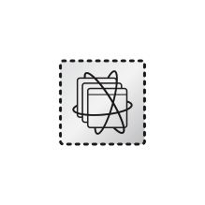
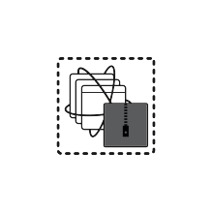

More serious workloads require orchestration like Kubernetes to offload management overhead
Notes:
However, one of the key challenges for docker, is how to manage at scale
Google’s Kubernetes provides orchestration and scheduling for containers at scale
and wire them together.

Slide 30
Kubernetes allow operations teams to describe an application via json
~/MyApp/kubernetes/prod_description.json
{
"id": "frontend-controller",
"kind": "ReplicationController",
"apiVersion": "v1beta1",
"desiredState": {
"replicas": 3,
"replicaSelector": {"name": "frontend"},
"podTemplate": {
"desiredState": {
"manifest": {
"version": "v1beta1",
"id": "frontend",
"containers": [{
"name": "php-redis",
"image": "kubernetes/example-guestbook-php-redis",
"cpu": 100,
"memory": 50000000,
"ports": [{"name": "http-server", "containerPort": 80}]
...
Notes:
To define an application, which consists of several containers or microservices
With Kubernetes, you use a JSON file, describe what’s in application, what are the cpu and memory application requires

Slide 31



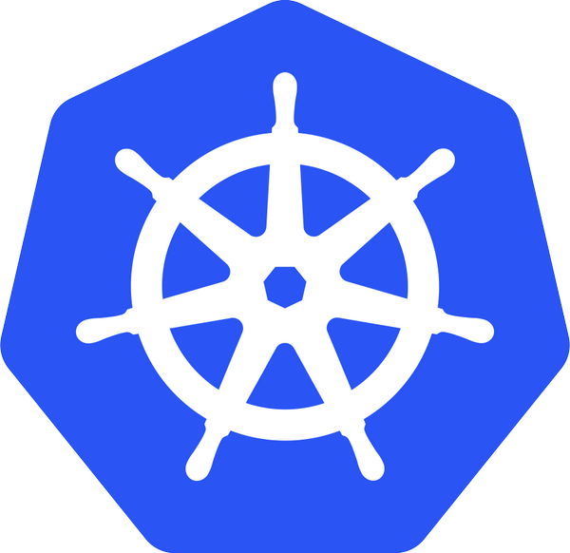
Once created, Kubernetes will keep the environment online as described in the json file
JSON
Kubernetes
Notes:
Kubernetes will go out and try to create environment described in json file

Slide 32


Once created, Kubernetes will keep the environment online as described in the json file
JSON
Kubernetes
Notes:
if there is an issue, kubernetes will try to correct the issue, may take a few seconds to detect

Slide 33

Once created, Kubernetes will keep the environment online as described in the json file
JSON
Kubernetes
Notes:
will try and find space to create new container, and then cleanup the old container

Slide 34
Once created, Kubernetes will keep the environment online as described in the json file
JSON
Kubernetes
Notes:
and then your system is back online
kubernetes has self healing - will do its best to keep environment up and running - great for those who are on call

Slide 35

New applications can be spun up and tested before old applications are removed, lowering risk for upgrades
Version 1
Notes:
so deploying new applications with kubernetes is very easy, doing upgrades is the next thing you are going to do
we recommend doing things perhaps a bit differently than what you do today
in this example, we have version 1 and want to move to version 1.2

Slide 36

Some call this method of deployment red-black deployment, admins won't get stuck in the middle of an upgrade
Version 1
Version 1.2
Notes:
we recommend you build a new version 1.2 off to the side, while version 1 is taking all the traffic

Slide 37

Tests and certification can be done before customers access it
Version 1
Version 1.2
Tests / CI
Notes:
Docker and Kubernetes make it easy to test off to the side, you can complete all the Continuous Integration tests for version 1.2
on the new environment before taking outside traffic

Slide 38
Once ready, the new version is used and the old version can be removed
Version 1
Version 1.2
Notes:
once it is succesful, you can then move over to 1.2 and take down and remove the previous version
especially important if an upgrade takes a while to upgrade,
i’m sure many of you have been through experience of a broken upgrade process half way through, and then having to call in developers and ops to back out of the upgrade

Slide 39
Rollbacks can be done using the same method if desired
Version 1.2
Notes:
if you do move forward and find some issue later, you can do a rollback and move back to the old version

Slide 40
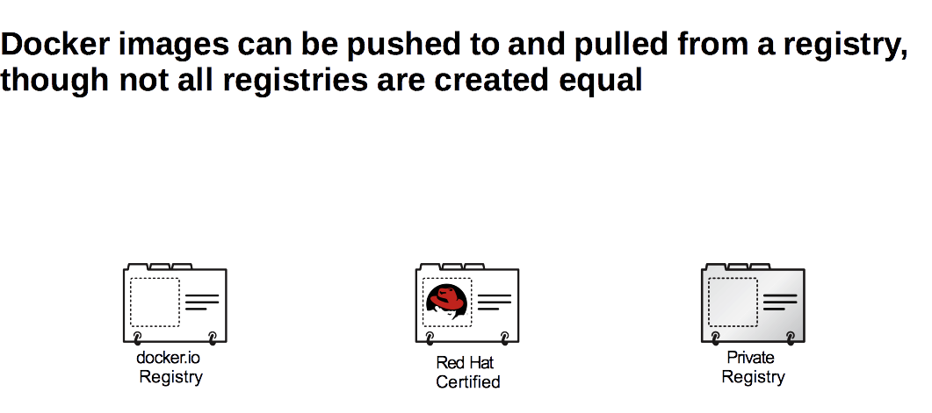

Slide 41
THANK YOU

Slide 42

BIMODAL IT
To capture digital opportunities, CIOs need to
deal with speed, innovation, and uncertainty.
This requires operating two modes of enterprise IT: conventional and “nonlinear.”
Executive Summary:
Taming the Digital Dragon: The 2014 CIO Agenda
Notes:
Gartner calls this the ERA of bimodal IT.
One one side you have an IT serving the existing conventional applications
and separately an IT focused on serving this new frontier for dynamic and scale-out Cloud & Mobile Applications
Going forward Organizations will have both.
There is a need for both sometimes known as your Marathoners and Sprinters

Slide 43
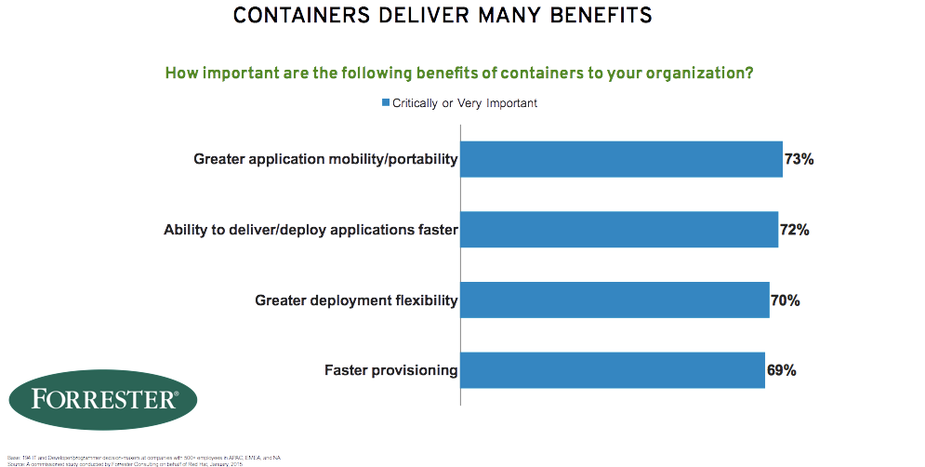
Notes:
Forrester polled enterprise IT about the benefits of containers
PORTABILITY - across computing environments
FASTER DELIVERY - from Development to Product
DEPLOYMENT FLEXIBILITY -
FASTER PROVISIONING
and so you can see that these benefits are well aligned with enabling the business to deliver product sooner

Slide 44
TOP 5 MISCONCEPTIONS OF CONTAINERS
Containers are new.
Containers equal virtualization.
Containers are universally portable.
Containers are secure by default.
Containers are not enterprise-ready.
1
2
3
4
5
Notes:
4) Containers do not contain, not as good as VMs,
cgroups, namespace (6 namespaces)
- /sys, /sys/fs, /proc/sys not namespaced

Slide 45
EVOLUTION TO CONTAINERS
APP A
APP A
APP B
BINS/
LIBS
BINS/
LIBS
BINS/
LIBS
APP A
APP A
APP B
APP C
APP D
GUEST
OS
GUEST
OS
GUEST
OS
APP A
APP B
APP C
BINS/
LIBS
BINS/
LIBS
BINS/
LIBS
BINS/
LIBS
BINS/
LIBS
BINS/LIBS
HYPERVISOR
OS & SHARED SERVICES
HOST OS
HOST OS, SHARED SERVICES
HARDWARE
SERVER
HARDWARE, VIRT, CLOUD
PHYSICAL
VM
CONTAINER
Notes:
PHYISCAL - hard to manage, resources under utilized
VM -
Nice isolation,
Performance - VM Tax
each Virtualized application includes not only app and necessary binaries and libraries but ALSO entire guest operating system - takes up lot of memory and disk space
Container - comprises just the app and its dependencies, runs as an isolated process in userspace on host os, sharing the kernel with other containers, thus enjoys benefits of resource isolation and allocation benefits of VMs but is much more portable and efficient
Linux Containers Compared to KVM Virtualization
The main difference between the KVM virtualization and Linux Containers is that virtual machines require a separate kernel instance to run on, while containers can be deployed from the host operating system. This significantly reduces the complexity of container creation and maintenance. Also, the reduced overhead lets you create a large number of containers with faster startup and shutdown speeds.
Both Linux Containers and KVM virtualization have certain advantages and drawbacks that influence the use cases in which these technologies are typically applied:
KVM virtualization:
• KVM virtualization enables booting full operating systems of different kinds, even non-Linux systems. However, a complex setup is sometimes needed. Virtual machines are resource-intensive so it is possible run only a limited number of them on one host machine.
• Running separate kernel instances generally means better separation and security. If one of the kernels terminates unexpectedly, it does not disable the whole system. On the other hand, this isolation makes it harder for virtual machines to communicate with the rest of the system, and therefore several interpretation mechanisms must be used.
• Guest virtual machine is isolated from host changes, which allows to run different versions of the same application on the host and virtual machine. KVM also provides many useful features such as live migration.
Linux Containers:
• Linux Containers are designed to support isolation of one or more applications. You can create or destroy containers very easily and they are convenient to maintain.
• System-wide changes are visible in each container. For example, if you upgrade an application on the host machine, this change will apply to all sandboxes that run instances of this application.
• Since containers are lightweight, a large number of them can run simultaneously on a host machine. The theoretical maximum is 6000 containers and 12,000 bind mounts of root file system directories. Also, containers are faster to create and have low startup times.
PHYSICAL
Single userspace runtime shared between applications
Environment and lifecycle define by host operating system
Trend to isolate apps on hardware
Managed by IT, very limited delegation
Stable, long maintenance, few updates, and hardware centric
Very limite flexibility
Resources generally under utilized
VM
1 App per VM
Guest environment and lifecycle defined by app
App and runtime abstracted from runtime
Higher flexibility at cost of increased redundancy and overhead (VM)
Complex multi-level mgmt of hosta and VM layers
Delegation along host / VM boundary
Containers
App pkged with individual runtime stack using docker and deployed into container
Multi-instance, multi-version, max flexibility, minimal overhead
Delegation along the container boundaries
shared services provided by host./container env
Standardized hardened container host, clustering, orchestration

Slide 46

SOME OF THE MOST ADVANCED INFRASTRUCTURES RUN ON CONTAINERS
“Everything at Google, from Search to Gmail, is packaged and run in a Linux container.”¹
- Eric Brewer, VP of Infrastructure, Google
¹ Source: http://googlecloudplatform.blogspot.com/2014/06/an-update-on-container-support-on-google-cloud-platform.html
Notes:
Google is one example of a very large infrastructure running billions of containers. Everything at Google runs in a container. Google starts over 2 billion containers per week, over 3000 per second -- and that’s not counting long-running containers.
Another example is Red Hat OpenShift. OpenShift enables developers to quickly build, launch, and host innovative applications in the public cloud. The elastic, multi-language, PaaS architecture of OpenShift automates the provisioning, management, and scaling of applications so developers can focus on writing the code for these applications.
OpenShift leverages Red Hat Enterprise Linux and the SELinux subsystem for a secure, multi-tenant architecture. Users and ISV partners can also take advantage of third-party extensions or build their own through OpenShift’s extensible, pluggable cartridge framework, all built on containers. OpenShift Online hosts over 2 million applications.

Slide 47

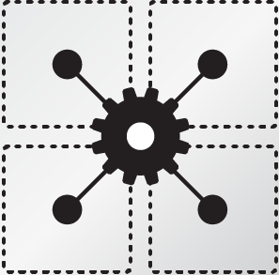

ESTABLISHING STANDARDS AROUND…
ISOLATION WITH
LINUX CONTAINERS
CONTAINER FORMAT WITH DOCKER
ORCHESTRATION WITH
KUBERNETES
REGISTRY / CONTAINER DISCOVERY
Notes:
ISOLATION - Libcontainer, Selinux
CONTAINER FORMAT - Docker
ORCHESTRATION - Kubernetes
REGISTRY / CONTAINER DISCOVERY - Private Image and Certified Hubs

