Slide 1

在平台即服务（PaaS）上 部署和优化应用与数据库
包彤
tony.bao@oracle.com
甲骨文（中国）软件系统有限公司

Slide 2

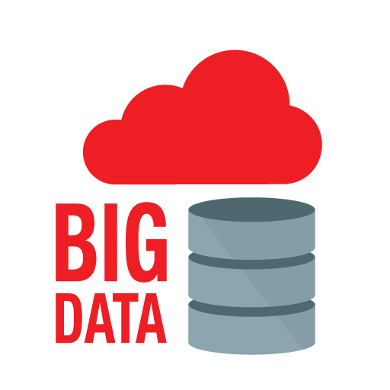

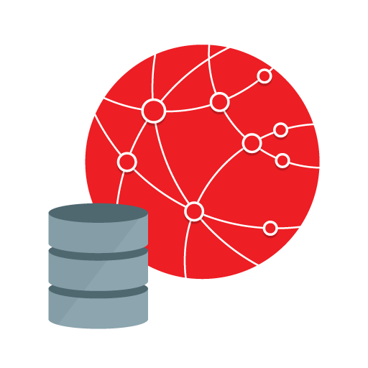
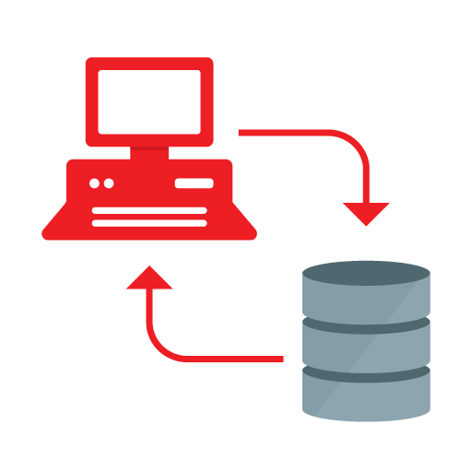

Database Application Development
Big Data, Cloud
Internet
Client Server
1990
1995
2000
2005
2010
2015

Slide 3

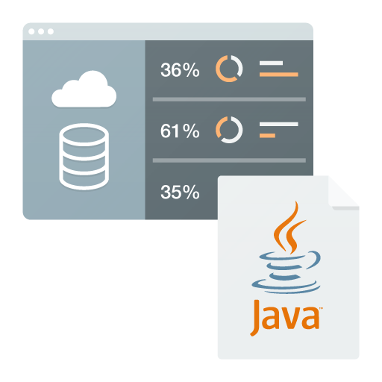
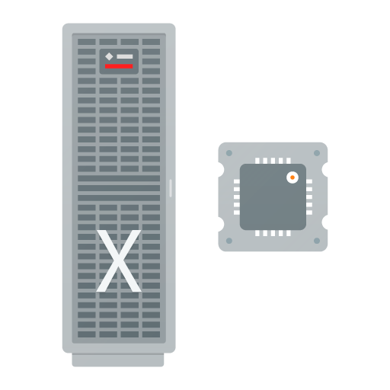
Cloud Services
Apps
Platform
Infrastructure
Software as a Service (SaaS)
Platform as a Service (PaaS)
Infrastructure as a Service (IaaS)

Slide 4

Cloud Adoption is Growing
Cloud is Mainstream
SaaS is Exploding
IaaS & PaaS Growing Rapidly
84%
$56B
~90%
Using Cloud today or will be in Two Years
Total spending on SaaS by 2018 at 20% CAGR
Will adopt PaaS within Five Years @ 22% CAGR
Source: Multiple

Slide 5








Oracle Cloud - Software as a Service
CX
HCM
ERP
Supply Chain
EPM
Analytics
Social
Data
https://cloud.oracle.com

Slide 6


Oracle Cloud - Software as a Service
CX
HCM
ERP
Supply Chain
EPM
Analytics
Social
Data
Comprehensive portfolio of home grown

Slide 7
Oracle Cloud - Software as a Service
CX
HCM
ERP
Supply Chain
EPM
Analytics
Social
Data
Comprehensive portfolio of home grown and acquired solutions
BigMachines (10/13)
BlueKai (2/14)
Collective Intellect (6/12)
Compendium (10/13)
Datalogix (12/14)
Eloqua (12/12)
Involver (7/12)
LiveLOOK (6/14)
Responsys (12/13)
SelectMinds (9/12)
Taleo (2/12)
TOA Technologies (7/14)
Vitrue (5/12)
http://www.oracle.com/us/corporate/acquisitions/index.html

Slide 8

The Oracle Cloud: Platform
Move to Cloud – Move Back: No Code Changes!
Non-Java App
Java App
Database
Database
Java App
Non-Java App
WebLogic Java Server
Oracle Database Server
Oracle Database Platform Service
WebLogic Java Platform Service
Infrastructure Compute & Storage Service
Customer Data Center
Oracle Cloud

Slide 9
Oracle Cloud - Platform as a Service (PaaS)
CX
HCM
ERP
Supply Chain
EPM
Analytics
Social
Data
Adding platform services addresses the SaaS extension and the rapidly growing standalone PaaS market
https://cloud.oracle.com

Slide 10














Oracle Cloud - Platform Services
CX
HCM
ERP
Supply Chain
EPM
Analytics
Social
Data
Database
Java
EM
Node.js
Big Data
Big Data
Discovery
Business
Intelligence
Mobile
Integration
Developer
Documents
Messaging
Process
Database
Backup
https://cloud.oracle.com

Slide 11


Oracle Cloud - Infrastructure Services
CX
HCM
ERP
Supply Chain
EPM
Analytics
Social
Data
Database
Java
EM
Node.js
Big Data
Big Data
Discovery
Business
Intelligence
Mobile
Integration
Developer
Documents
Messaging
Process
Database
Backup
Compute
Storage
https://cloud.oracle.com

Slide 12
Oracle Cloud - Database Cloud Services
CX
HCM
ERP
Supply Chain
EPM
Analytics
Social
Data
Database
Java
EM
Node.js
Big Data
Big Data
Discovery
Business
Intelligence
Mobile
Integration
Developer
Documents
Messaging
Process
Database
Backup
Compute
Storage

Slide 13
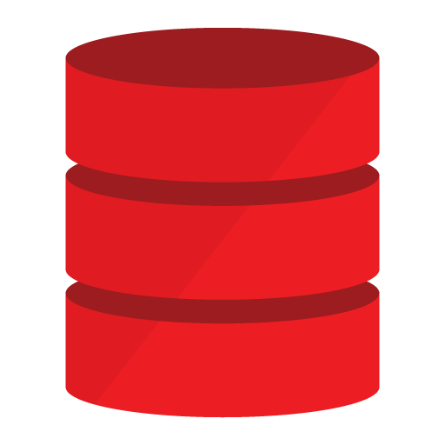


Oracle Database Cloud Services
Same Architecture
Same Software
Same Skills
On-Premises
Oracle Cloud
Unified Management
Enterprise Manager manages both On Premise and Cloud*
* Planned for a future release.

Slide 14

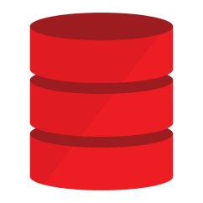


Oracle Database Cloud Services
Gracefully move workloads between on-premise and the cloud
Quickly create databases using automated provisioning.
Data Center
Easily move data and workloads.
Oracle Cloud

Slide 15




Oracle Database Cloud Services
Extend the enterprise data center to the cloud
Instantly gain access to infrastructure
Elastic CPU and memory
Elastic block and object storage
Backup database to the cloud
On Premises
Oracle Cloud

Slide 16
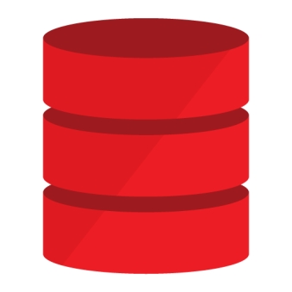




Oracle Database Cloud Services
One Database Cloud Solution
Private Cloud
Oracle Managed Cloud Services
Amazon, Microsoft Azure, Verizon, CenturyLink, Infosys, Wipro, Nuvola Italiana, eDBA, Ativas, Dimension Data, …
Oracle Cloud
Preserve investment with any deployment choice

Slide 17

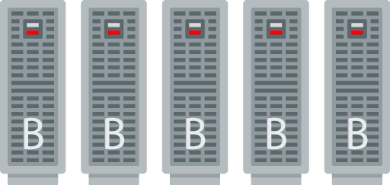
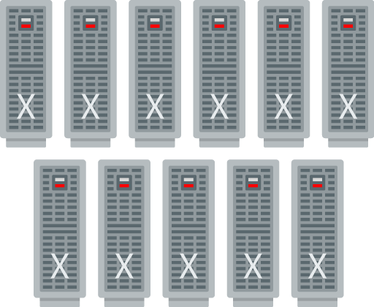
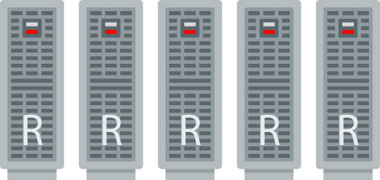

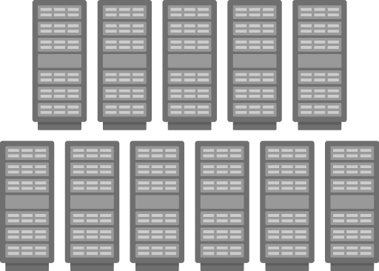
Oracle Database Cloud Strategy
Big Data
Exadata
Backup
Engineered
Commodity
General Purpose

Slide 18
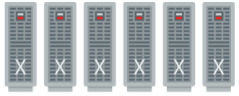

Oracle Cloud - Large and Rapidly Growing
19 Tier 4 Data Centers
540 PB+ storage
34 Million+ SaaS users/day
23 Billion+ Database transactions/day
Very Large Exadata Deployment

Slide 19

Oracle Database Cloud – Infrastructure
General Purpose
Engineered Systems*
General Purpose Infrastructure
Test, Development, Departmental Applications
Compute Shapes - by OCPU, Standard or High RAM
Block Storage – by the GB, Up to 5TB
Engineered Infrastructure
Mission Critical, Intensive OLTP and Decision Support
¼, ½ and Full Rack Shapes
Fixed Storage and Memory by Shape
5TB +, mission critical, intensive OLTP, DSS
Greater Capabilities

Slide 20
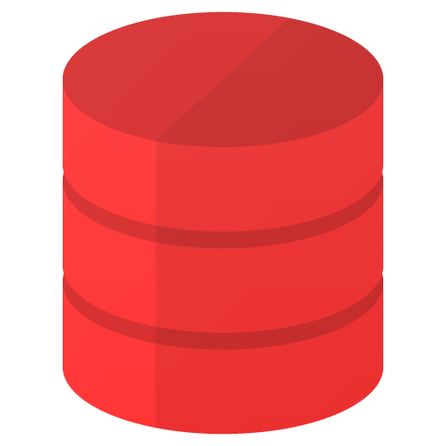
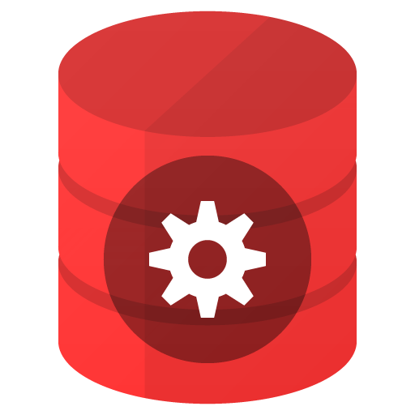
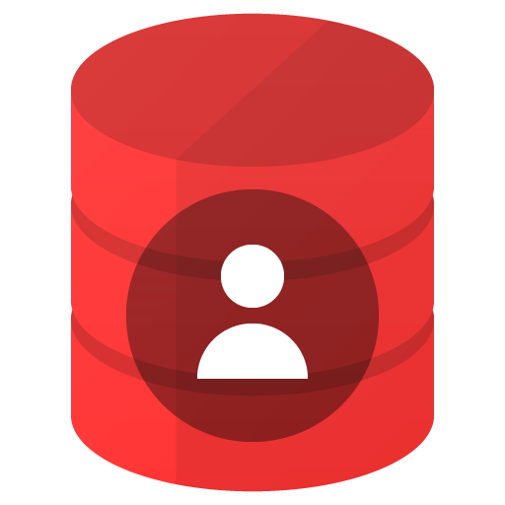
Oracle Database Cloud – Management Levels
Virtual Image
Automated
Managed*
Virtual Image
Database software ready for install
Tenant has root privilege
Does not provide automated orchestrations
Only available on general purpose infrastructure
Automated install, patch, upgrade, upsize/downsize, backup/restore, recovery, data guard configuration, TDE encryption, monitoring…
Tenant has root privilege
Oracle monitors and is responsible for keeping the database available
Oracle manages install, patch, upgrade, upsize/downsize, backup/restore, recovery
Oracle maintains privileged user access, tenant controls data.
General
Purpose
Greater Capabilities
* Planned for a future release.

Slide 21

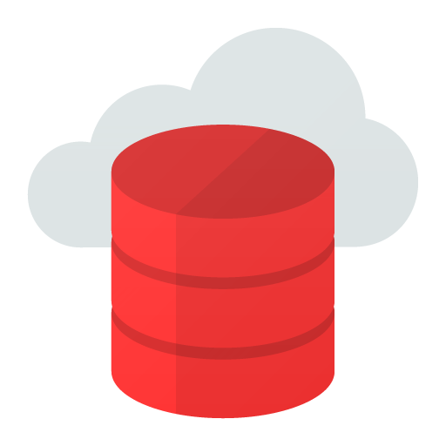
Oracle Database Cloud – Service Types
Schema
Full Instance
Single database Schema available as a monthly Subscription by Size (5, 20, 50 GB)
Fully Managed Service on Engineered Systems
Database patches and upgrades performed during scheduled maintenance windows
Editions: Modified (security locked down) EE
Also underpins the BI, Document, Mobile, Java SaaS Extension,Developer Messaging, JaaS Extension…
Full Database available as a metered service (Hourly or Monthly)
Available as a Virtual Image, Automated, or Managed Service
Tenant controls patch and upgrade schedule
Available on general purpose and engineered systems
Editions: SE1, EE, EE High Performance, EE Extreme Performance
Greater Capabilities

Slide 22
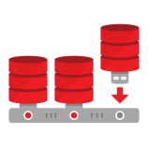










Oracle Database Cloud – Full Instance Editions
Enterprise Edition (EE)
EE High Performance
EE Extreme Performance
adds…
adds…
adds…
Transparent Data Encryption (TDE)
All standard EE features
Multitenant
Real Application Clusters (RAC)
Data Guard
In Memory
Partitioning
Advanced Compression
Active Data Guard
Standard Edition 1
Advanced Security, Label Security, Database Vault
Real Application Testing
Full database instance
Up to 16 OCPUs
OLAP, Analytics, Spatial and Graph
Management Packs
Reference: http://www.oracle.com/us/products/database/enterprise-edition/comparisons/index.html
Greater Capabilities

Slide 23
Database Cloud Delivery Strategy
Engineered infrastructure for highest performance, scalability, and availability
General purpose infrastructure for test, development, departmental applications
Engineered
General
Purpose
General
Purpose

Slide 24
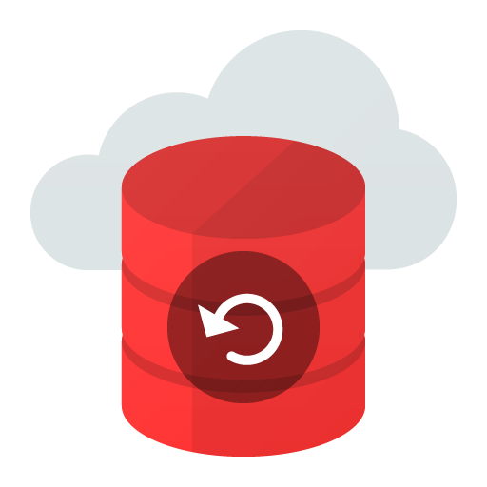

Oracle Database Cloud Backup
On Premises
Oracle Cloud
Oracle Database
Backup Service
Available Today

Slide 25
Oracle Database Cloud - Capabilities
Automated Provisioning
Automated Infrastructure and Database Administration
Data Transfer and Connectivity
Security
High Availability
High Performance
Simplified consolidation, deployment, and integration (Multitenant)
Database Application Development features
Application Development Frameworks Support

Slide 26




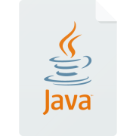







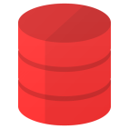



Automated Provisioning
Database
Ready for Use
Request
for
Service
Allocate Compute
Allocate Storage
Provision
OS
Set Keys &
Privileges
Install &
Configure
Database
Configure
Backups
Configure
Tools
(configure
Access)
Benefits
Reduced time and complexity to provision database services
Increased standardization of the “fleet”
New use cases that were not practical before.

Slide 27
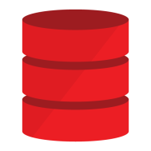





Oracle Database as a Service
11g
12c
Compute Shape
CPU and Memory On-Demand
Block and Object Storage
Upsize, add archives all with encryption
Upgrade and Patch
Upgrade automation
Point-in-time Recovery
Recover from human error
Point-to-point Networking
Open just the ports you need
Service Integration
Add PaaS offerings when Needed
Robust automation reduces administrative time and promotes standardization improving manageability and availability. Available with all cloud editions.

Slide 28
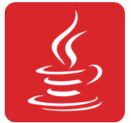
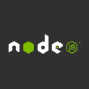









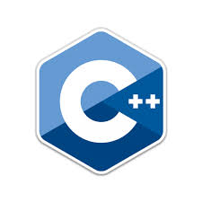


Application Development Framework Support
*
*
Java
Node.js
Oracle APEX
Oracle REST
Data Services
Ruby
Python
Perl
Go
Available as a PaaS Service
Available on Oracle Cloud via Compute Service*
Oracle Cloud
* Planned for a future release.

Slide 29
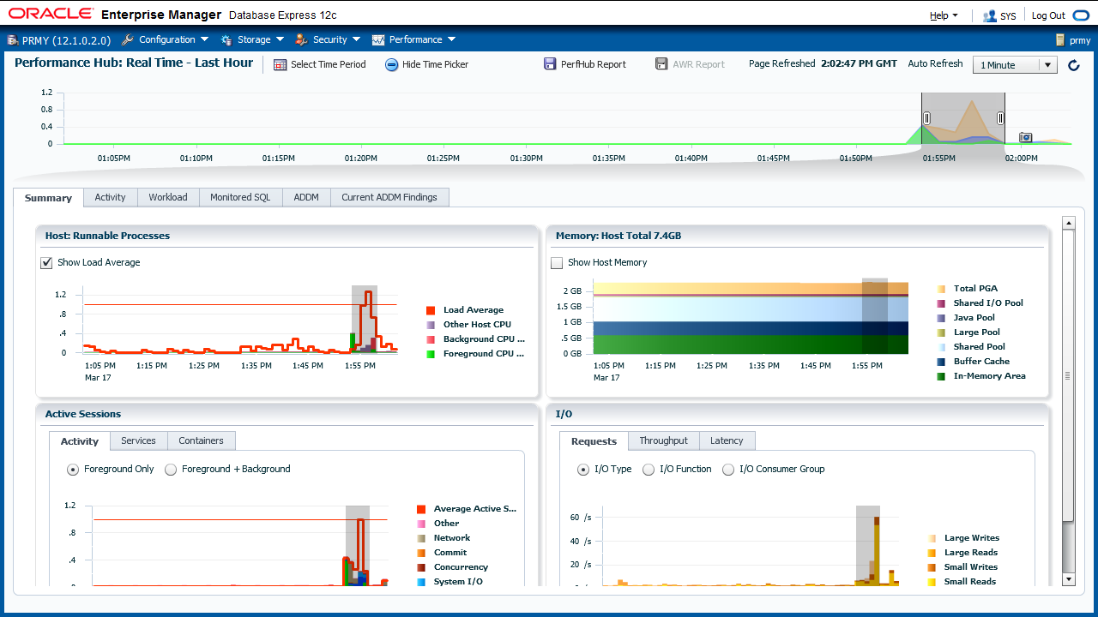
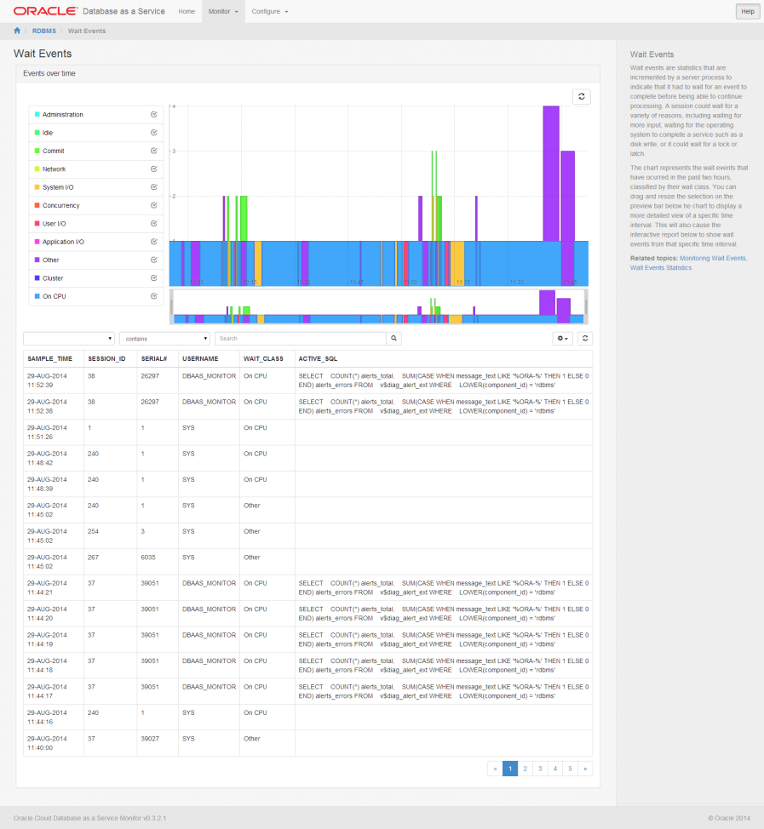
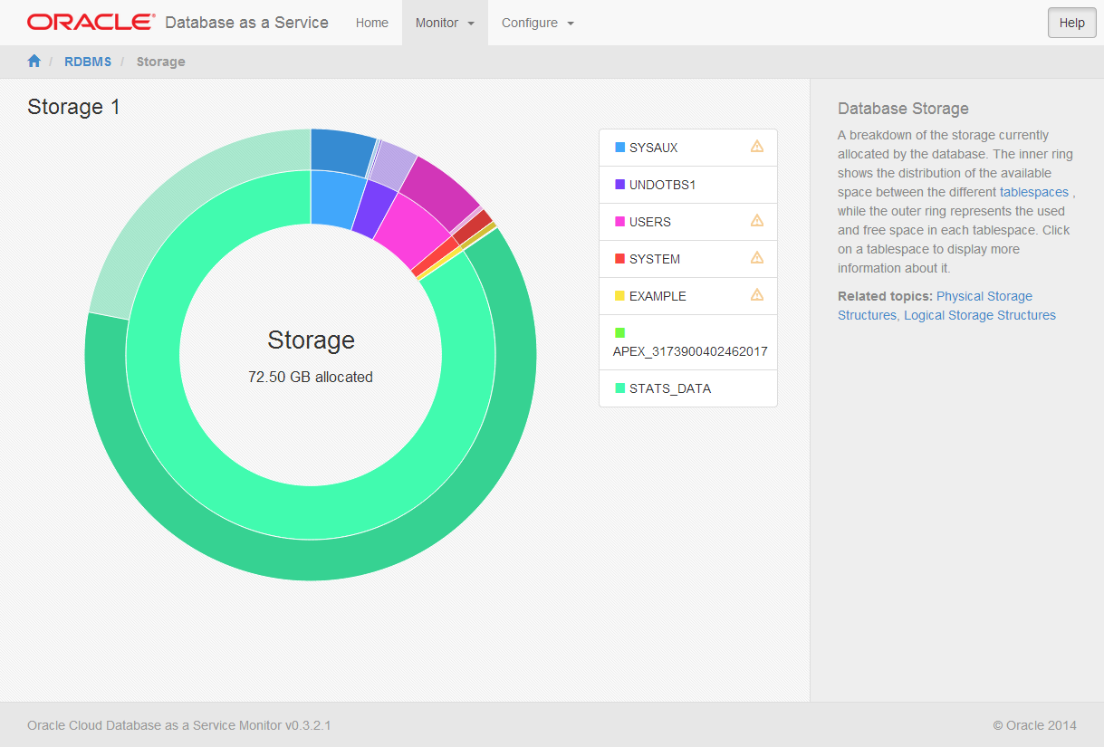
Development and Administration Consoles /Tools
Cloud.oracle.com Database Service console
Storage console
Networking console
Enteprise Manager Express
Full Enterprise Manager from On Premise
Database Cloud Services monitor
GlassFish Administration console
SQL Developer
REST Data Services
Appliction Express (APEX)

Slide 30
Oracle Database Cloud - Use Cases
Provision Database for: development, test, production, feature evaluation
Migration of on premise data to the cloud
Protect data with Backup & Recovery Service
Deploy a database application in the cloud
Change compute shape
Add Storage
Patch and upgrade
Clone 12c Pluggable Database (PDB)

Slide 31
Oracle Database Provisioning comparison
On-Premise
Oracle Cloud
Procure Data Center Floor space
Procure Servers
Procure Storage Devices
Procure SSL Certificates & Keys
Procure HSM Devices (for encryption)
Procure OS Licenses
Procure Anti-Virus Licenses
Procure SIEM Licenses
Allocate Storage Admin
Allocate System Admin
Allocate Database Admin
Allocate Network Admin
Install Server
Cable Server to Network
Install SSL Certificates & Keys
Acquire Public/Private IP Addresses
Acquire Domain Name (from internal DNS)
Install Storage Devices
Acquire IP Addresses
Install SSL Certificates and Keys
Create Physical Storage Volumes
Register Storage Devices with Server
Install Operating System
Create System Administrator Accounts
Register with Corporate LDAP Directory
Register with Audit Software
Add Users to System Administration Accounts
Register Servers with Redhat Administrative Console
Install Hypervisor
Create Virtual LAN Partitions
Allocate IP Addresses (Private)
Carry out Network Address Translation (NAT)
Register Virtual LANs with Network Switch
Add Users to Hypervisor Administrator Accounts
Register Guests with VMWare ESX Console
Run Clusterware Pre-requisite checks
Run Oracle DBMS Install Pre-requisite checks
Read database installation guild
Stage Oracle Database software
Configure Oracle Database
Log in to the system as root
Check HW, Memory, System, Disk, software, OS, OS Kernel, package, compiler, and additional software requirements
Create required OS Groups and Users, Oracle Inventory group, oracle software owner, OSDBA group, OSOPER group
Synchronize groups with LDAP repository
Configure Kernel parameters and resource limits, create required directories, configure user
Install oracle database; select clusterware/grid installation, specify base installation pathname
Specify software location, choose file system or ASM, specify file location, specify ASNSNMP password, database edition, OSDBA group, global name
Specify database name, database name domain, administrative password, confirm password
Verify database is functioning properly
Email developers access credentials and configuration details
Choose version of DBMS
Choose Edition SE, EE, EE High, EE Extreme
Choose Shape – storage, cores, memory
Choose Backup and Patching windows
Upload Key
Press Go
30 Minutes
Days or Weeks

Slide 32
Oracle Database Total Cost of Ownership (TCO) cost breakdown
Ongoing Maintenance
Backup, patching, hardware upgrade, OS upgrade, firmware upgrade, software upgrade, storage management, Test-Dev synchronization, cloning, data masking, security policies and auditing, configuration checks, monitoring, diagnosability…
Software
License, installation, configuration, security, high availability setup…
Hardware
Server, storage, network, …
Facilities
Data center, ISP, CDN, DNS,…
Based on costs incurred by Oracle managed cloud services

Slide 33
Oracle Database TCO comparison
On-Premise
Oracle Cloud
Ongoing Maintenance
PaaS Cost Reduction
Software
Hardware
IaaS Cost Reduction
Facilities
PaaS Cost Reduction
Based on costs incurred by Oracle managed cloud services

Slide 34
Oracle Database TCO comparison; per core per month
On-Premise
Oracle Cloud
Ongoing Maintenance
$980
$550
Software
$400
$350
Hardware
$100
Facilities
$75
$50
$25
$1,550
$1,000
Based on costs incurred by Oracle managed cloud services

Slide 35


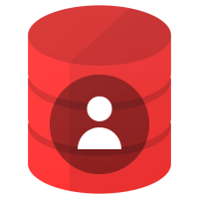
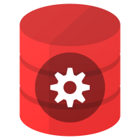
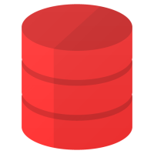
Oracle Database Cloud - Summary
Extend Enterprise Data Center to the Cloud
Same database software and unified management on premises and cloud
Freedom of choice to deploy on premises, on Oracle Cloud, and 3rd party clouds
Gracefully move workloads between on-premise and public cloud, and back
Easily offload availability, management and security services
Take Advantage of Cloud Computing
Choice of general purpose and engineered infrastructure
Choice of management levels; virtual image, automated and fully managed
Choice of editions, Oracle 11g or Oracle 12c
Large portfolio of complementary platform, data and infrastructure services

Slide 36

“Database is our largest software business and Database will be our largest cloud service business.”
Larry Ellison, CTO, Oracle Q1 2015 Earnings Call on 9/18/2014

Slide 37
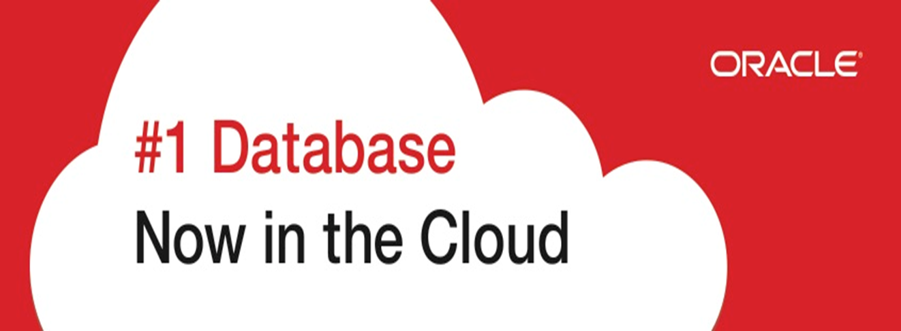
Thank You!

