Slide 1

Gearpump 基于Akka的新一代流处理引擎
QCON Beijing 2015
钟翔
Mail: xiang.zhong@intel.com
Weibo：http://weibo.com/clockfly
Intel亚太研发中心 | Intel 软件与服务部
Big Data Technology Department
2015/4/24

Slide 2

What is Gearpump
Akka based lightweight Real time data processing platform.
Apache License http://gearpump.io
What is Akka?
Simple and Powerful
Akka:
通信, 并发，隔离，容错
Message level streaming
Long running daemons
Notes:
Gerpump是一个轻量级的实时计算引擎。
为什么用这个名字？我们想强调Gearpump非常简单又强大，看这张图，齿轮帮是工业设计的杰作，只有两个齿轮，就能有效泵水。
Gearppump基于Akka，那什么是Akka呢？
simplifies communication, concurrency, isolation, and fault tolerance,

Slide 3
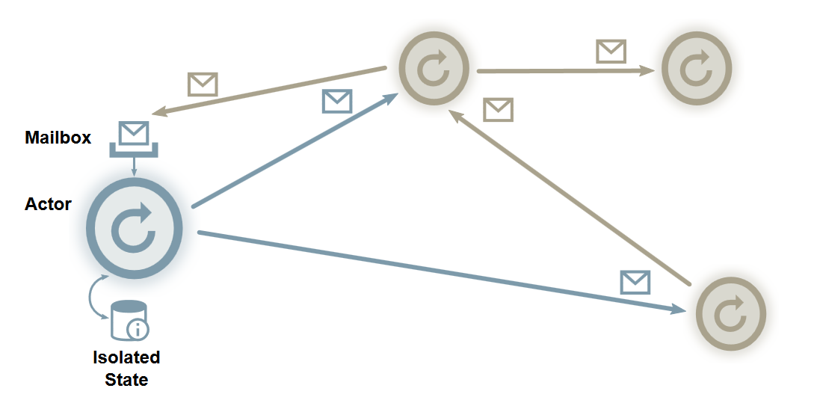
What is Akka?
Micro-service(Actor) oriented.
Message Driven
Lock-free
Location-transparent
Better performance
Fail in-dependently
Scales linearly
It is like our human society, driven by message
Notes:
Akka是一个开源库，Akka应用是由许许多多的微型服务即Actor编织而成，每个微型服务粒度很小，只做一件简单的事情；微型服务间通过异步的消息发送驱动对方工作，一起组合实现应用所需的功能。
Reactive架构极像我们人类社会的架构，每个人独立承担自己的工作，通过邮件等消息驱动对方工作，高效并发，而且每个人可以独立容错，人类社会也许是已知的最大的分布式系统。

Slide 4

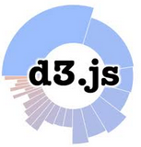

















Gearpump in Big Data Stack
visualization
Cluster manager
monitor/alert/notify
Visualization
& management
Cloudera
Manager
SQL
Data explore
Machine learning
Catalyst
StreamSQL
Impala
Analytics
Graphx
Here！
batch
stream
Engine
storm
Gearpump
store
Storage
Notes:
在计算引擎一层，
/
/
/
/
/
/
/
/
/
/
/

Slide 5
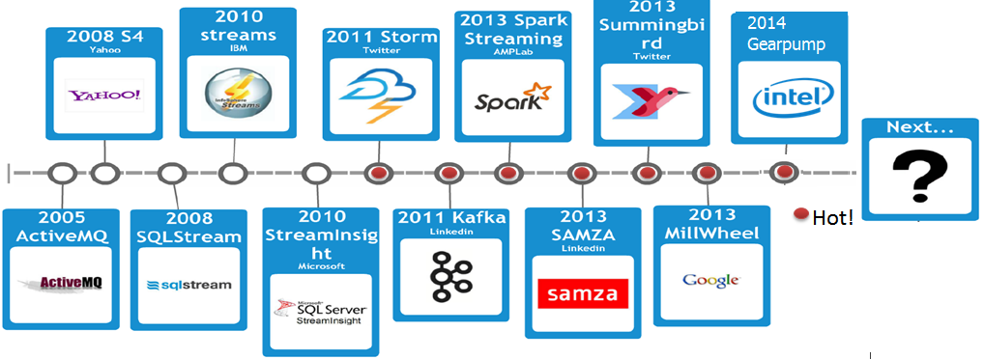
Why another streaming platform?
The requirements are not fully met.
We need a higher abstraction to build software!
Notes:
近年来，流处理已经有很多年了，每年都有些新东西，为什么又做一个？
需求未满足
软件发展到一定规模会出现瓶颈，需要更高的抽象，才能简单干净的解决问题，软件发展的历史就是抽象层次不断跳跃的过程，我认为对大数据栈，现在到了这个节点。Hive，100万行代码。

Slide 6

Streaming requirements
Michael Stonebraker, The 8 Requirements of Real-Time Stream Processing (2006)
My summary
活
Flexible
大
Volume
快
Speed
准
Accuracy
见
Visual
Easy programing
Any time
Any where
Any size
Any source
Any use case
Dynamic DAG
②StreamSQL
High throughput
⑦Scale linearly
①In-Stream
Zero latency ⑥HA
⑧Responsive
Exactly-once
③Message loss/delay/out of order
④Predictable
WYSWYG
Notes:
图灵奖获得者Michael,在2006年提出了流处理的六个需求，我把它重新总结了一下，放在下面，5个字，活，大，快，准，见。
大部分平台只部分满足了这个要求，Gearpump和他们相比最大的不同在于灵活性，灵活性是指用起来简单，适应性强。

Slide 7
Gearpump Highlights
100% Akka
Throughput
11 million/s (*)
2ms Latency
performance
Exactly-once
Dynamic DAG
Out of Order
Message
function
Flexible DSL
DAG
Visualization
Internet of Thing
usability
[*] on 4 nodes
Notes:
性能上。功能上：可用性上，数据源上：端到端延时，
2020年，将有260亿物联网设备

Slide 8
Using Gearpump 用户接口

Slide 9



How to Submit an application
Master
Master
Workers
1. Submit a Jar
Workers
AppMaster
2. Create AppMaster
1
2
Ask YARN for Resource
3
4
Master
YARN
3. Request Resource
Workers
Master
Workers
AppMaster
Executor
Executor
Executor
AppMaster
4. Report Executor to AppMaster
Notes:
1.用户提交Jar给集群，创建AppMaster，AppMaster申请申请资源，继而向YARN申请咨询，创建container, 在每个机器上运行副本，分布式程序开始运行。

Slide 10
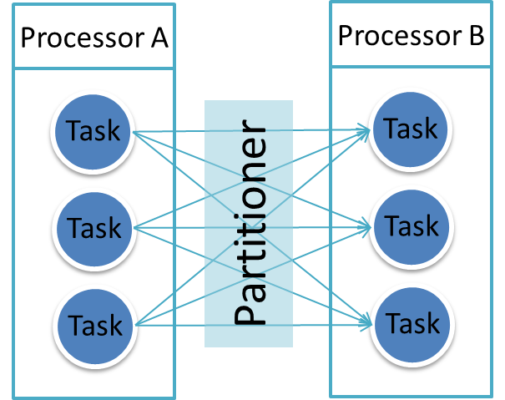
DAG representation and API
DAG API Syntax:
Graph(A~>B~>C~>D, B~>E~>D)
Processor
DAG
E
Processor
A
B
C
D
Shuffle
Processor
Processor
Processor
Notes:
这是我们的DAG，对每个节点我们叫Processor，每个Procesor可以并发出多个Task，上下游之间可以shuffle。上图是我们的API，箭头，超级简单。

Slide 11
DAG API Example - WordCount
val context = new ClientContext()
val split = Processor[Split](splitParallism)
val sum = Processor[Sum](sumParallism)
val app = StreamApplication("wordCount", Graph(split ~> sum), UserConfig.empty)
val appId = context.submit(app)
context.close()
class Split(taskContext : TaskContext, conf: UserConfig) extends Task(taskContext, conf) {
override def onNext(msg : Message) : Unit = { /* split the line */ }
}
class Sum (taskContext : TaskContext, conf: UserConfig) extends Task(taskContext, conf) {
override def onNext(msg : Message) : Unit = {/* do aggregation on word*/}
}
Notes:
Wordcount，两步
第一步：把一行拆解成单词，第二部，单词计数。
这种

Slide 12
WordCount with DSL API
val context = ClientContext()
val app = new StreamApp("dsl", context)
val data = "This is a good start, bingo!! bingo!!"
app.fromCollection(data.lines)
// word => (word, count = 1)
.flatMap(line => line.split("[\\s]+")).map((_, 1))
// (word, count1), (word, count2) => (word, count1 + count2)
.groupByKey().sum.log
val appId = context.submit(app)
context.close()
Notes:
这种DSL API怎么实现的呢？

Slide 13
High level DSL API Details
Concepts | Description
StreamApp | OP(Operator) Graph
Stream | path of OP Graph
OP Transformer | Transformation on Stream
OP Graph
Processor Graph
source
source
merge
Optimize
flatmap
reduce
sink
flatmap
Transformer Operators
flatMap | merge
map | groupBy
filter | process
reduce
map
Co-locate
X
join
sink
Bottom-up optimization
Notes:
StreamApp，图。Stream，路径，OP，运算节点。在运行时，我们会自下往上做优化，合并不需要网络shuffle的计算到一个Task里面，并不同的task做colocation的优化，减少跨机器的网络传输

Slide 14
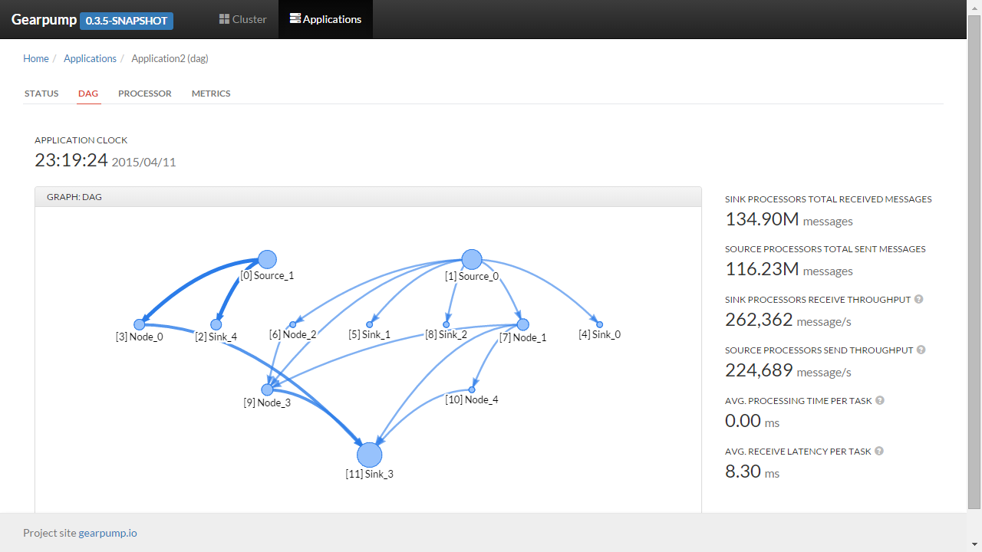
DAG Visualization
DAG Page
Track global min-Clock of all message
DAG:
Node size reflect throughput
Edge width represents flow rate
Red node means something goes wrong
Notes:
DAG，节点大小代表吞吐量，边的粗细代表流量，如果节点编程红色，说明出了故障。整个集群的运行状态一目了然。如果每个节点，点进去，我们可以看到每个并发的task的状态。

Slide 15
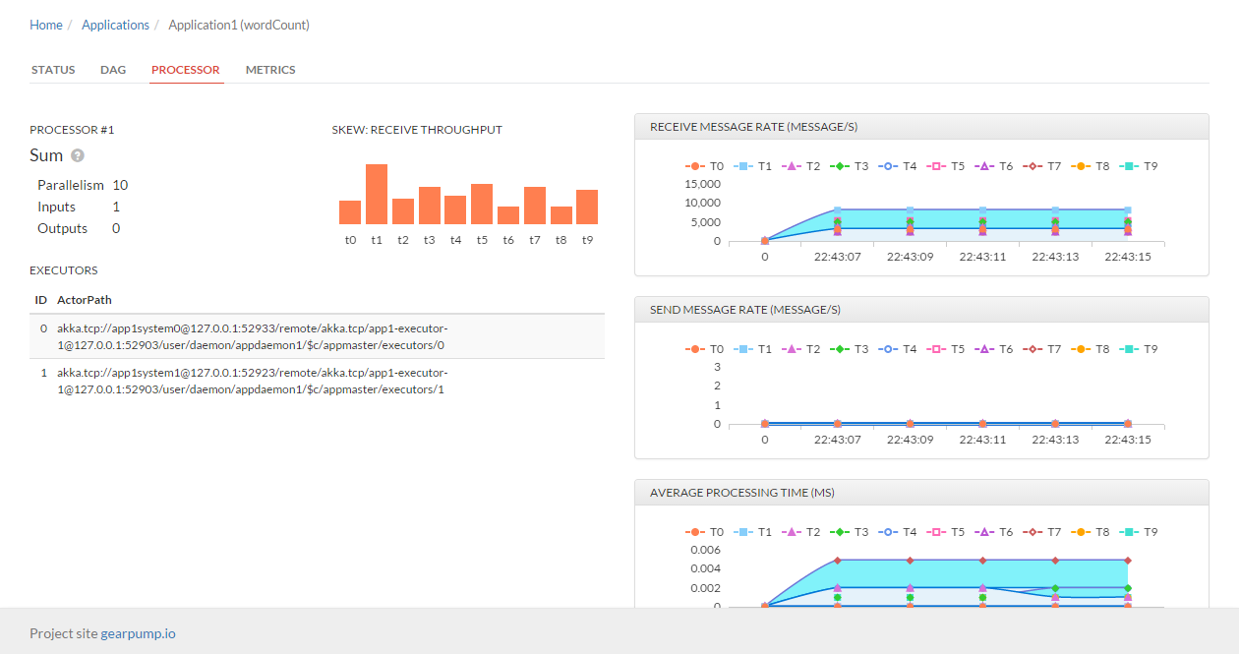
DAG Visualization
Processor Page
Skew analysis
Task throughput and latency
Executor JVM deployment
Notes:
最上面这个框是skew 分析，比如wordcount，不同单词的词频不同，如果skew 分析，我们就知道性能瓶颈在哪，右边是这个task的运行时性能，吞吐量，延时等指标。

Slide 16
Performance TEST 性能测试：吞吐量、扩展性、容错性
Notes:
讲了这么多，Gearpump能不能用? 看看性能测试结果。

Slide 17
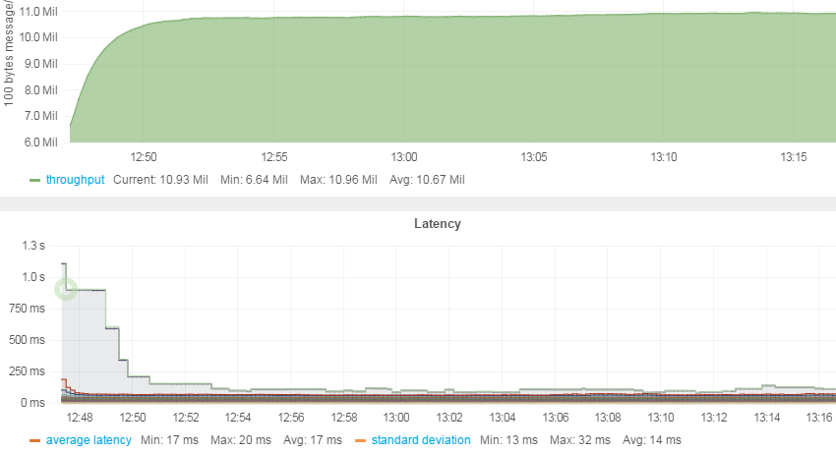
Throughput and Latency
Throughput: 11 million message/second
Latency: 17ms on full load
SOL Shuffle test
32 tasks->32 tasks
4 nodes 10GbE
32 core E52680
17
Notes:
延时 vs. 吞吐量关系
latency随着吞吐量的变化。

Slide 18
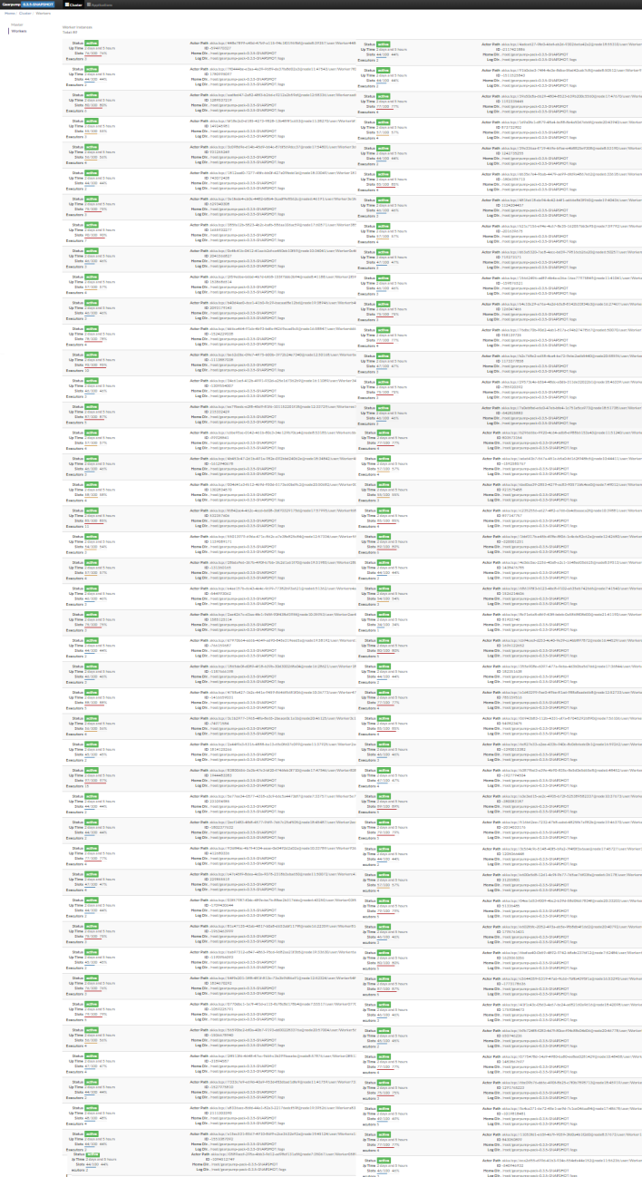
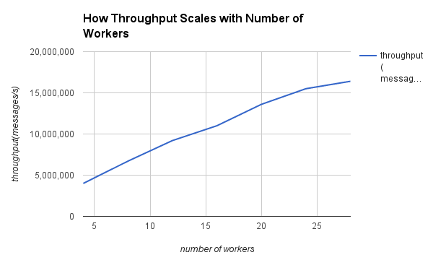
Scalability
Test run on 100 nodes and 3000 tasks
Gearpump performance scales:
100 nodes
Notes:
TODO: UI显示多少个executor，多少个task

Slide 19
Fault-Tolerance: Recovery time
91 worker nodes, 1000 tasks
Failure scenarios | Recovery time [*] | comment
Cluster Master node Down | 0 s | Master HA take effect
Cluster Worker node down | ~ 10 seconds | timeout detection take a long time
Message loss | ~ 300 ms | Still optimizing Target will be less than 10ms
Application AppMaster down | ~ 10 seconds | timeout detection take a log time
Test environment: 91 worker nodes, 1000 tasks (We use 7 machines to simulate 91 worker nodes)
[*]: Recovery time is the time interval between: a) failure happen b) all tasks in topology resume processing data.

Slide 20
Gearpump Internal 设计原理
Notes:
TODO: Add a overview

Slide 21



Overview and general ideas
MinClock service track the min timestamp of all pending messages in the system now and future
Minclock service
Replayable
Source
DAG runtime
Message(timestamp)
State
Every message in the system
Has a application timestamp(message birth time)
① High Performance Streaming
Normal Flow
21
Notes:
正常的数据流，
应用时钟，消息带时间戳，
DAG里面有很多long running的daemon进程，做高性能的计算。
上面有一个全局时钟，记录 现在和未来所有pending消息的最小时钟。

Slide 22
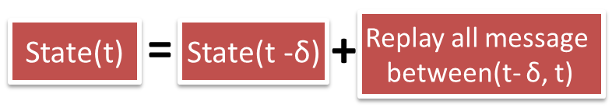
Overview and general ideas
Minclock service
④clock pause at Tp
② Detect Message loss at Tp
⑤ replay from Tp
③ recover DAG executor process
Replayable
Source
DAG runtime
Message(timestamp)
State
Checkpoint Store
⑥Exactly-once State can be reconstructed by message replay:
Recovery Flow
22
Notes:
如果消息丢失Tp，这个消息的状态在pending中，时钟会停住，错误的原因可能是机器故障，我们需要把计算节点重新启动，完成恢复，然后从Tp开始重放消息。
因为时间是在Tp停住的，Tp之前的消息都处理完了，只Tp之后消息就够了。
这只解决了at-least once, 未实现exactly once，还需要做状态的恢复。恢复的前提是：State可以由前一个时间点的State，加重放间隔内的消息恢复出来。如果这个假定成立，我们只需要阶段性的checkpoint好状态，然后就能实现Exactly-once。
讲到这边，大家可能有很多疑惑，比如怎么检测消息丢失，怎么追踪最小时钟，怎么确保一个state只处理某时间点前的数据？
下面会按照前面的1和2，3，4，5依次展开！

Slide 23
High performance streaming
Detect Message loss and other failures
DAG Executor Recovery
Clock Service, know when message is lost
Message replay from clock
Exactly-once, de-duplication
23

Slide 24
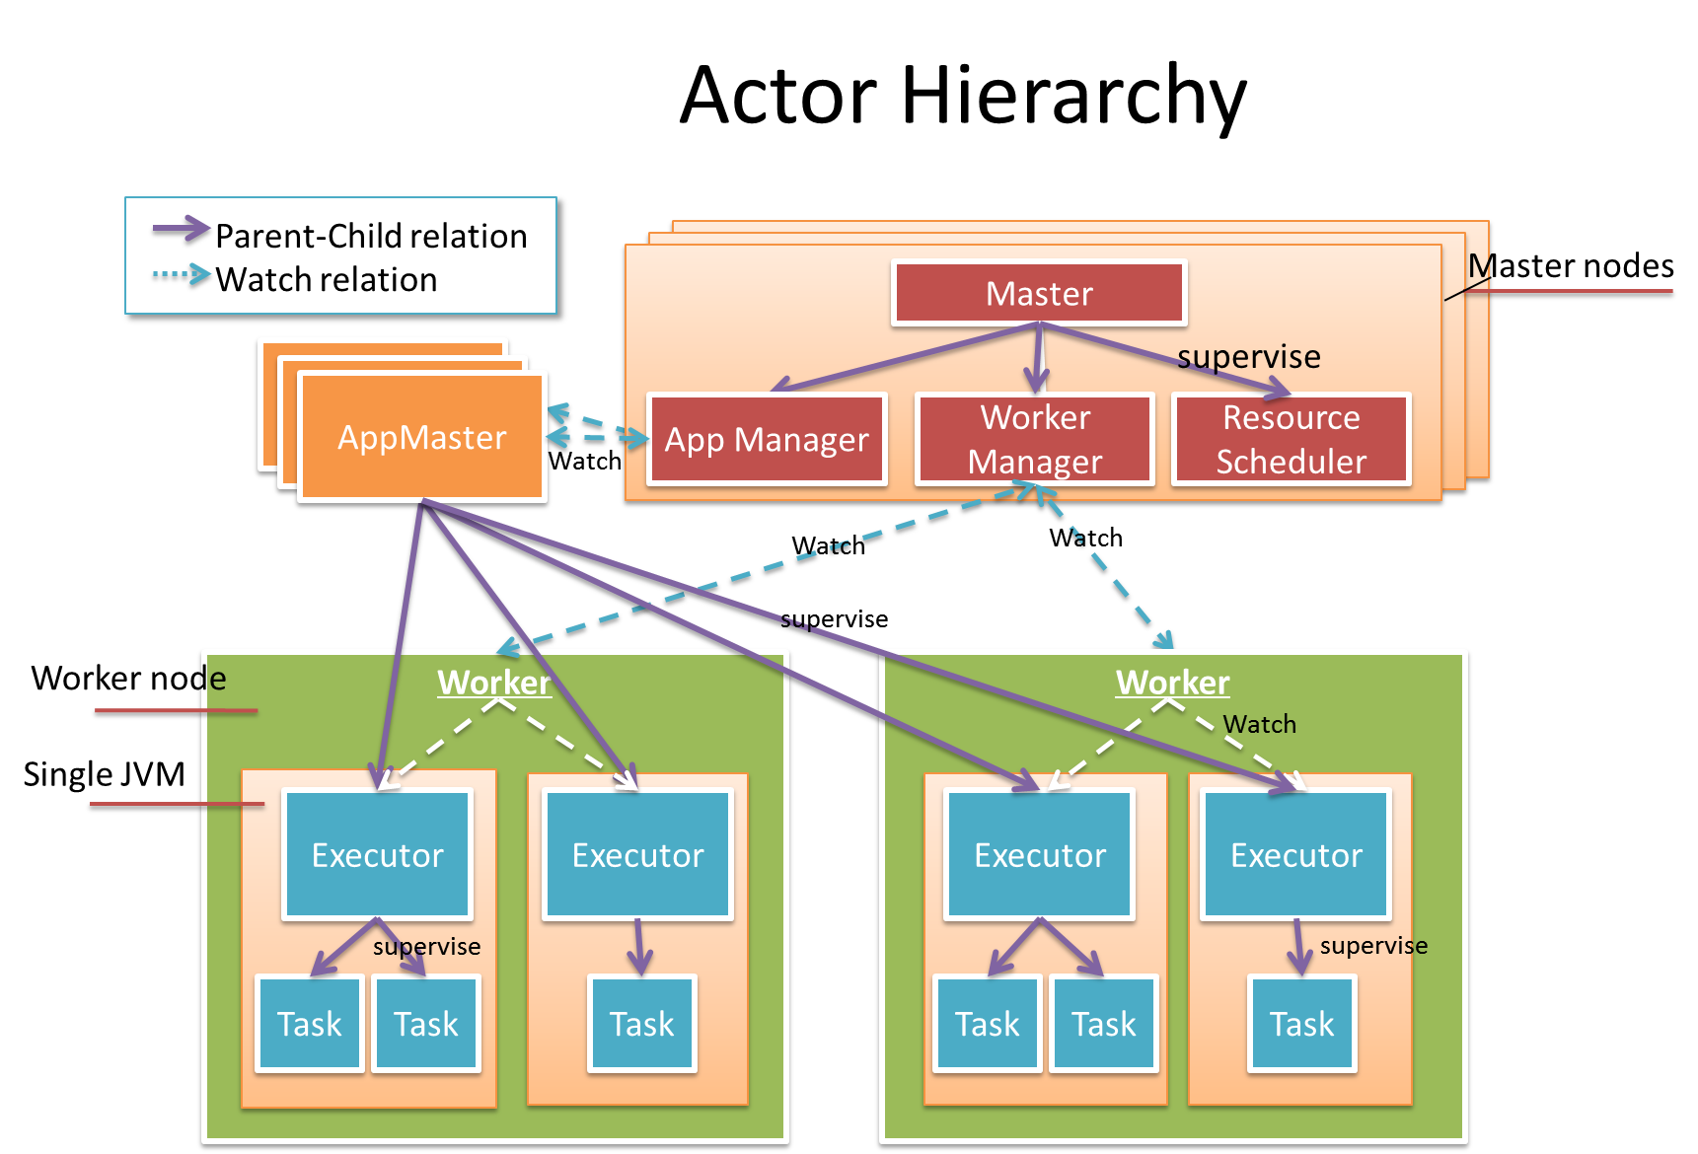
Actor Hierarchy
100% Actor: communication, concurrency, isolation, error handling
YARN
Master Cluster
HA Design
Client
Hook in and query state
As general service
Notes:
这是我们的overall架构图，我们由100%的Actor，也就是前面的微型服务，架构而成。
分成两部分，Master箭头往下是资源管理，AppMaster箭头往下是应用。Worker管理每个机器的资源和应用，master负责调度应用和资源。AppMaster往下，Executor是每个机器上的JVM，执行副本，下面有最小的执行单元Task。
我们怎么解决单点问题的呢？下一图。

Slide 25
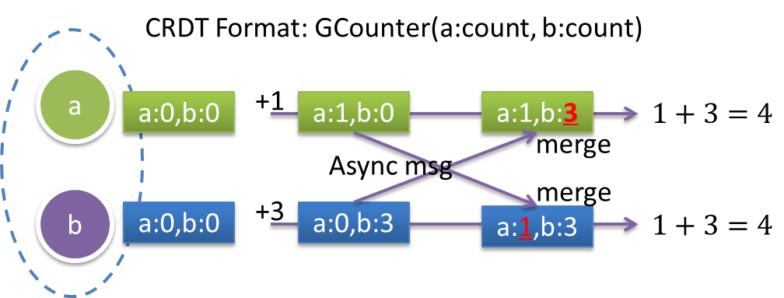
Master HA
Quorum (多数)
Conflict free data types(CRDT) for consistency
leader
CRDT Data type example:
Master
Worker
Worker
Gossip
Worker
Gossip
State
standby Master
Standby Master
Gossip
Akka Cluster
Decentralized: No central meta server
Notes:
多个Master节点，通过无中心的Gossip协议，(CCTV是中心模式，Gossip，谣言的传播模式，就是无中心的)。Gossip，闲言碎语，
状态，在每个Mater上有一个副本，又同时解决了数据的一致性问题，用CRDT类型。

Slide 26
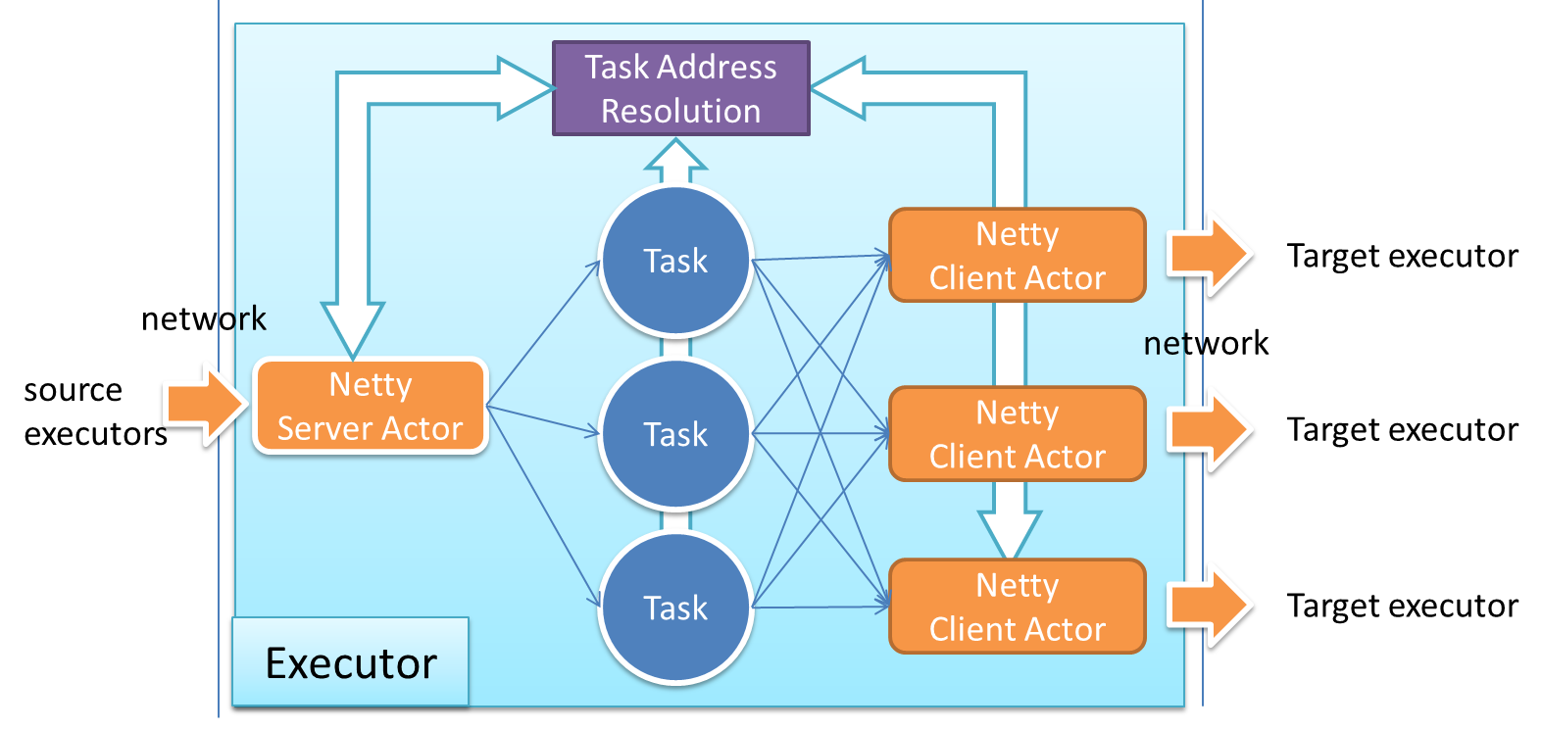
High performance Messaging Layer
Akka remote message has a big overhead, (sender + receiver address)
Reduce 95% overhead (400 bytes to ~20 bytes)
Effective batching
Sync with other executors
convert to short address
convert from short address
Notes:
Partition & Shuffle, 数据通道多，数据碎！
流内每个节点能力不同，处理速度不匹配，容易内存OOM，IO阻塞，CPU Hang等

Slide 27
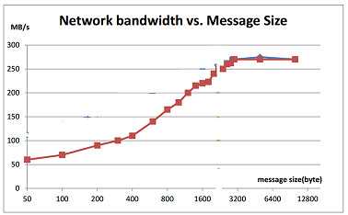
Effective batching
Network Idle: Flush as fast as we can
Network Busy: Smart batching until the network is open again.
Network Bandwidth
Doubled
For 100 byte per message
This feature is ported from Storm-297
Notes:
看这张图，是batch的大小和网络带宽利用率的关系。
对小消息尤其有用。

Slide 28
Flow Control
Pass back-pressure level-by-level
Task
Task
Task
Task
Task
Task
Task
Task
Task
Task
Task
Task
Back-pressure
Sliding window
Another option(not used): big-loop-feedback flow control

Slide 29
High performance streaming
Detect Message loss and other failures
DAG Recovery
Clock Service, know when message is lost
Message replay from clock
Exactly-once, de-duplication
29

Slide 30
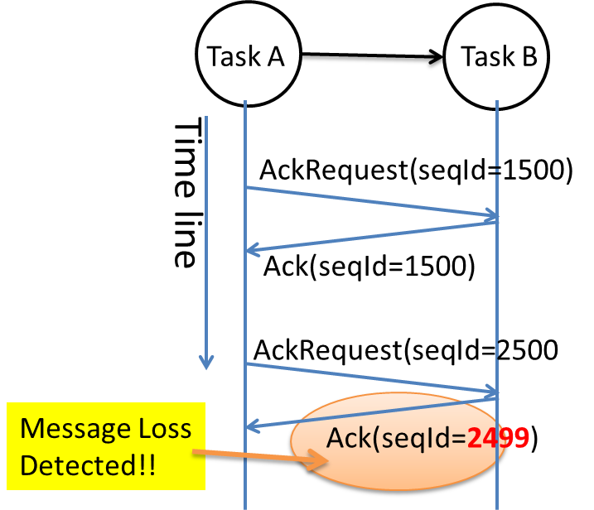
Failure Detection
For Message loss:
AckRequest and Ack
For JVM Crash, Network Down:
Actor Supervision
Master
Failure
AppMaster
Failure
Executor
Failure
Task
30

Slide 31
High performance streaming
Detect Message loss and other failures
DAG Recovery
Clock Service, know when message is lost
Message replay from clock
Exactly-once, de-duplication
31

Slide 32
DAG Recovery: Quarantine and Recover
1. Message loss detected
Global clock service
AppMaster
Source
① error detected
Store
Executor
Executor
Task
Task
Task
Send message

Slide 33




DAG Recovery: Quarantine and Recover
2. Use dynamic session ID to fence zombies
Global clock service
AppMaster
Source
① error detected
Store
Executor
Executor
Task
Task
Task
②Fence zombie
33

Slide 34
DAG Recovery: Quarantine and Recover
3. Recover the executor JVM, replay message
Global clock service
AppMaster
Replay
Source
① error detected
Store
Executor
Executor
Task
Task
③ Recover
②isolate zombie
34
Send message

Slide 35
High performance streaming
Detect Message loss and other failures
DAG Recovery
Clock Service, know when message is lost
Message replay from clock
Exactly-once, de-duplication
35

Slide 36
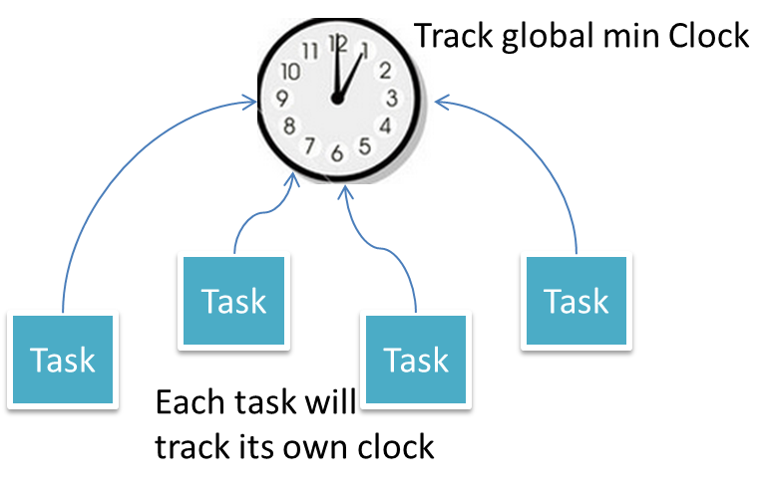
Global Clock Service – track application min-Clock (1)
A
Report task min-clock
B
C
E
D
Definition: Task min-clock is
Minimum of (
min timestamp of pending-messages in current task
Task min-Clock of all upstream tasks
)
Min-Clock of D is min-clock of global
36
Notes:
有了Clock Service，我们就知道如果消息丢失了，我们知道是什么时候丢失的。

Slide 37
Global Clock Service – track application min-Clock (2)
One Task can have thousands upstream tasks, how to effectively track all of them?
Report task min-clock
Source
task
task
task
Definition: Task min-clock is
Minimum of (
min timestamp of pending-messages in current task
Task min-Clock of all upstream tasks
)
Task
37

Slide 38

Global Clock Service – track application min-Clock (3)
One Task can have thousands upstream tasks, how to effectively track all of them?
Level Clock
Ever incremental
A
1000
Later
Source
B
800
task
task
task
Implementation
C
E
600
D
400
Earlier
Task
38

Slide 39
High performance streaming
Detect Message loss and other failures
DAG Executor Recovery
Clock Service, know when message is lost
Message replay from clock
Exactly-once, de-duplication
39

Slide 40
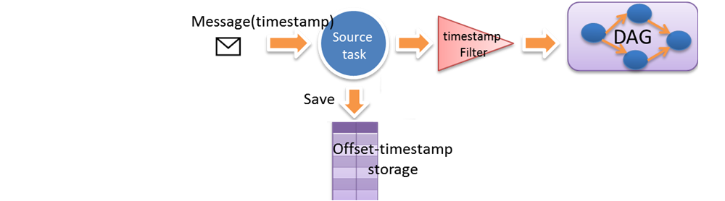
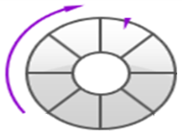
Source-based Message Replay
Replay from the very-beginning source
Source
Normal Flow
40

Slide 41
Source-based Message Replay
Replay from the very-beginning source
Source
②Replay from offset
①Resolve offset
Recovery Flow
Global Clock Service
41

Slide 42
High performance streaming
Detect Message loss and other failures
DAG Executor Recovery
Clock Service, know when message is lost
Message replay from clock
Exactly-once, de-duplication
42

Slide 43
Exactly-once message processing
Key: Ensure State(t) only contains message(timestamp <= t)
How?
DAG runtime
Checkpoint Store
43

Slide 44
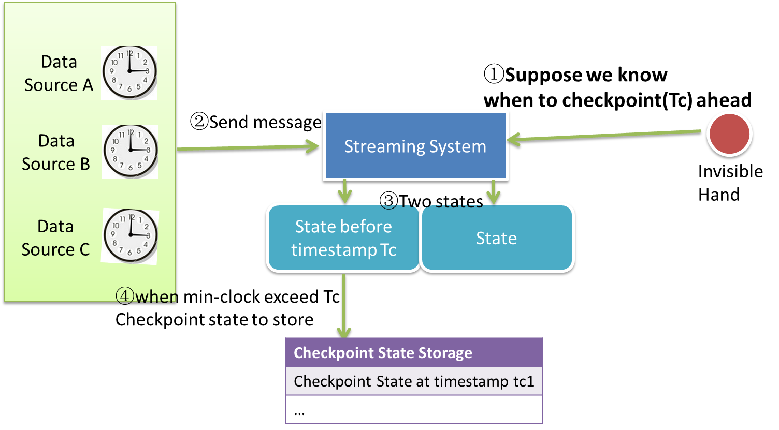
Exactly-once message processing
Checkpoint Flow
44

Slide 45
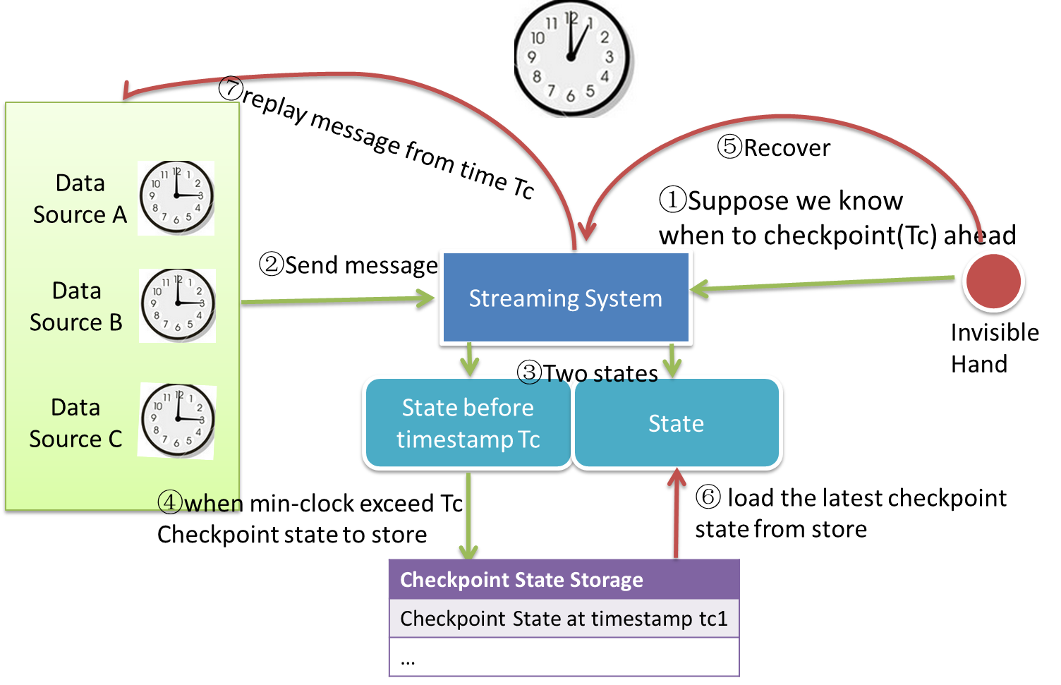
Exactly-once message processing
Recovery Flow

Slide 46
Dynamic DAG
Use Pub-Sub model
Maintain the correct min clock during transition
② Remove processor E
Un-subscribe E from B
E
Un-subscribe D from E
A
B
C
D
F
Subscribe F to A
Subscribe C to F
① Add processor F
46
Notes:
每个Processor（图中的节点）有很多task，每个task都实现了Pub-sub模型，可以动态修改拓扑。
难点在于怎么保证时钟的语义。

Slide 47
Unique Use cases 独特用例

Slide 48

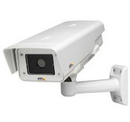






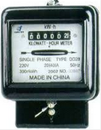


IOT Transparent Cloud
Target Problem Large gap between edge device with data center
Location transparent. Same programming model on IOT device
dag on device side
Data Center
log
Notes:
Edge device是越来越强了，，现在手机都8核了，五年后(2020年），有260亿物联网设备
把 edge 设备当成数据中心的服务器用，位置透明的部署计算子图。

Slide 49

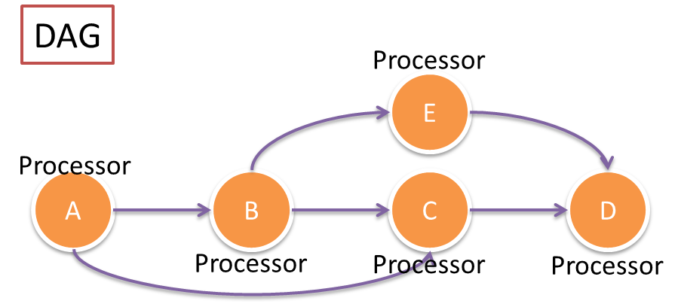

Unified log ingestion and processing
Target Problem Distributed application is broken into many isolated pieces
Single Gearpump Application For All
Deploy agents
Manage query service
Manage processing
Agent
Kafka queue
DAG
Query
Agent
Visualization
Agent
Collect logs from different
places
Notes:
之前是分离的割裂的应用，生命期分别管理的。Gearpump可以统一管理，当成一个应用程序，有HA的实现。

Slide 50





Exactly-once: Financial use cases
Target Problem transactional exactly-once real-time streaming system
Admin Portal
Service
Billing System
User
Model
Bill
Streaming
System
Notes:
收钱的应用，数据不能丢，不能重。

Slide 51
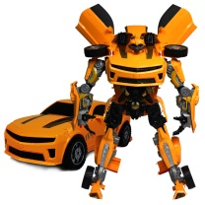
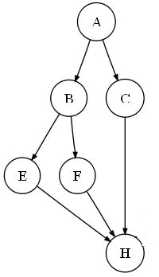
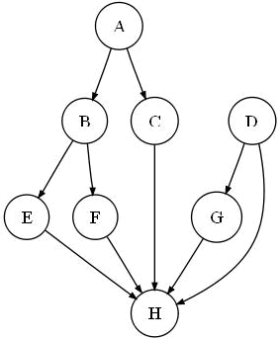
Transformers: Dynamical DAG
Target Problem No existing way to manipulate the DAG on the fly
Manipulate the DAG on the fly
Dynamic Attach
Dynamic Replace
Dynamic Remove
Add Sub Graph
Delete
B
51
Notes:
新奇的功能，彩蛋：变形金刚。

Slide 52


Eve: Online Machine Learning
Target Problem ML train and predict online in real-time for decision support.
Decide immediately based online learning result
Learn
Input
sensor
Predict
Output
Decide
52
Notes:
彩蛋，扫描，绿色植物，威胁，激光炮。

Slide 53


Google used streaming update for its search index in 2010. New pages are indexed in 10-15 min.
Other Applications
search
Smart city, ITS
ad
immediate recommendation
Ad pricing in search engine
Public
security
Public
service
Power network abnormal detection, terrorism detection。
social
Tweet analysis, relation analysis
IOT
Online study capability
Carrot mobile app for power analysis
robot
Crowd
sourcing
LBS
Location based recommendation
Mobile
QoS
Load, throughput monitoring
IT System
security
Telco fraud prevention
Finance log audit,
Online fraud prevention
log

Slide 54
Application and DEMO

Slide 55




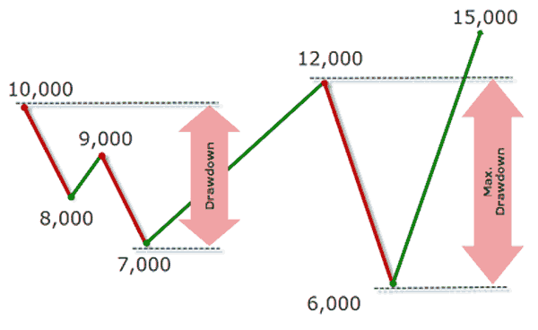
Example1: Stock Drawdown Tracking
Publish
Alerts
Query
Group by
Stock id
Crawlers
More than 3000 index
55
Drawdown Definition

Slide 56



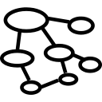
Example2: Intelligent Traffic System
KV Query
专线
Gateway
3000 cross roads
Realtime analysis
DAG
Travel time
Fake Plate
Over speed
Traffic planning
Real time statistics
56

Slide 57
Other demos
complex Graph
Stock data analysis (Drawdown tracking)
ITS
Scalability, 100 nodes, 1,000,000 tasks
DSL

Slide 58
Status & Plan
Our goal: Make this an Apache project
Welcome code contribution!
http://gearpump.io
Plan:
Connect: IOT
Platform: Dynamic DAG, Exactly-once, etc. (release soon)
Data: Real-time analysis algorithm
58

Slide 59
References
钟翔 大数据时代的软件架构范式：Reactive架构及Akka实践, 程序员期刊2015年2A期
Gearpump whitepaper http://typesafe.com/blog/gearpump-real-time-streaming-engine-using-akka
吴甘沙 低延迟流处理系统的逆袭, 程序员期刊2013年10期
Stonebraker http://cs.brown.edu/~ugur/8rulesSigRec.pdf
https://github.com/intel-hadoop/gearpump
Gearpump: https://github.com/intel-hadoop/gearpump
http://highlyscalable.wordpress.com/2013/08/20/in-stream-big-data-processing/
https://engineering.linkedin.com/kafka/benchmarking-apache-kafka-2-million-writes-second-three-cheap-machines
Sqlstream http://www.sqlstream.com/customers/
http://www.statsblogs.com/2014/05/19/a-general-introduction-to-stream-processing/
http://www.statalgo.com/2014/05/28/stream-processing-with-messaging-systems/
Gartner report on IOT http://www.zdnet.com/article/internet-of-things-devices-will-dwarf-number-of-pcs-tablets-and-smartphones/

Slide 60


60

