Slide 1
Data Science Challenge
Lefteris Vazaios

Slide 2
The data
25 car journeys
Accelerometer and GPS measurements

Slide 3
The goal
Clean and transform the data
Detect ‘events’ that represent road accidents
Evaluate solution

Slide 4
Pre-processing
Converted timestamp to readable format
Fixed unit of scale on accelerometer values
Introduced new variable for acceleration, regardless of movement axis

Slide 5
The problem
Anomaly Detection
Unsupervised Learning
Actual accidents not known

Slide 6
The algorithms
Moving Average
Local Outlier Factor
One-class SVM
Isolation Forest

Slide 7
Implementation
Apply algorithms to each journey
Apply algorithms to all journeys at once
Combine results

Slide 8
Results
Journey ID | timestamp | Models that spotted the accident
2 | 30:45.3 | 4
4 | 52:18.9 | 3
5 | 11:14.3 | 3
10 | 35:20.9 | 3
12 | 04:23.4 | 3
15 | 37:29.2 | 4
21 | 28:41.2 | 3
22 | 56:35.3 | 3

Slide 9
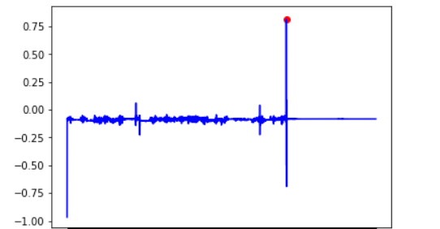
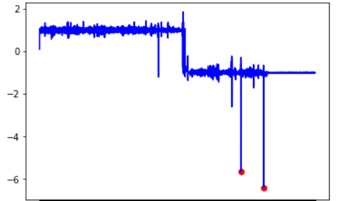
Visual representation

