Slide 1
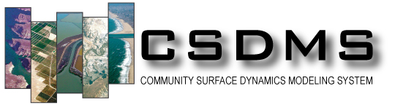

The CSDMS Standard Names: Cross-Domain Naming Conventions for Describing Process Models, Data Sets and Their Associated Variables
Scott D. Peckham, University of Colorado, and
Former Chief Software Architect for CSDMS
September 30, 2014
The Meaning of Names: Naming Diversity in the 21st Century, Boulder, Colorado

Slide 2
Linking Component-based Models:
How Can Two Models Differ?
Programming language
(C, C++, Fortran, Java, Python, etc.)
Solution: Babel and Bocca (CCA toolchain)
Computational grid
(triangles, rectangles, Voronoi, etc.)
Solution: ESMF regridder (parallel, spatial interpol.)
Timestepping scheme
(fixed, adaptive, local)
Solution: Temporal interpolation tool
Variable names
    Need some means of “semantic mediation”
Solution: CSDMS Standard Names
Variable units
Solution: UDUNITS (Unidata)

Slide 3
Semantic Matching for Model Variables
Hydro Model A
Output variables:
streamflow
rainrate
CSDMS Standard Names
channel_exit_water_x-section__
volume_flow_rate
atmosphere_water__rainfall_volume_flux
Hydro Model B
Input variables:
discharge
precip_rate
Goal: Remove ambiguity so that
the framework can automatically
match outputs to inputs.

Slide 4
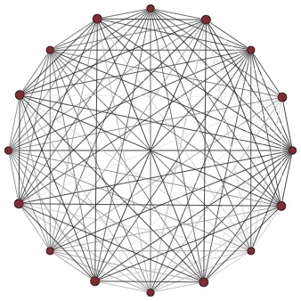
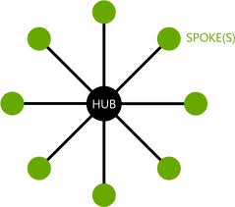
Reconciling Differences with Standards
vs.
Introduce a new, generic or standard representation (the “hub”), then map resources to and from it. The amount of work, maintenance, etc. drops to:
Cost(N) = N.
If we reconcile differences between the resources in a pairwise manner, the amount of work, etc. grows fast:
Cost(N) = N (N-1) / 2 ~ N².

Slide 5
Motivation for Standard Names
Most models require input variables and produce output variables. In a component-based modeling framework like CSDMS, a set of components becomes a complete model when every component is able to obtain the input variables it needs from another component in the set. Ideally, we want a modeling framework to automatically:
Determine if a set of components provides a complete model.
Connect each component that requires a certain input variable to another component in the set that provides that variable as output.
This kind of automation requires a matching mechanism for determining whether — and the degree to which — two variable names refer to the same quantity and whether they use the same units and are defined or measured in the same way.

Slide 6
Important Note
Model developers do not replace variables in their code with CSDMS Standard Names. They only need to provide a mapping (e.g. a Python dictionary) of their input and output variables to CSDMS Standard Names and provide a Model Metadata File with assumptions, units, grid type, etc.
This is part of the Basic Model Interface (BMI) that CSDMS asks model developers to provide.

Slide 7
Types of Quantities we Need
Associated with Processes:
snow__melt_rate, atmosphere_water__rainfall_volume_flux
Generated from mathematical operations:
bedrock_surface__time_derivative_of_elevation
sea_water__north_component_of_velocity
Dimensionless numbers:
channel_water_flow__froude_number
Mathematical and physical constants:
earth__standard_gravity_constant (“little g”)
physics__universal_gravitational_constant (“big G”)
Empirical parameters:
glacier_glen-law__exponent
Flow rates and fluxes (incoming or outgoing):
lake_incoming-water__volume_flow_rate
Reference quantities:
atmosphere_air_flow__reference-height_speed

Slide 8
Unambiguous Quantity Names
Avoid jargon and keep objects out of quantity names
rainrate
precipitation_rate
precipitation_leq-volume_flux
rainfall_volume_flux
snowfall_volume_flux
As opposed to:
liquid_water_equivalent
snow_water_equivalent
streamflow
discharge
volume_flow_rate
Note: Text books and Wikipedia pages are often good sources for learning about how to use
quantity names correctly within a given science domain.
specific_discharge
darcy_velocity
relative_humidity
atmosphere_air_water-vapor__relative_saturation

Slide 9
What About CF Standard Names?
Created by LLNL for naming variables in NetCDF files.
Domain-specific: Almost exclusively ocean and atmosphere model variables. (e.g. “tendency_of” instead of “time_derivative_of”)
Incomplete rules: No rules for constants, dimensionless numbers , reference quantities and many other quantity types.
Complex name-generation template (& inconsistently used):
[surface] [component] standard_name [at surface] [in medium]
[due to process] (for terms in an equation)
[assuming condition] (for assumptions)
May also have a transformation prefix (e.g “magnitude_of”)
Assumptions are included in the name itself via “_assuming_*”.
http://cf-pcmdi.llnl.gov/documents/cf-standard-names/guidelines

Slide 10
The CSDMS Standard Names
Data Models like RDF and EAV use triples like:
Subject + Predicate + Object, and
Entity/Object + Attribute + Value (object-oriented)
CSDMS Standard Names use a similar template for creating unambiguous and easily understood standard variable names or preferred labels according to a set of rules. These are then used to retrieve/match values (and metadata). The template is:
Object name + [Operation name] + Quantity name
Examples:
atmosphere_carbon-dioxide__partial_pressure
atmosphere_water__precipitation_leq-volume_flux
earth_ellipsoid__equatorial_radius
soil__saturated_hydraulic_conductivity

Slide 11
CSDMS Standard Names: Basic Rules
All names consist of an object name and a quantity name separated by double underscores (e.g. air__temperature)
Object name + [Operation name] + Quantity name
Standard names consist of lower-case letters and digits. They contain no blank spaces. Underscores are inserted into some compound words.
Underscores are used as separators between words and hyphens are used in two-word object names such as carbon-dioxide.
The rightmost word in an object name is a base_object. The rightmost word in a quantity name is a base_quantity.
Some naming rules use reserved words, such as: of, in, on, at and to.
A possessive “s” is never added to the end of a person’s name, but many names end in “s”, like “Reynolds” and “Stokes”.

Slide 12
Object Name Patterns
A fairly small number of patterns covers most object names.

Slide 13
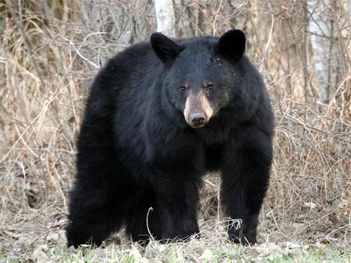
Word Order in Object Names
Starting with a base object, descriptive words are added to the left in an effort to construct an unambiguous and easily understood object name. The addition of each new word (or words) produces a more restrictive or specific name from the previous name. For example:
bear tree
black_bear oak_tree
alaskan_black_bear bluejack_oak_tree
However, in the Part of Another Object Pattern, words added to the left could be objects that indicate nested containment, e.g.:
bluejack_oak_tree_trunk_x-section__diameter

Slide 14
Part of Another Object Pattern
alaskan_black_bear_brain_to_body__mass_ratio
alaskan_black_bear_head__mean_diameter
bluejack_oak_tree_trunk_x-section__diameter
brammo_empulse_electric_motorcycle__rake_angle
brammo_empulse_electric_motorcycle__wheelbase_length
channel_water_x-section__wetted_area
channel_water_x-section__wetted_perimeter
earth_axis__tilt_angle
earth_orbit__eccentricity
gm_hummer_gas-tank__volume
gm_hummer__fuel_economy [mpg]
We can also use “nested containment” to indicate which part of an object, as in: atmosphere_top, channel_bed, channel_inflow_end, glacier_top,
sea_floor_surface, sea_surface.

Slide 15
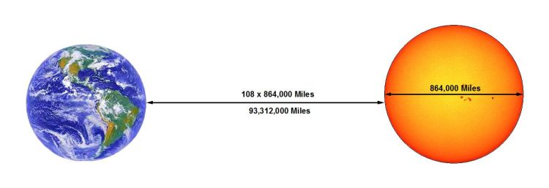
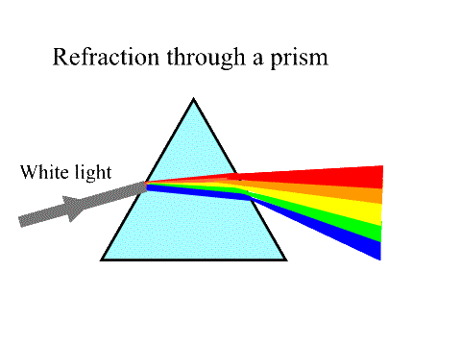
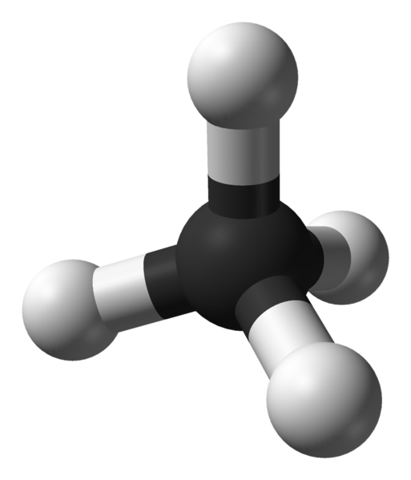

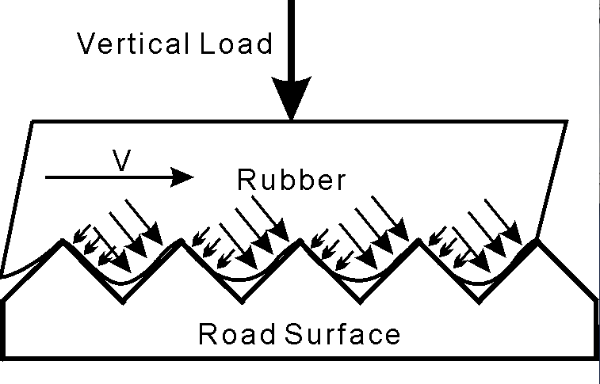
Two-Object Quantities
glass_visible-light
__standard_
refraction_index
earth_to_sun__mean_distance
methane_molecule_c_to_h
__bond_length
concrete_rubber
__kinetic_friction_coefficient
water_carbon-dioxide__solubility

Slide 16
Object-in-object Quantity Pattern
air_carbon-dioxide__partial_pressure
air_water-vapor__relative_saturation
water__carbon-dioxide__solubility
soil_clay__volume_fraction (or silt or sand or water)
air_helium_plume__richardson_number
water_oxygen__mole_concentration
water_suspended-sediment__volume_concentration
air_visible-light__speed
ethanol_water__dilution_ratio
Object-to-object Quantity Pattern
brain_to_body__mass_ratio
carbon_to_hydrogen_bond__length
carbon_to_hydrogen_bond__dissociation_energy
earth_to_mars__travel_time
earth_to_sun__mean_distance
rubber_to_pavement__static_friction_coefficient

Slide 17
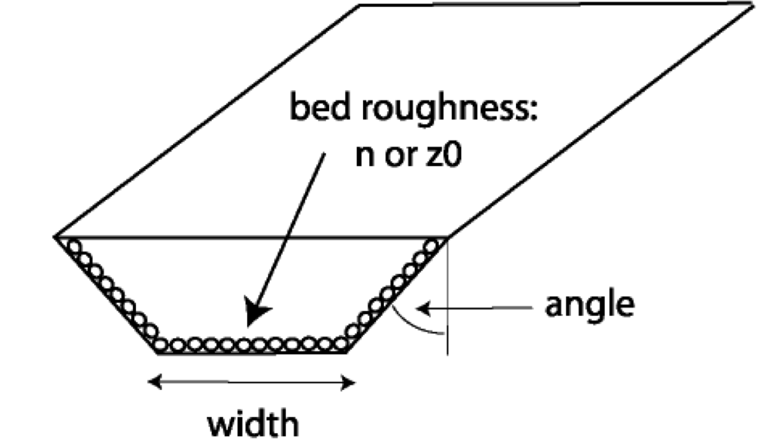
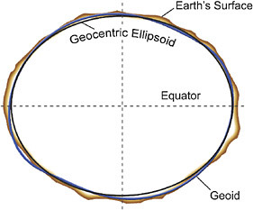
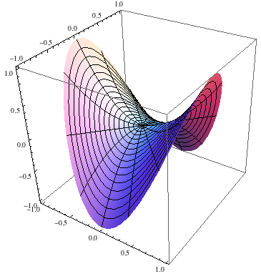
Object Name + Model Name Pattern
Objects are often idealized by a geometric shape or other “model”. Certain quantities may only be well-defined for the model as opposed to the actual object. Examples include:
channel_centerline__valley_sinuosity
channel_x-section_trapezoid_bottom__width
crater_circle__radius, earth_black-body__temperature
earth_ellipsoid__equatorial_radius
earth_mean-sea-level-datum_air__pressure
land_surface__plan_curvature

Slide 18
Quantity Name Patterns
A fairly small number of patterns covers most quantity names.

Slide 19
“Base Quantity” Name Examples
altitude, amplitude, angle, area, capacity, charge, code, coefficient, conductivity, constant, cost, current, date, density, depth, diameter, distance, duration, efficiency, elevation, energy, factor, fee, flux, force, fraction, frequency, heat, height, index, intensity, length, mass, number, parameter, period, pressure, price, radius, rate, ratio, slope, speed, stress, temperature, time, velocity, viscosity, voltage and wavelength.

Slide 20
Word Order in Quantity Names
Starting with a base quantity, descriptive words are added to the left in an effort to construct an unambiguous and easily understood object name. The addition of each new word (or words) produces a more restrictive or specific name from the previous name. For example:
conductivity
hydraulic_conductivity (vs. electrical or thermal)
saturated_hydraulic_conductivity
effective_saturated_hydraulic_conductivity
Note: hydraulic_conductivity and saturated_hydraulic_conductivity are both fundamental quantities used in groundwater models. The adjective effective could be applied to either of them to indicate application at a given scale. Note also that saturated could have been applied to "soil", the associated object, but saturated_hydraulic_conductivity is a fundamental quantity.

Slide 21
Standard Process Names
From this work it became clear that process names could be viewed as nouns derived from verbs, usually ending with:
tion (e.g. absorption, convection, radiation),
sion (e.g. conversion, dispersion, submersion),
ing (e.g. melting, swimming, upwelling),
age (e.g. drainage, seepage, storage),
y (e.g. discovery, recovery, reentry),
ance (e.g. acceptance, disturbance, maintanence),
ment (e.g. alignment, improvement, recruitment),
al (e.g. arrival, disposal, removal, retrieval) and
sis (e.g. osmosis, metamorphosis, dialysis, paralysis)
A collection of over 1300 standardized process names can be found at: http://csdms.colorado.edu/wiki/CSN_Process_Names

Slide 22
Process Name + Quantity Pattern
Much of science is concerned with the study of natural and physical processes, so it should not be surprising that a large number of quantity names are constructed from a process name and a base quantity name. (See CSDMS wiki for over 525 examples.)
However, for process names that end with ing, the ending is often dropped as in: burn, creep, flow, lapse, melt, shear and tilt.
(e.g. snow__melt_rate, channel_bed__shear_stress.)
Many process names can be paired with "_rate” to create a quantity name: e.g. precipitation_rate. Some process names are more naturally paired with an ending other than "_rate", e.g.
dilution_ratio
drainage_area
escape_speed
gestation_period
identification_number
inclination_angle
penetration_depth
radiation_flux
relaxation_time
striking_distance
turning_radius
vibration_frequency

Slide 23
Flow Rates and Fluxes
Process + Quantity Name Pattern
Flow rates and fluxes are used to quantify the rate at which mass, momentum, energy, volume or moles move into or out of a control volume. Rate implies “per unit time” and a flux is a flow rate per unit area. e.g. mass_ flow_rate [kg s-1], mass_flux [kg s-1 m-2].
When a process name is used to construct a quantity name, the process should be one that pertains to the object name part. If chosen carefully, the process name can clarify whether the flux or flow rate is incoming or outgoing (incident or emitted), e.g.
land_surface_incoming-longwave-radiation__energy_flux
land_surface__longwave_radiation_flux
lake_incoming-water__volume_flow_rate
lake_outgoing-water__volume_flow_rate

Slide 24
Model-specific Quantity Pattern
Many variables are associated with some kind of mathematical model of a natural object or its properties. Many are associated with power-law approximations and a person’s name, e.g.
channel_water__hydraulic_geometry_depth_vs_discharge_exponent
channel_water__hydraulic_geometry_slope_vs_discharge_coefficient
channel_water__hydraulic_geometry_width_vs_discharge_exponent
channel_bed__manning_coefficient
glacier__glen_law_coefficient
glacier__glen_law_exponent
soil__brooks_corey_conductivity_exponent (Smith, 2002)
soil__brooks_corey_pore_size_distribution_parameter
soil__green_ampt_capillary_length_scale
soil__brooks_corey_smith_curvature_parameter (Smith, 2002)
watershed__flint_law_coefficient
watershed__flint_law_exponent
watershed__hack_law_coefficient
watershed__hack_law_exponent

Slide 25
Operation Name + Quantity Pattern
Mathematical operations are often applied to a quantity in order to create a new quantity which often has different units. These operations have standard names or abbreviations and in the CSDMS Standard Names they always end with the reserved word of (used as a delimiter) as in:
bedrock_surface__2nd_time_derivative_of_elevation
sea_water__time_derivative_of_north_component_of_velocity
soil__log_of_hydraulic_conductivity
soil__time_derivative_of_saturated_hydraulic_conductivity
watershed_outlet_water__area_time_integral_of_volume_outflow_rate
watershed_outlet_water__daily_mean_of_volume_outflow_rate
watershed_outlet_water__time_max_of_volume_outflow_rate
Note that they can also be chained together as in the second example.

Slide 26
Standard Assumption Names
Assumptions --- interpreted broadly to include:
conditions, simplifications, approximations, limitations,
conventions, provisos, exclusions, restrictions, etc.
--- are not included in CSDMS Standard Variable Names.
Instead, developers are encouraged to use multiple <assume> tags in a Model Metadata File to clarify how they are using a CSDMS Standard Name within their model. (Read once at start.)
In order for a Modeling Framework to be able to compare the assumptions made by different models (about the model or its variables), standard assumption names are needed, in addition to the standard variable names.

Slide 27
Standard Assumption Names
Assumption Type: Example
Boundary conditions: no_slip_boundary_condition
Conserved quantities: momentum_conserved
Coordinate system: cartesian_coordinate_system
Angle conventions: clockwise_from_north_convention
Dimensionality: 2_dimensional
Equations used: navier_stokes_equation
Closures: eddy_viscosity_turbulence_closure
Flow-type assumptions: laminar_flow
Fluid-type assumptions: herschel_bulkley_fluid
Geometry assumptions: trapezoid_shaped
Named model assumptions: green_ampt_infiltration_model
Thermodynamic processes: isenthalpic_process
Approximations: boussinesq_approximation
Averaging methods: reynolds_averaged
Numerical methods used: arakawa_c_grid
State of matter: liquid_phase

Slide 28
Summary
The CSDMS Standard Names can be viewed as a lingua franca that provides a bridge for mapping variable names between models. They play an important role in the Basic Model Interface (BMI). Model developers are asked to provide a BMI interface that includes a mapping of their model's internal variable names to CSDMS Standard Names and a Model Metadata File that provides model assumptions and other information.
IMPORTANT: Model developers continue to use whatever variable names they want to in their code, but then "map" each of their internal variable names to the appropriate CSDMS standard name in their BMI implementation.
For More Information
Main Page: csdms.colorado.edu/wiki/CSDMS_Standard_Names
Basic Rules: csdms.colorado.edu/wiki/CSN_Basic_Rules
Object Names: csdms.colorado.edu/wiki/CSN_Object_Templates
Operation Names: csdms.colorado.edu/wiki/CSN_Operation_Templates
Quantity Names: csdms.colorado.edu/wiki/CSN_Quantity_Templates
Process Names: csdms.colorado.edu/wiki/CSN_Process_Names
Assumption Names: csdms.colorado.edu/wiki/CSN_Assumption_Names
Metadata Names: csdms.colorado.edu/wiki/CSN_Metadata_Names
Model Metadata Files: csdms.colorado.edu/wiki/CSN_MMF_Example

Slide 30
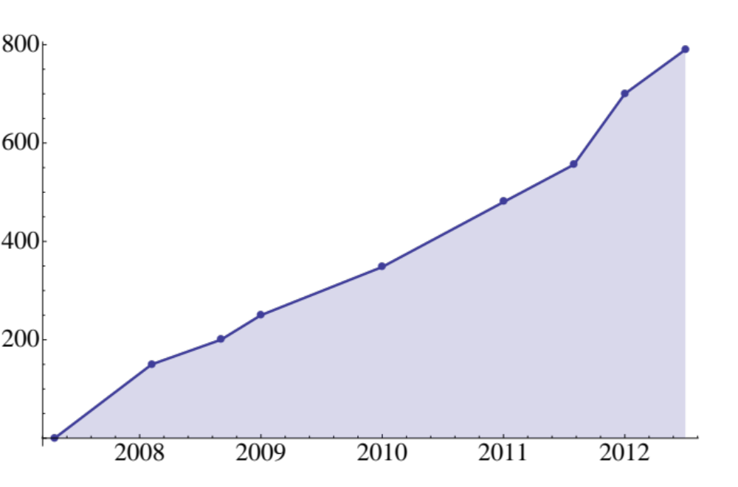
Number of CSDMS Members vs. Time
Working Groups:
Focus Research Groups:
Terrestrial: 456
Hydrology: 349
Coastal: 354
Chesapeake: 62
Carbonate: 65
Marine: 240
Critical Zone: 7
Cyber: 150
Anthropocene: 3
EKT: 152
982 Members
as of Feb. 19, 2013

Slide 31
List of Design Objectives
Avoid ambiguous variable names.
Avoid domain-specific terminology.
Use generic or already-standardized object names.
Support for approximate or closest matches.
Ability to specific multiple objects.
Avoid mixing object names into quantity names.
Parsability and strict adherence to rules.
Natural grouping by object via alphabetization.
Support for mathematical operations.
Support for dimensionless numbers.
Support for mathematical and physical constants.
Support for empirical parameters.
Support for incoming or outgoing flow rates and fluxes.
Support for reference quantities.
Support for an arbitrary number of assumptions for each name.

Slide 32
The CSDMS Standard Names
Actually consist of several “controlled vocabularies” and a set of naming conventions or rules for combining them, i.e.
Standard Variable Names
Standard Process Names
Standard Base Quantity Names
Standard Quantity Names
Standard Operation Names
The rules are derived from spoken English and analysis of speech patterns. Scientists often use domain-specific jargon for expediency, but most also know how to avoid this jargon and use more widely understood terms (not prone to ambiguity) when speaking to scientists in other domains.

