Slide 1
W-CHAT
Where Conversations Flourish in a Digital Realm

Slide 2
INTRODUCTION
In a world increasingly interconnected through the web, social media platforms have become the heartbeat of our digital existence. They shape our conversations, connect communities, and empower individuals to share their stories on a global stage. With this project we wanted to create a social media website that will allow users to communicate effortlessly with each other. The name of the website is W_CHAT.
W_CHAT is all about making chatting online feel natural and enjoyable. Whether you're sending messages to a friend, joining a group chat with people who share your interests, or sending media, W_CHAT is there to make it easy. And when it comes to keeping your conversations secure, you can trust W_CHAT to keep your information safe. With strong security measures in place, you can chat with peace of mind, knowing that your privacy is protected.
That's the vision behind W_CHAT, a new online chat platform designed to make interacting with people on the internet simple, safe, and fun.

Slide 3
What is w-chat?
W-Chat isn't just another social media platform; it's an innovative space designed to foster genuine connections. As we delve into the creation of W-Chat, our focus remains on providing a platform where users can engage in authentic conversations, share their passions, and build meaningful relationships.
W-Chat is more than just a collection of features; it's a carefully curated environment that prioritizes user experience. From intuitive interfaces to, instant notification and advanced security measures, W-Chat aims to redefine how we interact in the digital sphere.

Slide 4
AIM: The primary aim of W_CHAT is to provide users with a dynamic and versatile online chat experience that surpasses traditional communication barriers. By implementing innovative features, W_CHAT seeks to facilitate effortless communication, collaboration, and connectivity among users across the globe.
OBJECTIVES:
User-Centered Design: W_CHAT will prioritize user experience and interface design, ensuring that the platform is intuitive, accessible, and visually appealing to users .
Security and Privacy: Ensuring the utmost security and privacy of user data will be a paramount concern for W_CHAT. Protection measures and transparent privacy policies will be implemented to safeguard user information and prevent ay breach
Scalability and Reliability: W_CHAT will be built on a scalable and reliable infrastructure capable of accommodating rapid user growth while maintaining optimal performance and uptime.

Slide 5
FUNCTIONALITY
One on one chat
Search button
Read receipt
Online status
Notification
Customize profile
Share multimedia

Slide 6
FEATURES
User Profiles
Create Account
Messaging
Notification
Voice call
MULTIMEDIA

Slide 7
FEATURES
User profiles: When you sign up for W_CHAT, you'll create your own user profile where you can add your details and customize how you want to appear to others. You can update your profile anytime to keep it fresh and relevant.
Messaging : You can send messages to your friends or groups instantly. Whether it's a quick hello or a long conversation, W_CHAT's messaging feature ensures your messages reach the intended recipients promptly and smoothly.
Notification: W_CHAT keeps you informed with notifications whenever you receive new messages, get mentioned in a chat, or when there's any other relevant activity. This ensures you stay updated and never miss out on important conversations or events.
Multimedia: With W_CHAT's multimedia capabilities, you can share photos and files with your contacts or groups. Whether you're sharing a funny meme, a memorable photo, or an important document, W_CHAT makes it easy to exchange multimedia content seamlessly.

Slide 8
CHART-FLOW OF HOW W-CHAT OPERATES

Slide 9
SIGN-UP PAGE
The signup page is the page where new users are allowed to create new accounts
It requires you to provide your details such as your first name and your last name
Your email is also required in order to sign up if you are a new user
You need to also provide a Password of not less than 8 characters
You can also add a profile picture

Slide 10
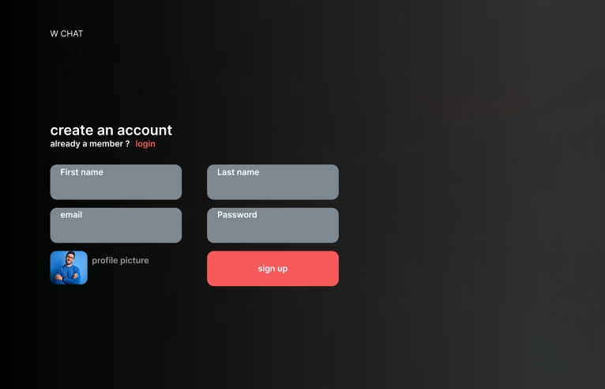

Slide 11
SIGN-IN PAGE
The sign in page is for existing users to login into their account
It requires your email you used for registration
It also asks for your password
If you are a new user it will require you to signup

Slide 12
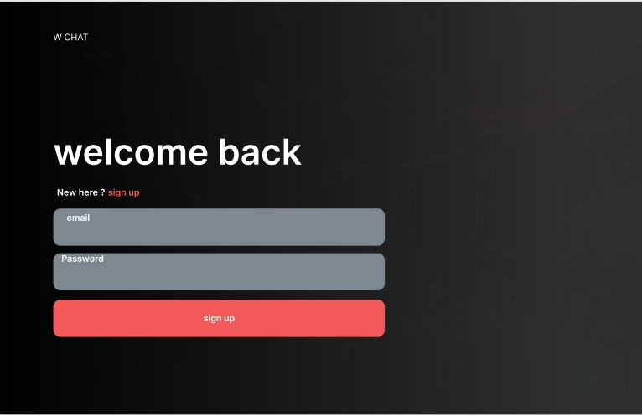
SIGN-IN PAGE

Slide 13
THE CHAT INTERFACE
The chat page consists of all the users you are interacting with including all your unread messages
Once you click on a chat an interface opens which allows you to interact with another user
You can also send media including images and video to another user
When you receive a message a notification will pop out with the name of the user
It also includes a search button where you can add other users to interact with

Slide 14
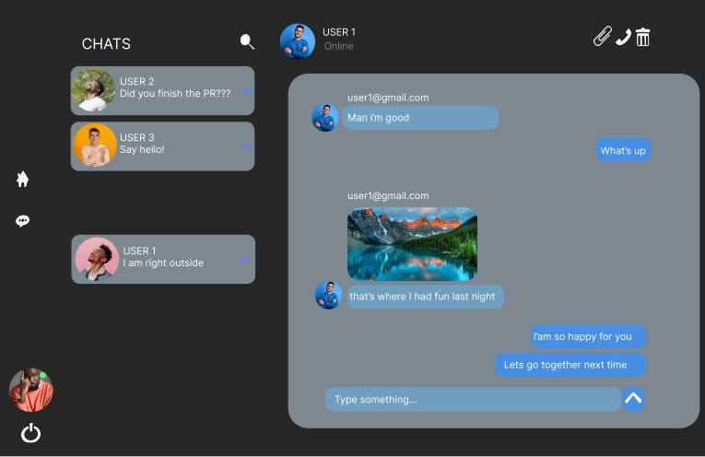
CHATS

Slide 15
UI/UX
The User Interface (UI) and User Experience (UX) play crucial role in the success of a social media site like W-Chat.
The UI/UX was tasked with:
Designing an intuitive and visually appealing onboarding process to help users create profiles easily.
Develop a clear and user-friendly navigation system with easy-to-understand icons and menus.
Create visually appealing and customizable user profiles
Design a clean and user-friendly messaging interface with clear indicators for unread messages.
Create an easy pathway for users to recover Passwords when they forget

Slide 16
FRONT – END DEVELOPERS
The role of the front-end developers in the project are as follows
Designing of the user interface: Frontend developers were tasked with designing the user interface (UI) of the chat platform. This includes creating layouts, designing buttons, input fields, and other UI elements. The goal is to make the interface intuitive and visually appealing.
Designing of the user experience to allow easy navigation: UX design is vital for ensuring that the chat platform is easy to use and navigate. Frontend developers worked on optimizing the user flow, minimizing friction, and providing a seamless experience for W_CHAT users
Implementation of chat features : Frontend developers were responsible for implementing various chat features such as sending and receiving messages, displaying online/offline status, typing indicators, emojis, file sharing, and notifications.
Cross browser accessibility in order to work across different platforms: Frontend developers designed W_CHAT to ensure that the chat platform works consistently across different web browsers (e.g., Chrome, Firefox, Safari, Edge). They implemented browser-specific CSS or JavaScript fixes to address compatibility issues.

Slide 17
BACK –END DEVELOPERS
The role of the back-end is very crucial in developing an online chat platform like w-chat
Server side logic : Backend developers created the logic that runs on the server and handles various aspects of the chat platform, such as user authentication, message handling, and real-time communication.
Database Management : Backend developers designed and managed the database schema for storing user profiles, chat messages, metadata, and other relevant information.
API Development : Backend developers designed and implemented the APIs (Application Programming Interfaces) that allow the frontend of the W-CHAT to communicate with the server. These APIs define the endpoints and data formats for exchanging information between the client and server.
Security: Backend developers were responsible for implementing security measures to protect W-CHAT from various threats, including unauthorized access, data breaches, and attacks. This involves implementing secure authentication mechanisms.
Scalability and Overall performance : Backend developers were tasked with designing the architecture of W-chat to ensure scalability and optimal performance, especially during peak usage periods.

Slide 18
PROJECT MANAGERS
A project such as an online chat platform need good project managers to handle and implement it . The work of the project managers were as follows
Project Planning: We defined the scope, objectives, and requirements of the W-CHAT platform. I created a detailed project plan, outlining tasks, timelines, resource allocation, and dependencies for the team.
Team Management : We lead and coordinated the project team, we collaborated with the frontend developers, backend developers and UI/UX, to develop the project. We assigned tasks, provided guidance, and ensured that team members have the resources they need to make the project successful.
Documentation and Reporting: We maintained comprehensive documentation related to the project, including project plans, requirements documents and other documents of team members .
Quality Assurance : The project managers ensured that the chat platform meets quality standards and user expectations. We established quality assurance processes, conducted regular reviews and inspections, and coordinated testing activities to identify and address problems.

Slide 19
CONCLUSION
In conclusion, W_CHAT represents a bold endeavor to redefine the landscape of online communication. With its user-centric design, security measures, and innovative features, W_CHAT is set to emerge as a leader in the online chat space, empowering users to connect and communicate with ease and convenience. By embracing technological innovation and prioritizing user satisfaction, W_CHAT is set to change the way individuals interact and engage in the digital age.

Slide 20
GROUP MEMBERS
JOSHUA KWESI ESHUN YAAFO - UEB1108720
FRIMPONG KENNETH - UEB1101620
SOFARAA AGYEI JOSEPH - UEB1107720
ANKUDEY –MORGAN OSBORN - UEB1105720
KAITU LORD BOTCHWAY - UEB1110020
KORANG–BOAMAH SLYVESTER - UEB11O5220
ACQUAH KELVIN MENSAH - UEB1103720
ARO NKETSIA AIDOO - UEB1108020
ANOKYE TWUM SAMUEL EUGENE – UEB1102720
ASENSO DERRICK - UEB11O4520
PROJECT MANAGER
PROJECT MANAGER
FRONT-END
UI/UX
FRONT-END
BACK-END
FRONT-END
BACK-END
UI/UX
FRONTEND

