Slide 1

Julia Acosta
Miguel Barrales
Elijah Davis
Mario Hernandez
Miguel Trigueros

Slide 2
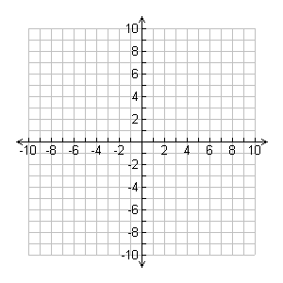
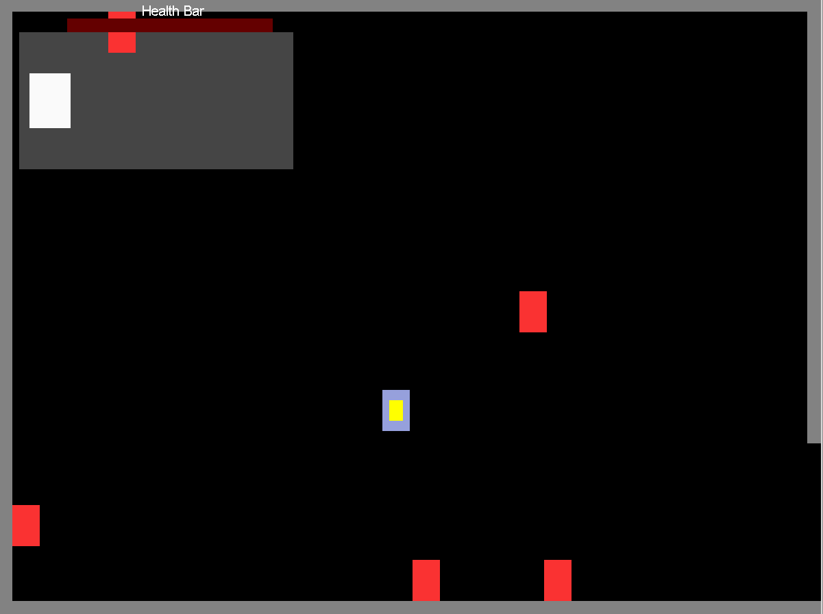
Layout of Game
Graph Layout
Starts at (0, 0)
2D Top Down
Zelda

Slide 3
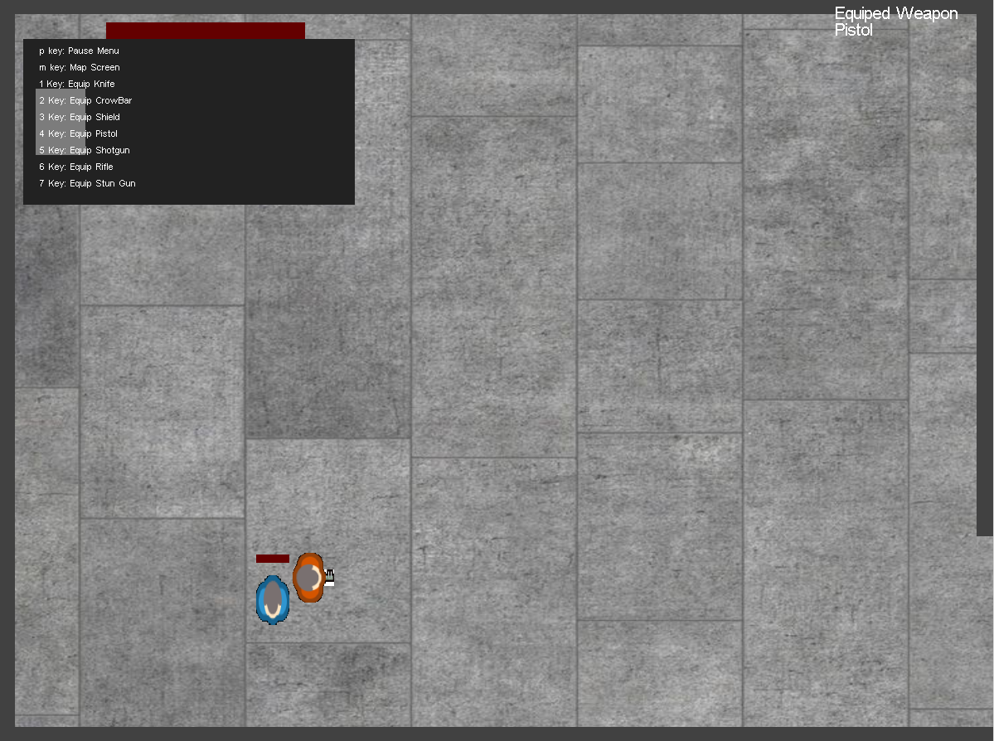
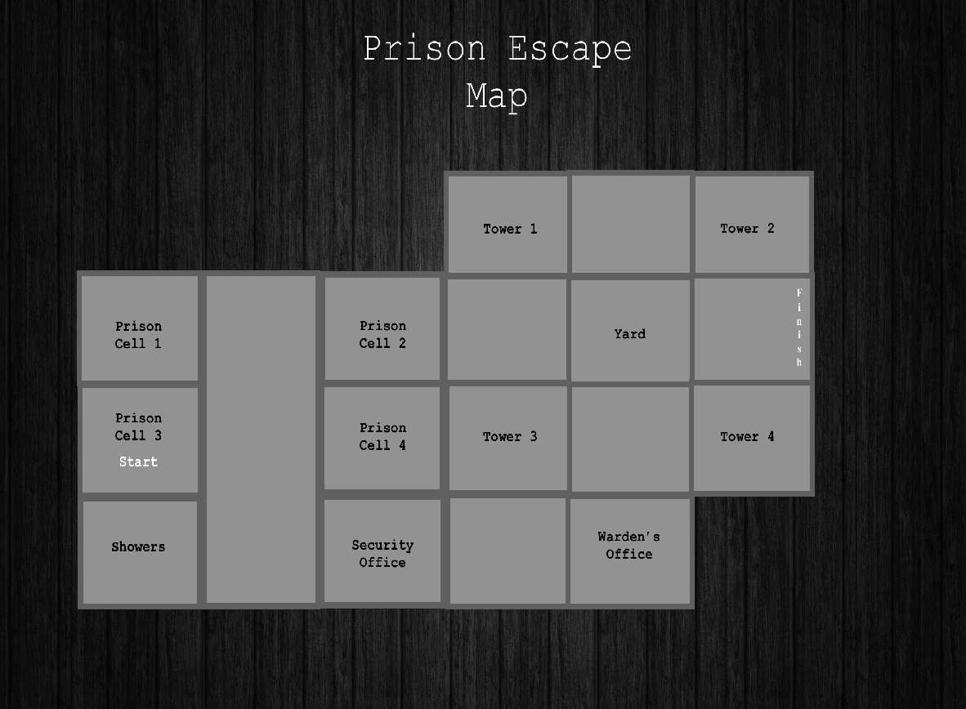
Layout of Game
Set in Prison
Concrete floor
Rain forest code
Function
Press 'm'
Game pauses and the map shows up

Slide 4
Physics
Physics is implemented through bounds checking between all objects on the screen
If the objects collide then an effect is called
With each object a specific effect is called such as knock back for enemies, stopping the character for the walls, ect.

Slide 5
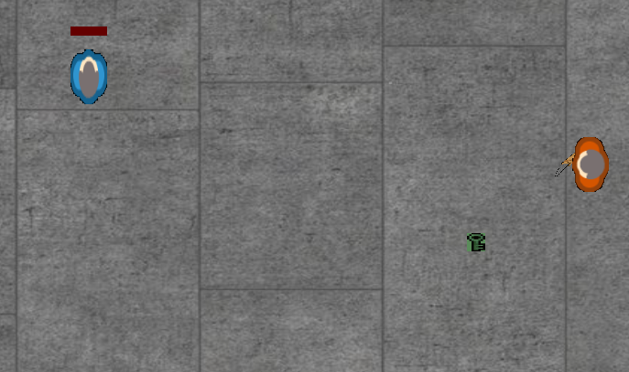
Doors
For a progression system keys were added to the game that are required for each door to open
The doors run on the same collision as the walls and stop the player from progressing

Slide 6


Enemies
Based on player structure
Have their own random movement
Two versions
Easy Mode Hard Mode

Slide 7
Enemies
Easy enemies have limited visibility of player and slower movement.
Checked distance to see if the player is within the enemies vision, if they are the enemy will take chase, player is able to escape.
Room for Improvement:
  Add collision to enemies themselves.
  Fix detection of player in certain situations.

Slide 8
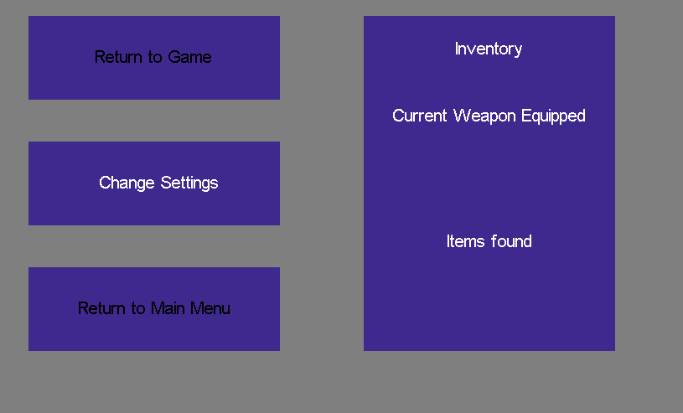
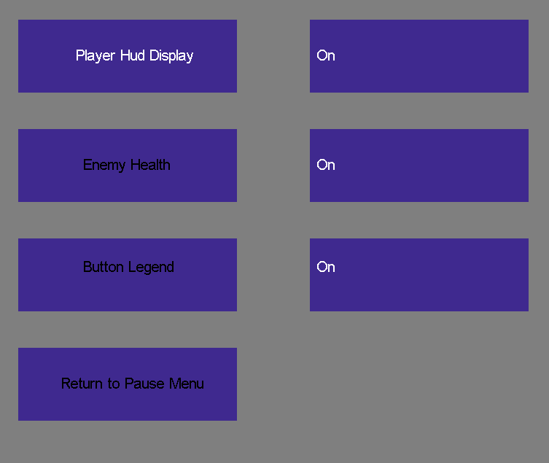
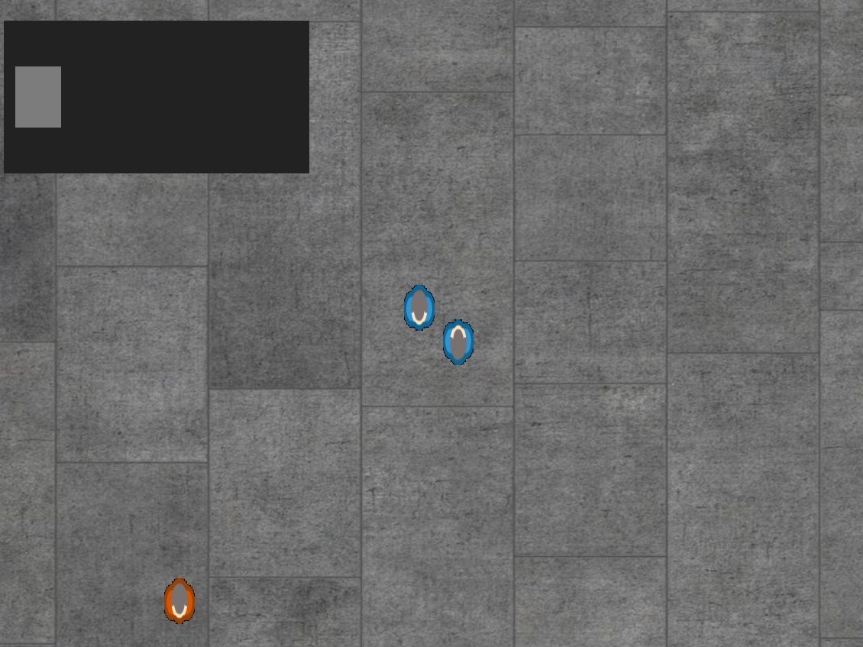
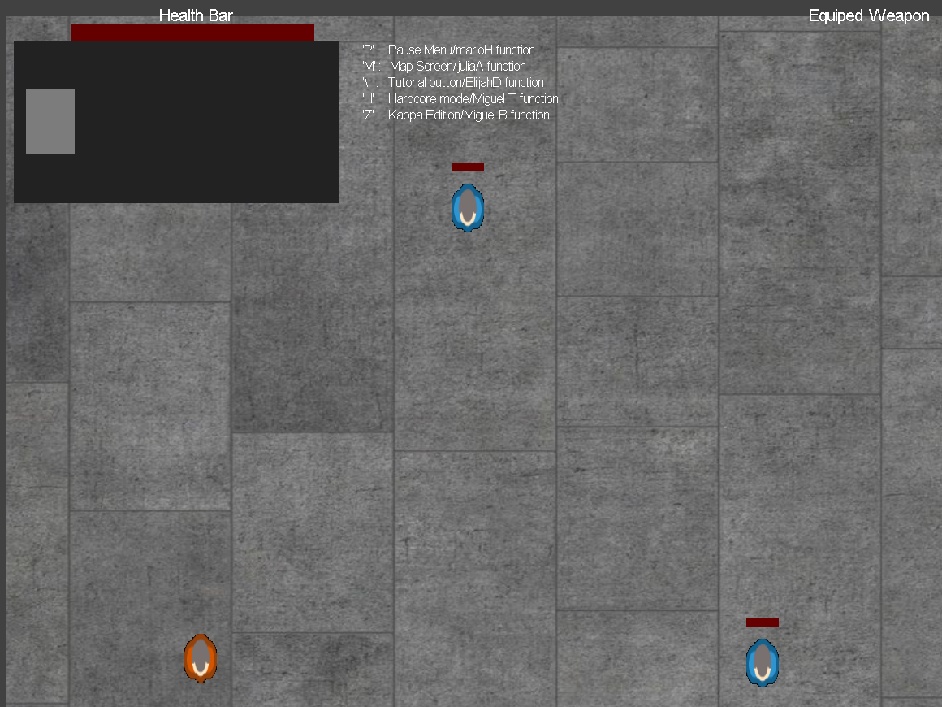
UI

Slide 9
UI
Room for Improvement
Reduce redundancy/optimization
Adding more UI Elements
CursorPos Bug

Slide 10
Weapons
Weapon were buggy at the start because they would not switch in the correct direction with the player so I had to create many if statement for each direction the player moved around.
Room for improvement
Weapons needs a inventory system and randomly spawn around the map so players have to search for the weapons

Slide 11



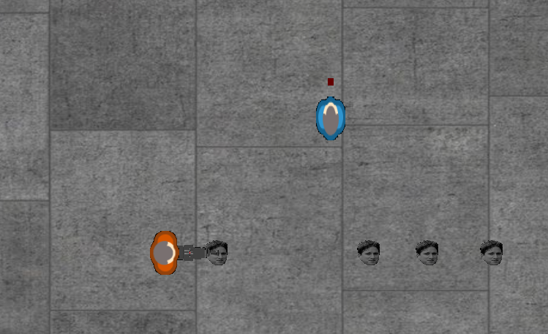
Weapons

