Slide 1

Notes:
Introduce team here too
Good Morning,
Today, we will present to you our project, Sandy, an AI-powered Tinder-like app for pets connecting pet owners with pet sitters.
I’m the project manager & designer of the team, Aryan Shah
The tech lead, Darina
And the product owner, Nilou

Slide 2
Table of contents
The Business Case
Requirements
Pet Owner Journey
Pet Sitter Journey
Live Demo (😬😓)

Slide 3
The Business Case
Notes:
Lets go over the business case given by the global supply chain management students

Slide 4
The Business Case | Root
Issue
Solution
58% households have pets
165 pets abandoned daily
Lack of responsibility
Manage busy schedules
Manage unexpected situations
Solve limited pet care options
Notes:
Today, 58% of belgian households have pets
Daily, 165 pets get abandoned in Belgium
This is due to lack of responsibility from factors like busy schedules, unexpected situations and limited pet care options
So, the GSCM students wanted to build a solution for this to solve all of those problems

Slide 5
The Business Case | Approach
Mobile Application
Offer a platform
Connect pet owners to pet sitters
Freemium model
Two-sided matching system
Provide:
Day-care
Walking
Feeding
…
Notes:
We built a mobile application as a platform for pet owners to connect with pet sitter.
The app uses a freemium two sides model so it is accessible to everyone and you can pay a small fee for additional features.
The platform provides services like day care, walking, feeding and much more depending on your subscription.

Slide 6
The Business Case | Goal
Pet Owners
Pet Sitters
Stress-free
Reliable
Convenient
Sit pets
Earn money
Notes:
The goal which we aim to achieve is for pet owners to let pet sitters take care of their pets stress free, reliably and conveniently.
For pet sitters, the goal is to have fun sitting pets and earn money from doing it.

Slide 7
Requirements
Notes:
Let’s go over the main requirements given by the GSCM students

Slide 8
Requirements
Pet Owners
Pet Sitters
Matching system interaction ✅
Compare relevant options ✅
Send requests ✅
Fluent & easy flow ✅
Pet management system ✅
Chat interactions ✅
Breathing rate monitor ❌
Matching system interaction ✅
Accept/deny requests ✅
Fluent & easy flow ✅
Profile management ✅
Availability management ✅
Notes:
For pets owners: …
For pet sitters: …

Slide 9
Authentication
Notes:
Every app needs authentication, so it only makes sense to start off with this

Slide 10
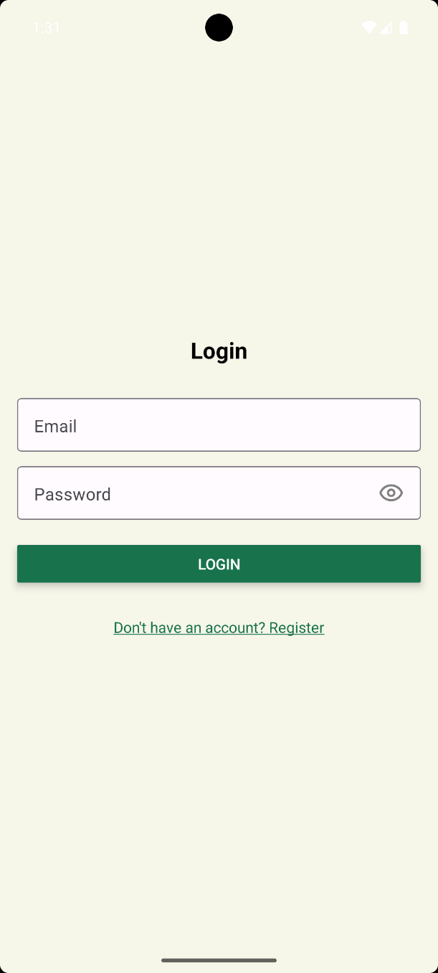
Login
Email
Password
Switch to register

Slide 11
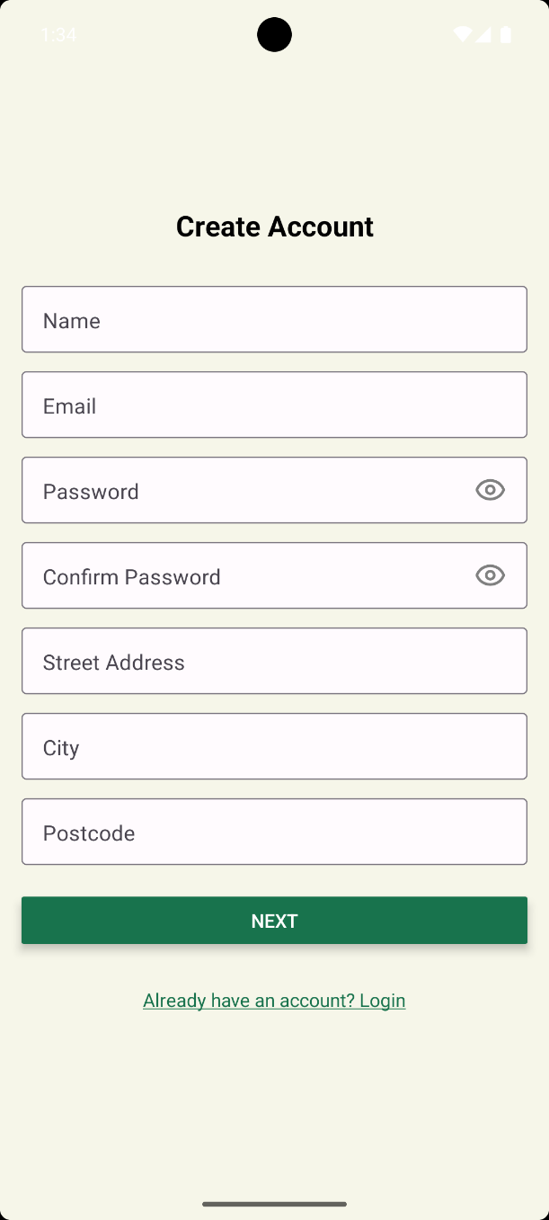
Registration | Create Account
Personal Details
Start onboarding
Switch to login

Slide 12
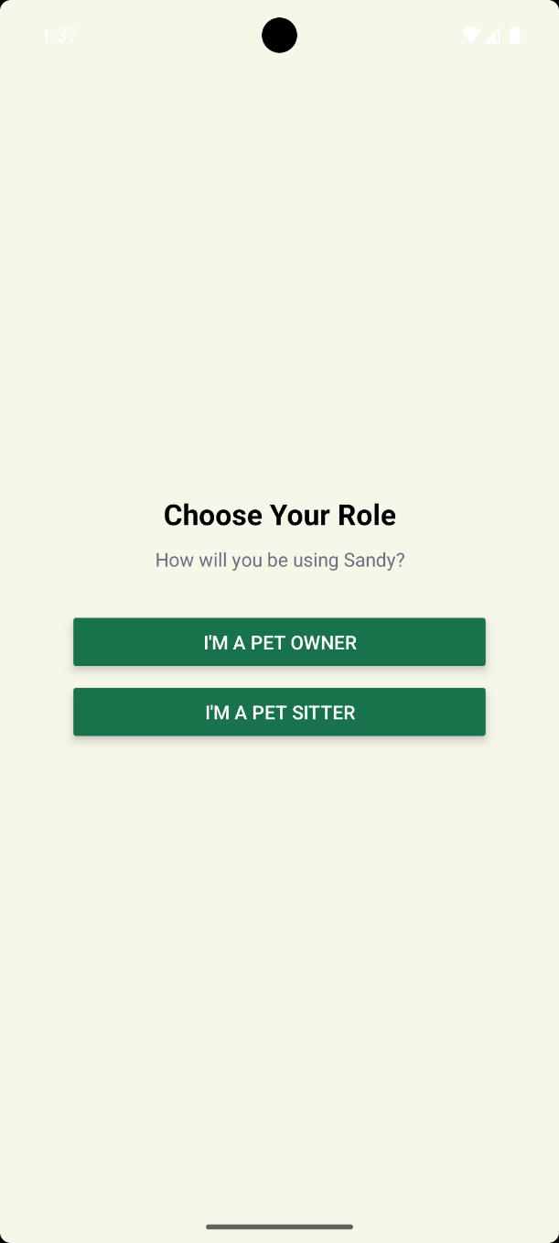
Registration | Role Selection
Pet Owner
Pet Sitter

Slide 13
Pet Owner Journey

Slide 14
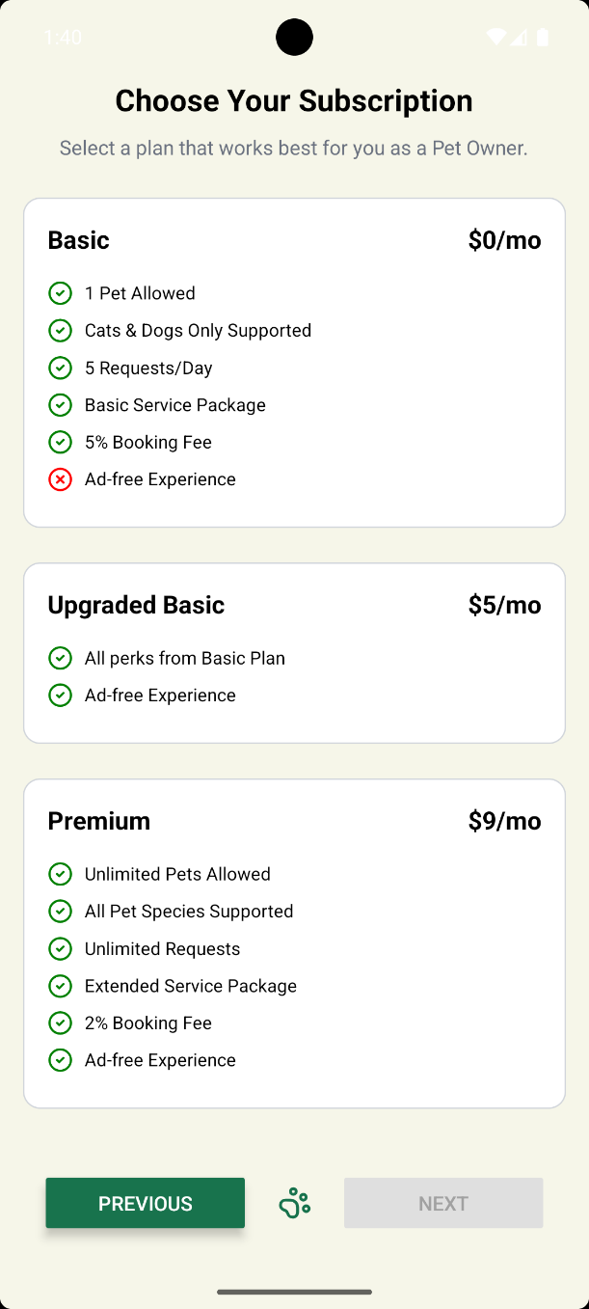
Registration | Subscription
Basic
Upgraded Basic
Premium

Slide 15
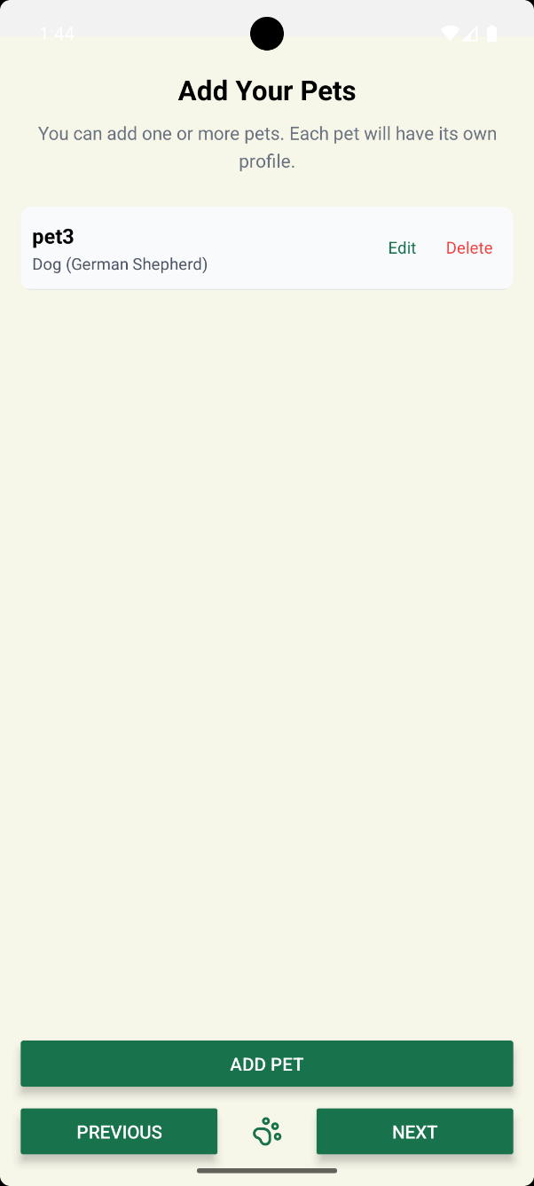
Registration | Add pets
Add pet
Edit pet
Delete pet

Slide 16
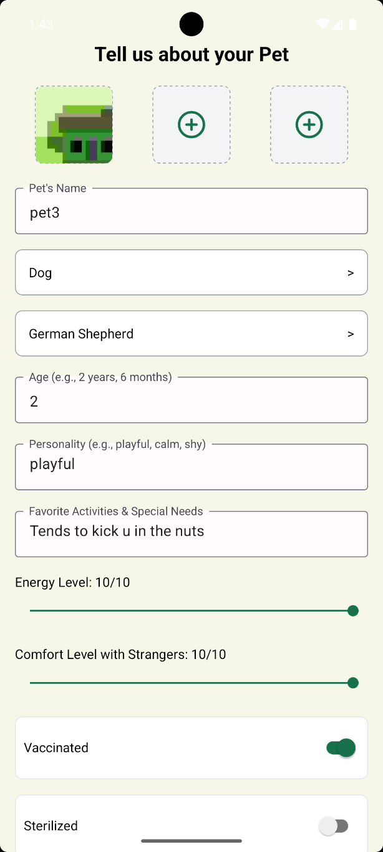
Registration | Add pets
Add individual pet details

Slide 17
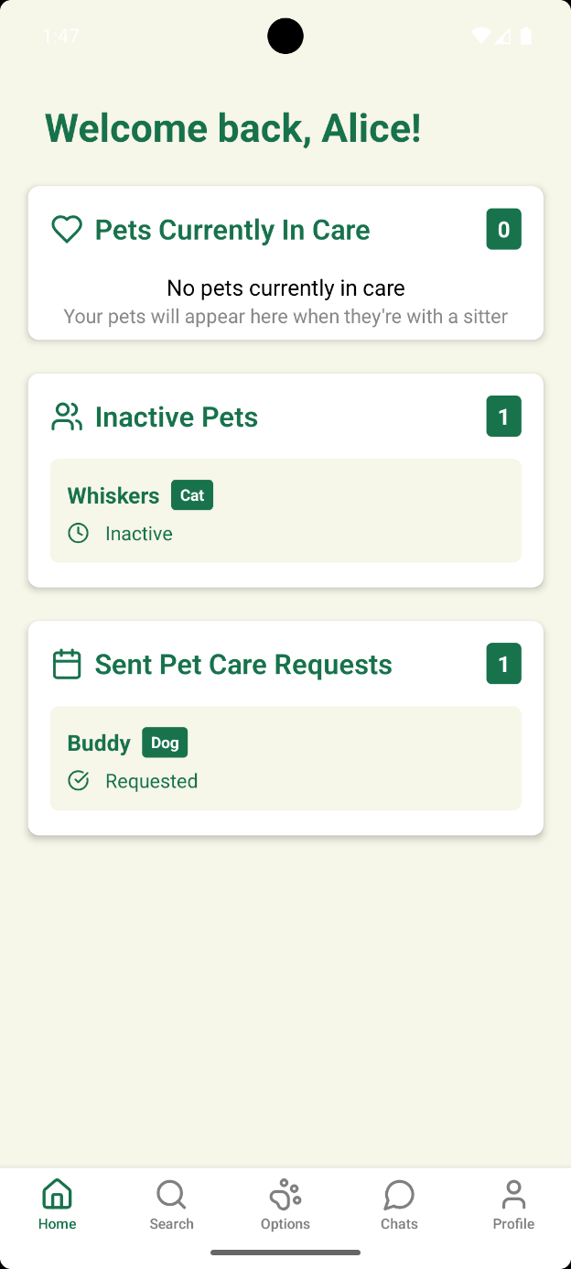
Home
Greeting
Pets in care
Inactive pets
Sent pet care requests

Slide 18
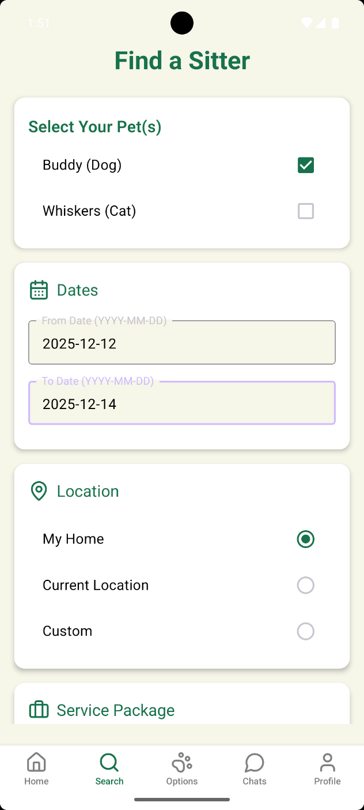
Search | Filters
Select a pet
Start & end dates
Location
Service Package

Slide 19
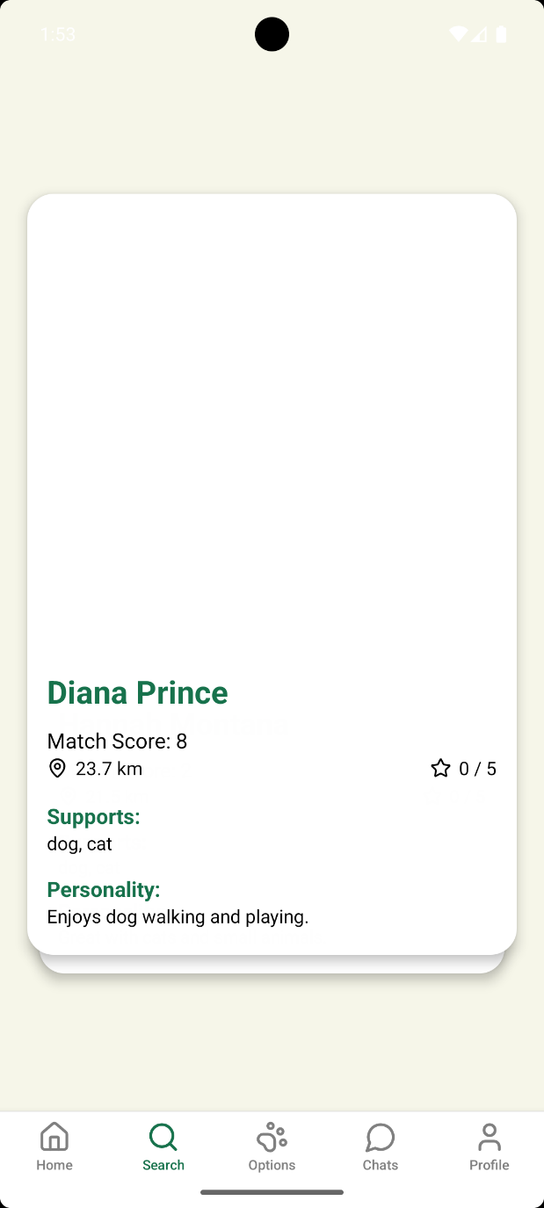
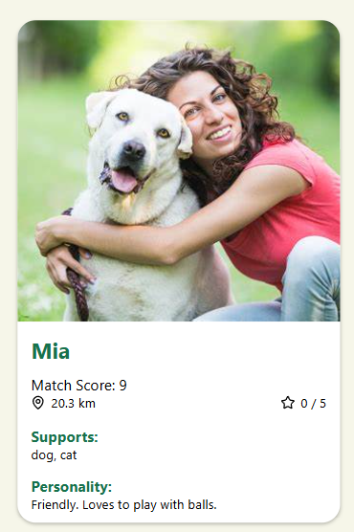
Search | Results
Matching sitter cards
Name
Match score
Distance
Pets supported
Personality
Using AI for matching personalities

Slide 20
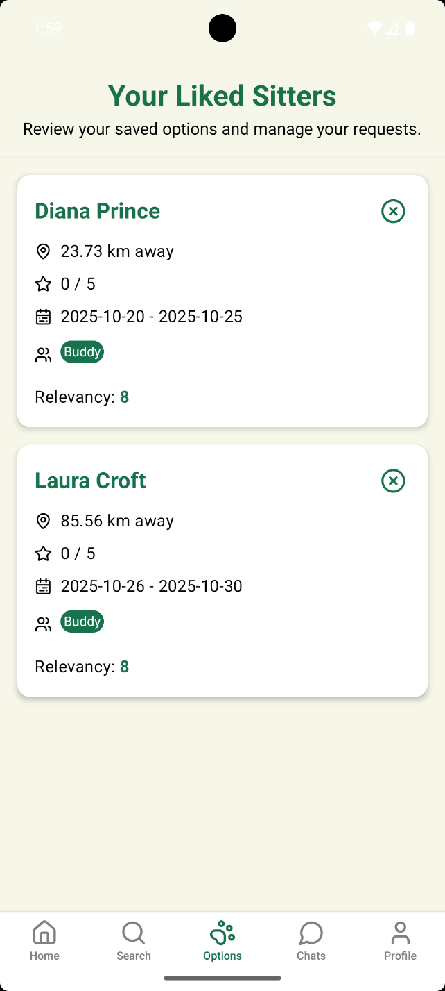
Options
Liked sitter cards
Distance
Rating
Dates
Pets chosen
Relevancy

Slide 21
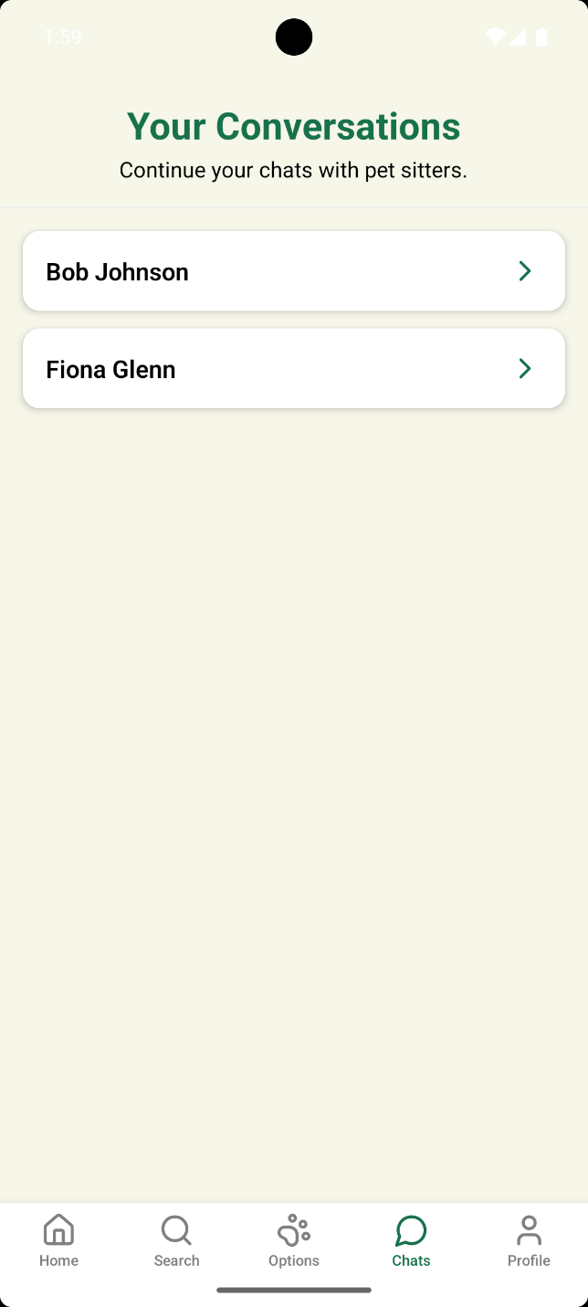
Chats | All
All open chats
Accepted requests by sitters

Slide 22
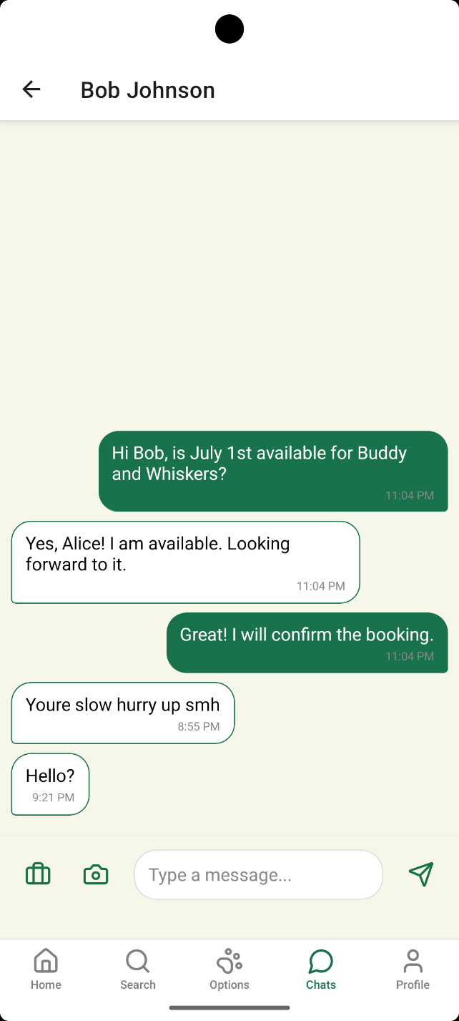
Chats | Single
Conversation with sitter
Pictures updates
In-chat booking confirmation
Real-time socket connection

Slide 23
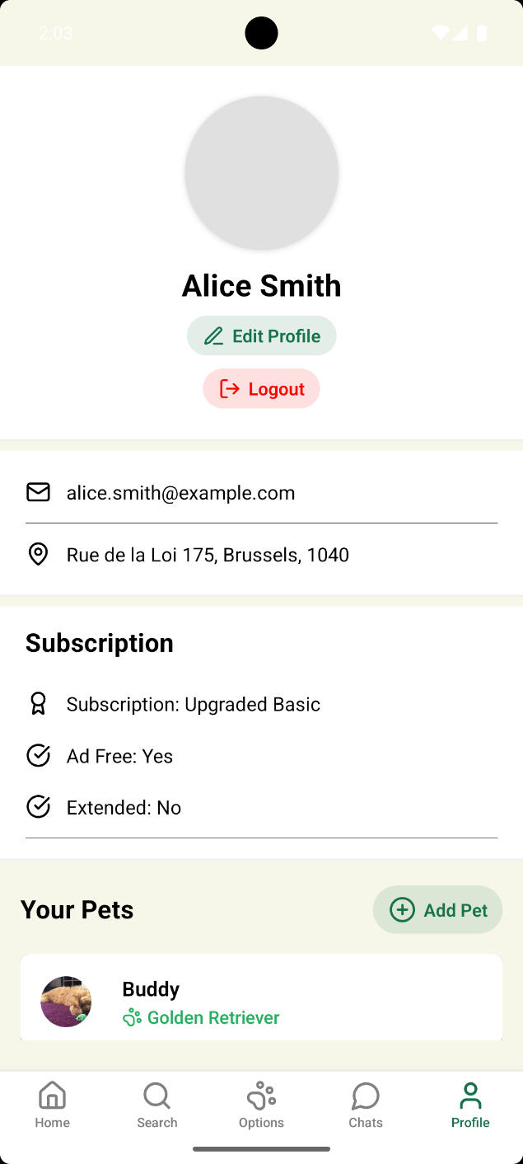
Profile
Personal information
Edit profile
Subscription type
Your pets
Add a pet
Logout

Slide 24
Pet Sitter Journey

Slide 25
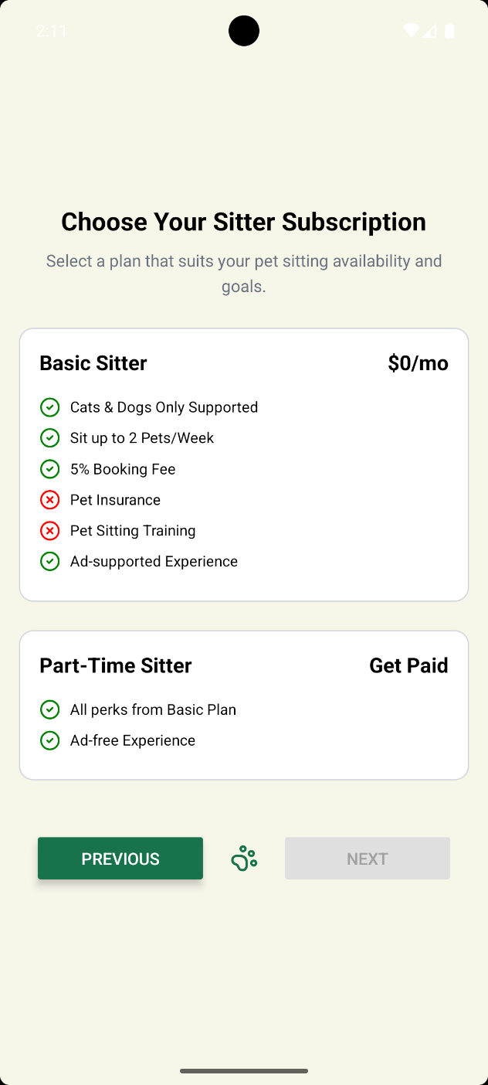
Registration | Subscription
Basic
Part-time

Slide 26
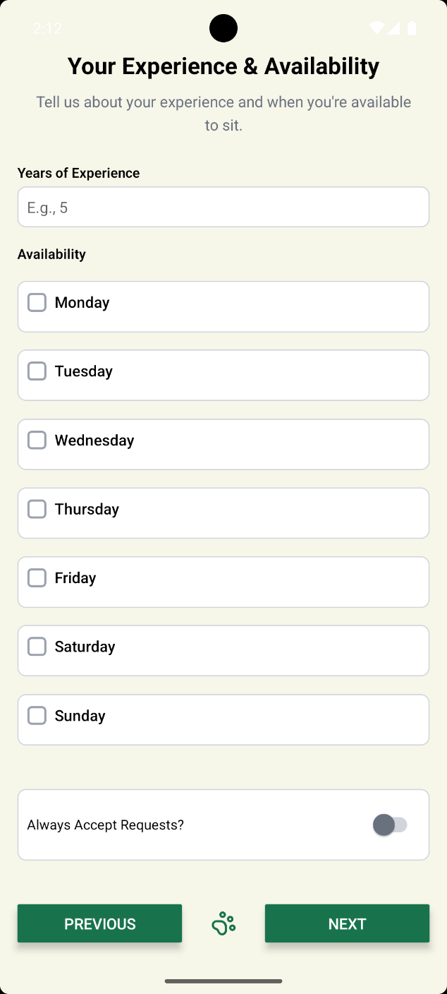
Registration | Profile (1)
Year of experience
Days/hours available

Slide 27
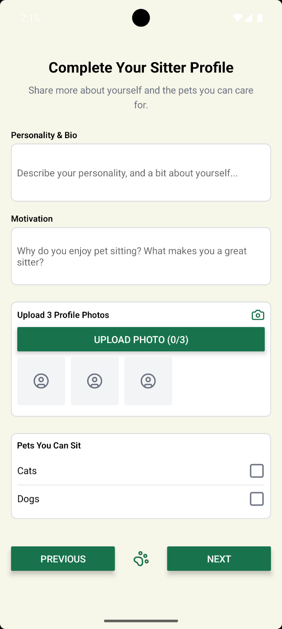
Registration | Profile (2)
Bio & Motivation
Profile picture
Select Pet type to sit

Slide 28
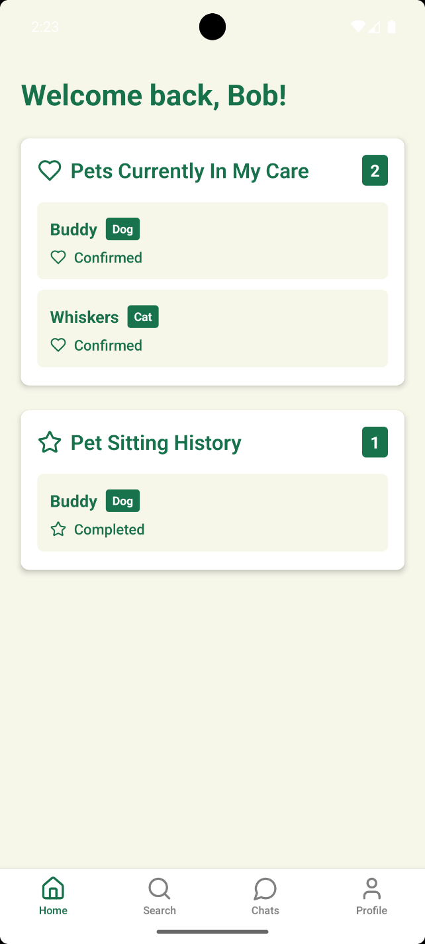
Home
Pets Currently in care
History of pet sitting

Slide 29
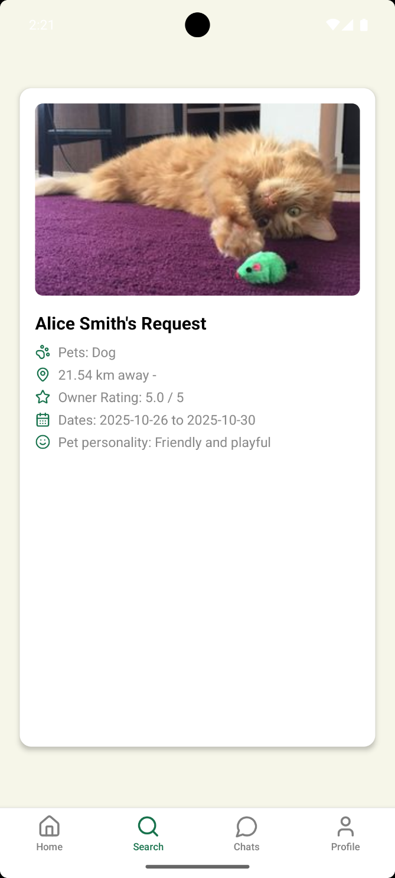
Search
Requested pets to sit
Accept/Reject

Slide 30
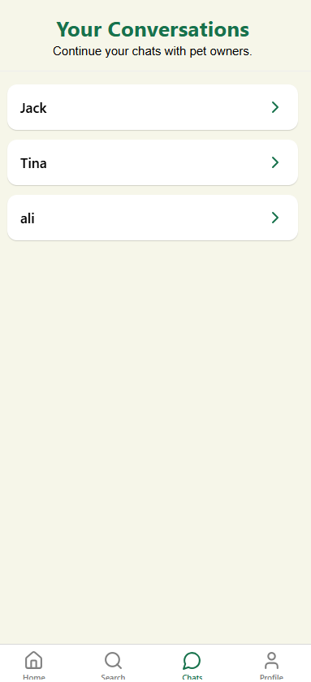
Chats | All
All open chats
Accepted requests by sitters (you)

Slide 31
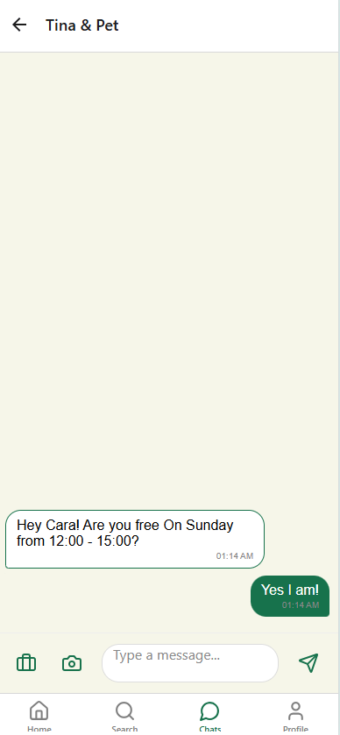
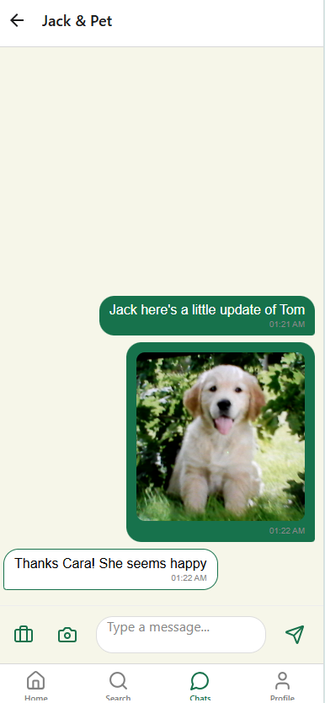
Chats | Single
Conversation with owner
Pictures updates
In-chat booking confirmation
Real-time socket connection

Slide 32
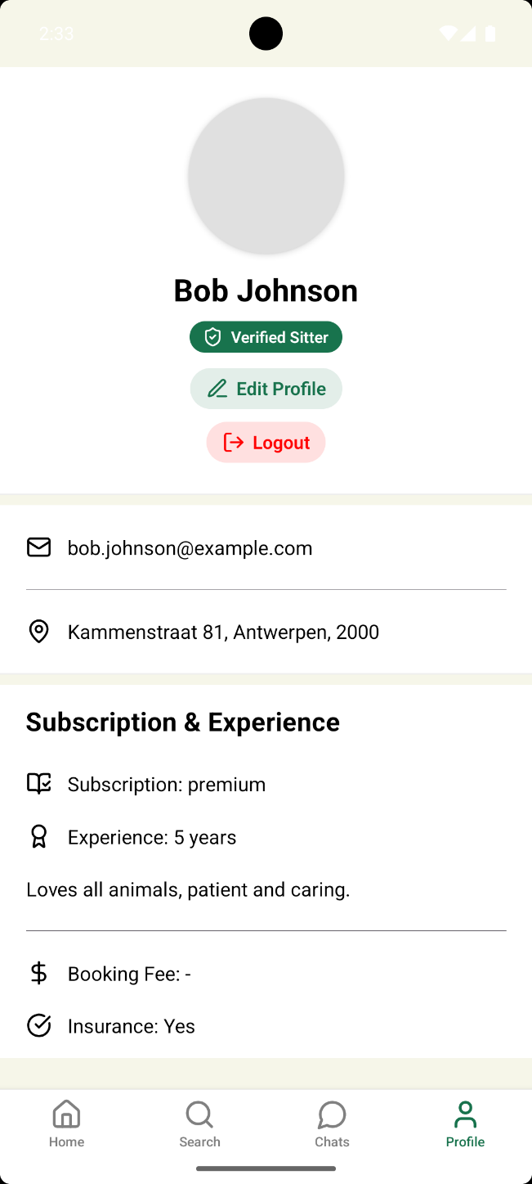
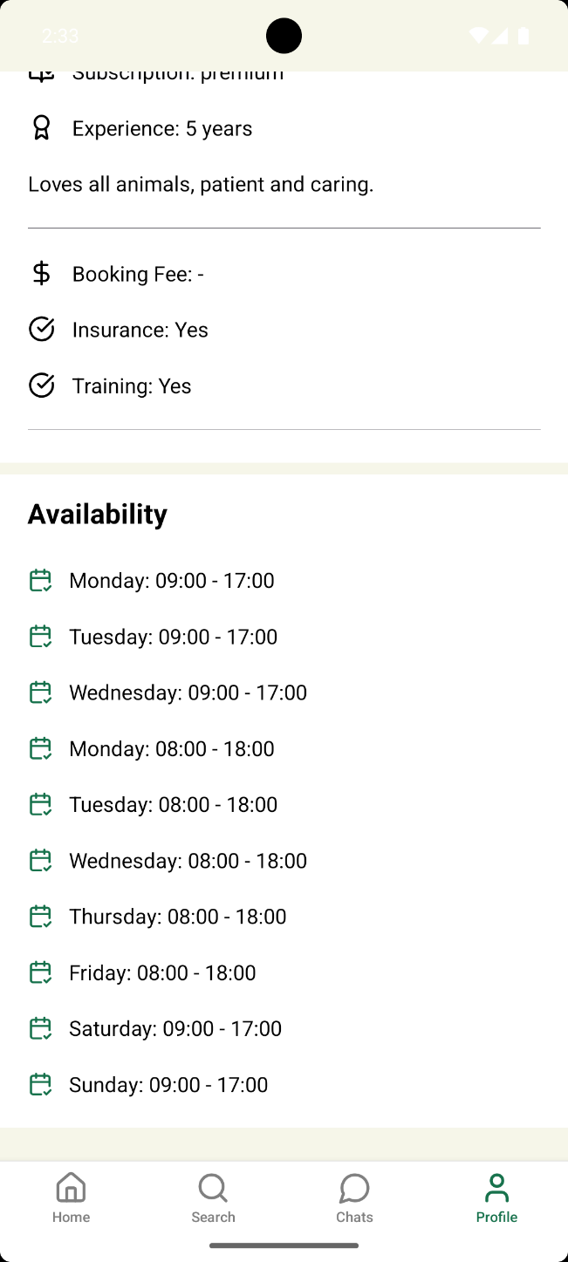
Profile
Personal Profile Overview
Edit profile
Subscription & Experience
Availability
Logout

Slide 33
Live Demo (😬😓)

Slide 34
Thanks!
Questions?

