Slide 1
Bullet
Everything about…

Slide 2
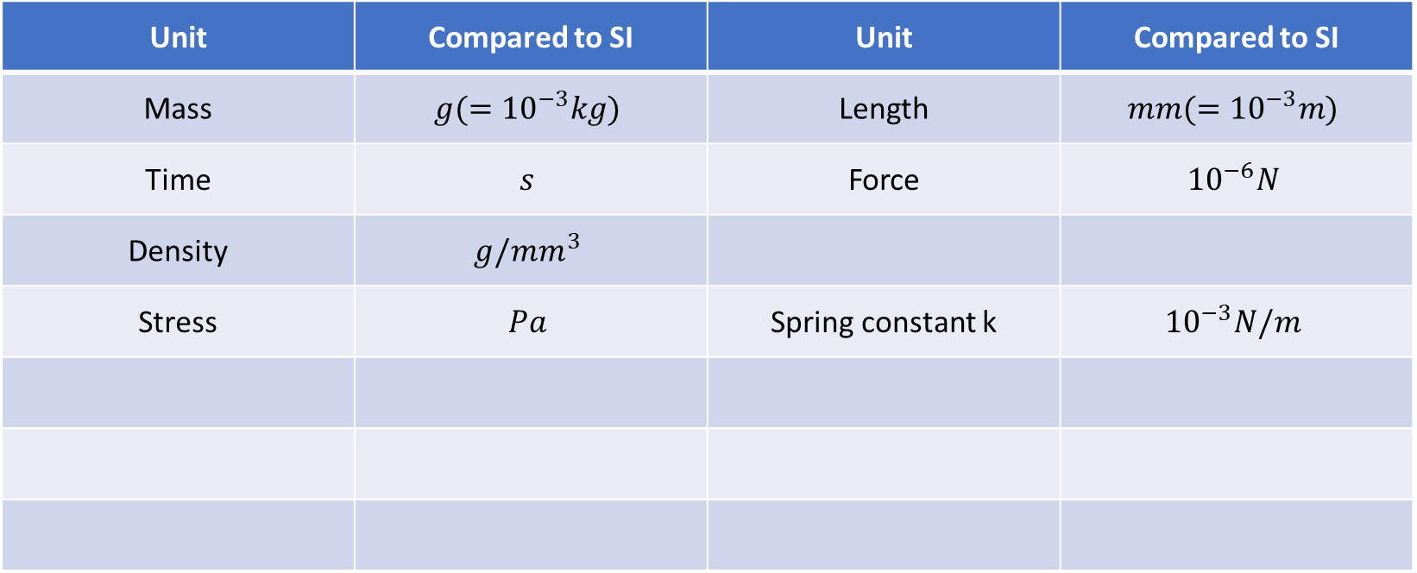
Unit in Bullet, compared to SI unit
Unit | Compared to SI | Unit | Compared to SI
Mass | $$g(={10}^{−3}kg)$$ | Length | $$mm(={10}^{−3}m)$$
Time | $$s$$ | Force | $${10}^{−6}N$$
Density | $$g/mm^{3}$$
Stress | $$Pa$$ | Spring constant k | $${10}^{−3}N/m$$

Slide 3
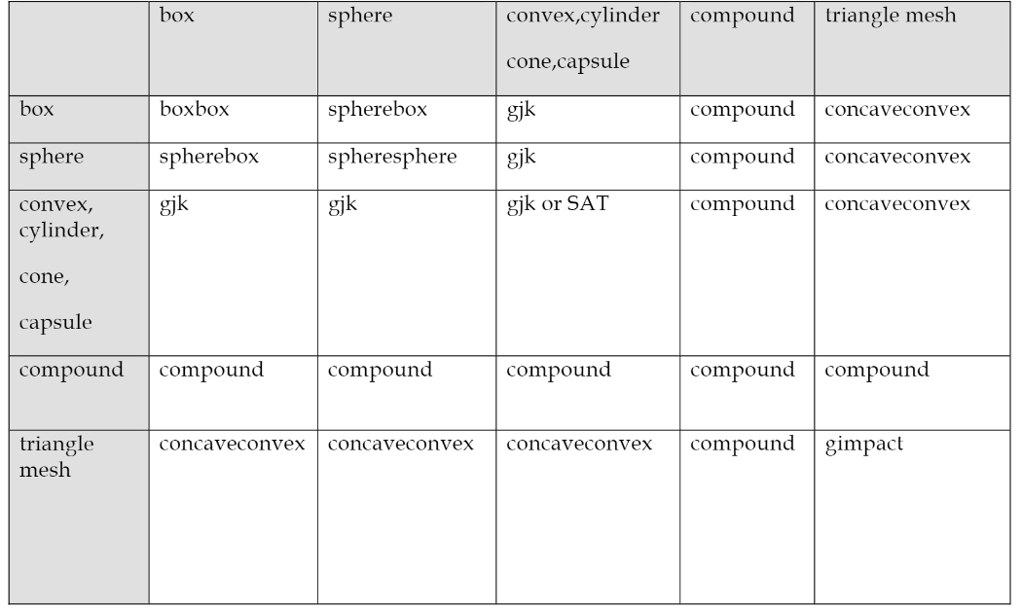
Collision detection
Broadphase: DBVT (dynamic bounding volume tree) or SAP (sweep and prune)
Bullet uses: AABB tree
Narrowphase (dispatcher):
Notes:
学习以下算法：
DBVT (dynamic bounding volume tree)
SAP (sweep and prune)
SAT (Separate axis theorem)
复习kd-tree, 顺便复习一下geometric algorithm
学习heap

Slide 4
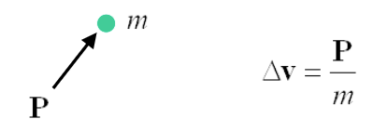
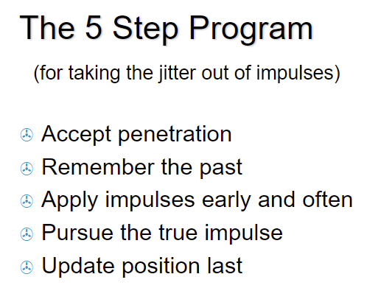
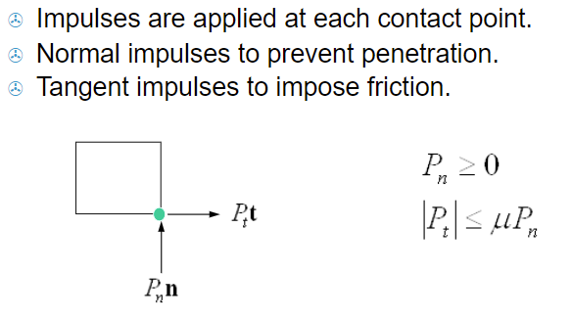
Constraint solver
btSequentialImpulseConstraintSolver
Sequential Impulse Solver for Rigid Body Dynamics - Intermediate graduation project presentation (mft-spirit.nl)
Fast and Simple Physics using Sequential Impulses - ppt video online download (slideplayer.com)
In Bullet project:
Solver: SIMD
Using warm starting
Randomize order

Slide 5
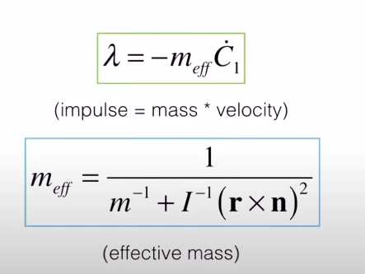
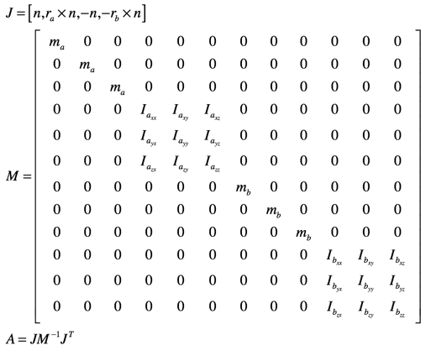
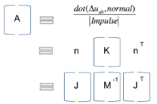
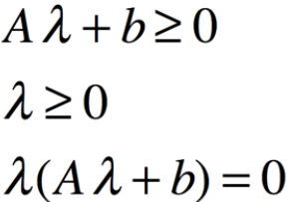
Linear complementarity problem
Why global solver is bad? 1. time complexity 2. sudden collapse for a single frame because two constraints are inconsistent
Formula for impulse:
Mass matrix. Its inverse is also symmetric and positive definite. So for this LCP problem, convergence guaranteed using PGS solver.
LCP problem setup:
image.diku.dk/kenny/download/erleben.05.thesis.pdf
Sequential impulse constraint solver is just an implementation of PGS solver.

Slide 6
Integration
Integrator: sympletic integration (semi-implicit integration)
Object velocity is updated by (line 324 of btRigidBody.cpp)
First update velocity then update position.

Slide 7
Call stack
btDynamicsWorld->stepsimulation();
btDynamicsWorld->internalSingleStepSimulation();
predictUnconstraintMotion();
performDiscreteCollisionDetection();
updateAabbs();
computeOverlappingPairs();
dispatcher->dispatchAllCollisionPairs();
calculateSimulationIslands(); // based on speculative contact manifolds
solveConstraints(); // for each rigid body: update m_linearVelocity and m_angularVelocity
m_sortedConstraints; // based on predicated constraint islands
integrateTransforms();
integrateTransformsInternal(); // for each rigid body: get predicted Transform
// position: explicit += m_linearVelocity
// rotation: “Practical Prameterization of Rotations using the exponential map” by F. Sebastian Grassia
updateActions(); // for vehicles
updateActivationState(); // for graphics
synchronizeMotionStates();
synchronizeSingleMotionState(); // for each body, interpolate transform
body->setWorldTranform(interpolatedTransform); // finally..
// repeat single step simulation 20 times…

