Slide 1
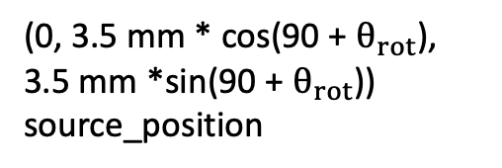
Point in simulation
Important Points in Simulation
(ICPC Detector)
Point just for clarity
z
(0, 3.5 mm * cos(90 + $θ_{rot}$), 3.5 mm *sin(90 + $θ_{rot}$)) source_position
x out of page
y
17 mm
1 mm
8.0 mm
(0, 0, 0) Origin= Rotation Axis
175.1 mm
(0, 0, -22.5 mm)
(0, 0, -28.85 mm) topHat_center
86.4 mm
(0, 0, -65.7 mm) detector_center
(0, 0, -108.9 mm)
25.4 mm
(0, 0, -121.6 mm) coldPlate_center
Cold Finger

Slide 2
Point in simulation
Clearances with LMFE
(ICPC Detector)
Point just for clarity
z
48.7 mm
(0, 0, 3.5 mm) source_position
x out of page
y
17 mm
8.0 mm
(0, 0, 0) Origin
9.5 mm
4.5 mm
15.5 mm
175.1 mm
7 mm
LMFE (not included in sim!)
2 mm
(0, 0, -22.5 mm)
3.57 mm
(0, 0, -28.85 mm) topHat_center
86.4 mm
(0, 0, -65.7 mm) detector_center
(0, 0, -108.9 mm)
25.4 mm
(0, 0, -121.6 mm) coldPlate_center
Cold Finger

Slide 3
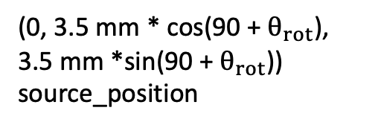

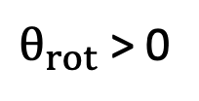
Point in simulation
Source Rotation rotate about x-axis
Point just for clarity
(0, 3.5 mm * cos(90 + $θ_{rot}$), 3.5 mm *sin(90 + $θ_{rot}$)) source_position
Longest distance for clearance
z
$θ_{rot}$ > 0
18.87 mm
$$θ_{rot}=0$$
16.03 mm
8.6 mm
15.5 mm
(0, 0, 0) Origin
x out of page
y
(second) Longest distance for clearance
2 mm
LMFE (not included in sim!)
7 mm
3.57 mm
9.5 mm
(0, 0, -22.5 mm)

Slide 4
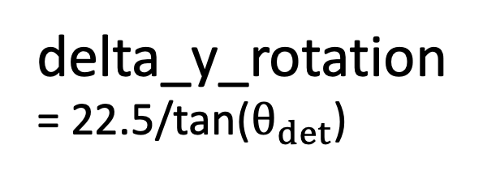
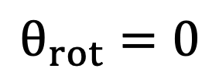
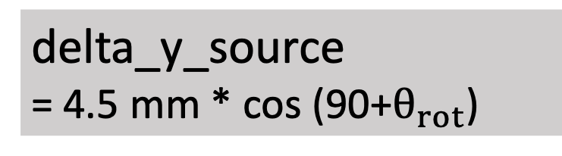
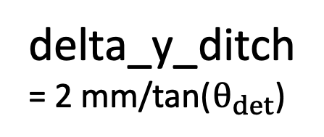
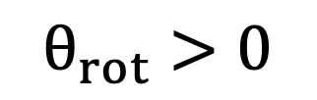
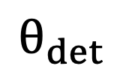

Rotation axis; (x, y, z) of “sourceRotationVolume”
Coords. of source activity:
(0, source_yPos, source_zPos)
Figure corresponding to positionCalc() function in /CAGE/sims/source_placement.py
(0, 0, 0) Origin
$$θ_{rot}>0$$
$$θ_{rot}=0$$
18.87 mm
Longest distance for clearance
z
22.5 mm
x out of page
y
$$θ_{rot}$$
$$θ_{det}$$
P+ contact
ditch_depth = 2mm
delta_y_source = 4.5 mm * cos (90+$θ_{rot}$)
ICPC ditch
y_det
(= y_final when not in ditch)
y_final
source_yPos
delta_y_ditch = 2 mm/tan($θ_{det}$)
axis_yPos
delta_y_rotation = 22.5/tan($θ_{det}$)
PPM natGe ICPC
y = 13 mm
y = 16 mm

Slide 5
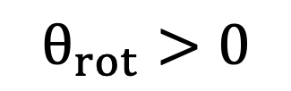
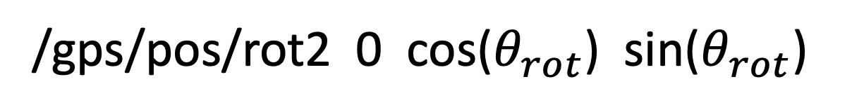
Continued from previous slide! How to rotate source activity in run macro using rotation matrices
New unit vector of source activity in run macro
When at non-normal incidence
/gps/pos/rot2 0 cos($θ_{rot}$) sin($θ_{rot}$)
$$θ_{rot}>0$$
/gps/pos/rot2 0 1 0
Original unit vector of source activity in run macro
Figure also corresponding to source_placement.py
We rotate about x-axis: always /gps/pos/rot1 1 0 0

Slide 6
OPPI

Slide 7
Point in simulation
Important Points in Simulation
(OPPI Detector)
Point just for clarity
z
x out of page
y
(0, 3.5 mm * cos(90 + $θ_{rot}$), 3.5 mm *sin(90 + $θ_{rot}$)) source_position
(0, 0, 9.55 mm) topHat_center
175.1 mm
17 mm
1 mm
8.0 mm
(0, 0, 0) Origin= Rotation Axis
(0, 0, -22.0 mm)
51 mm
(0, 0, -50.5 mm) detector_center
(0, 0, -73.0 mm)
25.4 mm
(0, 0, -85.7 mm) coldPlate_center
Cold Finger
Not to scale!

Slide 8
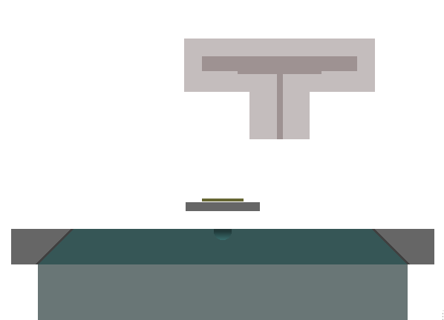
LMFE Placement
(0, 0, 0)
22.0 mm
3.0 mm
ring_height
This is with the view rotated to 17.92 degrees, looking along the LMFE
The source is also translated to 10 mm
The rotational position of the LMFE is nominally at <rotation name="OPPI1_diving_board_volume_Rotation" z=”(180-17.92)" unit="deg"/> (see sims_rotaryRotation.pptx for details)

